Slide 1
World War in the Neighborhood Global and Local politics in Shapira Neighborhood (Tel Aviv’s Black City) Sharon Rotbard

Slide 2
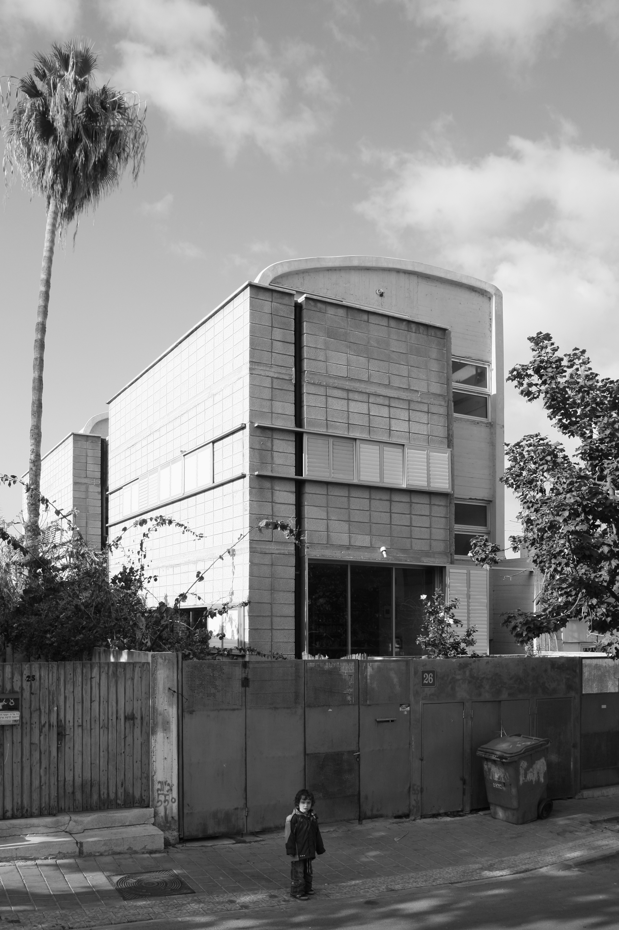
Sharon Rotbard, Housing project, Shapira Neighborhood, 2000 (photo: Roi Boshi)

Slide 3
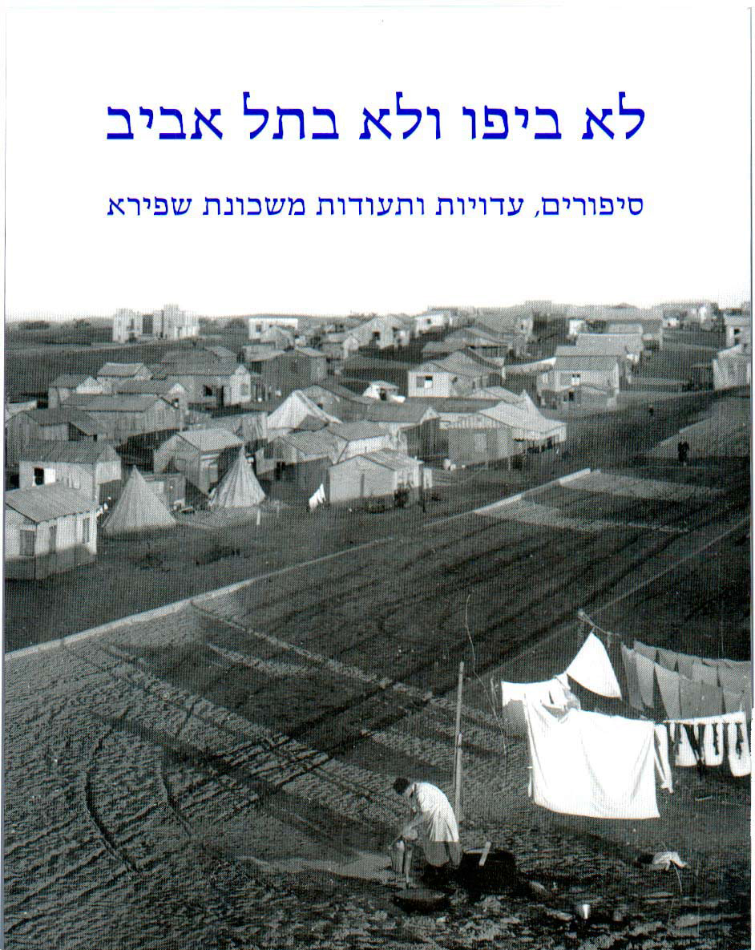
Muki Tsur, Sharon Rotbard (editors), Neither in Jaffa, Nor in Tel Aviv: Stories, Testimonies and Documents from Shapira Neighborhood, Babel, 2009

Slide 4
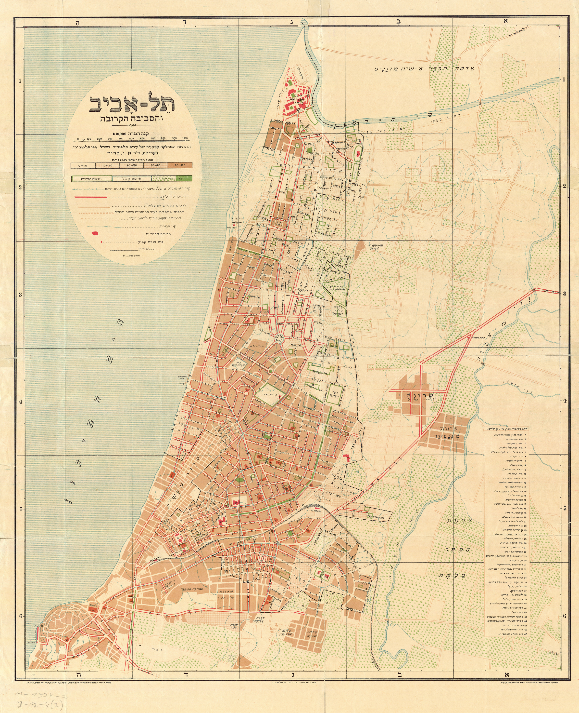
Map of Tel Aviv, 1935

Slide 5
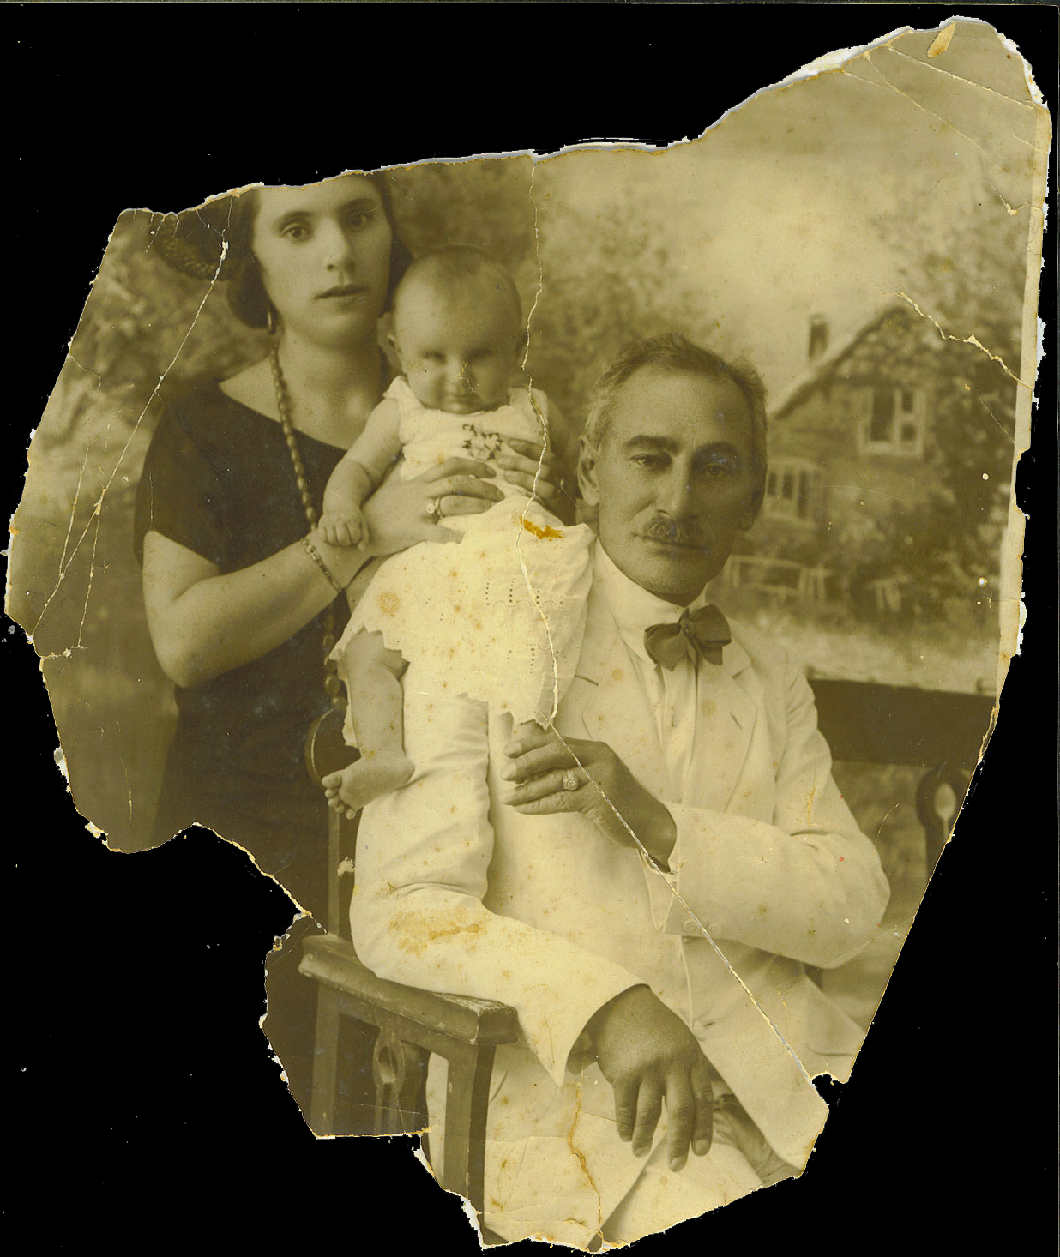
Meir Getzel Shapira, his wife Sonya and their elder son, mid-1920s

Slide 6
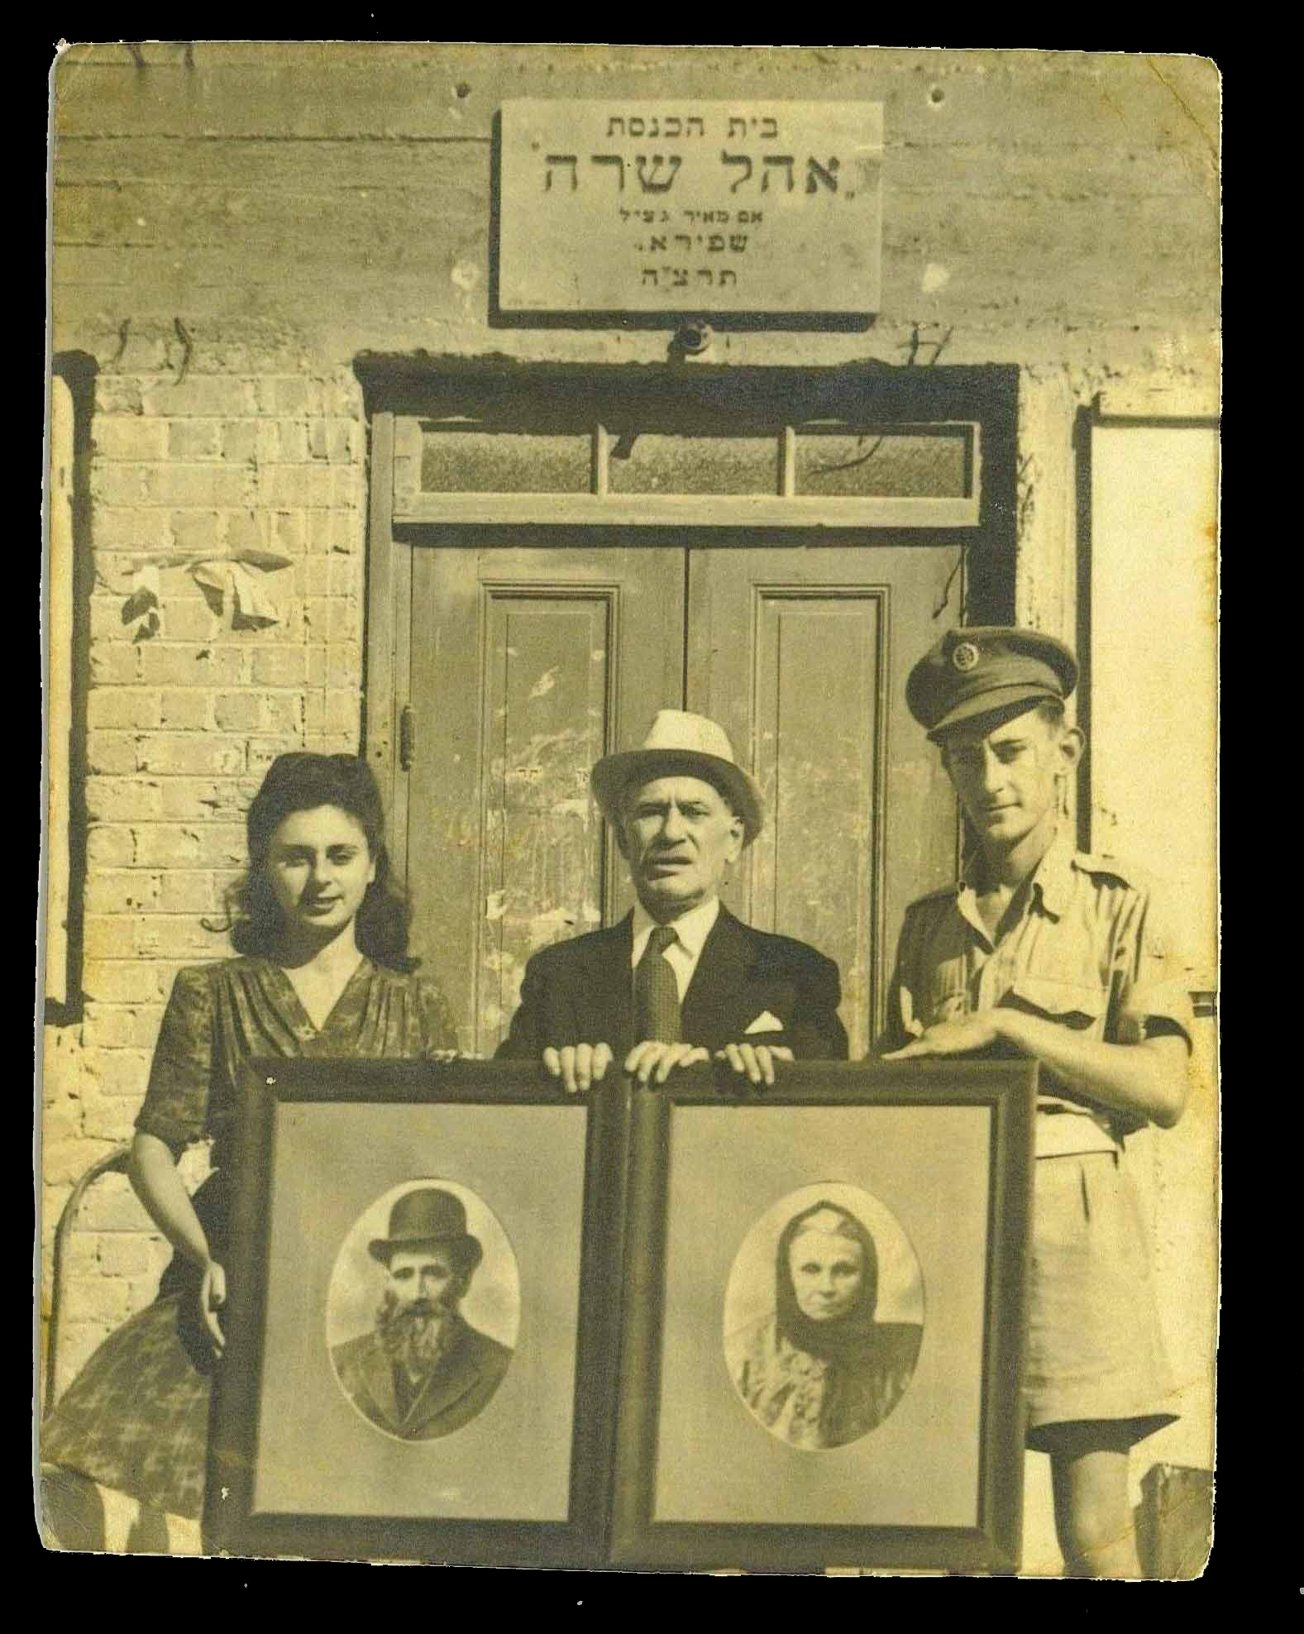
Meir Getzel Shapira, his doughter and son in front of Ohel Sara, the synagogue he had erected in memory of his mother, the only public building in the early days of the neighborhood. (photo, end of 1940s)

Slide 7
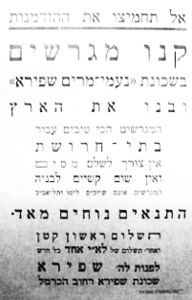
Publicity for Shapira neihjborhood, mid 1920s by Meir Getzel Shapira:
Do not miss this opportunity, Buy plots at Naomi-Miryam Shapira Neighborhood and build the Land.
Best plots for industry.
No need to pay taxes and no diffivulties for building – the plots are neither in Jaffa nor in Tel Aviv.
Very convenient conditions – first payment is very small and then only a monthly payment of 1 Palestinian Pound.
Address Mr. Shapira, Shapira neighborhood HaCarmel Street.

Slide 8
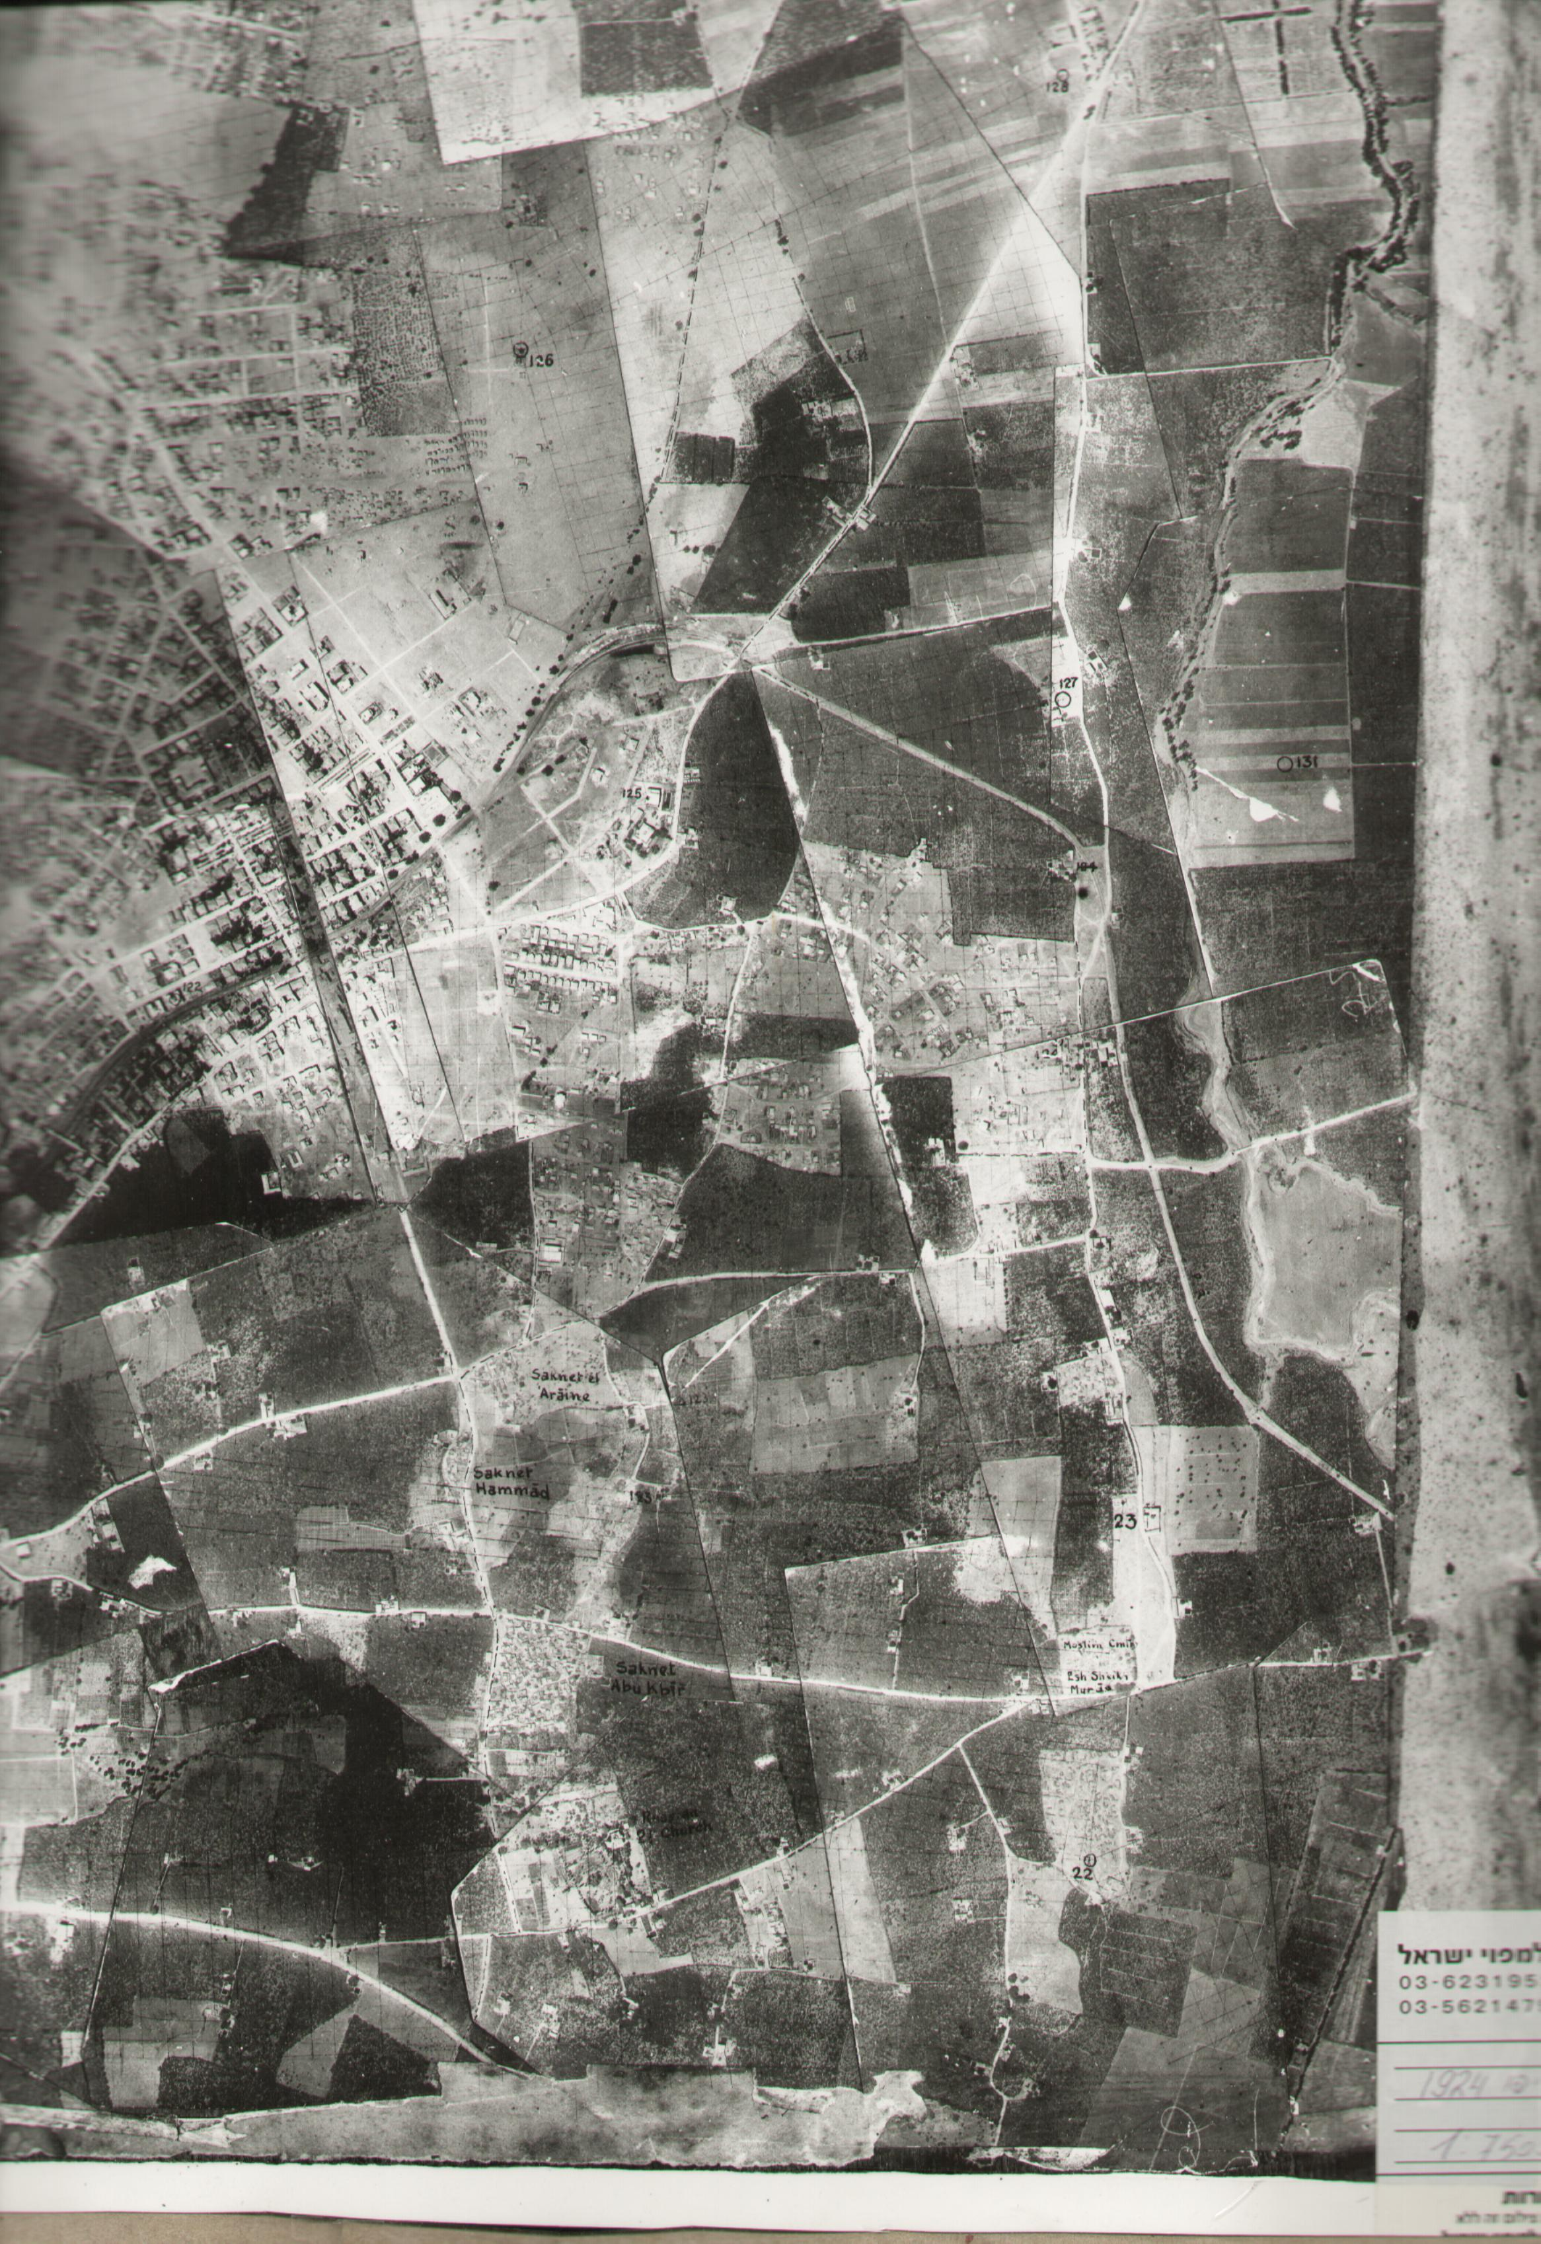
Shapira Neighborhood area, 1924

Slide 9
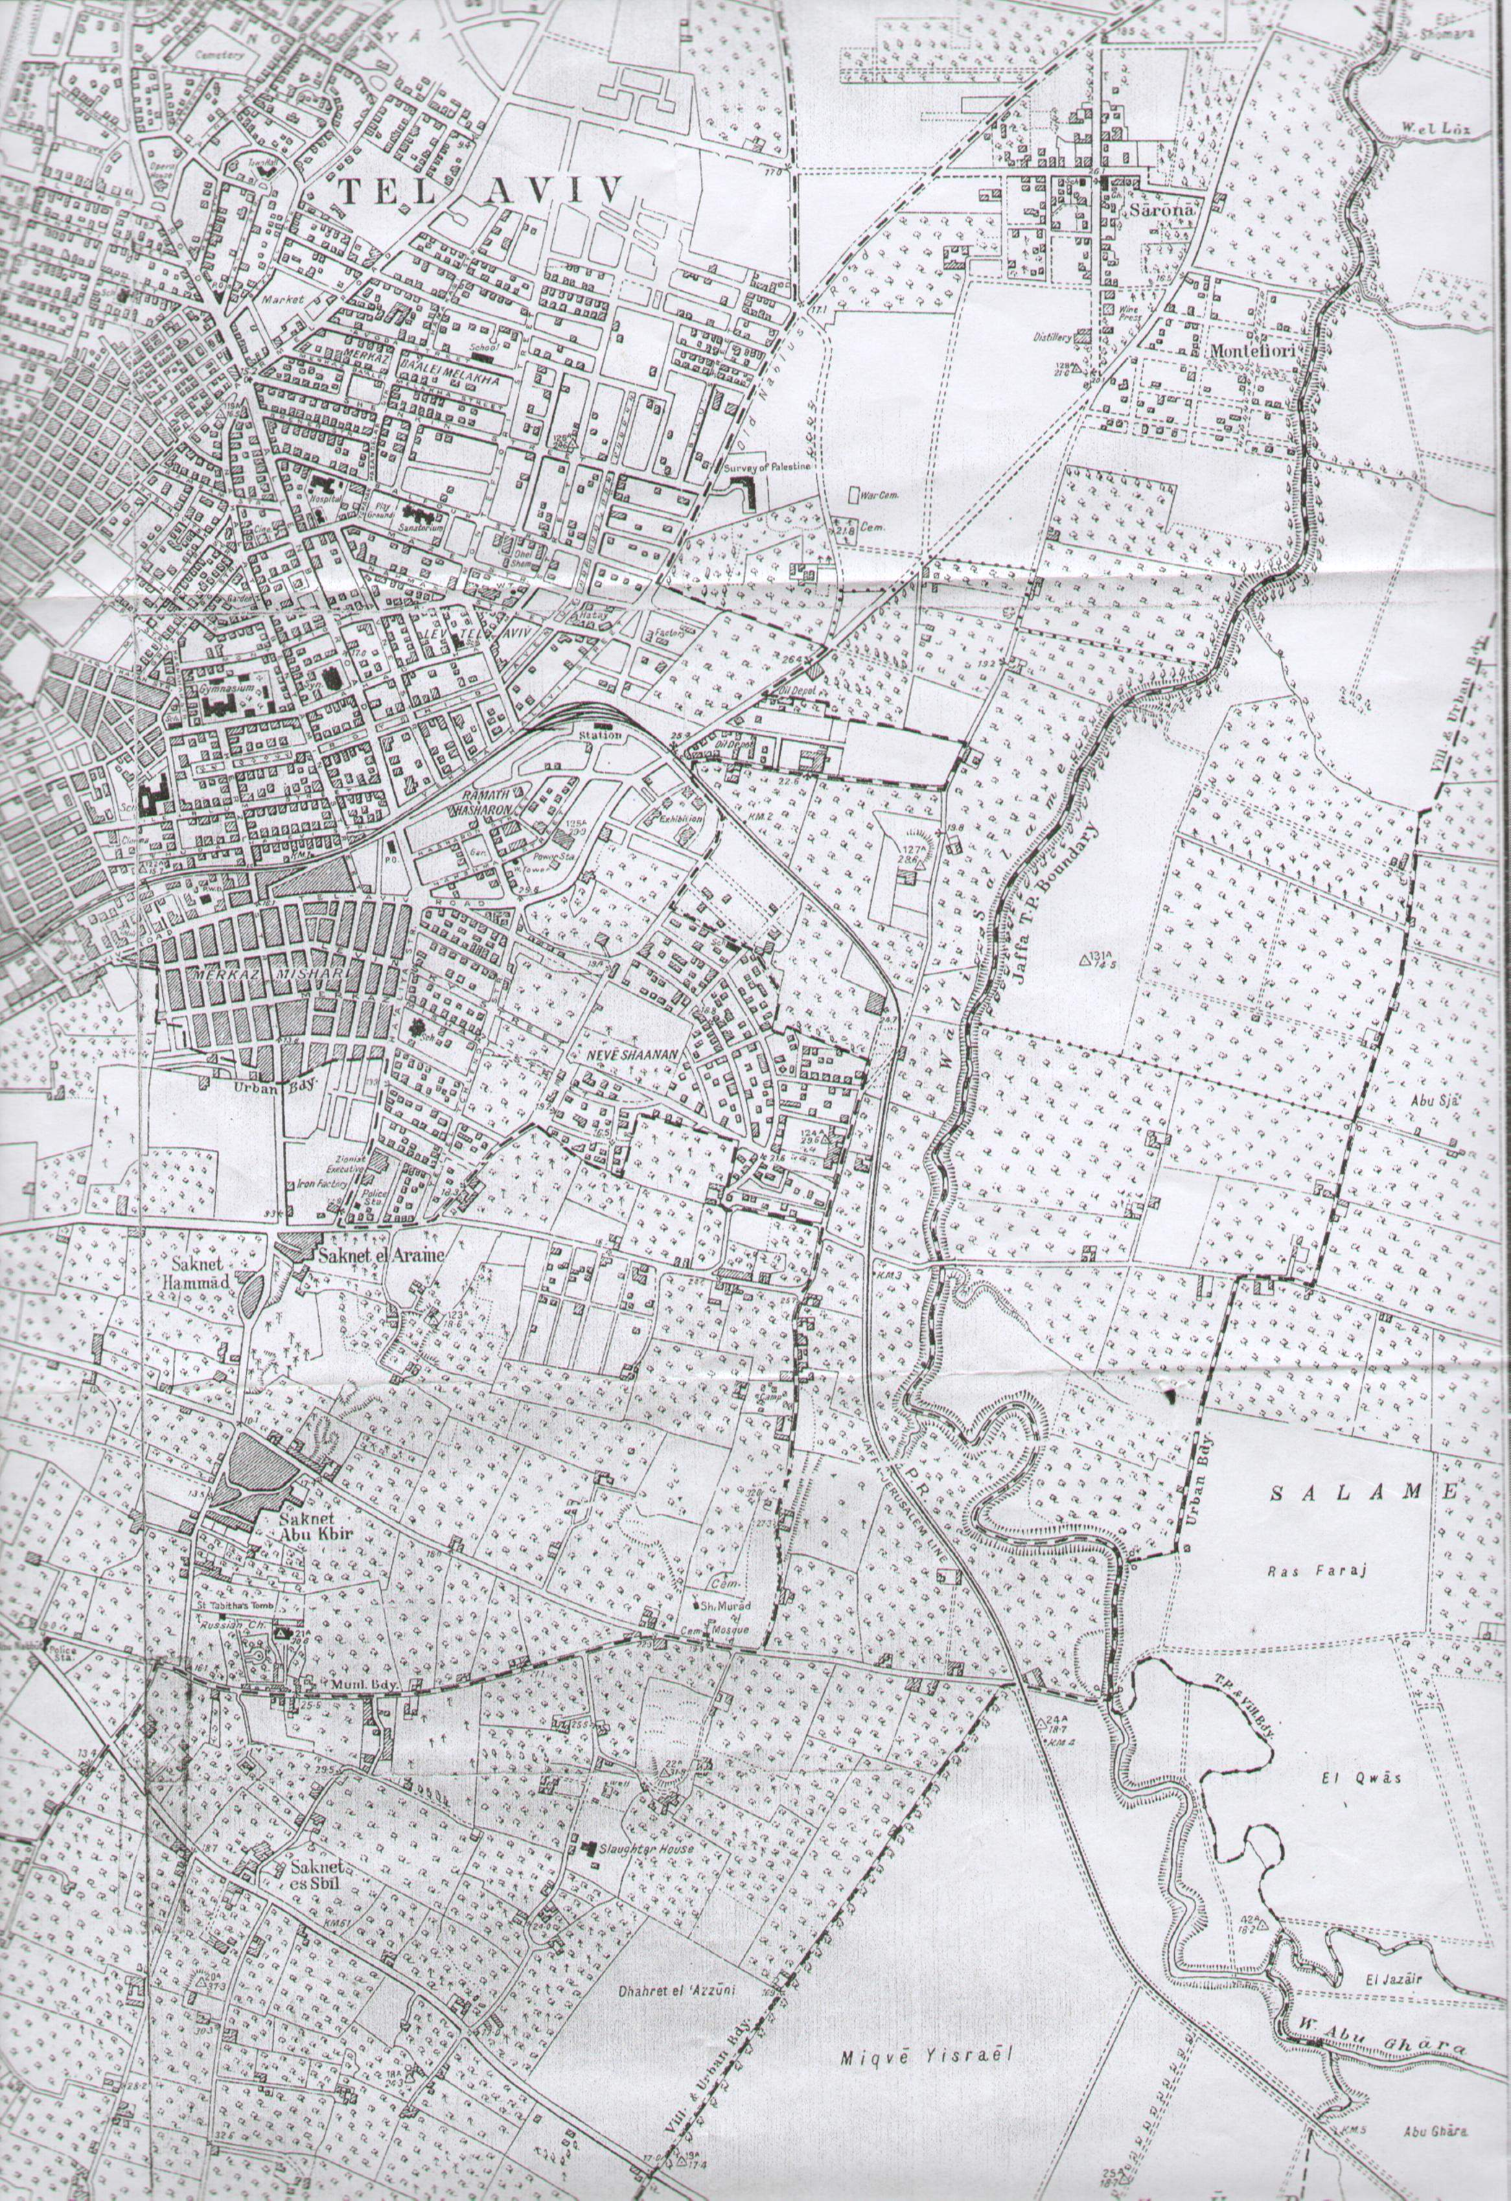
Shapira Neighborhood area, 1927

Slide 10
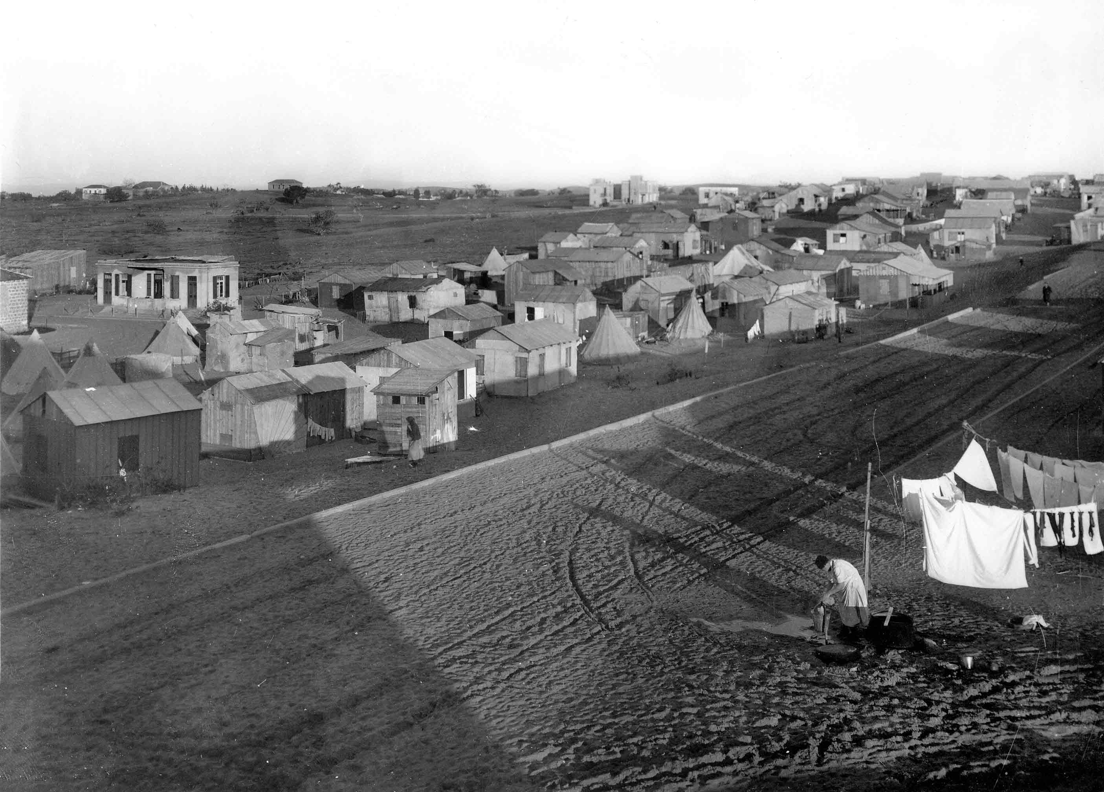
Shapira Neighborhood in the late 1920s (photo: Zvi Oron)

Slide 11
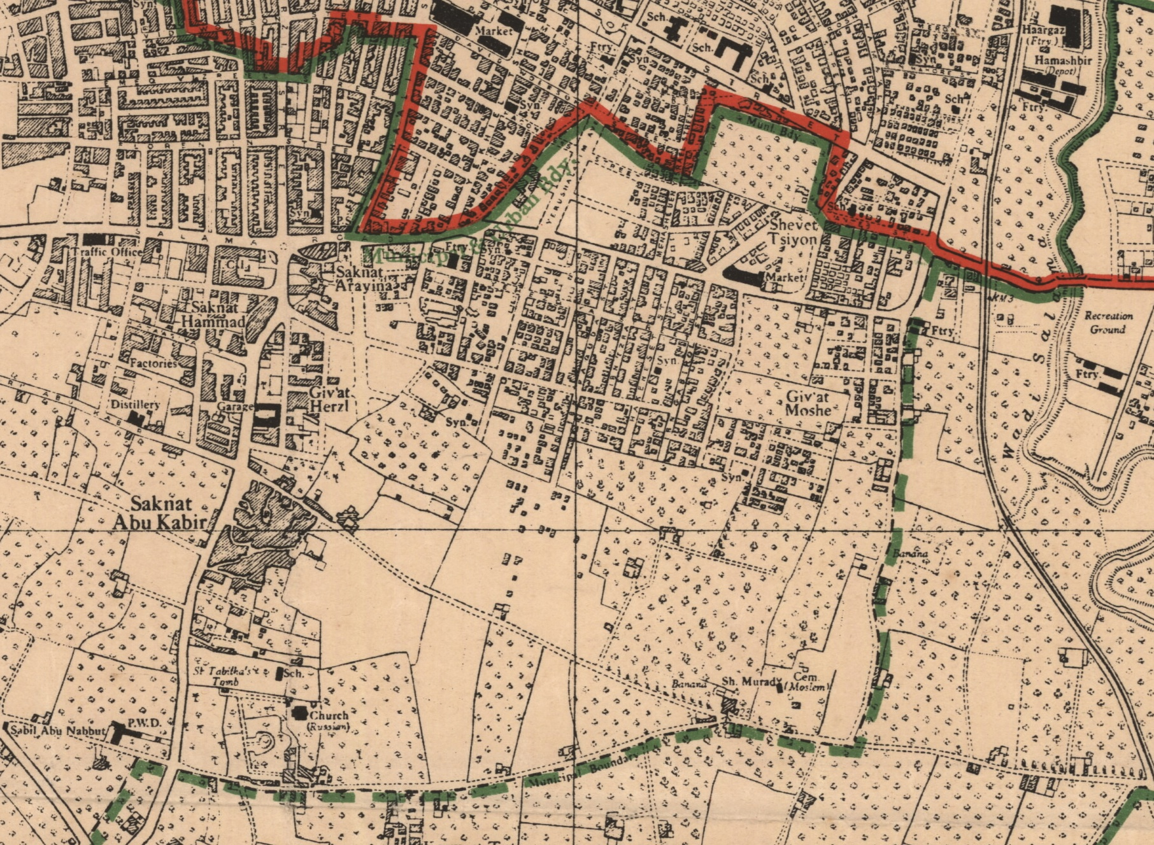
Shapira Neighborhood area, 1945

Slide 12
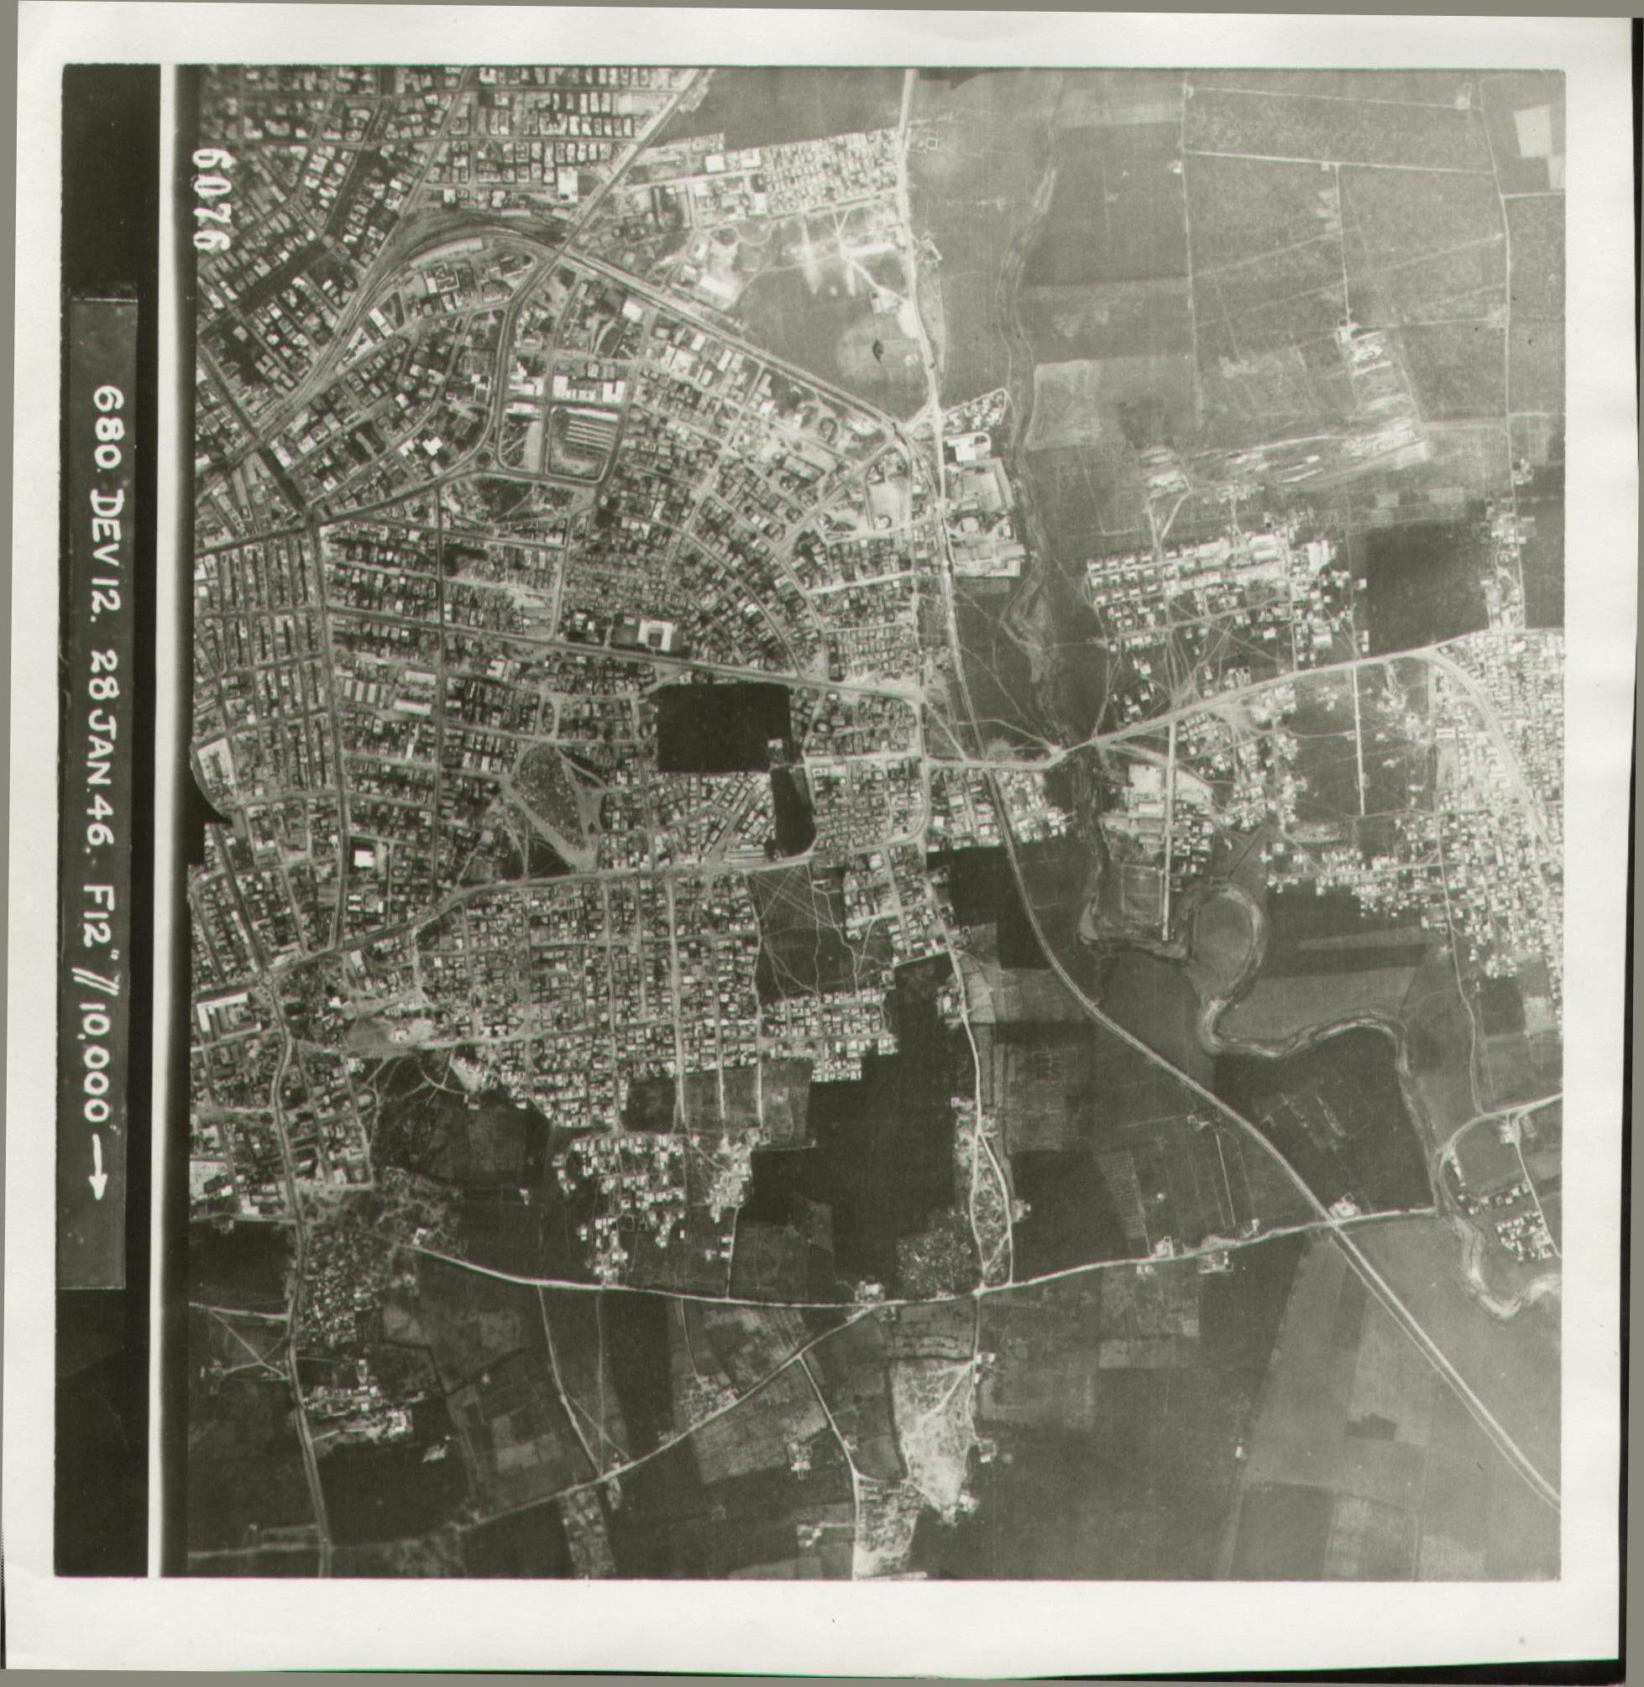
Shapira Neighborhood area, 1946

Slide 13
Shapira Neighborhood area, 1949

Slide 14
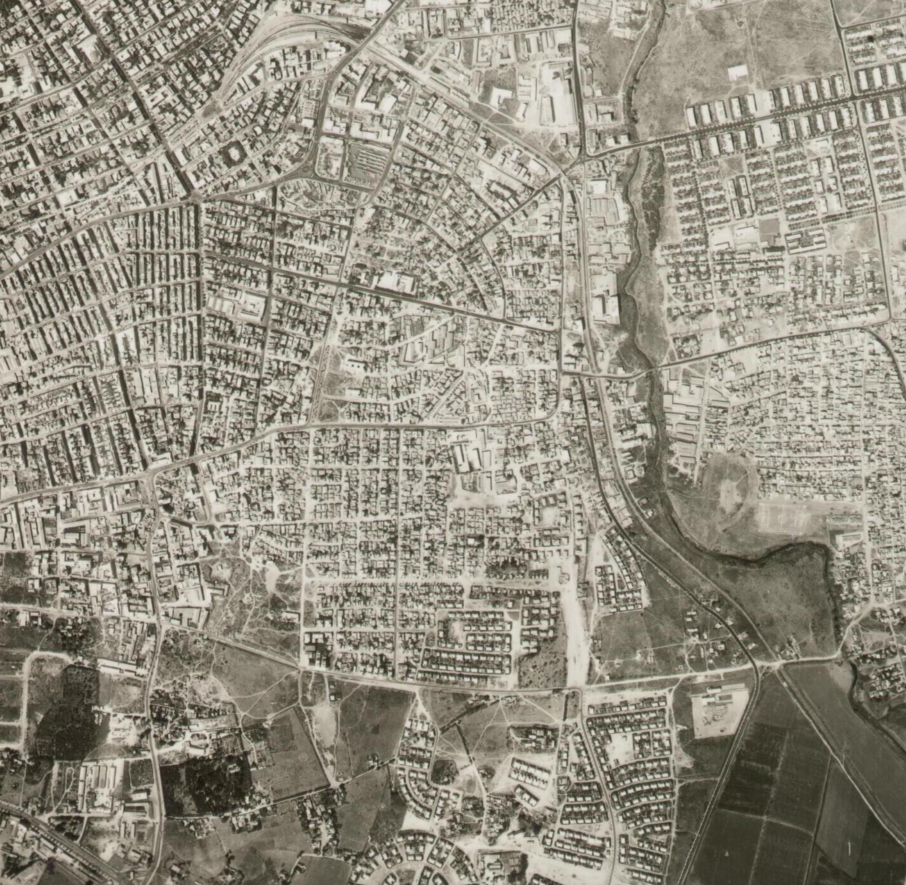
Shapira Neighborhood area, 1956

Slide 15
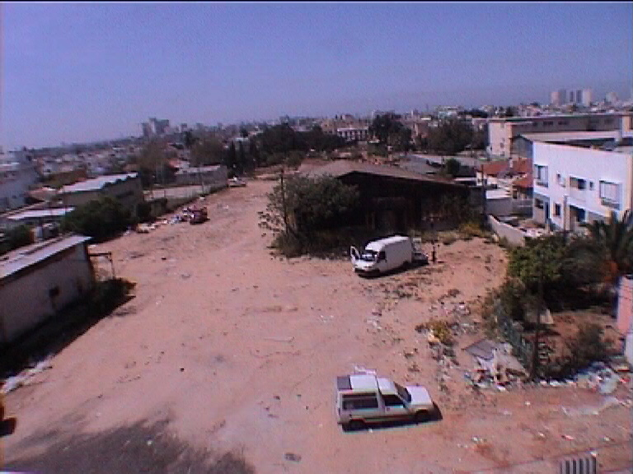
Shapira Neighborhood, 2000s

Slide 16
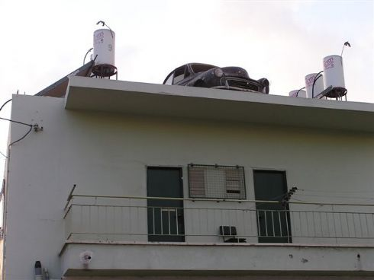
Shapira Neighborhood, 2000s

Slide 17
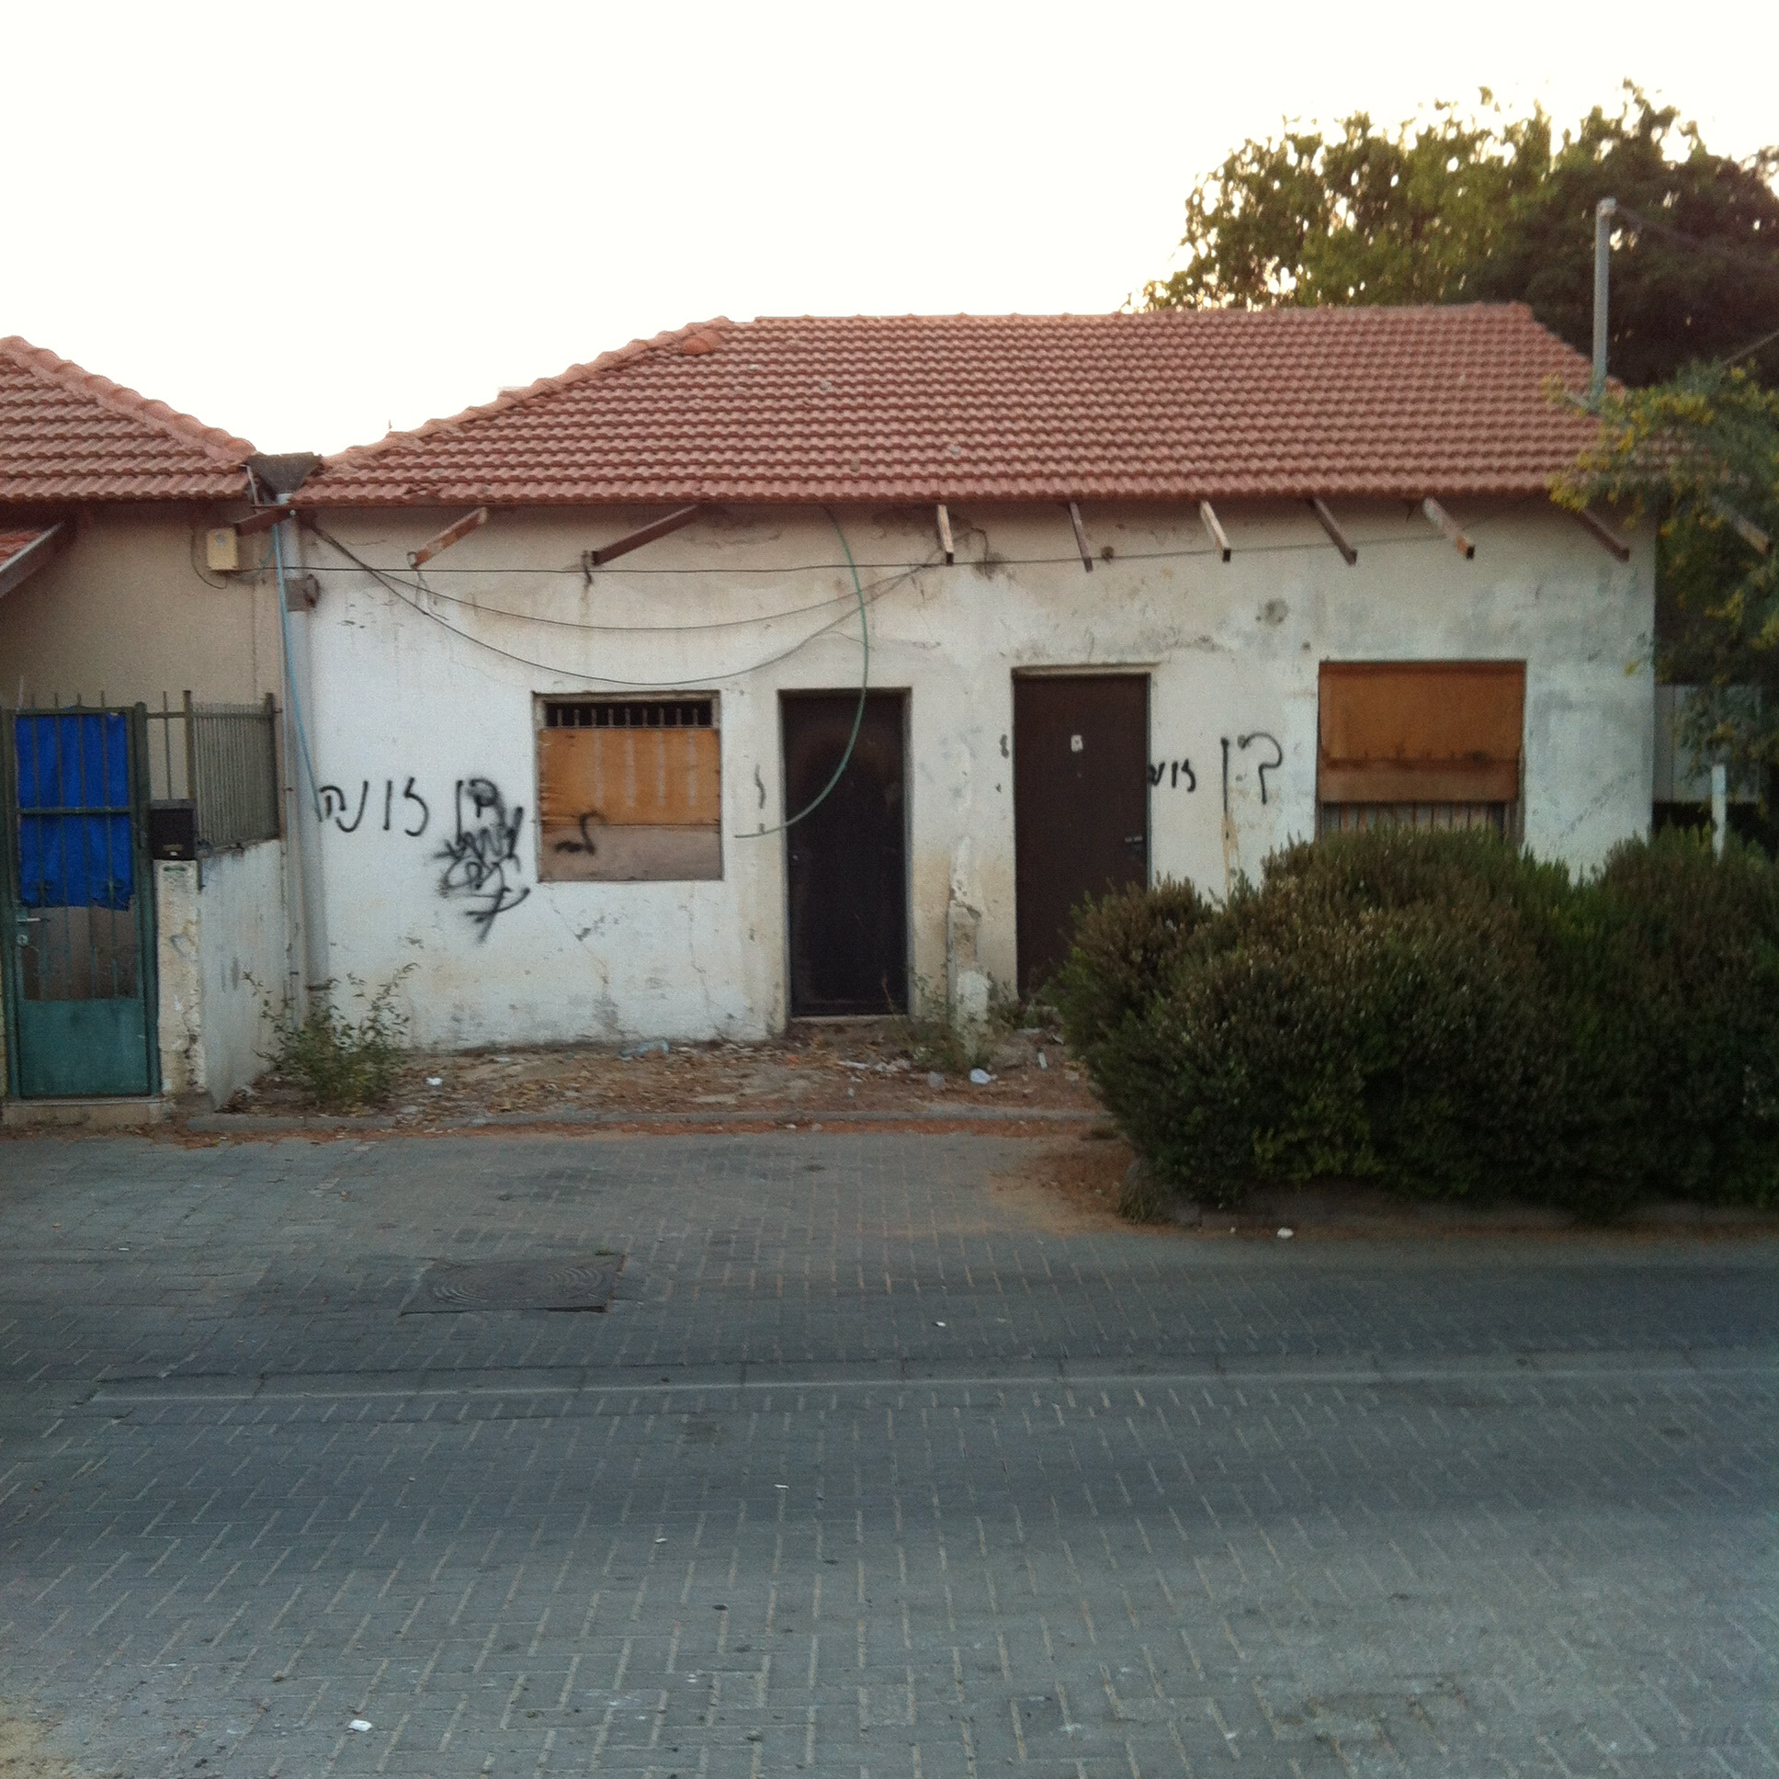
Son of a Bitch home, Shapira Neighborhood, 2007 (“before”)

Slide 18
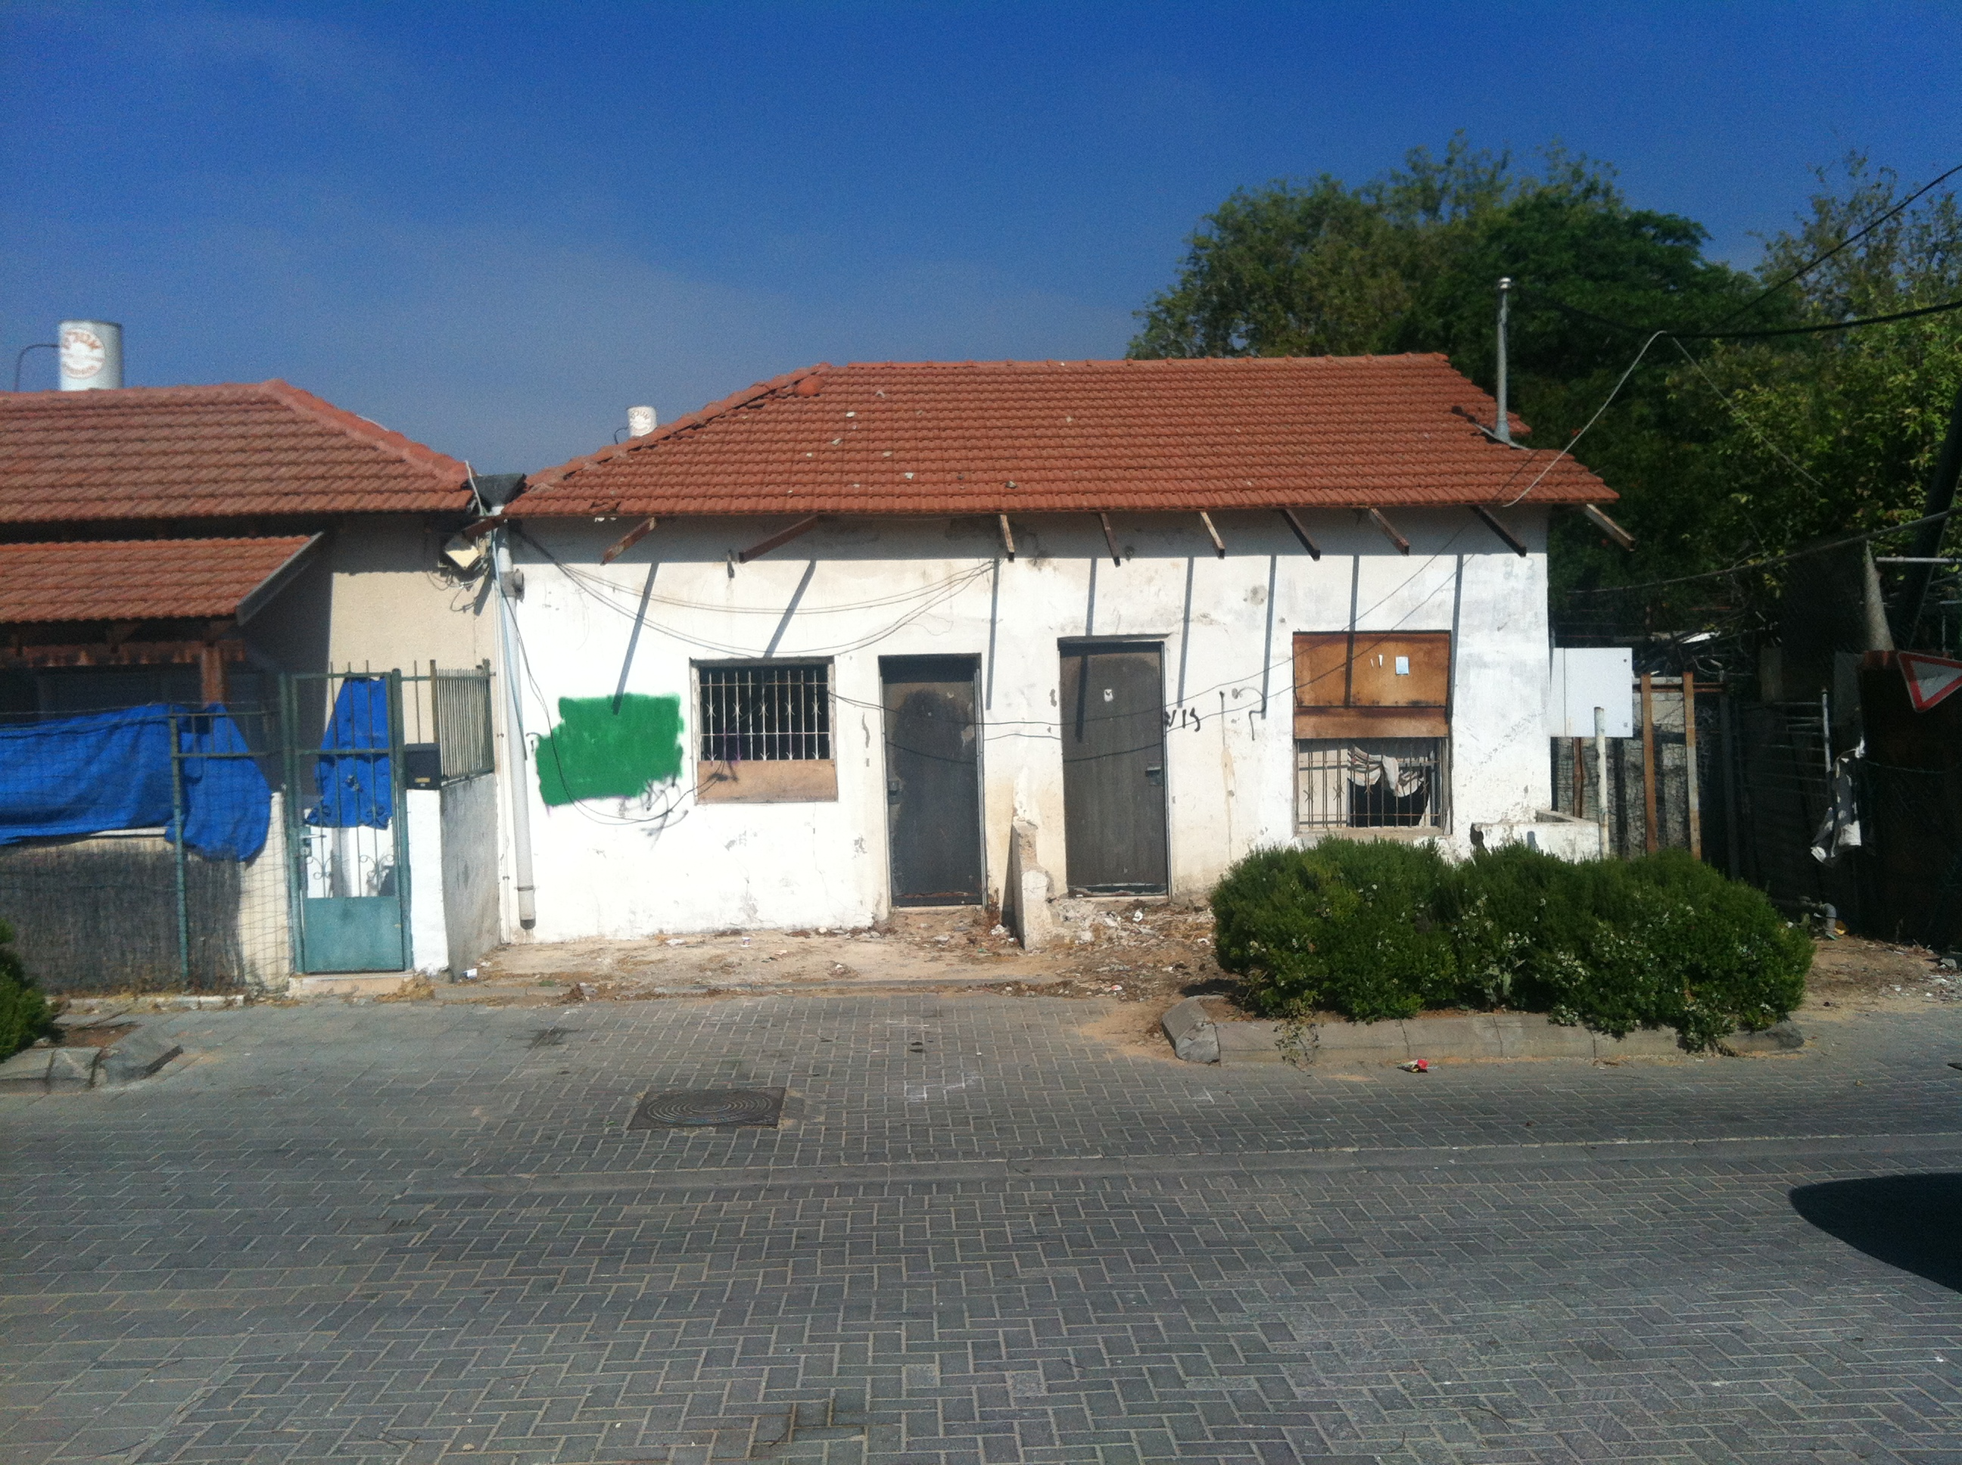
Son of a Bitch home, Shapira Neighborhood, 2009 (“after”)

Slide 19
Shapira Neighborhood, 2000s

Slide 20
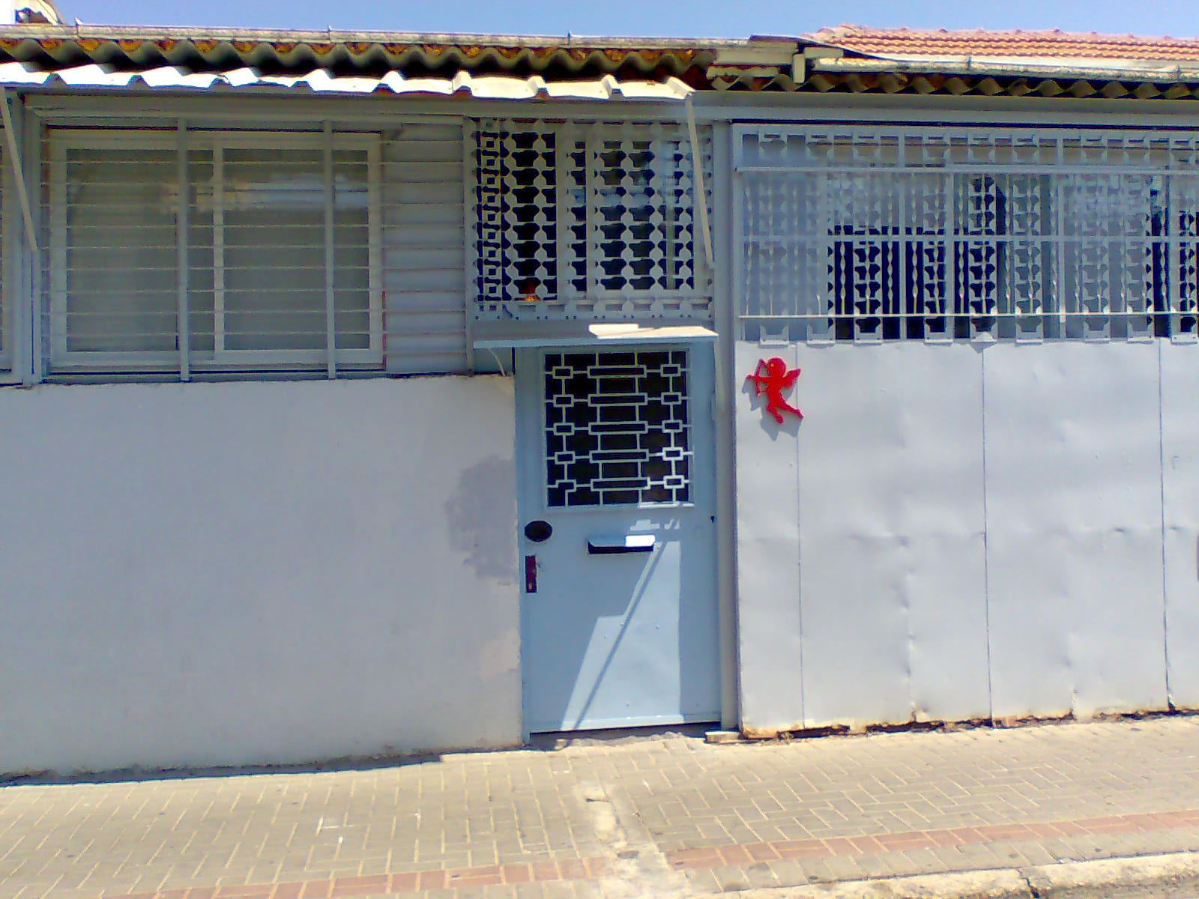
Shapira Neighborhood, 2000s

Slide 21
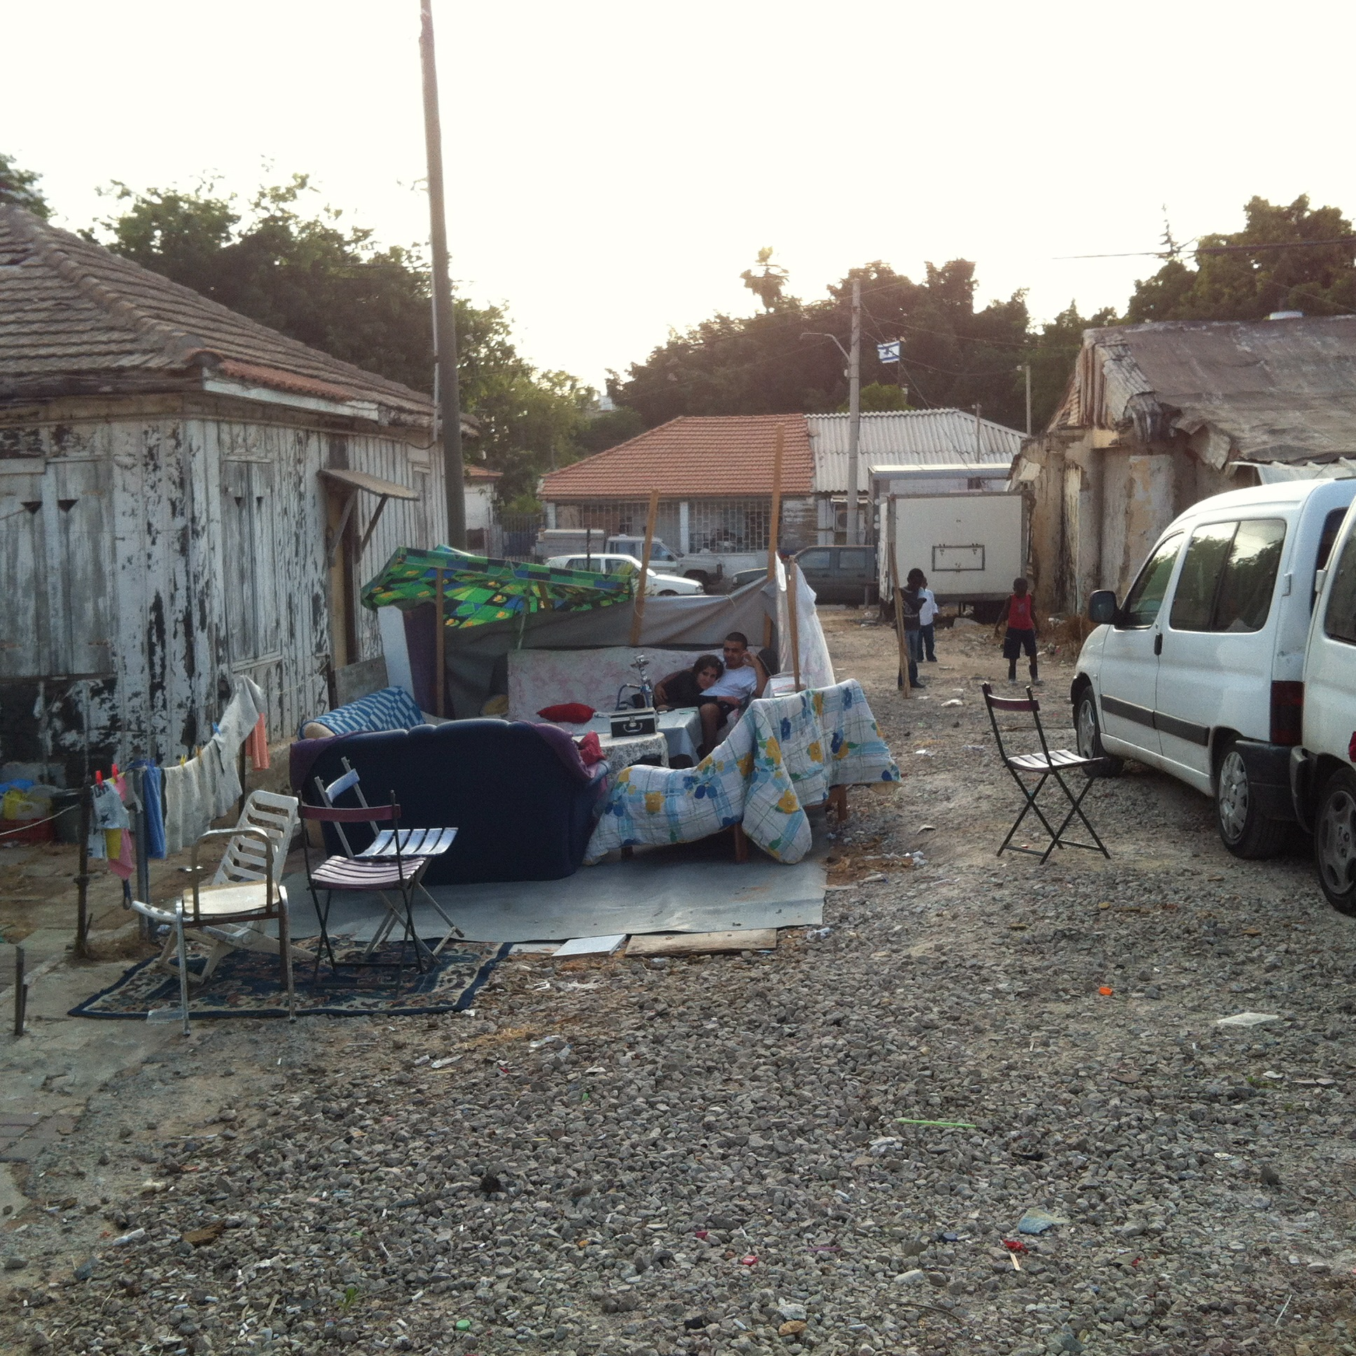
Shapira Neighborhood, 2000s

Slide 22
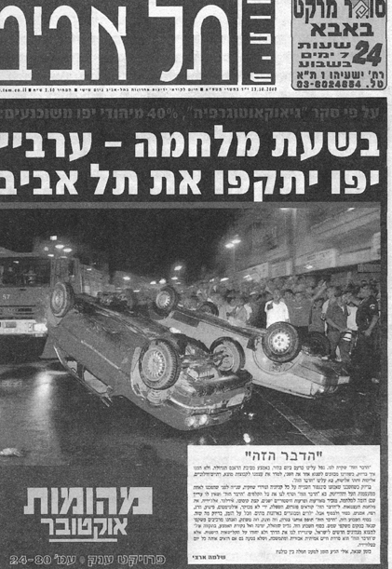
“In the event of war, Jaffa Arabs will attack Tel Aviv” – Tel Aviv local newspaper headline, October 2000

Slide 23
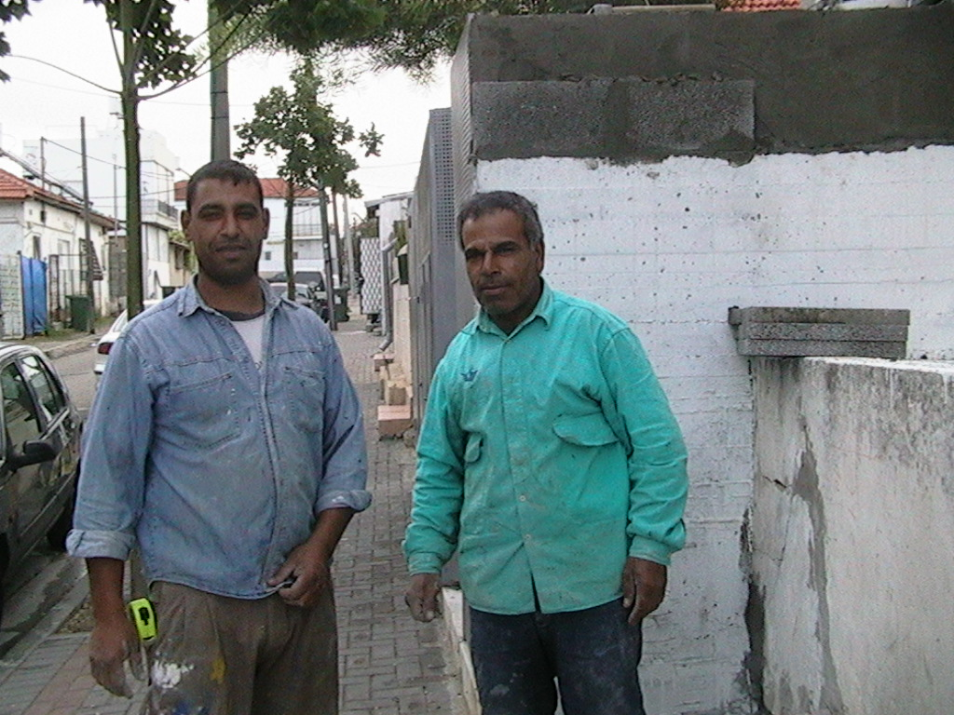
Fauzi and Djamil, Palestinian workers from Khan Yunis (Gaza Strip), Shapira Neighborhood 2000

Slide 24
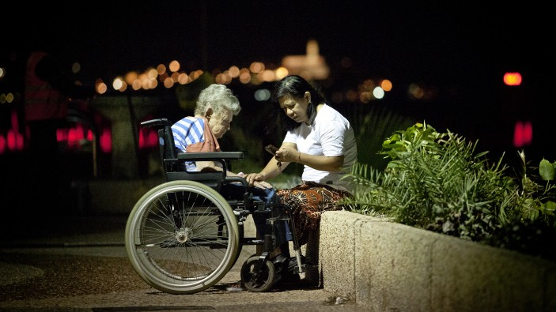
Philippine caretaker and her Israeli patient, Tel Aviv, 2012

Slide 25
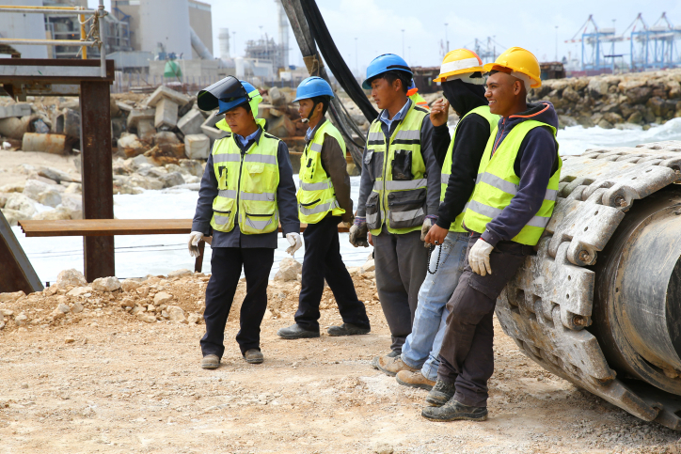
Chinese construction workers, Tel Aviv, 2010s

Slide 26
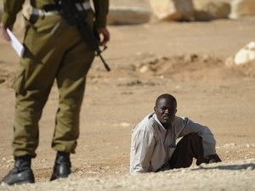
An African refugee captured at the Egyptian border, circa 2012

Slide 27
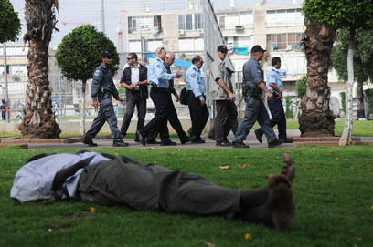
Minister of Interior touring the Black City, circa 2012

Slide 28
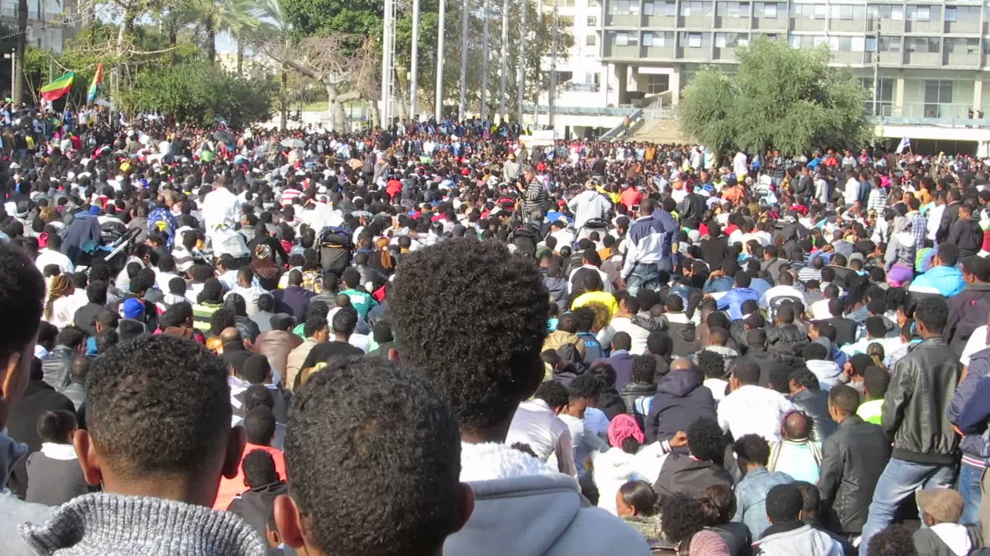
Refugees protest in Rabin Square, Tel Aviv, 2014

Slide 29
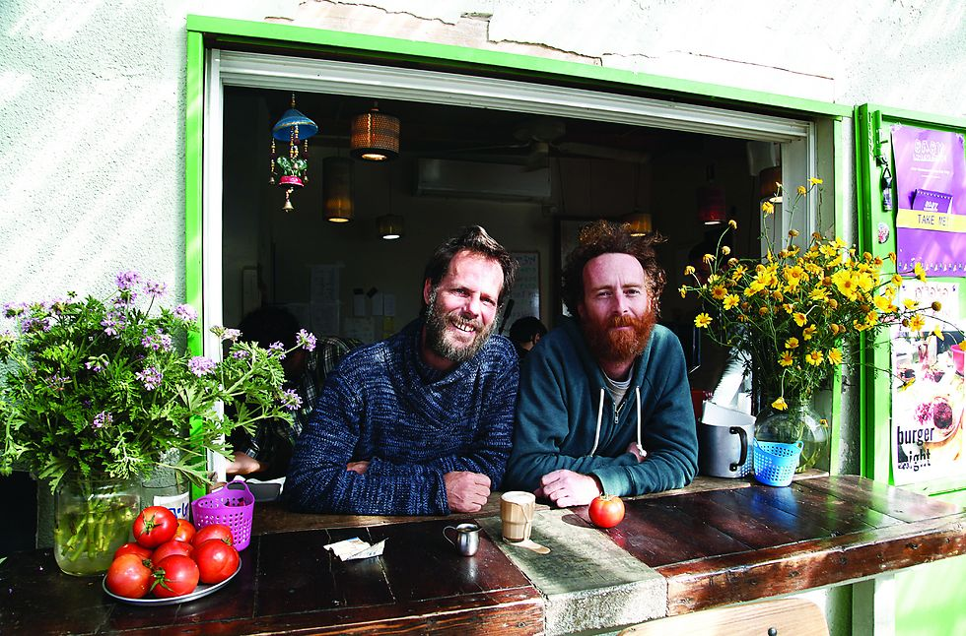
Yonatan and Hanan, owners of Shapira Café, the first Café in Shapira Neighborhood, 2015

Slide 30
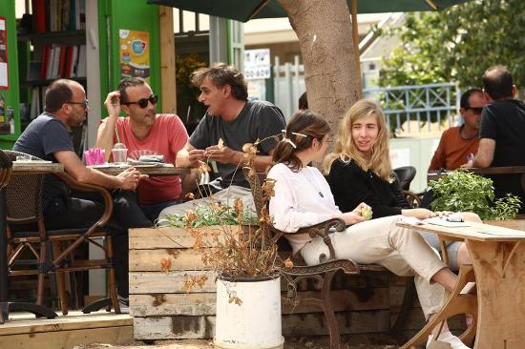
Artists and hipsters at Shapira Café,, Shapira Neighborhood, 2015

Slide 31
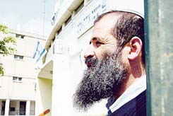
Rabbi Mishal Cohen (Hebron), head of Orot Aviv Yeshiva, Shapira Neighborhood, 2008

Slide 32
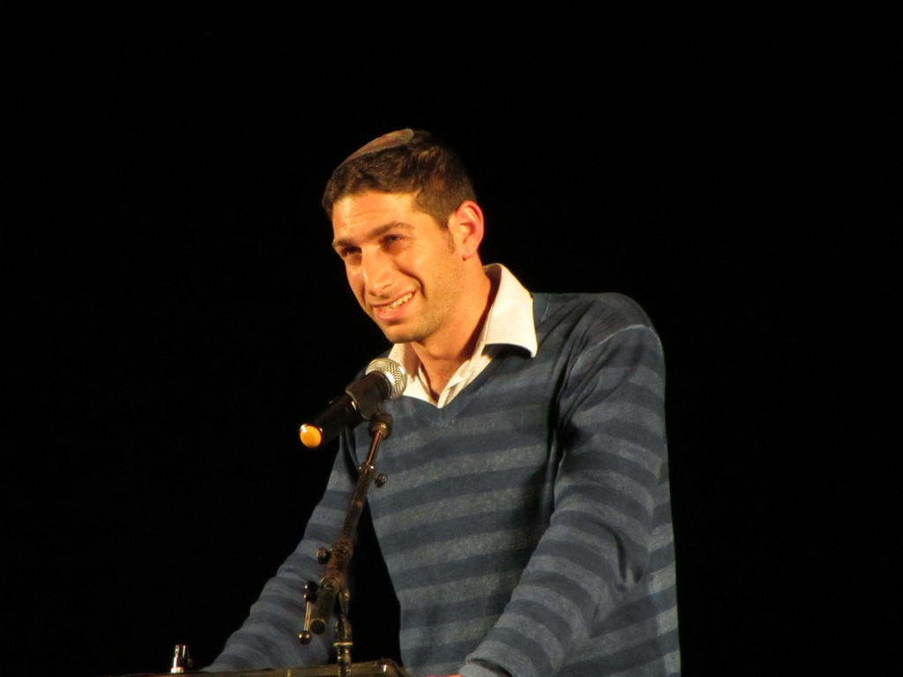
Chaim Goren (Ofra), representative of South Tel Aviv

Slide 33
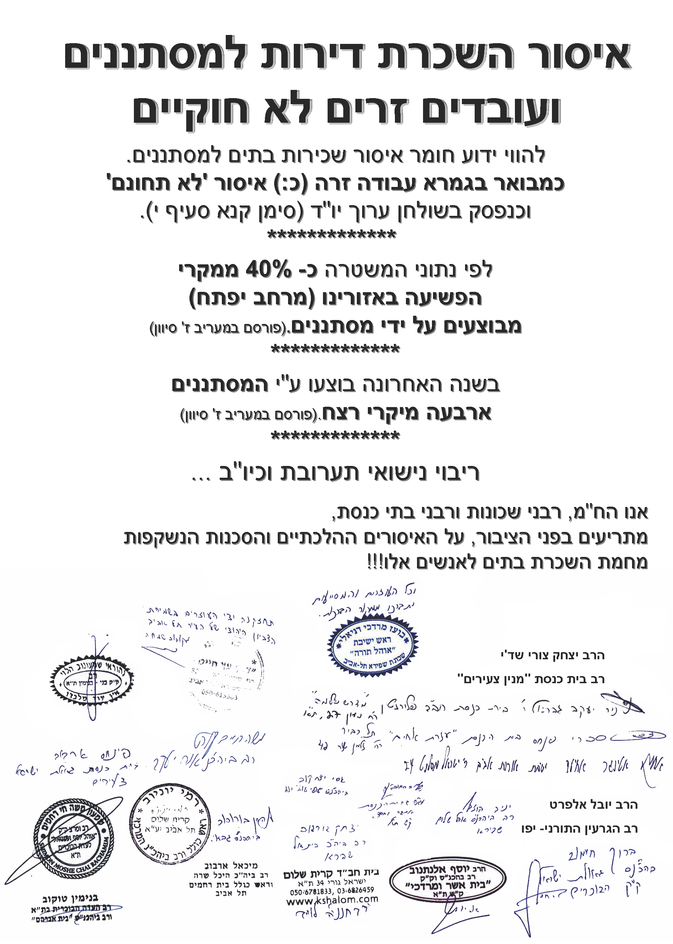
July 2010, rabbinical decree forbidding their communities from renting apartments to foreign work migrants or African refugees.

Slide 34
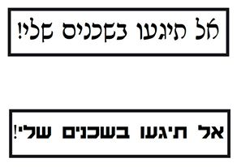
July 2010, “Do not touch my neighbors”, Leftist response poster, Shapira neighborhhod, 2010

Slide 35
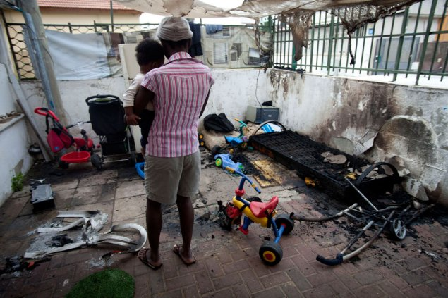
African kindergarten after a Molotov cocktail attack, Shapira neighborhood, 2012

Slide 36
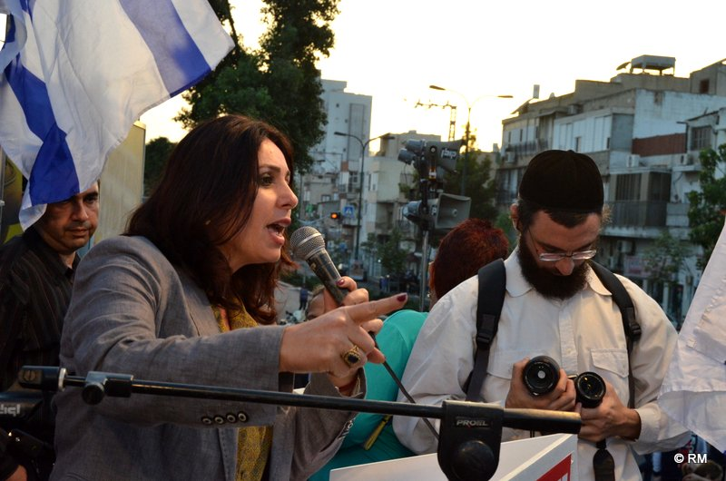
MK Miri Regev (today Israel’s minister of Culture) at a South Tel Aviv anti-African rally, 2012

Slide 37
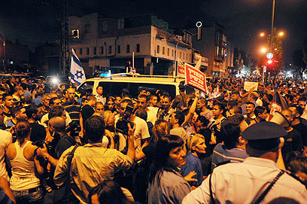
South Tel Aviv anti-African rally, 2012

Slide 38
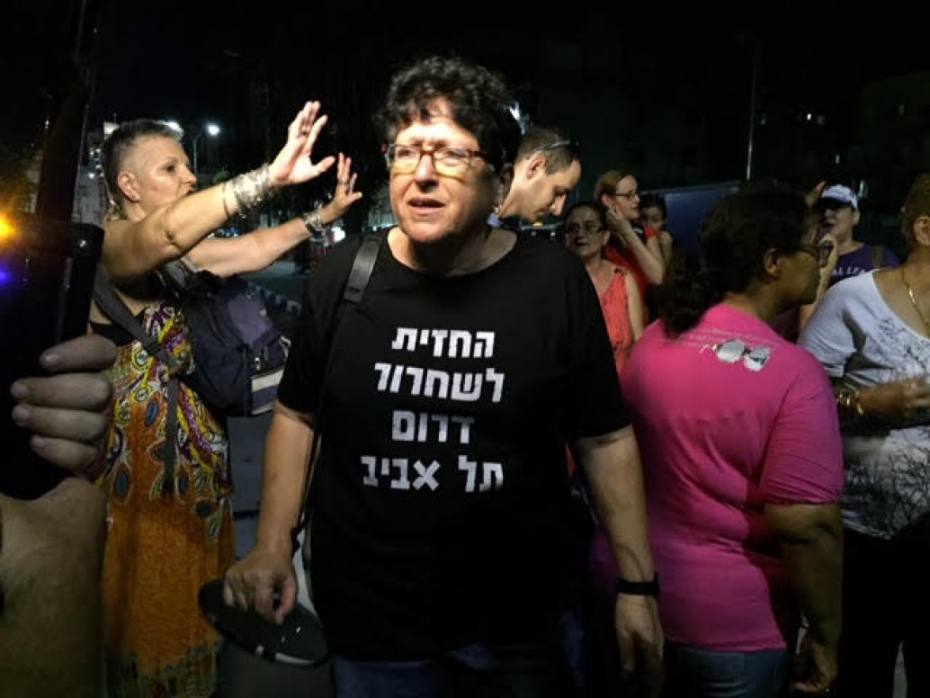
Sheffi Paz, leader of “South Tel Aviv Liberation Front”, Tel Aviv, 2015

Slide 39
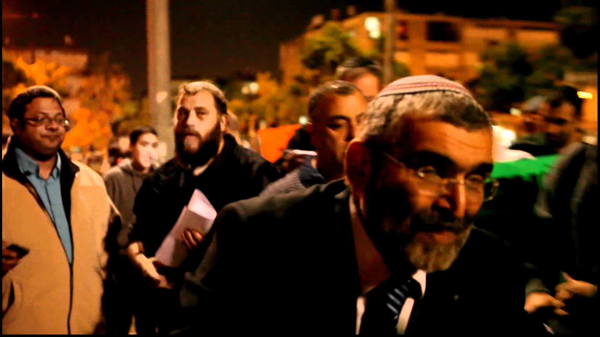
Far Right in the Black City.
From left tp right: Itamar Ben Gvir, Betzi Gufstein, Michael Ben Ari, South Tel Aviv, 2015

Slide 40
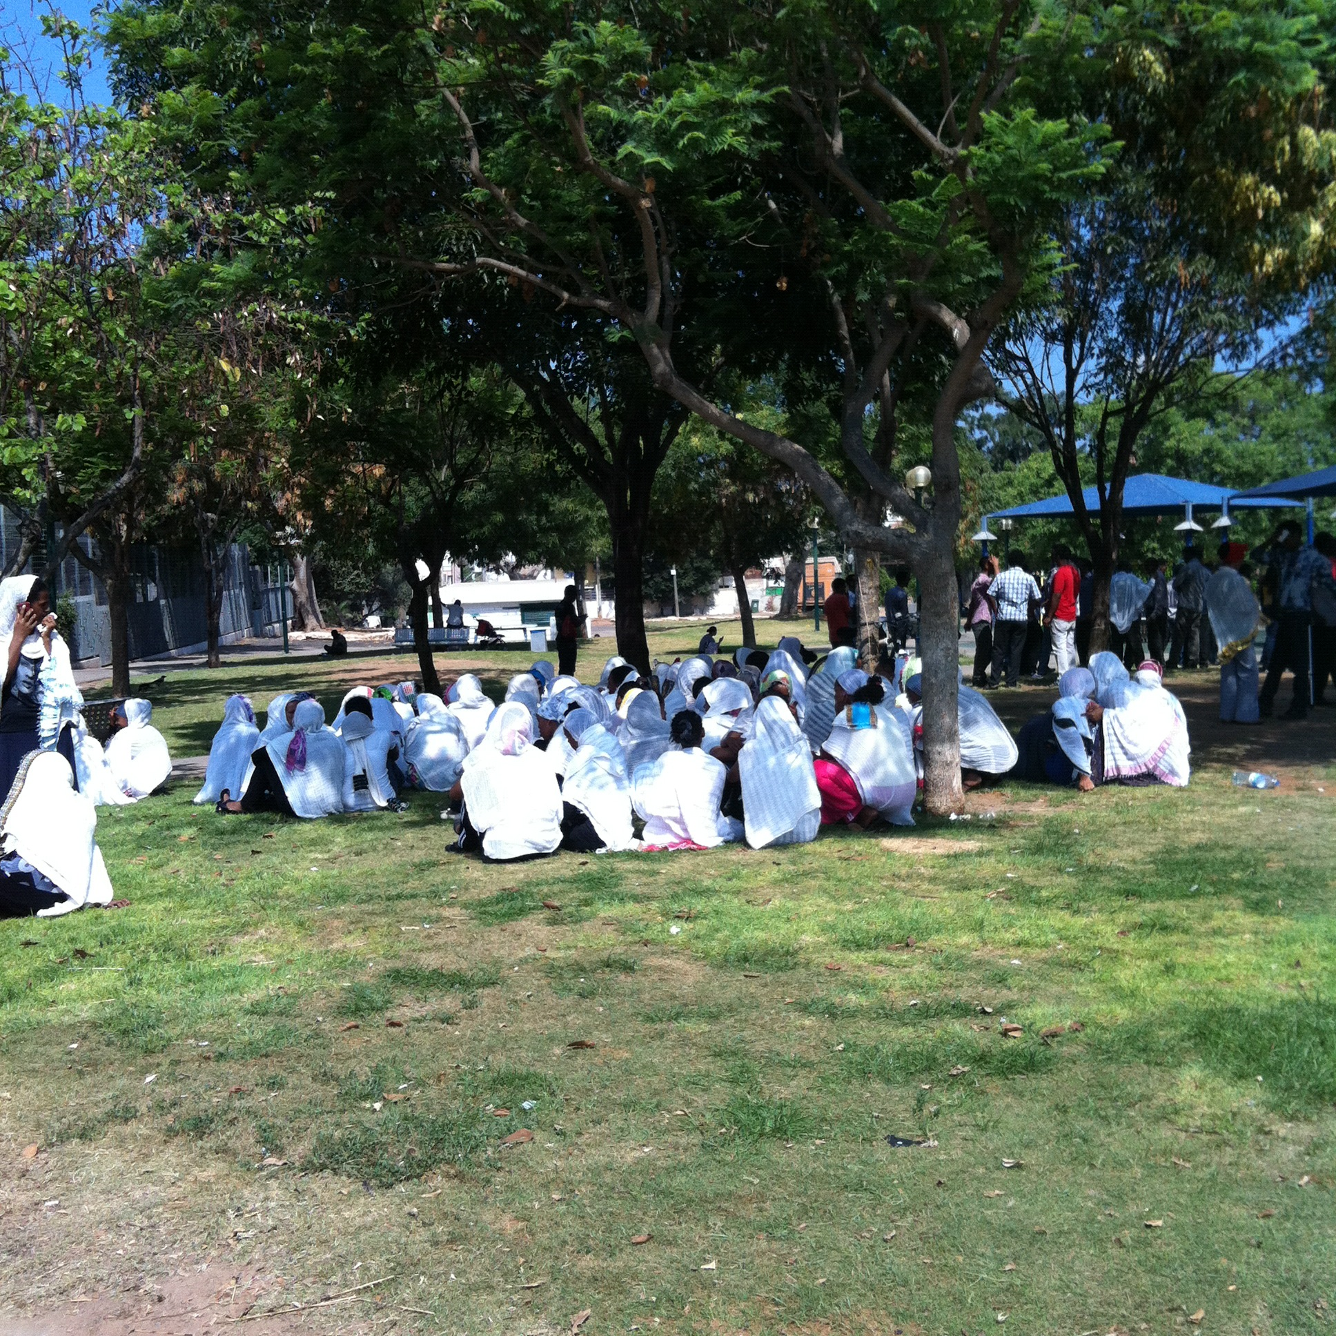
Mourning ceremony of Eritrean refugees, circa 2012

Slide 41
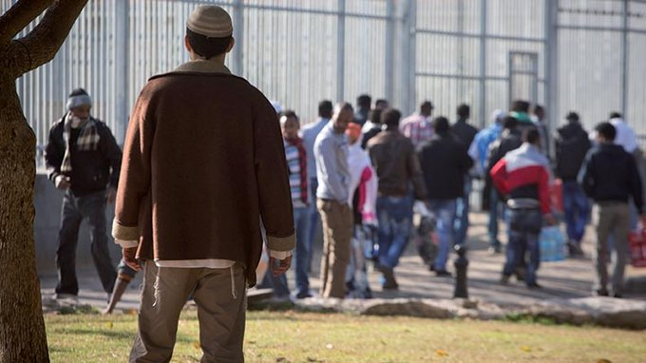
Anti-African activists interrupting a mourning ceremony held by Eritrean refugees, Shapira Neighborhood, 2013

Slide 42
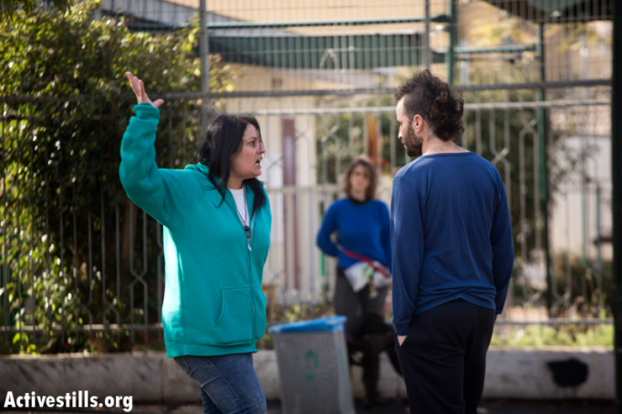
Suzi Cohen from the “South Tel Aviv Liberation Front” confronting an opponent at an anti-African demonstration, Shapira Neighborhood, 2013 - https://youtu.be/_b5hjonRcEs?t=2m24s

