Slide 1
Linguicide and Revival Prof. Ghil‘ad Zuckermann (Гилад Цукерман) D.Phil. (Oxon.), Ph.D. (Cantab., titular) Chair of Linguistics & Endangered Languages, The University of Adelaide http://www.zuckermann.org ghilad.zuckermann@adelaide.edu.au Moscow, 11 November 2018

Slide 2
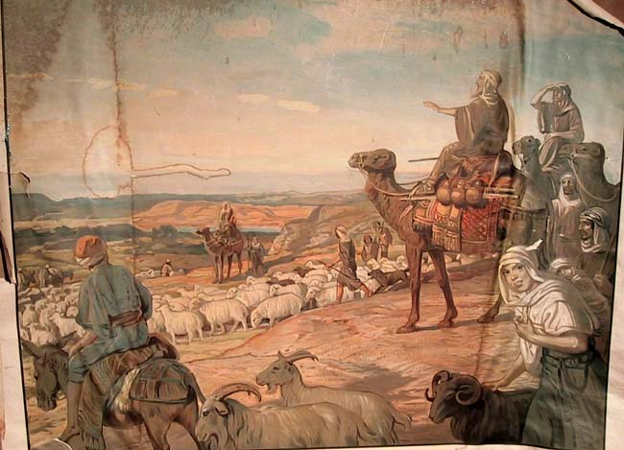
Professor Ghil‘ad Zuckermann 诸葛漫
DPhil (Oxford), PhD (Cambridge, titular)
Chair of Linguistics & Endangered Languages
The University of Adelaide
ghilad.zuckermann@adelaide.edu.au
www.adelaide.edu.au/directory/ghilad.zuckermann
www.facebook.com/ProfessorZuckermann
Professor Ghil‘ad Zuckermann

Slide 3
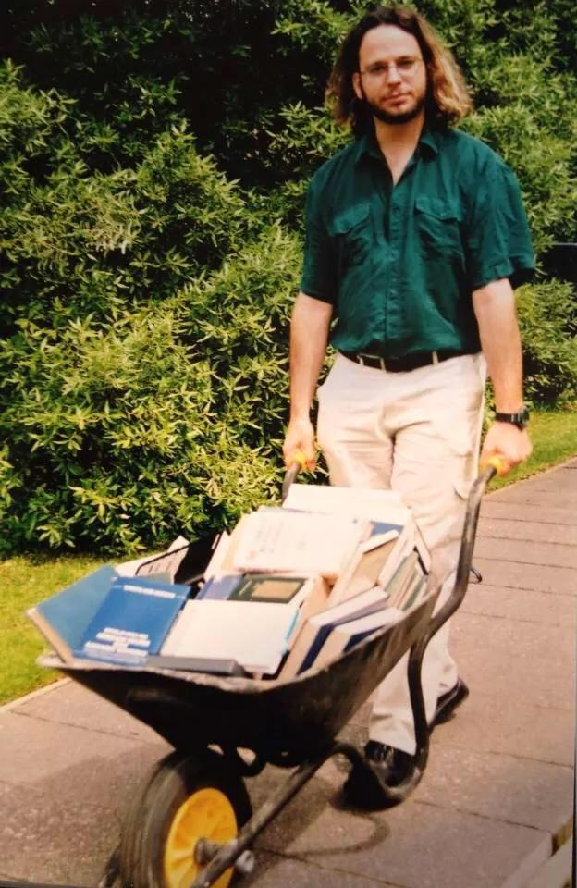
Ghil‘ad Zuckermann,
University of Oxford,
c. 1999
Professor Ghil‘ad Zuckermann

Slide 4
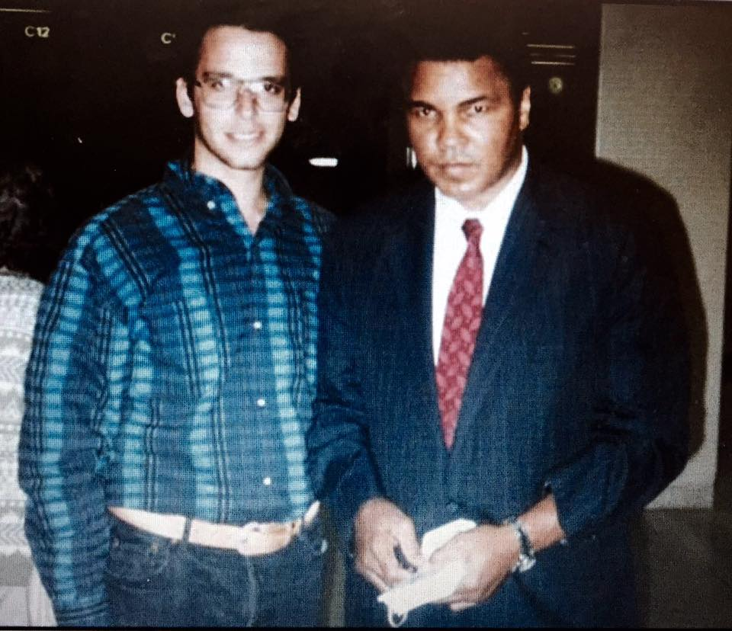
Resilience
Detroit, Michigan, USA
September/October 1993
L-R:
Ghil‘ad Zuckermann, Muhammad Ali
Professor Ghil‘ad Zuckermann

Slide 5
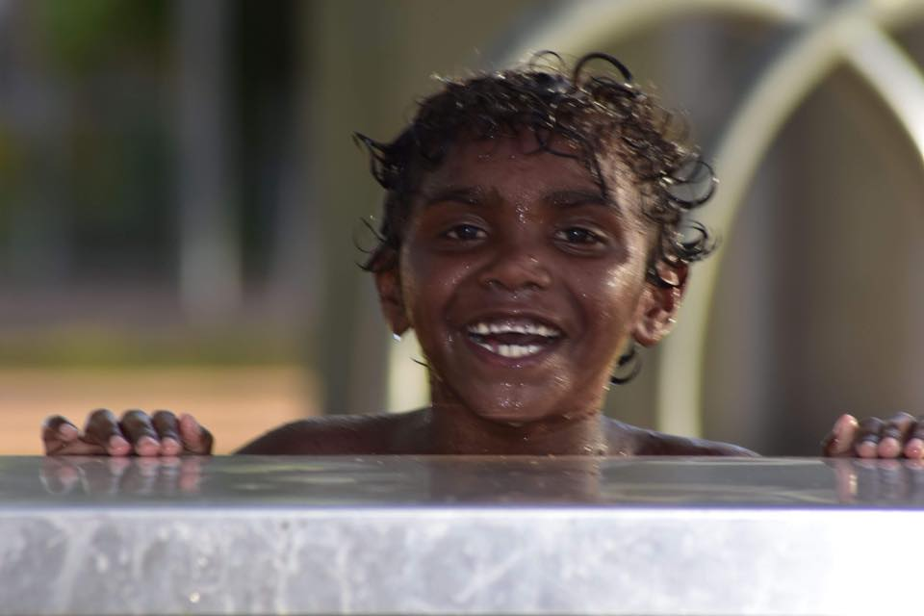
Barngarla Lisa Taylor's son Liam, March 2018, Port Augusta
Professor Ghil‘ad Zuckermann

Slide 6
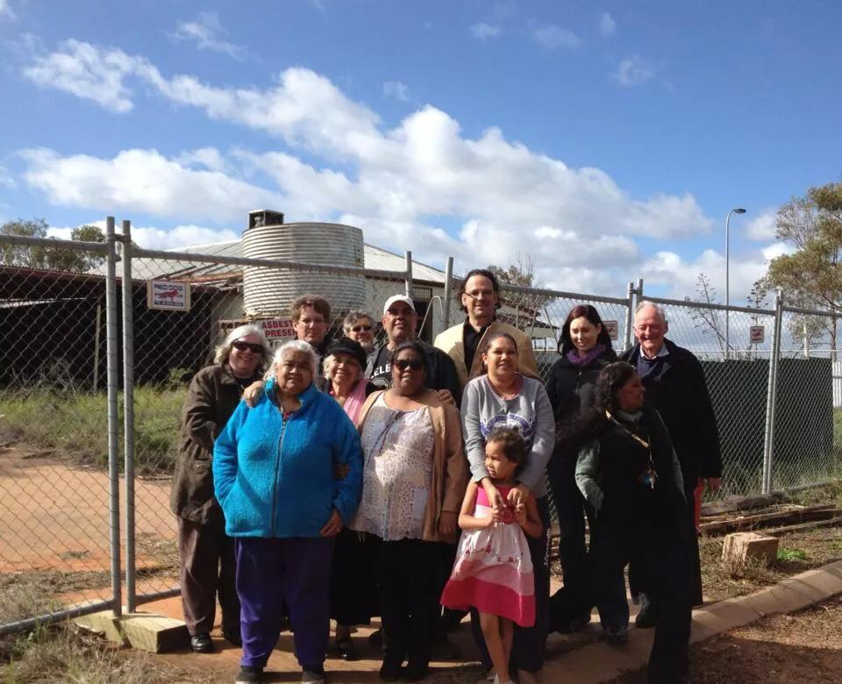
With Tony RATHJEN RIP (Yitpi Foundation)
(far right),
Revd Volker DALLY (then director of the Leipzig Lutheran Mission (second from left), and BARNGARLA people,
Umeewarra Mission, Goordnada (=Port Augusta),
2013
Professor Ghil‘ad Zuckermann

Slide 7
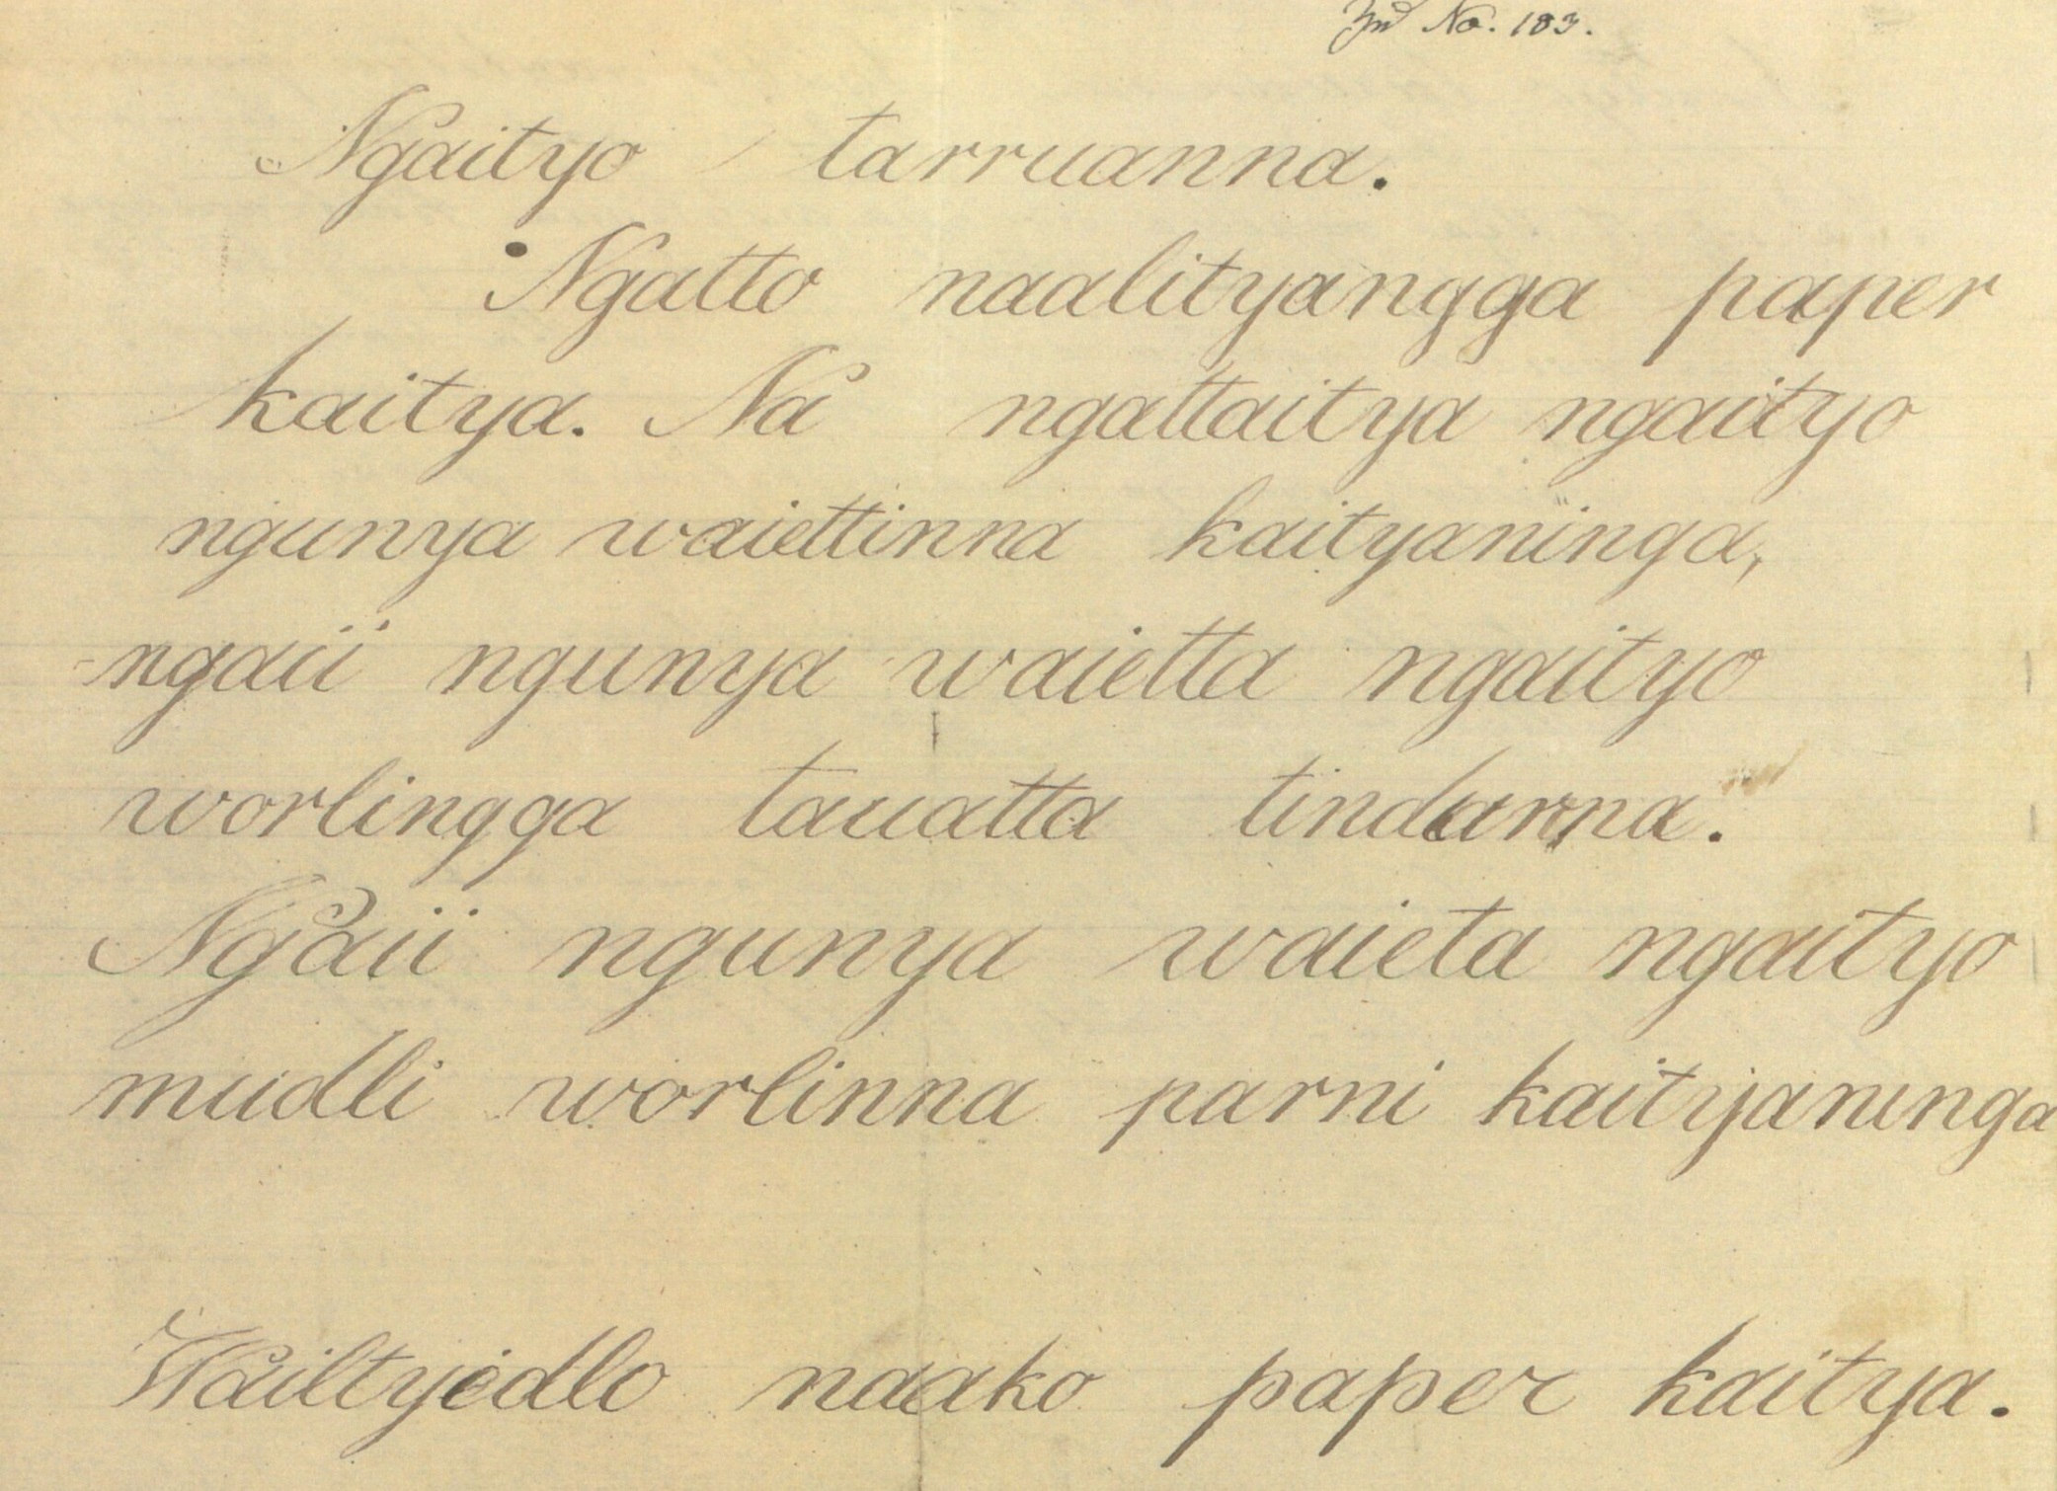
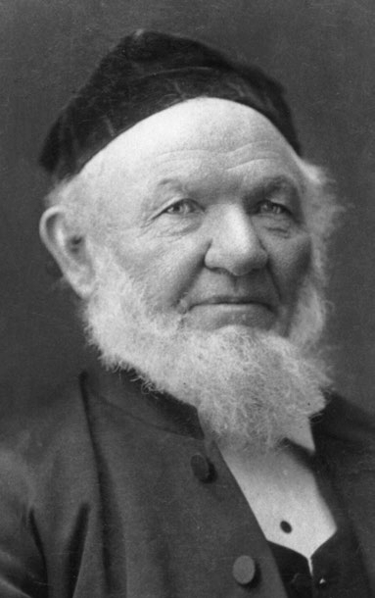
Clamor Wilhelm Schürmann
Professor Ghil‘ad Zuckermann

Slide 8
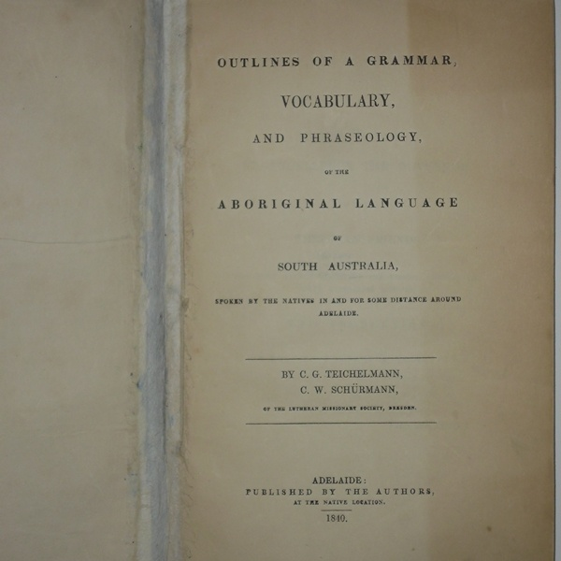
E.g. Outlines of a grammar, vocabulary and phraseology of the Aboriginal language of South Australia.
Professor Ghil‘ad Zuckermann

Slide 9
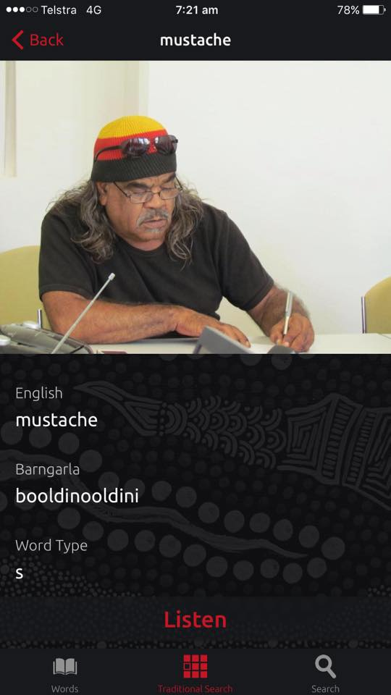
Barngarla elder Harry DARE, Port Augusta, featuring in the Barngarla app.
Professor Ghil‘ad Zuckermann

Slide 10
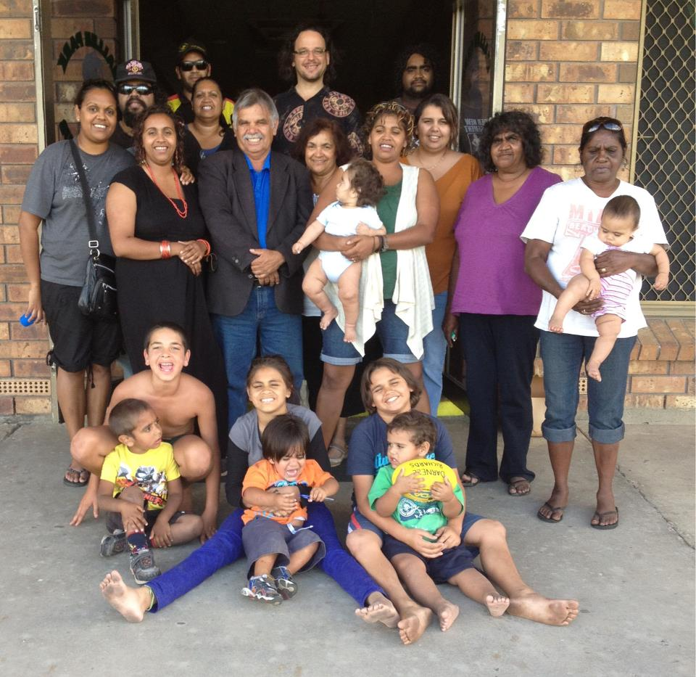
Gabmididi Barngarlidi Manoo
‘Learning and Speaking Barngarla Together’
Galinyala (=Port Lincoln), South Australia, Professor Ghil‘ad Zuckermann with participants in the first Barngarla reclamation workshop,
18-20 April 2012
Professor Ghil‘ad Zuckermann

Slide 11
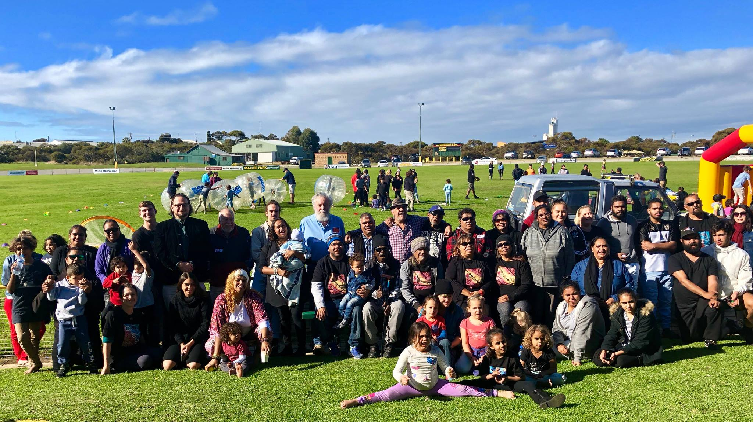
Gabmididhi Barngarlidhi Manoo ‘Learning and Speaking Barngarla Together’, Galinyala (=Port Lincoln), 12 July 2018
Professor Ghil‘ad Zuckermann

Slide 12
Abstract of Today’s Talk
This lecture will analyse the ethical/moral, aesthetic, epistemological, cognitive, psychological, economic and health benefits of language revival and diversity.
With coca-colonization and homogenization there will be more and more groups added to the forlorn club of the lost-heritage peoples. Language reclamation, revitalization and reinvigoration will become increasingly relevant as people seek to recover their cultural autonomy, empower their spiritual and intellectual sovereignty, and improve their wellbeing and mental health.
There is an urgent need to offer perspicacious comparative insights, for example from the Hebrew revival, which is so far the most successful known linguistic reclamation. The lecture will explore current attempts to reclaim Australian Aboriginal sleeping beauty languages such as Barngarla.
Given capricious governmental policies, the lecture will propose
‘Native Tongue Title’, legal compensation (for linguistic activities) for Indigenous peoples who lost their tongue due to linguicide (language killing),
making Indigenous tongues the official languages of their region, inter alia resulting in bilingual signs.
Professor Ghil‘ad Zuckermann

Slide 13
The Main Question of Today’s Lecture
WHY on earth should we invest time and money in reviving ‘dead’ languages?
(1) Ethical (what is right)
(2) Aesthetic (what is beautiful)
(3) Utilitarian (e.g. health, wellbeing)
(what is useful)
reasons
Professor Ghil‘ad Zuckermann

Slide 14
Outline of Today’s Lecture
Related Questions:
Is there a link between language and mental health?
Should we financially compensate Indigenous people for the loss of their native tongues?
Should indigenous languages be defined as official languages, e.g. of Australia?
Should we erect bilingual signs?
Does language dictate the way we think?
Is it possible at all to reclaim a ‘dead’ language?
Professor Ghil‘ad Zuckermann

Slide 15
INTRODUCTION
Professor Ghil‘ad Zuckermann

Slide 16
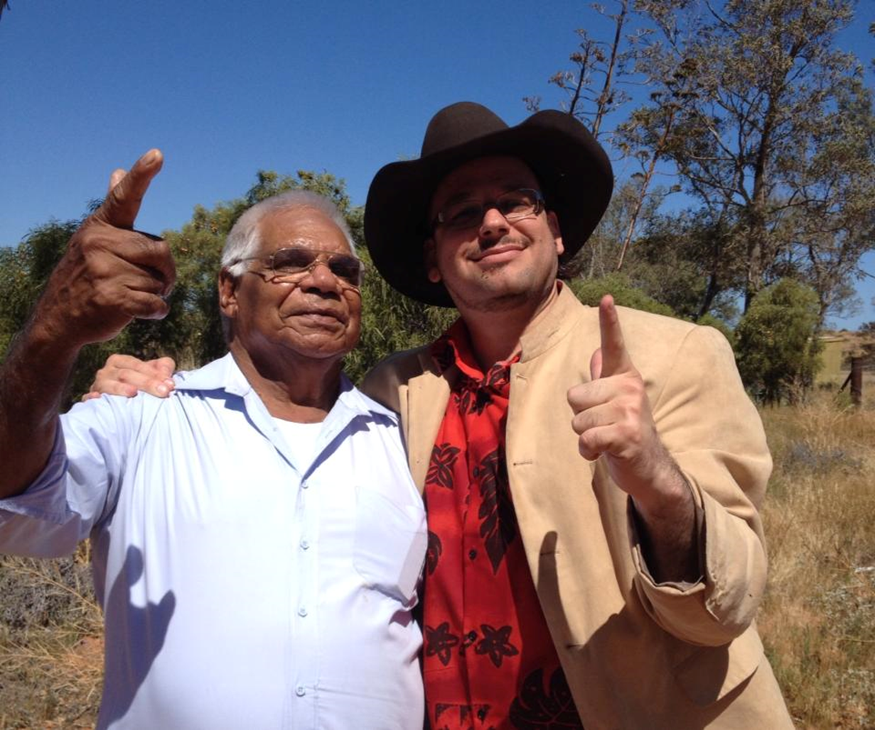
Before I speak, I would like to say a few words. ☺
Professor Ghil‘ad Zuckermann

Slide 17
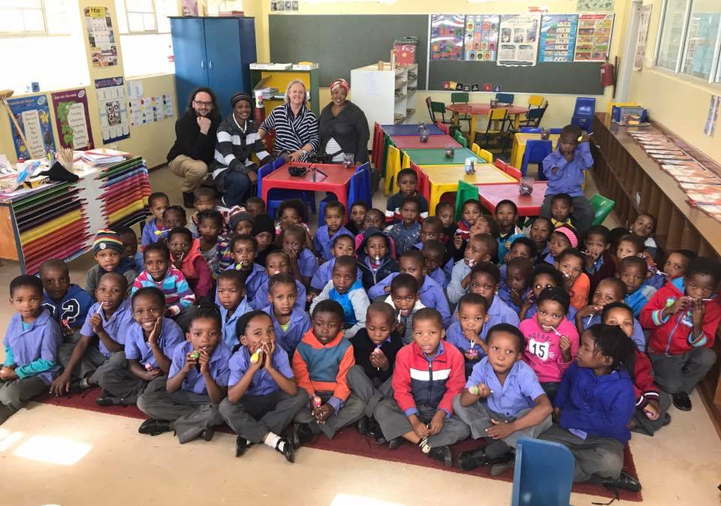
With Khwe (Khoe) and !Xun (ǃKung) speakers, Platfontein, near Kimberley, Northern Cape, South Africa, 26 April ’17
Professor Ghil‘ad Zuckermann

Slide 18
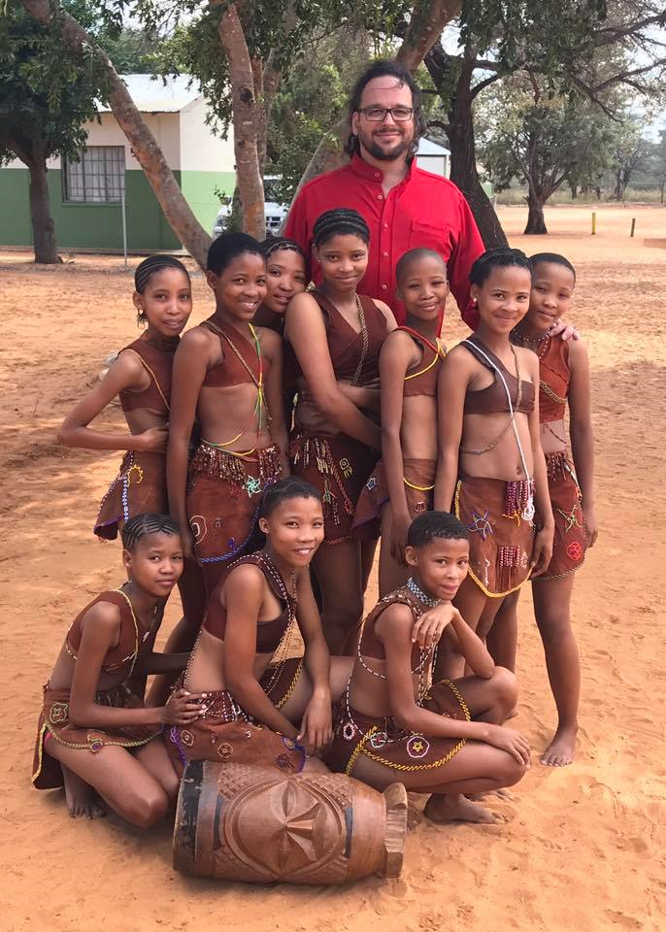
With Ju/'hoansi speakers,
Omaheke Region, Namibia,
20 April 2017
Professor Ghil‘ad Zuckermann

Slide 19
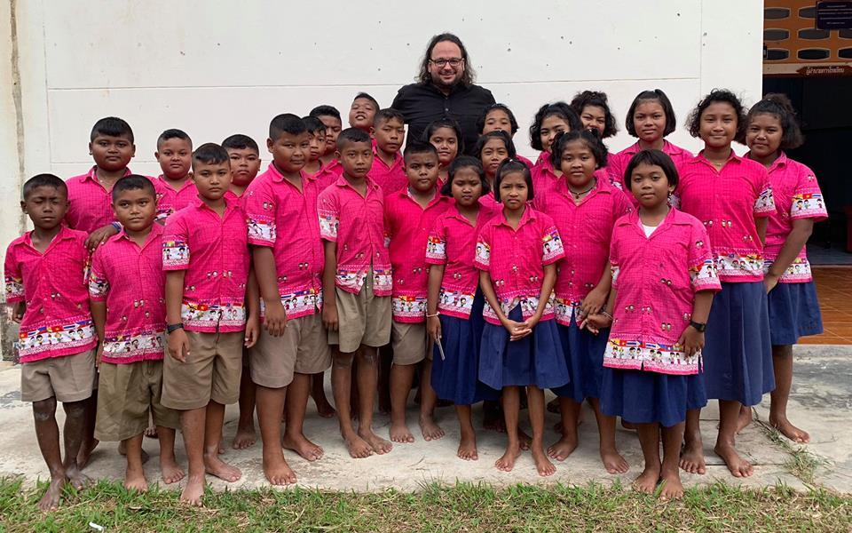
With learners of the endangered Urak Lawoi (Austronesian) language, Sang ka au (village of Urak Lawoi “people [of the] sea”), Koh Lanta Yai, Krabi, Thailand, 6 November 2018
Professor Ghil‘ad Zuckermann

Slide 20
I am a native speaker of Reclaimed Hebrew (Israeli).
In reality, the fin-de-siècle Hebrew revivalists were a small, unsupported group!
Never doubt that a small group of thoughtful, committed citizens can change the world.
Indeed, it is the only thing that ever has.
Controversially attributed to Margaret Mead
(controversial American cultural anthropologist, 1901-1978)
Professor Ghil‘ad Zuckermann

Slide 21
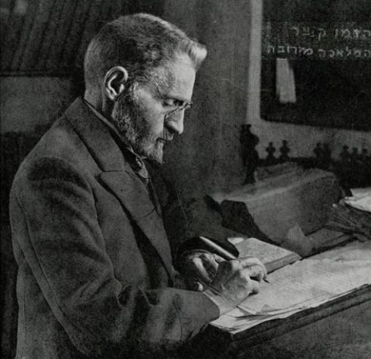
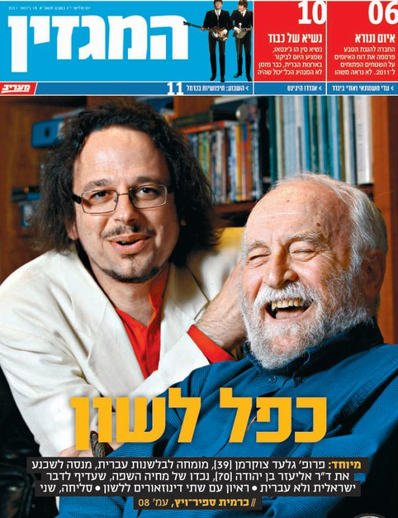
Eliezer Ben-Yehuda,
the main Hebrew revivalist
Eliezer Ben-Yehuda
the grandson
Professor Ghil‘ad Zuckermann

Slide 22
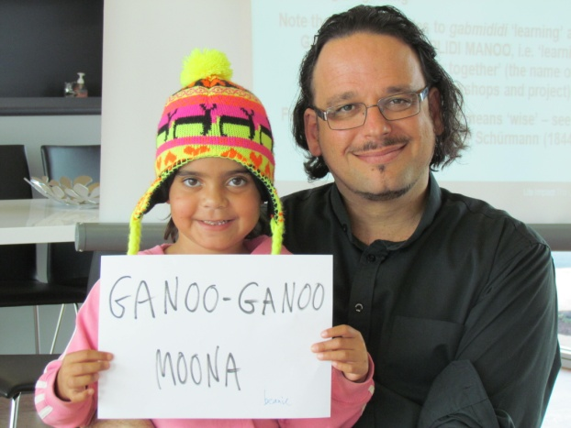
Whyalla
2013
Professor Ghil‘ad Zuckermann

Slide 23
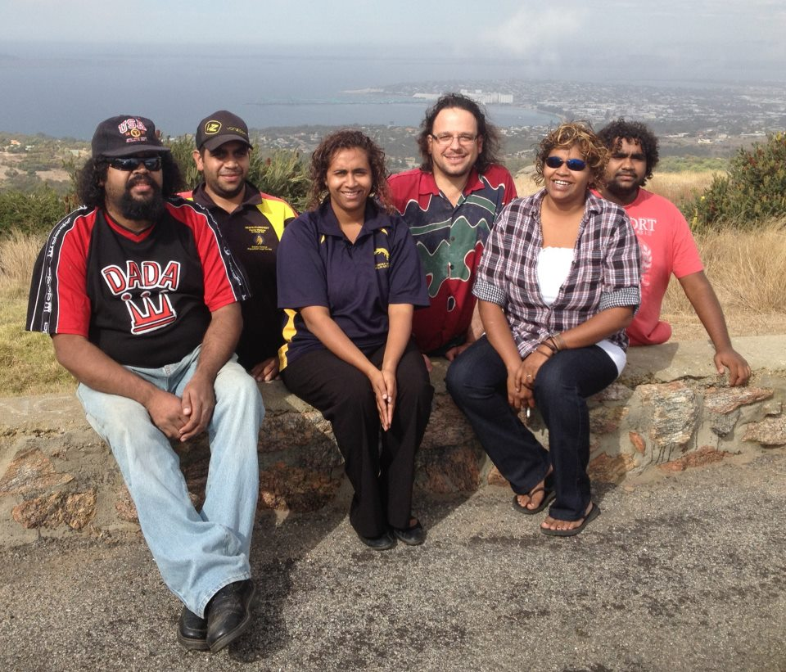
Gabmididi Barngarlidi Manoo
‘Learning and Speaking Barngarla Together’
Port Lincoln, South Australia, Professor Ghil‘ad Zuckermann with several participants in the first Barngarla reclamation workshop, 18-20 April 2012
Professor Ghil‘ad Zuckermann

Slide 24
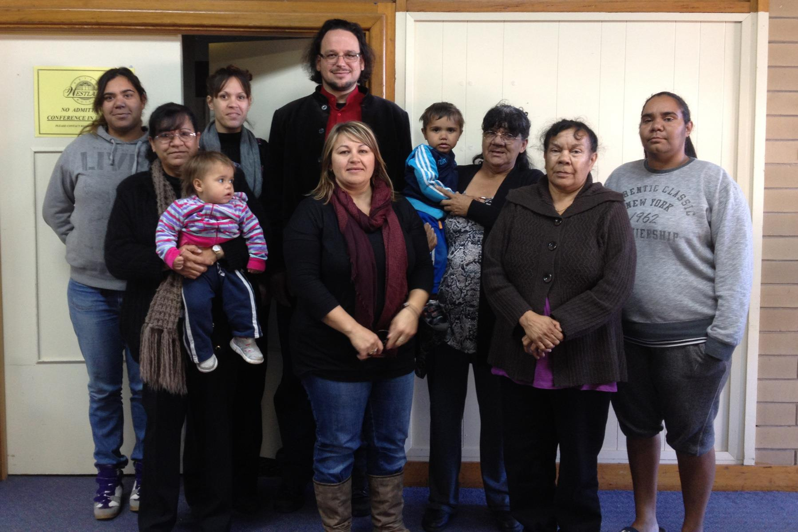
Whyalla, South Australia, Professor Ghil‘ad Zuckermann with several participants in one of the Barngarla Aboriginal language reclamation workshops
Professor Ghil‘ad Zuckermann

Slide 25
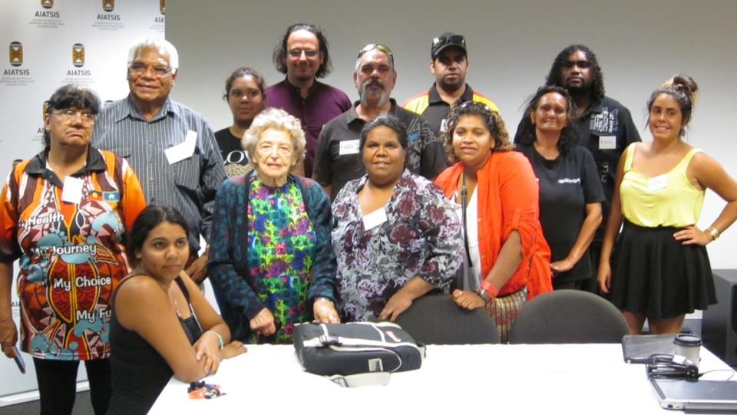
The first Barngarla delegation to AIATSIS, Canberra (2013), with Dr Luise Hercus and Professor Ghil‘ad Zuckermann (13 February 2013): Vera Richards (Port Lincoln), Elizabeth Saunders (Port Lincoln), Sheldon Richards (Port Lincoln), Jayden Richards (Port Lincoln), Dawn Taylor (Whyalla), Dawneen Saunders (Whyalla), Jeanita Taylor (Whyalla), Malika Carter (Whyalla), Linda Dare (Port Augusta), Steve Atkinson (Port Augusta), Robert Wilton (Port Augusta).
Professor Ghil‘ad Zuckermann

Slide 26
I must study Politicks and War that my sons may have liberty to study Mathematicks and Philosophy.
My sons ought to study Mathematicks and Philosophy, Geography, natural History, Naval Architecture, navigation, Commerce and Agriculture,
in order to give their Children a right to study Painting, Poetry, Musick, Architecture, Statuary, Tapestry and Porcelaine.
John Adams (second President of the United States in 1797–1801) to Abigail Adams
[post 12 May 1780] Adams Family Correspondence, 3:342
Professor Ghil‘ad Zuckermann

Slide 27
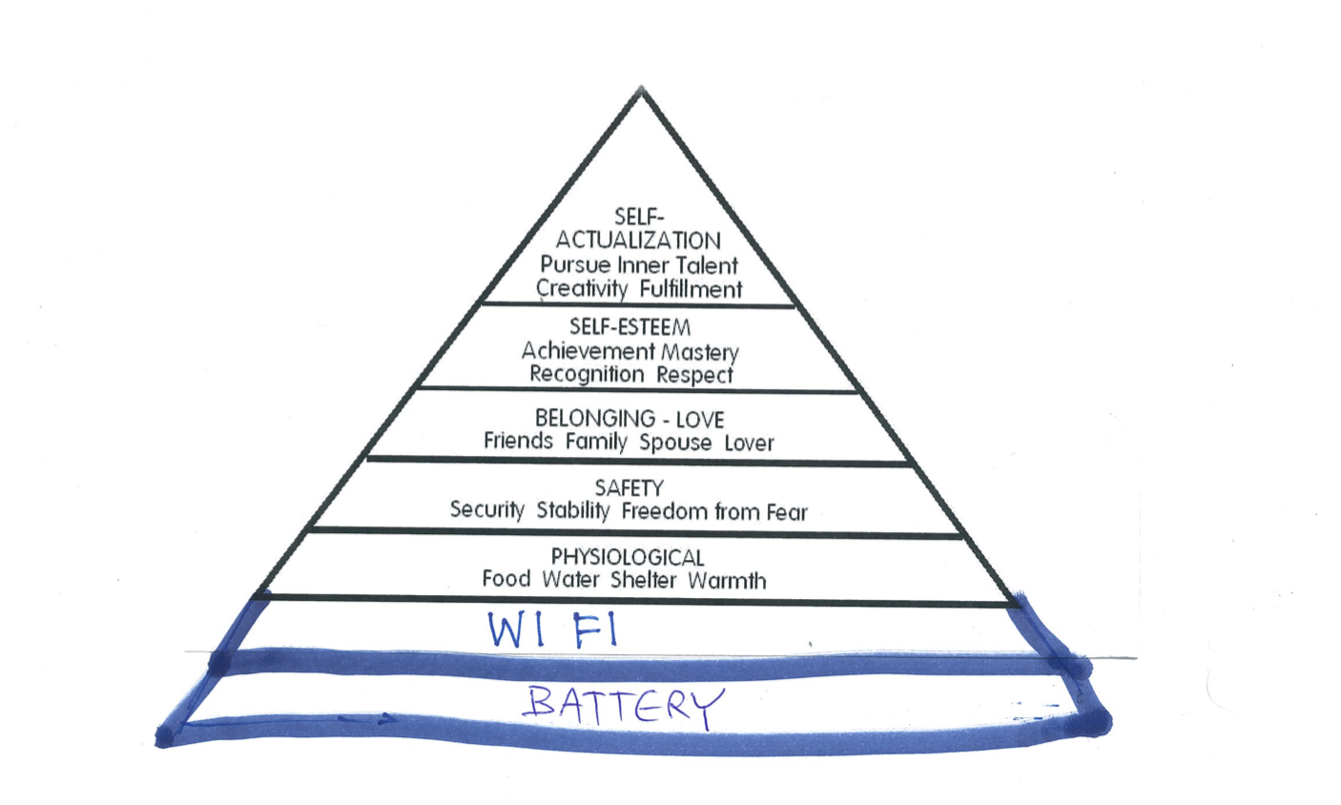
Basic Human Needs
Based on Abraham Maslow's 1943 hierarchy of needs in his seminal article ‘A Theory of Human Motivation’ (Psychological Review 50.4: 370–96)
Professor Ghil‘ad Zuckermann

Slide 28
Revolutions
The INDUSTRIAL Revolution
(1760→~1840):
Turned people from seeking FOOD to
seeking THINGS.
(2) The TALKNOLOGICAL Revolution
(C20-present):
Will turn people from seeking THINGS to
seeking IDEAS.
Professor Ghil‘ad Zuckermann

Slide 29
Four Linguistic Revolutions
1. Speaking: more than 70,000 years ago.
2. Writing: approx. 5200 years ago.
3. Type-Printing: c. 1450: Johannes Gutenberg develops the first European moveable type printing press, enabling mass production of books. (see parallel CHINESE developments)
4. Talknology (talk+technology): twentieth century-present: digital mass media, CNN, Facebook, Twitter…
(→‘big data’)
Professor Ghil‘ad Zuckermann

Slide 30
Pre-History
The universe is approximately 13.82 billion years old.
DNA is approximately 3.5 billion years old.
Homo sapiens has existed in Africa for at least 300,000 years.
Professor Ghil‘ad Zuckermann

Slide 31
Pre-History
The earliest known Homo sapiens that left Africa arrived in Israel between 177,000 and 194,000 years ago.
Hershkovitz et al. (2018) demonstrate that, analysing a maxilla (jaw) and dentition discovered at Misliya Cave, Mount Carmel, Israel.
Professor Ghil‘ad Zuckermann

Slide 32
Pre-History
Otherwise, Indigenous Australians represent one of the longest continuous cultural complexes.
Having conducted archeological excavations at Madjedbebe, a rock shelter in northern Australia, Clarkson et al. (2017) suggest that human occupation in Australia began 65,000 years ago.
Professor Ghil‘ad Zuckermann

Slide 33
Pre-History
On the other hand, Nagle et al. (2017) argue that Aboriginal people have been living in Australia for at least 50,000 years.
They analysed 111 mitochondrial genomes (mitogenomes) from historical Aboriginal Australian hair samples.
Professor Ghil‘ad Zuckermann

Slide 34
Pre-History
Marked geographic patterns and deep splits across the major mitochondrial haplogroups imply that the settlement of Australia comprised a single, rapid migration from northern Australia along the east (clockwise) and west (anti-clockwise) coasts, that reached Eyre Peninsula (South Australia) by 49,000-45,000 years ago.
Professor Ghil‘ad Zuckermann

Slide 35
LANGUAGE REVIVAL
Professor Ghil‘ad Zuckermann

Slide 36
WHY on earth should we invest time/money in reclaiming/revitalizing/ reinvigorating languages? E.g. Why should we reclaim dead / extinct / hibernating / sleeping beauties / no-longer-spoken languages?
A. Ethical, deontological reasons
B. Aesthetic motivations
C. Utilitarian and economic benefits
Professor Ghil‘ad Zuckermann

Slide 37
Why should we invest time/money in reclaiming/ revitalizing/reinvigorating languages?
Ethical
Reasons
Historical, humanistic and social justice
Professor Ghil‘ad Zuckermann

Slide 38
If you talk to a man in a language he understands,
that goes to his head.
If you talk to him in his language,
that goes to his heart. (Nelson Mandela)
Professor Ghil‘ad Zuckermann

Slide 39
Ethical reasons
Native Tongue Title:
Deontological compensation for language loss:
The loss of language is more severe than the loss of land
Language death = loss of cultural autonomy
Language death = loss of spiritual and intellectual sovereignty
Language death = loss of soul
Language is a repository of ideas, values and experience
Professor Ghil‘ad Zuckermann

Slide 40
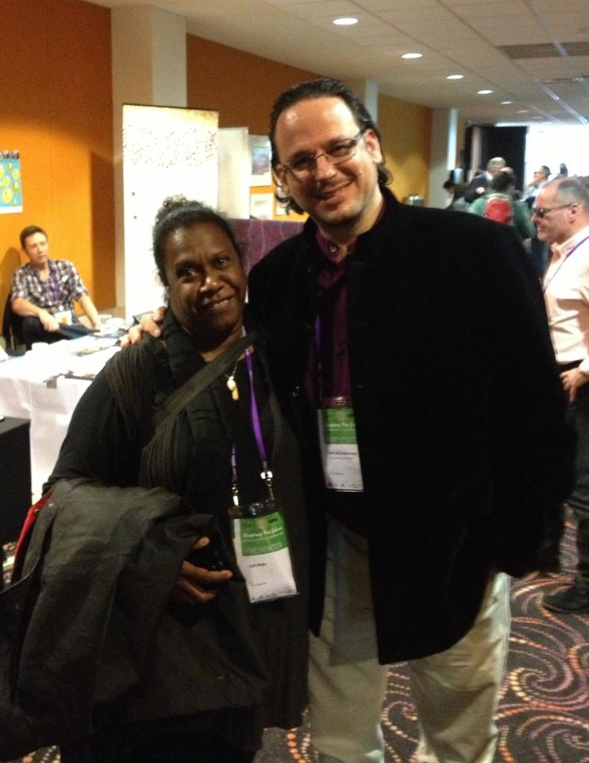
With Gail Mabo, Eddie Mabo's daughter, Alice Springs, 4 June 2013
Eddie Mabo (1936-92) was a Torres Strait Islander who campaigned for Indigenous land rights, achieving the landmark decision of the High Court of Australia that overturned the legal doctrine of terra nullius (‘land belonging to nobody’).
Professor Ghil‘ad Zuckermann

Slide 41
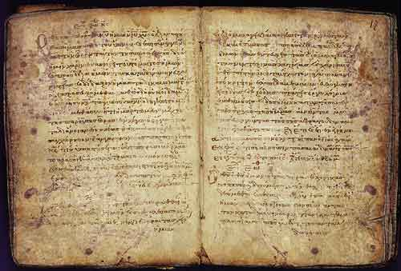
Russell Hoban (children’s writer, 1925-2011 – cf. Haffenden 1985: 138):
Language is an archaeological vehicle,
full of the remnants of dead and living pasts, lost and buried civilizations and technologies.
The language we speak is a whole palimpsest of human effort and history.
Professor Ghil‘ad Zuckermann

Slide 42
‘The native would be sooner civilised if their language was extinct.’
Antony Forster in a report on a public meeting of the South Australian Missionary Society in aid of the German Mission to the Aborigines,
Southern Australian
8 September 1843
p. 2
Anthony Forster (1813-1897)
colonist, financier and politician
Professor Ghil‘ad Zuckermann

Slide 43
‘Mr Forster afterwards adverted to the present mode of teaching the children in their own language. He, with all respect to the Missionaries, would say, on several grounds, that this was wrong.
The natives would be sooner civilized if their language was extinct.
The children taught would afterwards mix only with whites, where their own language would be of no use – the use of their language would preserve their prejudices and debasement, and their language was not sufficient to express the ideas of civilized life. He gave the Missionaries full credit for their talents and zeal, but he thought it would be better to teach the children in English.’
(Report on a public meeting of the South Australian Missionary Society in aid of the German Mission to the Aborigines, Southern Australian, 8 September 1843, p. 2, cf. Scrimgeour 2007: 116)
Professor Ghil‘ad Zuckermann

Slide 44
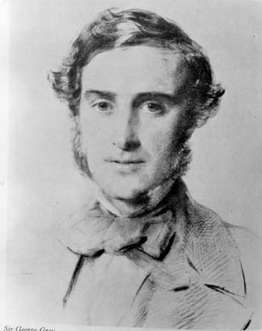
‘The merchant in London who lays on a vessel for a certain port, regards the affair as a mere mercantile speculation, but could he trace out the results he effects in their remotest ramifications, he would stand astonished at the changes he produces. With the wizard wand of commerce, he touches a lone and trackless forest, and at his bidding, cities arise, and the hum and dust of trade collect – away are swept ancient races; antique laws and customs moulder into oblivion. The strong-holds of murder and superstition are cleansed, and the Gospel is preached amongst ignorant and savage men.
The ruder languages disappear successively, and the tongue of England alone is heard around.’
George Grey 1841, Journals of Two Expeditions of Discovery, Vol. 2, pp. 200-201
South Australian Governor George Grey
Professor Ghil‘ad Zuckermann

Slide 45
Ethical reasons
(Native Tongue Title:
Deontological compensation for language loss:)
In case of linguicide (language killing) or glottophagy (language eating):
It is much harder to prove continuity in Native Title cases
Protection of Intellectual Property (IP): Traditional Indigenous knowledge: language, stories, music, dance, symbols, art, crafts, cosmology, medicinal and environmental knowledge etc.
See Mātauranga Māori in New Zealand
Cf. Conversations on Mātauranga Māori, edited by Professor Tai(arahia) Black
Professor Ghil‘ad Zuckermann

Slide 46
Ethical reasons
(Native Tongue Title:
Deontological compensation for language loss:)
Australia ought to learn from New Zealand.
→ Aboriginal and Torres Strait Islander vernaculars should be defined as official languages of their state/territory/land.
→ Signs (Linguistic Landscape) should be both in English and in the local Indigenous language.
Professor Ghil‘ad Zuckermann

Slide 47
Australia ought to learn from New Zealand
Māori Native Tongue Title: WAI 11 & WAI 262
There are two particularly important claims by Māori relating to te reo Māori (the Māori Language). These are WAI 11 and WAI 262 claims to the Waitangi Tribunal (set up in 1975 to hear claims relating to Crown violations of the Treaty of Waitangi).
WAI 11 (Year: 1985)
Claimants: Huirangi Waikerepuru and Nga Kaiwhakapumau i te Reo.
Claim: that the Crown had failed to protect the language (a taonga/ treasure) as required by article 2 of the Treaty of Waitangi. (Article 2 guarantees to Māori the right to keep their lands, forests, fisheries and all their treasures (taonga). It was noted that: Ka ngaro te reo, ka ngaro tāua, pērā i te ngaro o te moa (If the language be lost, man will be lost, as dead as the moa.)
Professor Ghil‘ad Zuckermann

Slide 48
WAI 11 (1985)
WAI 11 (1985) (cont.)
The tribunal found in favour of the claimants: When the question for decision is whether te reo Māori is a ‘taonga’ which the Crown is obliged to recognise we conclude that there can be only one answer. It is plain that the language is an essential part of the culture and must be regarded as ‘a valued possession’.
Recommendations in summary: legislation enabling use of te reo Māori in the courts by anyone who wishes to do so; establishment of a body to supervise and foster the use of te reo Māori; ensure all children who wish to learn Māori can do so with financial support from the State; develop broadcasting policy that acts on the Crown’s obligation to recognize and protect the language; bilingualism as a prerequisite for any positions of employment with the State services Commission.
Professor Ghil‘ad Zuckermann

Slide 49
WAI 262 (1991)
WAI 262 (Year: 1991)
Claimants: Haana Murray (Ngāti Kurī), Hema Nui a Tawhaki Witana (Te Rarawa), Te Witi McMath (Ngāti Wai), Tama Poata (Ngāti Porou), Kataraina Rimene (Ngāti Kahungunu), and John Hippolite (Ngāti Koata) – on behalf of themselves and their iwi
Claim: relates to the place of Māori culture, identity and traditional knowledge in New Zealand’s laws, and in government policies and practices.
Tribunal findings include: establishment of new partnership bodies in education, conservation, and culture and heritage; a new commission to protect Māori cultural works against derogatory or offensive uses and unauthorised commercial uses; a new funding agent for mātauranga Māori in science; expanded roles for some existing bodies including Te Taura Whiri (the Māori Language Commission), the newly established national rongoā body Te Paepae Matua mō te Rongoā, and Māori advisory bodies relating to patents and environmental protection.
Professor Ghil‘ad Zuckermann

Slide 50
WAI 262 (1991)
WAI 262 (1991) (cont.)
Findings relating to the language: The Crown’s support for revival of the language should include (1) effective policies, appropriate resourcing, and steps towards the provision of public services in te reo as well as English; (2) the provision of programmes – including Māori-medium education – that are highly focused and effective, and appropriately resourced; (3) an expanded role and powers for Te Taura Whiri (Māori Language Commission), including powers to require public sector agencies to produce Māori language plans (in consultation with iwi), and to approve those plans, and powers to set targets for training of te reo teachers, approve education curricula for te reo, and otherwise hold public sector agencies accountable for their responsibilities towards the language.
Professor Ghil‘ad Zuckermann

Slide 51
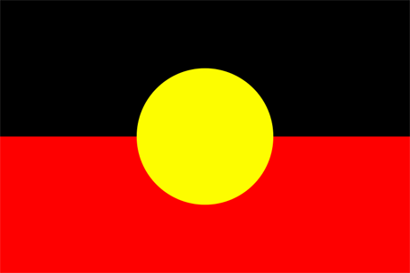
The Australian Aboriginal flag, designed by Harold Thomas;
first flown on 12 July 1971 at Victoria Square, Adelaide. (German influence?)
Professor Ghil‘ad Zuckermann

Slide 52
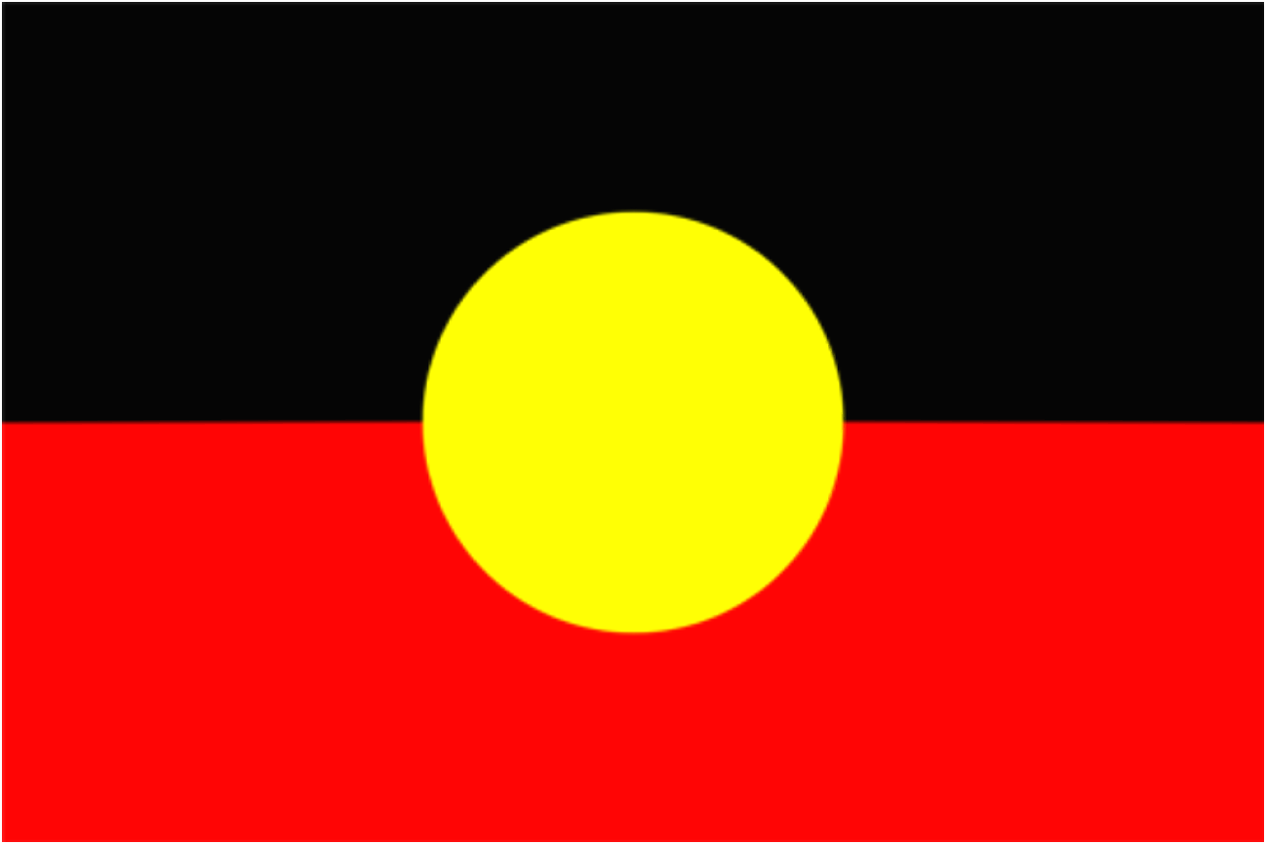
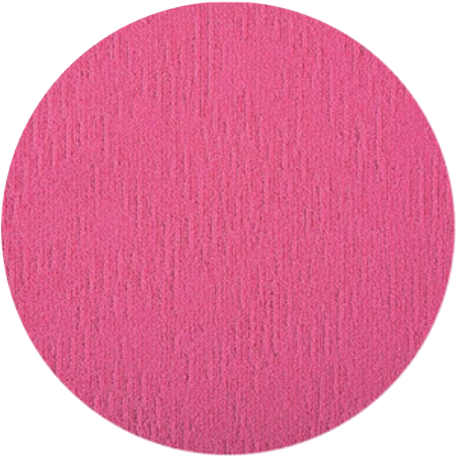
Lads/Lasses
Langue
Land
My proposed flag for a Language Day
reflecting the People-Land-Language trinity
Professor Ghil‘ad Zuckermann

Slide 53
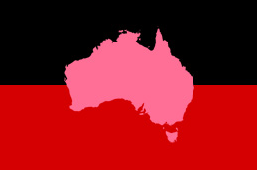
Lads/Lasses
Langue
Land
Professor Ghil‘ad Zuckermann

Slide 54
LINGUICIDE VS WELLBEING:
The Revival of the Barngarla Aboriginal Language of Eyre Peninsula, South Australia:
Andy Park interviews the Barngarla community of Port Augusta.
(SBS, 5 minutes)
http://www.youtube.com/watch?v=DZPjdNaLCho
Lads/Lasses
Land
Professor Ghil‘ad Zuckermann

Slide 55
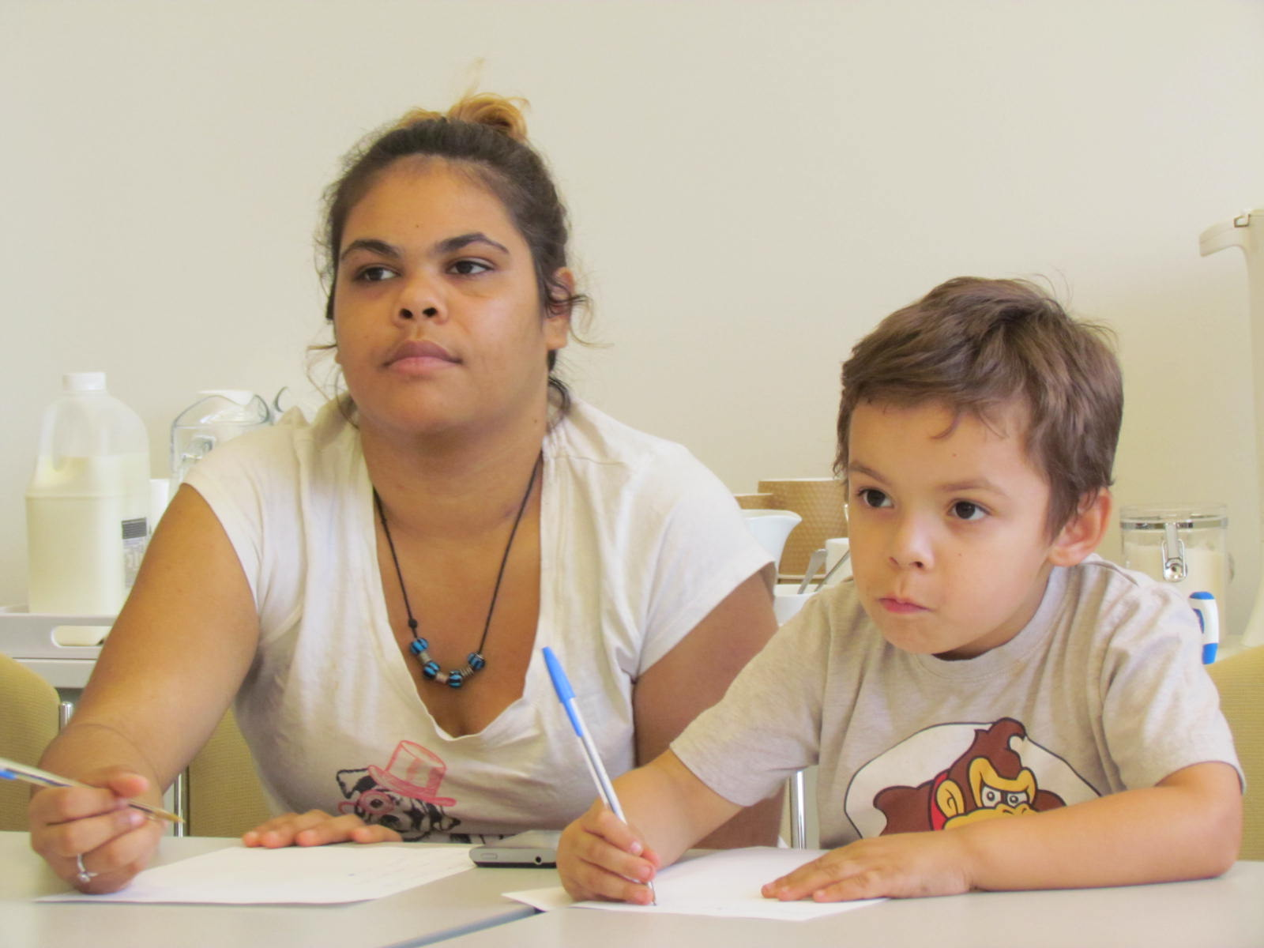
Port Augusta
2013
Professor Ghil‘ad Zuckermann

Slide 56
Why should we invest time/money in reclaiming/ revitalizing/reinvigorating languages?
Aesthetic
Motivations
Professor Ghil‘ad Zuckermann

Slide 57
Aesthetic Motivations
When you lose a language, you lose a culture, intellectual wealth, a work of art.
It’s like dropping a bomb on a museum, the Louvre.
(Ken Hale, The Economist, 3 November 2001)
Professor Ghil‘ad Zuckermann

Slide 58
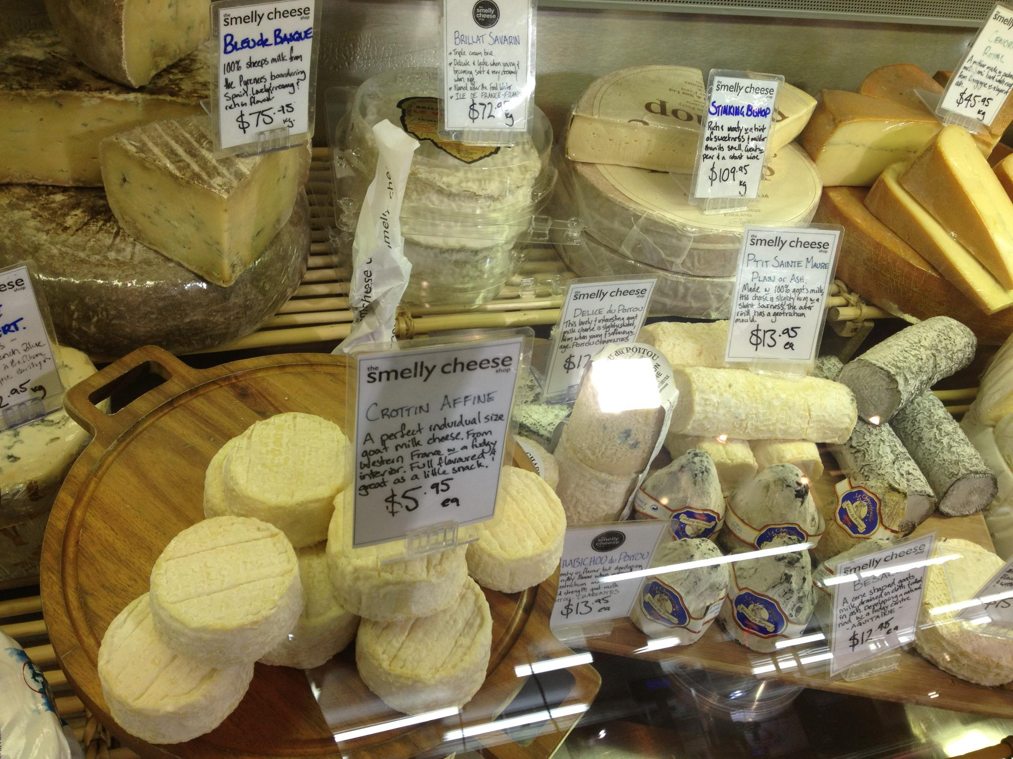
Diversity
Professor Ghil‘ad Zuckermann

Slide 59
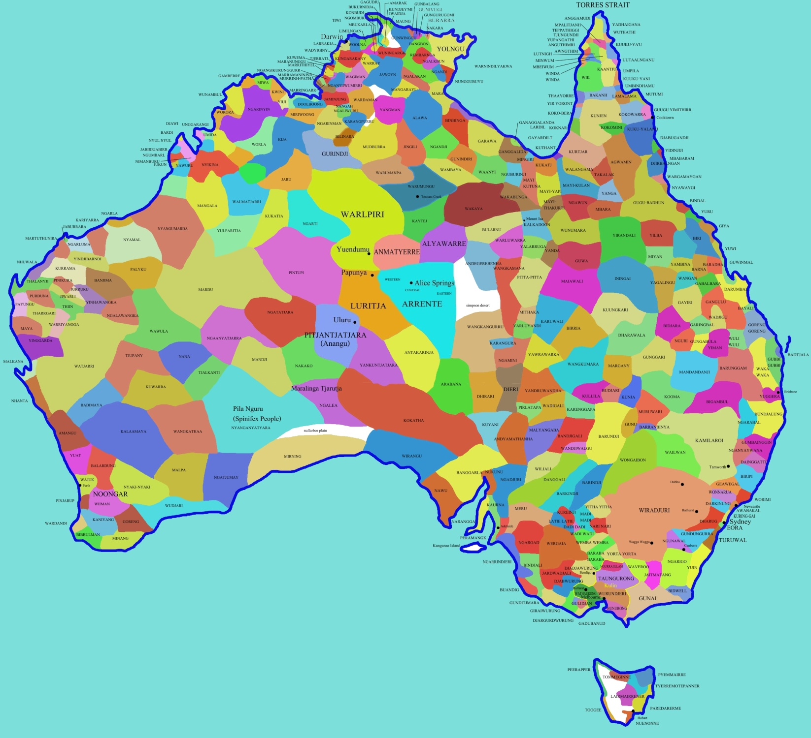
Rich, Colourful
Australia,
Lucky
Country
Professor Ghil‘ad Zuckermann

Slide 60
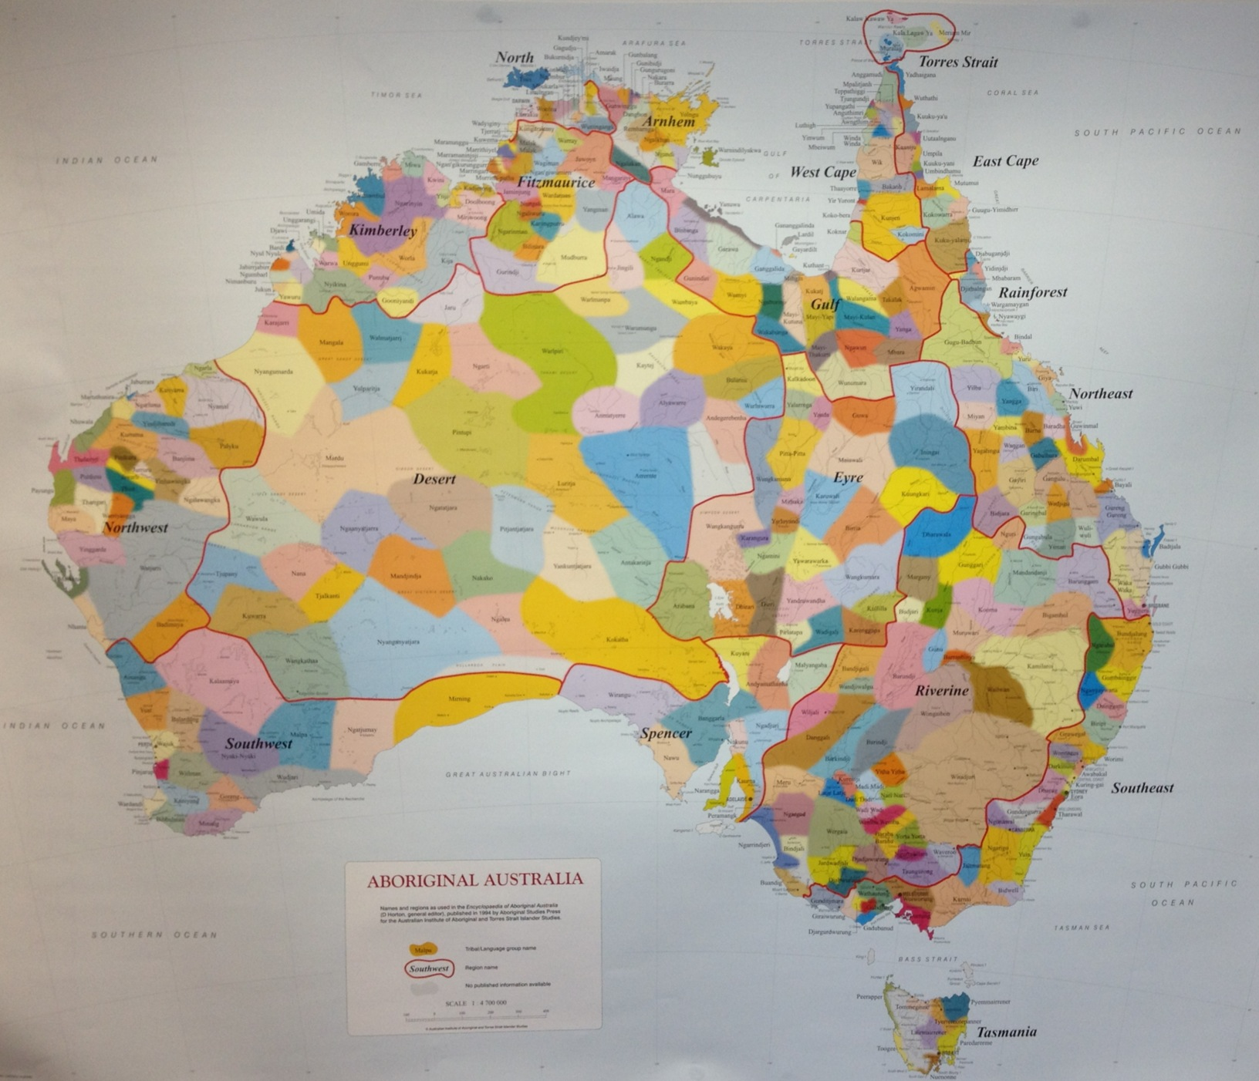
Professor Ghil‘ad Zuckermann

Slide 61
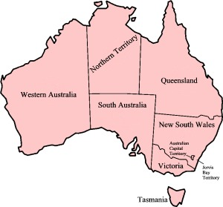
Monolingual
Mindset
Australia
Professor Ghil‘ad Zuckermann

Slide 62
Beauty
The political map of Australia is ugly (in my view) e.g. because of
(1) the one grey colour.
(2) the arbitrary straight lines -- as opposed to the beautiful divisions of 330 languages, represented by different colours and shades of colours.
But the political straight lines are not THAT arbitrary after all – cf.
Gammage, Bill 1981. 'Early Boundaries of NSW', Historical Studies 19, No 77: 524-531.
Professor Ghil‘ad Zuckermann

Slide 63
Rundle St, Adelaide, September 2016
Professor Ghil‘ad Zuckermann

Slide 64
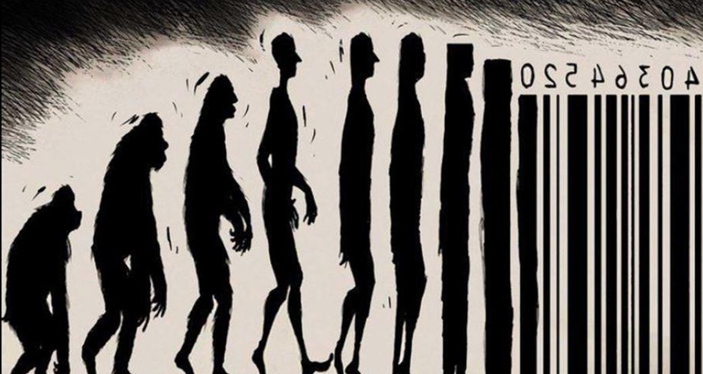
This is what we do not want:
Homo sapiens sapiens (the human who knows s/he knows)
Professor Ghil‘ad Zuckermann

Slide 65
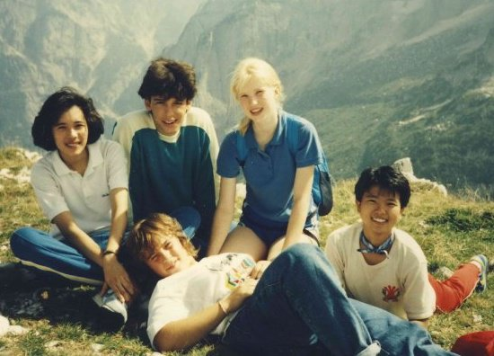
Professor Ghil‘ad Zuckermann

Slide 66
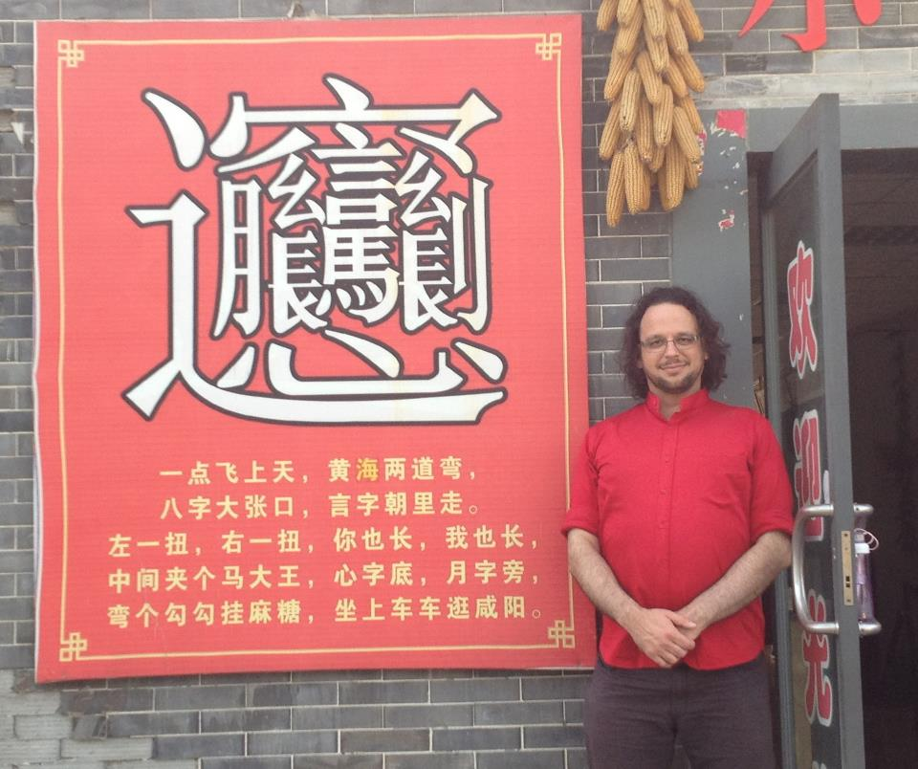
The most complex Chinese character I have ever encountered, pronounced biáng, referring to a specific kind of noodles; Xi'an, China
Professor Ghil‘ad Zuckermann

Slide 67
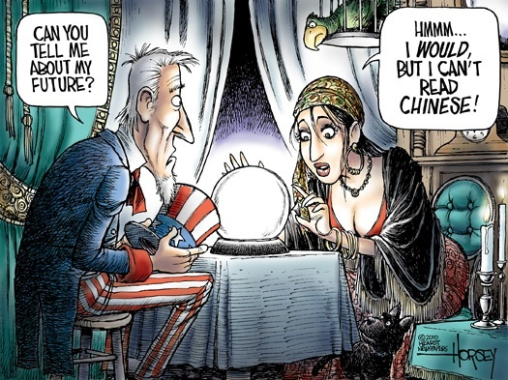
Professor Ghil‘ad Zuckermann

Slide 68
Diversity
Kuuk Thaayorre:
Boroditsky and Gaby (2010)
Professor Ghil‘ad Zuckermann

Slide 69
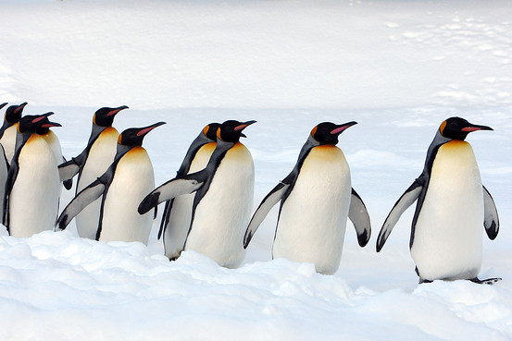
Professor Ghil‘ad Zuckermann

Slide 70
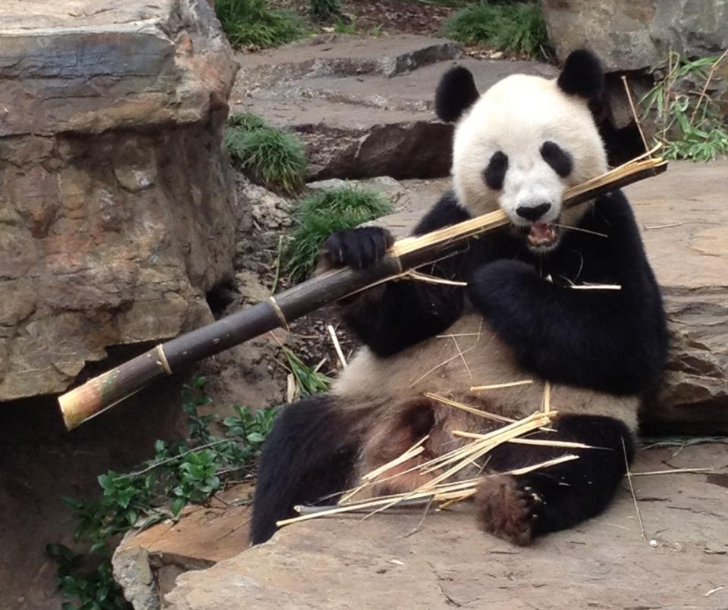
Adelaide Zoo (pandas are not endangered anymore, 2016)
Professor Ghil‘ad Zuckermann

Slide 71
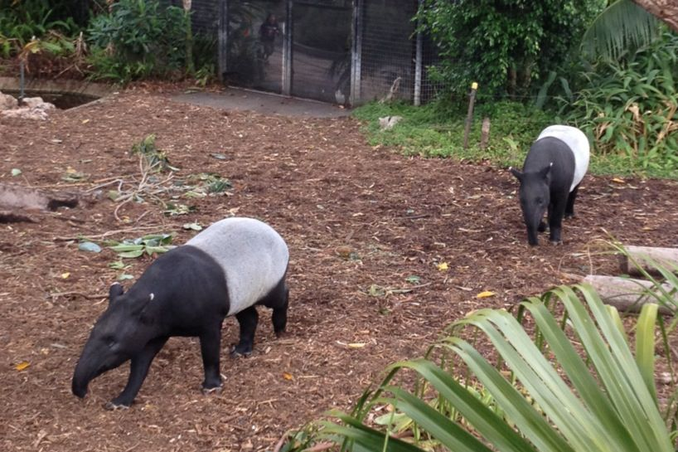
Professor Ghil‘ad Zuckermann

Slide 72
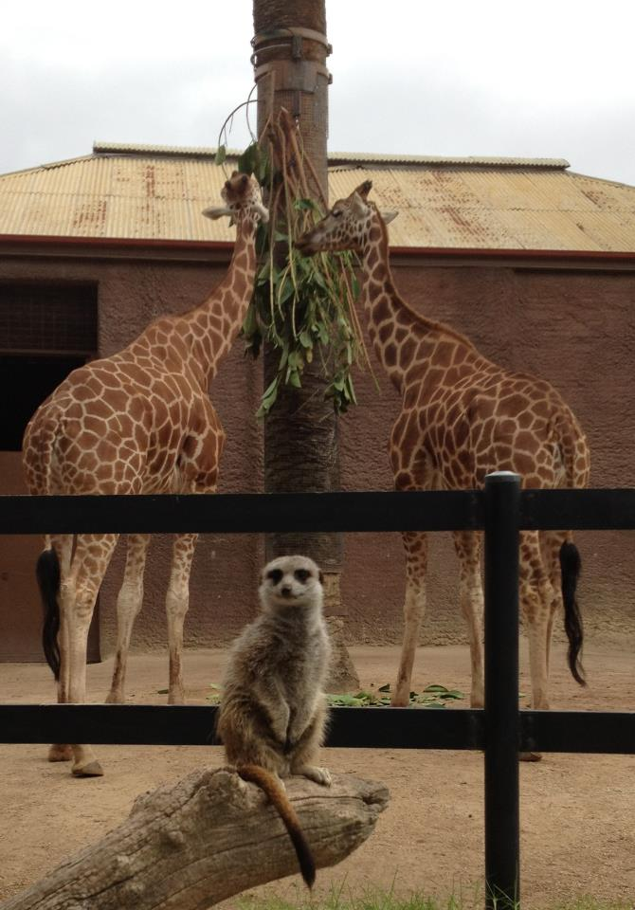
Adelaide Zoo
Professor Ghil‘ad Zuckermann

Slide 73
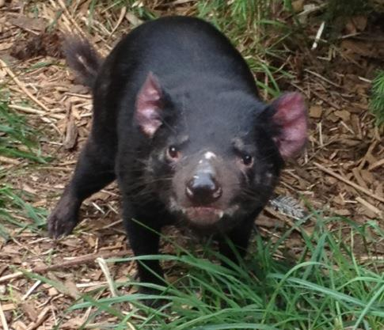
The survival of the Tasmanian Devil is important!
What about the survival of the Palawa languages of Tasmania?
Cleland
Professor Ghil‘ad Zuckermann

Slide 74
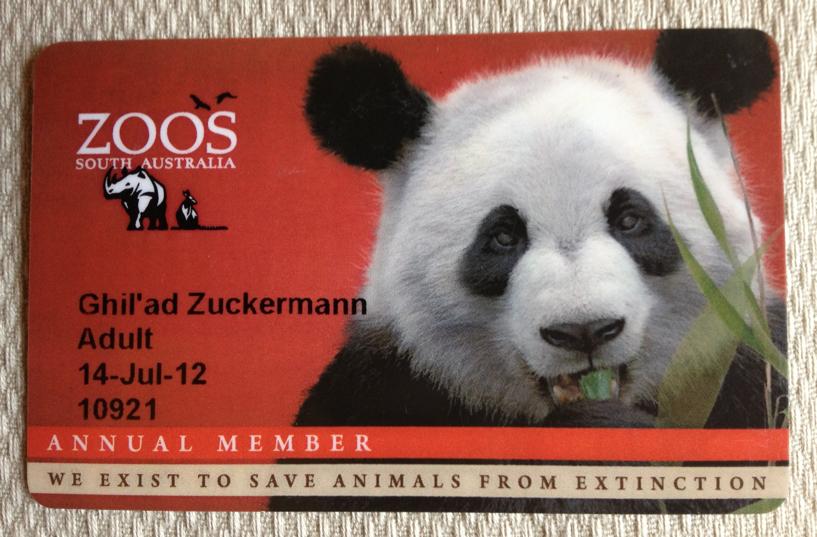
And we exist to save languages and cultures from extinction
Professor Ghil‘ad Zuckermann

Slide 75
Professor Ghil‘ad Zuckermann

Slide 76
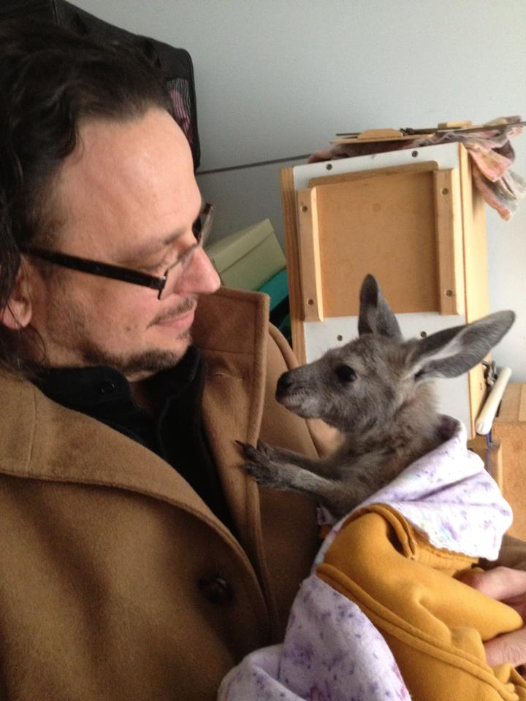
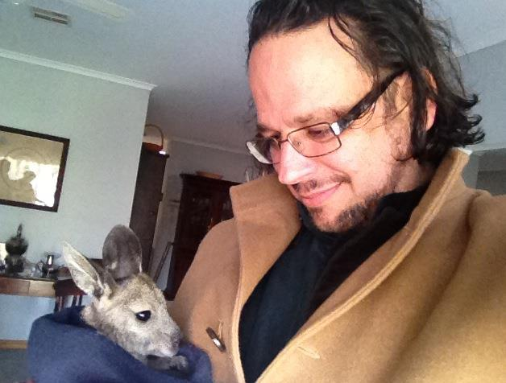
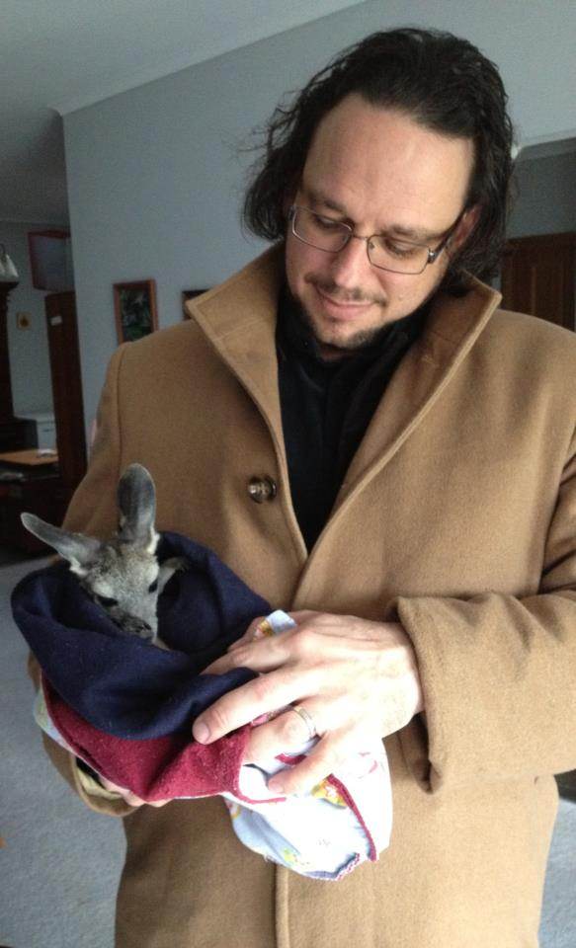
With orphan joeys,
Little-
-hampton, South Australia
Professor Ghil‘ad Zuckermann

Slide 77
(WHY should we invest time and money in reviving languages?) Diversity: Endangered grammatical ways to express familiar concepts
Mamihlapinatapai
Language: Yaghan (Tierra del Fuego, Chile & Argentina)
Meaning: A look shared by two people, each wishing that the other will offer something that they both desire but have been unwilling to suggest or offer themselves.
Professor Ghil‘ad Zuckermann

Slide 78
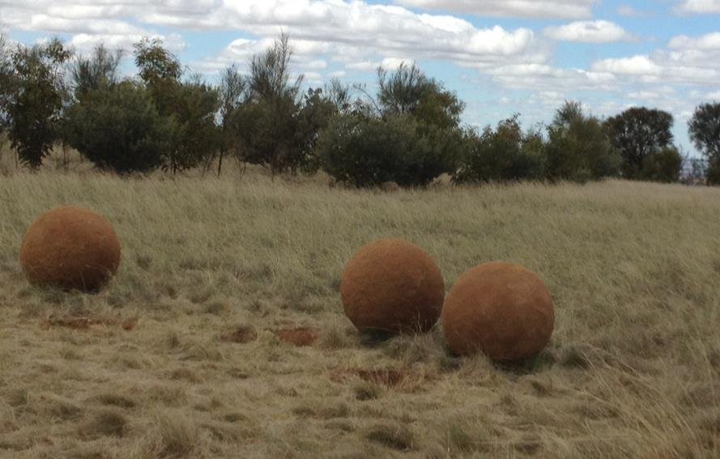
Morphemic Analysis
ma, a reflexive/passive prefix.
allomorph (before a vowel): mam-
ihlapi [iɬapi] ‘to be at a loss as what to do next’,
root (lexical morpheme)
-n, stative suffix
-ata, achievement suffix
-apai, a dual suffix, which in composition with ma- has a reciprocal sense (cf. circumfix)
Professor Ghil‘ad Zuckermann

Slide 79
Coffee
http://www.youtube.com/watch?v=mRAGb-6wAvk
Professor Ghil‘ad Zuckermann

Slide 80
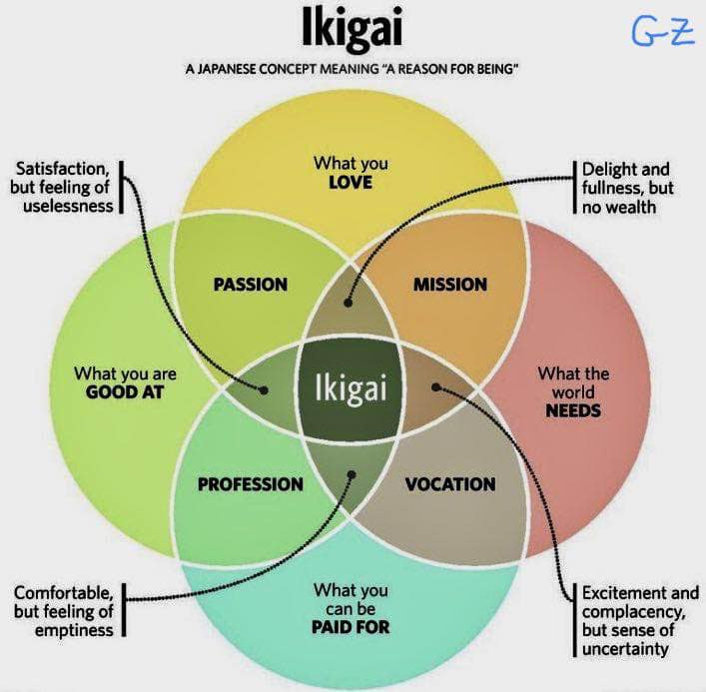
Diversity: Endangered grammatical ways to express familiar concepts
Professor Ghil‘ad Zuckermann

Slide 81
Diversity: Endangered concepts
Nakhur
Language: Persian
Meaning: A camel that will not give milk until her nostrils have been tickled.
Professor Ghil‘ad Zuckermann

Slide 82
Diversity: Endangered concepts
Tingo
Language: Rapa Nui (Pasquan), Eastern Polynesian language spoken on Rapa Nui (Easter Island)
Meaning: To take all the objects one desires from the house of a friend, one at a time, by asking to borrow them, until there is nothing left.
(de Boinod 2005)
Professor Ghil‘ad Zuckermann

Slide 83
Why should we invest time/money in reclaiming/ revitalizing/reinvigorating languages?
Utilitarian Benefits: Health, Wellbeing…
Professor Ghil‘ad Zuckermann

Slide 84
Utilitarian Benefits
Personal, mental, spiritual and physical well-being
sense of pride and self-esteem
antidote for self-loathing
Email from Jenna, 3 May 2012, 16:22:
Personally, I found the experience of learning our language liberating and went home feeling very overwhelmed because we were finally going to learn our "own" language, it gave me a sense of identity and I think if the whole family learnt our language then we would all feel totally different about ourselves and each other cause it's almost like it gives you a purpose in life.
Professor Ghil‘ad Zuckermann

Slide 85
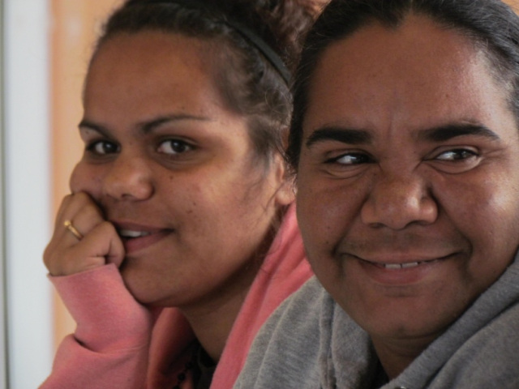
Professor Ghil‘ad Zuckermann

Slide 86
Utilitarian benefits
Facebook comment from Evelyn, 21 April 2012, 14:16:
A big thank you on behalf of our family here in Port Lincoln, our ancestors are happy ☺
‘Language is power; let us have ours!’
Aboriginal politician Aden Ridgeway
26 November 2009
Sydney Morning Herald
Professor Ghil‘ad Zuckermann

Slide 87
Port Lincoln, 2013
Professor Ghil‘ad Zuckermann

Slide 88
NILS 2 (2014): Goals of language activities
→
→
Data drawn from the Second National Indigenous Languages Survey (NILS 2) Report, analysed by Marmion, Kazuko, & Troy (2014)
Professor Ghil‘ad Zuckermann

Slide 89
Utilitarian benefits
(for bean-counters):
Saving governmental money associated with ill health and social dysfunction
ILS support: $50,000 per language per annum (2010-11) ($9,400,000 given to 78 projects involving 200 languages)
Incarceration: $100,000 per person per annum (2009)
Mental health (adolescent): $1,395 per patient per diem
Professor Ghil‘ad Zuckermann

Slide 90
Utilitarian benefits
Improving mental health
National Survey of Mental Wellbeing (Australia):
20% of Australians suffer from a chronic mental illness and experienced any mental disorder in the last 12 months (depression, anxiety disorders etc.)
40% of Australians suffer from any mental disorder in their life.
2008 National Aboriginal and Torres Strait Islander (ATSI) Social Survey (Australian Bureau of Statistics (ABS) Publication 4704.0): 31% of ATSI aged 15+ experience high or very high levels of psychological distress in the 4 weeks prior to interview!
This is 2.5 times the rate for non-Indigenous Australians!
Professor Ghil‘ad Zuckermann

Slide 91
Utilitarian benefits
Improving mental health
Darcy Hallett, Michael J. Chandler and Christopher E. Lalonde (2007). ‘Aboriginal language knowledge and youth suicide’, Cognitive Development 22: 392-399:
In British Columbia, Canada, there is a clear correlation between youth suicide and lack of conversational knowledge in the native language.
Professor Ghil‘ad Zuckermann

Slide 92
OUR NEW NHMRC PROJECT
Professor Ghil‘ad Zuckermann

Slide 93
Study of our NHMRC project rationale (Barngarla, Brown, Zuckermann)
Community and Policy interest in impact of mental illness
Broad contributors, yet few interventions
Social Determinants – culture, socioeconomic status (SES), racism critical
Moving beyond deficit approach to Aboriginal health
Decline of Indigenous languages has become a prevalent characteristic of colonization, negatively impacting the wellbeing of Indigenous populations over time.
No systematic study of the impact of language revival on mental health and wellbeing.
Professor Ghil‘ad Zuckermann

Slide 94
Measuring the Un-measurable?
““What scientists hold stock in is only what they can measure. But you can’t measure the mind or spirit. You can’t weigh it, you can’t deconstruct it. But only if we do will they see that Aboriginal people are spectators to the death of their culture, their lives….
We watch as our culture dies.
How are you going to measure that?” (Alex Brown)
Professor Ghil‘ad Zuckermann

Slide 95
Project team
Governance: Barngarla Language Advisory Committee (BLAC)
Chief Investigators
Prof. Alex Brown
Prof. Ghil‘ad Zuckermann
Ngiare Brown
Graham Gee
Project Staff
Community Research Associates: Emma Richards, Stephen Atkinson, Anita Taylor
Linguist
Psychologist
Study Coordinator: Leda Sivak
Professor Ghil‘ad Zuckermann

Slide 96
Project design
AIM
Systematically assess mental health impacts of reclaiming Indigenous language (Barngarla) in South Australia.
HYPOTHESIS
Improvements in mental health and social and emotional wellbeing during and following the language reclamation process.
OBJECTIVES
Continue delivering language reclamation activities with Barngarla
Explore the impacts of pilot language activities
Develop methods for measuring the impacts of language reclamation
Assess language use and social and emotional wellbeing
Professor Ghil‘ad Zuckermann

Slide 97
Utilitarian benefits
Cognitive advantages of bilingualism:
Kovacs and Mehler (2009)
‘The bilingual’s enhanced experience with sound results in an auditory system that is highly efficient, flexible and focused in its automatic sound processing, especially in challenging or novel listening conditions’ (Nina Kraus, 2012)
Medical advantages: anti-dementia
Evidence also shows that being natively bilingual slows dementia by approximately four and a half years, improving quality of life for many and reducing money spent on medical care.
Professor Ghil‘ad Zuckermann

Slide 98
Utilitarian benefits
Cognitive advantages of non-native bilingualism:
Using a foreign language reduces decision-making biases!
Four experiments show that the ‘framing effect’ disappears when choices are presented in a foreign tongue. Whereas people were risk averse for gains and risk seeking for losses when choices were presented in their native tongue, they were not influenced by this framing manipulation in a foreign language.
Two additional experiments show that using a foreign language reduces loss aversion, increasing the acceptance of both hypothetical and real bets with positive expected value. We propose that these effects arise because a foreign language provides greater cognitive and emotional distance than a native tongue does.
(Boaz Keysar, Sayuri L. Hayakawa and Sun Gyu An, 2012, Psychological Science)
Professor Ghil‘ad Zuckermann

Slide 99
CONCLUDING
REMARKS
Professor Ghil‘ad Zuckermann

Slide 100
See LARD in the Language Revival MOOC (Zuckermann & Amery), 2015
Professor Ghil‘ad Zuckermann

Slide 101
Immersion
Professor Ghil‘ad Zuckermann

Slide 102
MOOC (Massive Open Online Course) on Language Revival AVAILABLE NOW
https://www.facebook.com/Revivalistics
https://www.facebook.com/ProfessorZuckermann
Professor Ghil‘ad Zuckermann

Slide 103
As I am watching Bagan's hundreds of temples and pagodas from the very top of ShweSanDaw Pagoda, an American stranger approaches me and says: 'Professor Zuckermann!' 'Yes?' I say. (Who is this person?, I am asking myself.) 'I was your student', he says. ('But that's impossible', I say to myself, 'I remember all my past and present students. And I have never met this person.’) 'I took your MOOC on language revival'!', says the American.
Bagan, Myanmar, February 2016
Professor Ghil‘ad Zuckermann

Slide 104
ON SPELLING
William Shakespeare spelled his surname in FIVE different ways.
NONE of them was
S H A K E S P E A R E.
But spelling might be extremely important:
https://www.youtube.com/watch?v=0YM9Ereg2Zo
Professor Ghil‘ad Zuckermann

Slide 105
Professor Ghil‘ad Zuckermann

Slide 106
ON SPELLING
In the Australian 1976 Population Census,
Presbyterian Australians used
383 different spellings to describe their own denomination.
For example:
presbeterian, prespertarian, prespreterian, presbiterian, presbyrterian, presbytarians, presybyterian, presybeterian, presyterian, presbytrian, prespeterian, prebyterian, presbytarian, presbyerian, presbertarian, presbetraian, presybartian, presyberian, prysbyterian, presbyterian, presbetarian, presbaterian, prebytarian, prebysterian, presbertain, preysbyerian, presbitarin, prsbyterian.
Professor Ghil‘ad Zuckermann

Slide 107
Strine
Signs
Professor Ghil‘ad Zuckermann

Slide 108
Strine
Signs
Professor Ghil‘ad Zuckermann

Slide 109
Professor Ghil‘ad Zuckermann

Slide 110
Professor Ghil‘ad Zuckermann

Slide 111
Summary
(1) If your language is endangered
→ Do not allow it to fall asleep!
(2) If your language falls asleep → →
(3) If you revive a language →
→ Embrace the hybridity of the children’s emerging tongue!
(4) If your language is healthy →
→ Consider helping others in linguistic need!
Professor Ghil‘ad Zuckermann

Slide 112
Lads/Lasses
Summary
Why Revive A Dead Language?
Spontaneous Interview with Ghil‘ad Zuckermann by Babbel
https://www.youtube.com/watch?v=izVGZRqciTY
Land
Professor Ghil‘ad Zuckermann

Slide 113
Professor Ghil‘ad Zuckermann 诸葛漫
DPhil (Oxford), PhD (Cambridge, titular)
Chair of Linguistics & Endangered Languages
The University of Adelaide
ghilad.zuckermann@adelaide.edu.au
www.adelaide.edu.au/directory/ghilad.zuckermann
www.facebook.com/ProfessorZuckermann
Professor Ghil‘ad Zuckermann

Slide 114
FURTHER
QUESTIONS
Professor Ghil‘ad Zuckermann

Slide 115
To be discussed tomorrow
e.g.:
Professor Ghil‘ad Zuckermann

Slide 116
Video Clip
IDEOLOGY AND HYBRIDITY (Cross-Fertilization)
The Hebrew Revival:
British actor Stephen Fry interviewing
Professor Ghil‘ad Zuckermann
(BBC, 7.5 minutes)
http://vimeo.com/channels/357807/44019045
Lads/Lasses
Land
Professor Ghil‘ad Zuckermann

Slide 117
IS IT REALLY POSSIBLE to reclaim a no-longer spoken language? (Stephen Fry interviewing Ghil‘ad Zuckermann on the Hebrew revival)
Professor Ghil‘ad Zuckermann

Slide 118
Seven Jews have changed the world:
1. Moses
2. Jesus
3. Marx
4. Freud
5. Zuckermann ;-)
6. Zuckerberg
7. Einstein
Professor Ghil‘ad Zuckermann

Slide 119
The Relative Success of Language Reclamation
The success of language revival is relative.
(No language reclamation can be fully successful.)
‘Not that there’s anything wrong with that!’
(Jerry Seinfeld)
Professor Ghil‘ad Zuckermann

Slide 120
Butterflies, languages and beauty
Better a dirty, injured butterfly that is alive
than
a perfectly-beautiful butterfly stuck on the wall.
An alive Barngarla Aboriginal language, albeit hybridic, mixed and cross-fertilized, is better than an authentic, pure, perfect Barngarla that is dead.
Professor Ghil‘ad Zuckermann

Slide 121
Professor Ghil‘ad Zuckermann

Slide 122
Professor Ghil‘ad Zuckermann

Slide 123
Visual oxymoron
Professor Ghil‘ad Zuckermann

Slide 124
The Hebrew Revival In reality, Revived Hebrew is a hybrid language! Hybrid Vigour / Non ho studiato ornitologia!
A pheonicuckoo cross with some magpie characteristics
Phoenix
Magpie
Cuckoo
Professor Ghil‘ad Zuckermann

Slide 125
A reclaimed language as a pheonicuckoo cross with some magpie characteristics
Professor Ghil‘ad Zuckermann

Slide 126
The relationship between Hybridity and Diversity
Hybridization results in new diversity!
Professor Ghil‘ad Zuckermann

Slide 127
Professor Ghil‘ad Zuckermann

Slide 128
SELECTED
SOURCES
Professor Ghil‘ad Zuckermann

Slide 129
Professor Ghil‘ad Zuckermann,
China
Professor Ghil‘ad Zuckermann

Slide 130
Selected Trans-Disciplinary Revivalistics Sources
HISTORICAL LINGUISTICS:
Zuckermann, Ghil‘ad 2009. "Hybridity versus Revivability: Multiple Causation, Forms and Patterns". Journal of Language Contact Varia 2: 40-67. http://www.zuckermann.org/pdf/Hybridity_versus_Revivability.pdf
COMPARATIVE LINGUISTICS:
Zuckermann, Ghil‘ad & Walsh, Michael 2011."Stop, Revive, Survive!: Lessons from the Hebrew Revival Applicable to the Reclamation, Maintenance and Empowerment of Aboriginal Languages and Cultures". Australian Journal of Linguistics 31: 111-127.
http://www.zuckermann.org/pdf/Revival_Linguistics.pdf
Also published as Chapter 28 of Making Sense of Language. Readings in Culture and Communication 2012, Second Edition, edited by Susan D. Blum: http://www.oup.com/us/catalog/he/subject/Anthropology/CulturalandSocialAnthropology/LinguisticAnthropology/?view=usa&sf=toc&ci=9780199840922
Professor Ghil‘ad Zuckermann

Slide 131
Selected References (cont.)
TALKNOLOGY:
Zuckermann, Ghil‘ad & Monaghan, Paul 2012. "Revival Linguistics and the New Media: Talknology in the Service of the Barngarla Language Reclamation", pp. 119-126 of Foundation for Endangered Languages XVI. Auckland, New Zealand.
http://adelaide.academia.edu/Zuckermann/Papers/1971557/Revival_Linguistics_and_the_New_Media_Talknology_in_the_service_of_the_Barngarla_Language_Reclamation
LAW:
Zuckermann, Ghil‘ad, Shakuto-Neoh, Shiori & Quer, Giovanni 2014. ‘Native Tongue Title: Proposed Compensation for the Loss of Aboriginal Languages’, Australian Aboriginal Studies (AAS) 2014/1: 55-71.
Professor Ghil‘ad Zuckermann

Slide 132
Selected References (cont.)
MENTAL HEALTH:
Zuckermann, Ghil‘ad & Walsh, Michael 2014. ‘“Our Ancestors Are Happy!”: Revivalistics in the Service of Indigenous Wellbeing’, pp. 113-119 of Foundation for Endangered Languages XVIII. Naha, Ryukyuan Island, Okinawa, Japan.
Zuckermann, Ghil‘ad & Amery, Rob 2015. MOOC (Massive Open Online Course) edX Lang101x: Language Revival: Securing the Future of Endangered Languages
https://www.edx.org/course/language-revival-securing-future-adelaidex-lang101x
https://www.facebook.com/Revivalistics
Professor Ghil‘ad Zuckermann

Slide 133
Professor Ghil‘ad Zuckermann 诸葛漫
DPhil (Oxford), PhD (Cambridge, titular)
Chair of Linguistics & Endangered Languages
The University of Adelaide
ghilad.zuckermann@adelaide.edu.au
www.adelaide.edu.au/directory/ghilad.zuckermann
www.facebook.com/ProfessorZuckermann
Professor Ghil‘ad Zuckermann

