Slide 1
Dual Identity: Man Ray/ Emmanuel Radnitsky
Eshkolot Project, Moscow
Pushkin Museum, January 19, 2014
Prof. Milly heyd
The Hebrew University
Prof. Haim Finkelstein
Ben-Gurion University of the Negev

Slide 2
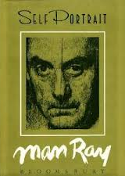
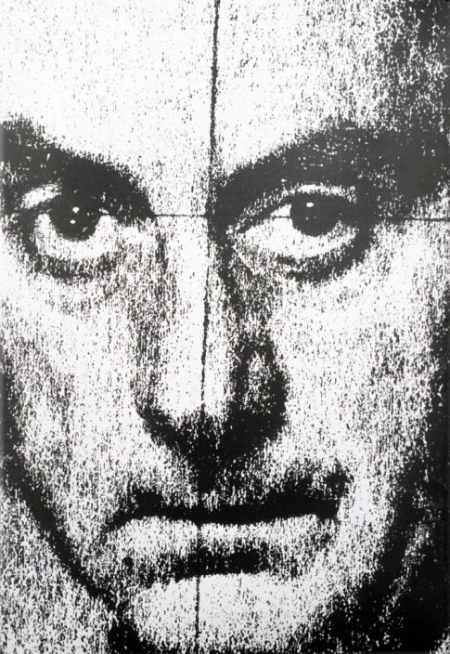
Man Ray, Self-portrait

Slide 3
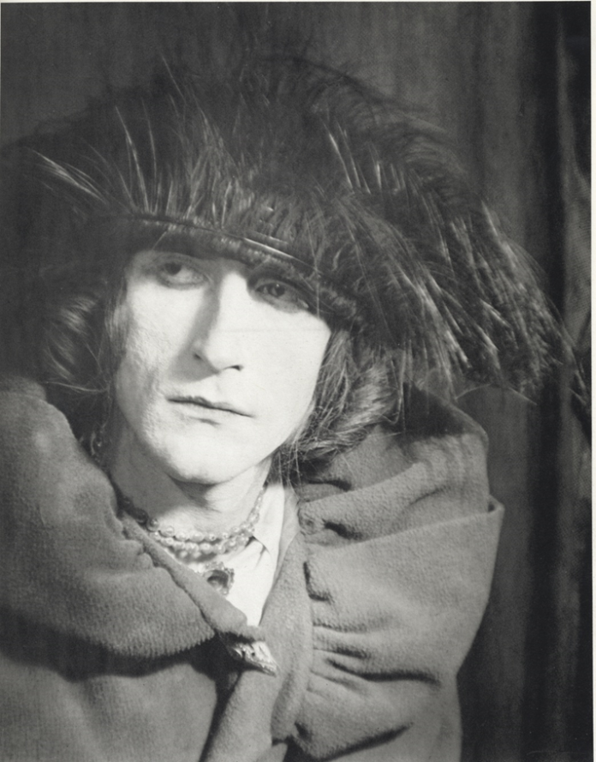
Man Ray, Marcel Duchamp, Rrose Sélavy, 1921

Slide 4
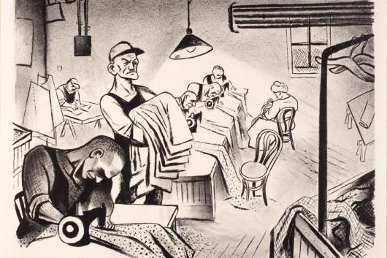
William Gropper, Sweatshop

Slide 5
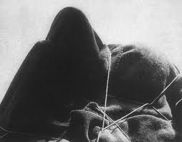
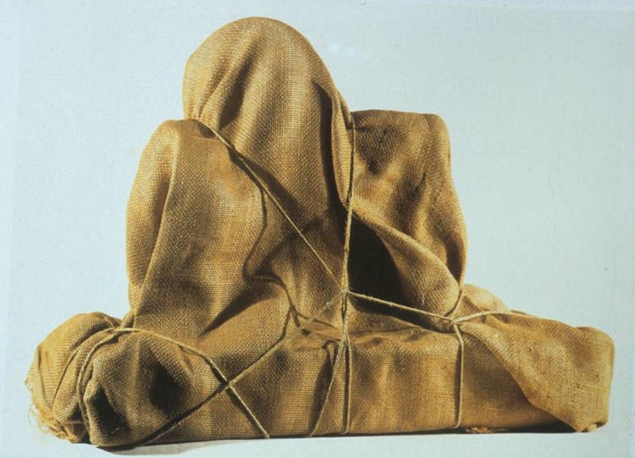
“Beautiful as the chance meeting of a sewing machine and an umbrella on a dissecting table.”
: “Beautiful as the chance Man Ray, The Enigma of Isidor Ducasse, 1920, photograph
Man Ray, The Enigma of Isidor Ducasse, 1920,
Assemblage, Israel Museum, Jerusalem

Slide 6
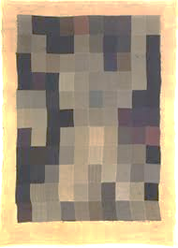
Man Ray., Tapestry, 1911

Slide 7
“Beautiful as the chance meeting of a sewing machine and an umbrella on a dissecting table.”
: “Beautiful as the chance Man Ray, The Enigma of Isidor Ducasse, 1920, photograph
Man Ray, The Enigma of Isidor Ducasse, 1920,
Assemblage, Israel Museum, Jerusalem

Slide 8
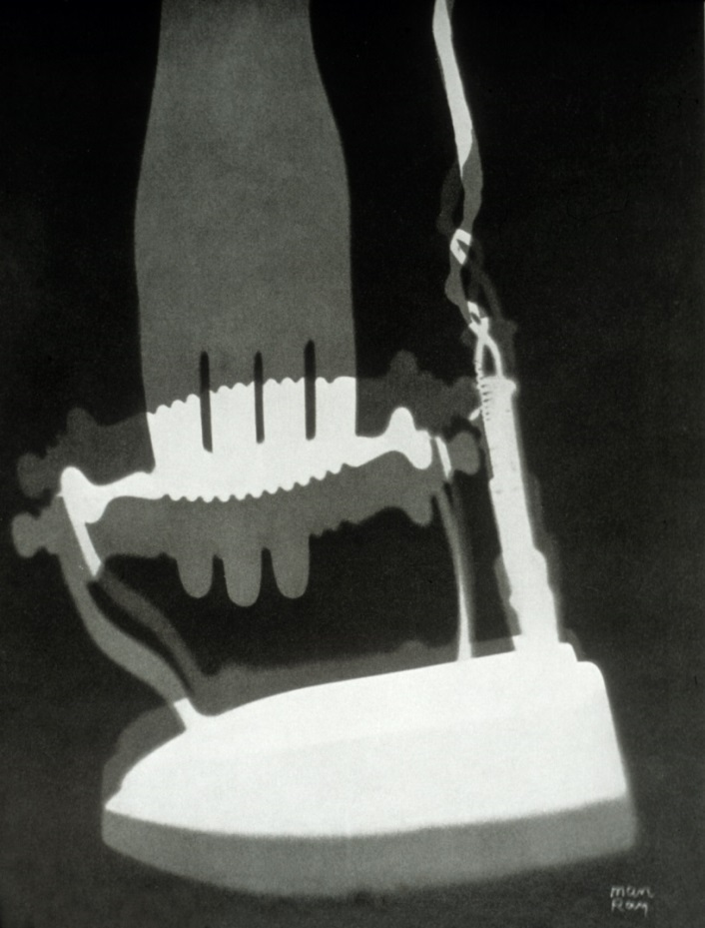
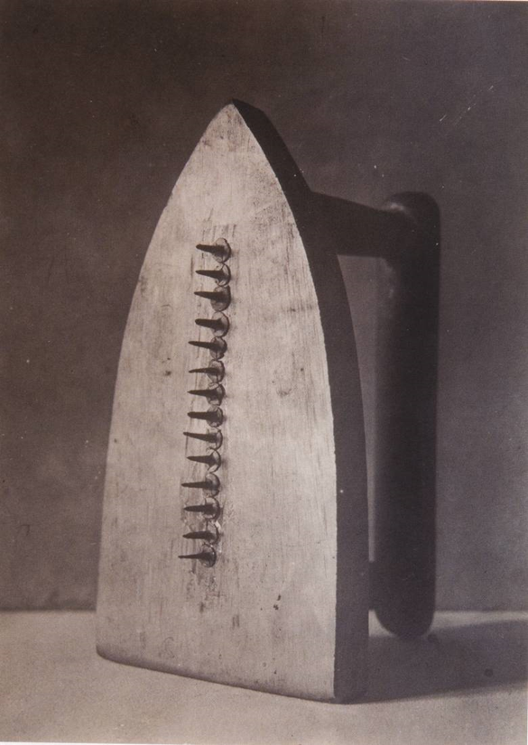
Man Ray, “Lingerie” (from Eléctricité), 1931)
rayograph
Man Ray, Cadeau, 1921

Slide 9
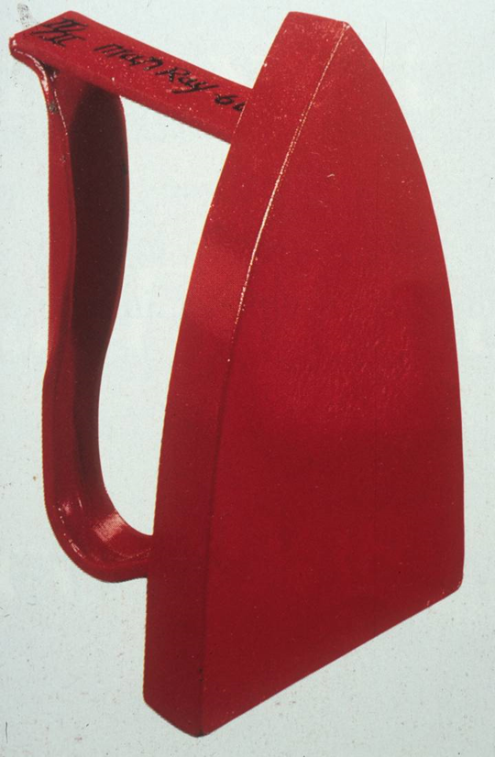
Man Ray, Red Hot Iron, 1965
Man Ray, Cadeau, 1921

Slide 10
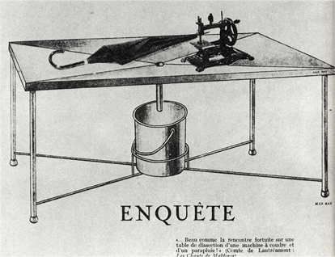
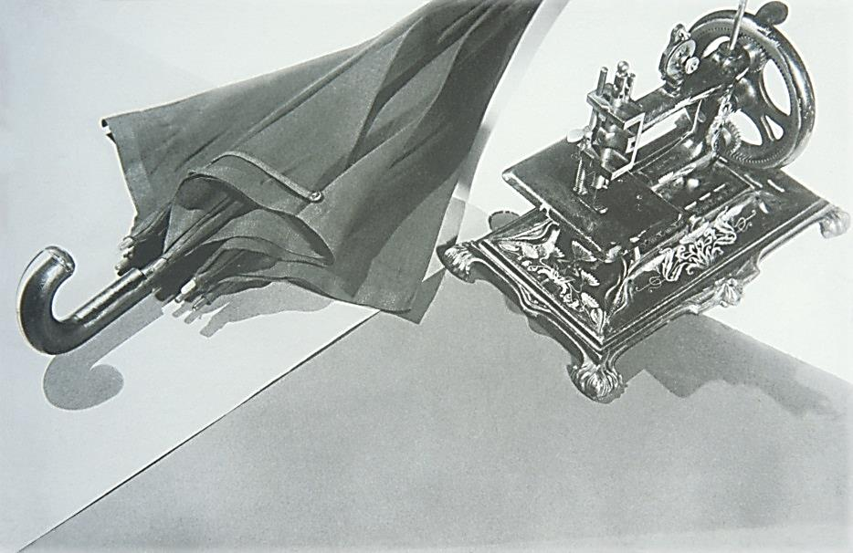
Man Ray, 1933
Man Ray, 1933

Slide 11
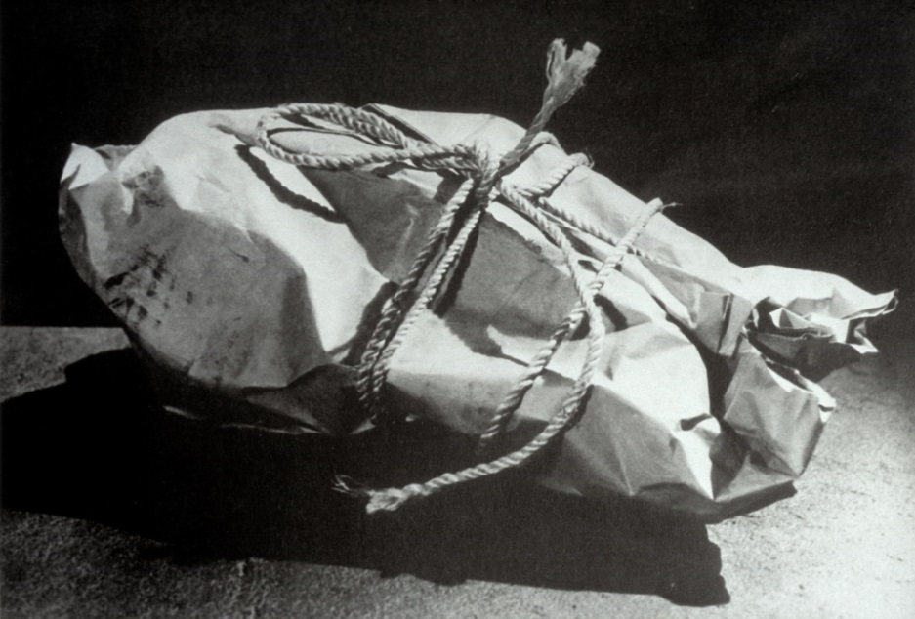
Man Ray, Enigma II, 1935

Slide 12
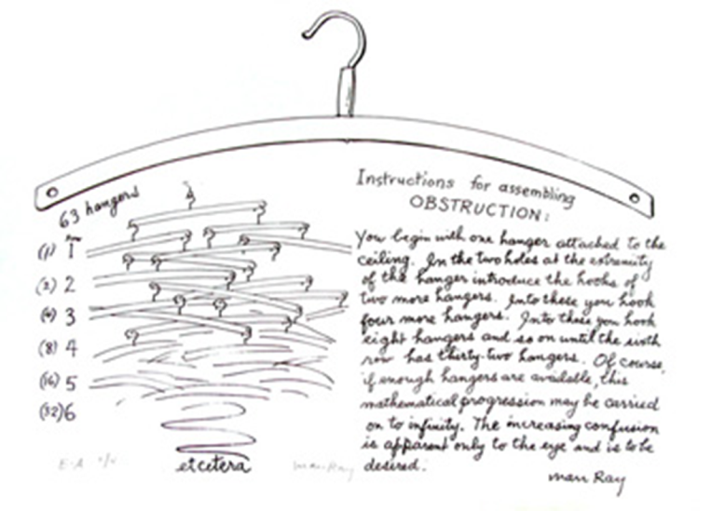
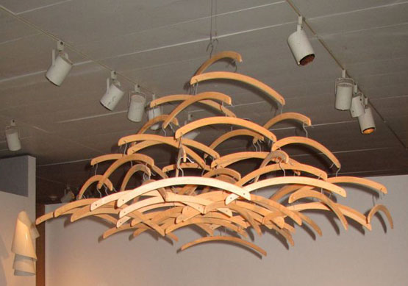
Man Ray
Obstruction, 1920/1964. 63 wooden coat hangers.

Slide 13
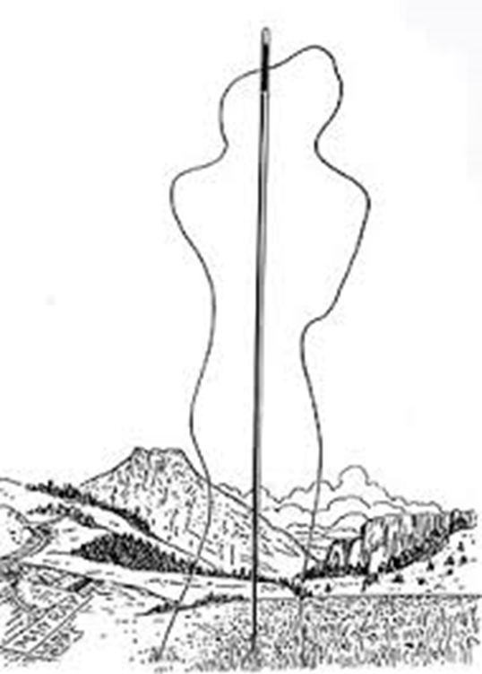
Man Ray, Needle and Thread, 1937. Illustration for Les Mains libres

Slide 14
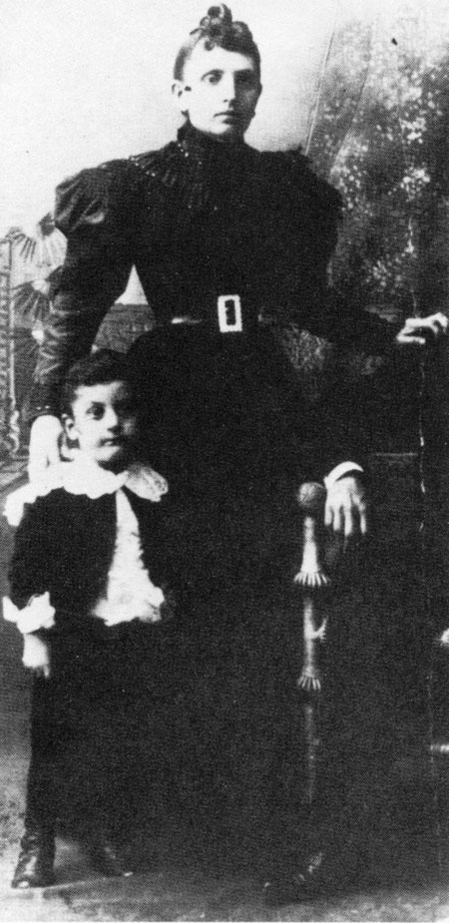
Man Ray and his mother, 1895
Man Ray, Needle and Thread, 1937

Slide 15
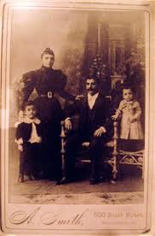
The Radnitsky family,
1895
Man Ray with his mother,
Cropped ,1895

Slide 16
Man Ray, Needle and Thread, 1937. Illustration for Les Mains libres

Slide 17
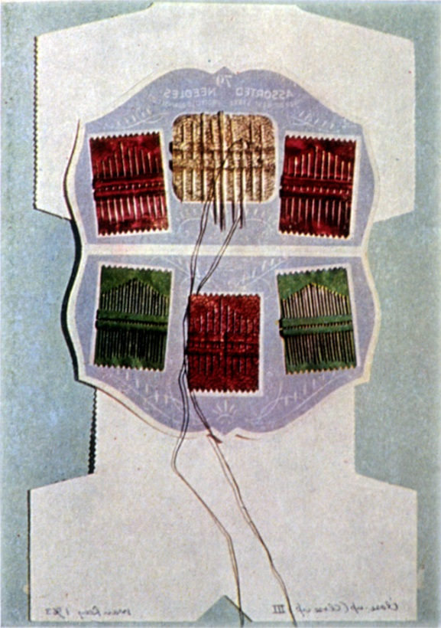
Man Ray, Close-up (fold up) III (1963)

Slide 18
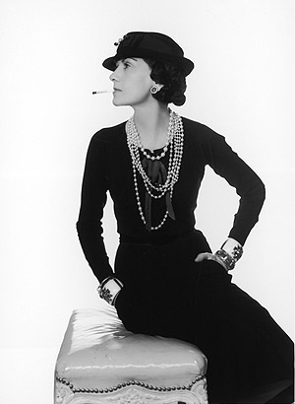
Man Ray, Coco Chanel, 1935
Man Ray and his mother, 1895

Slide 19
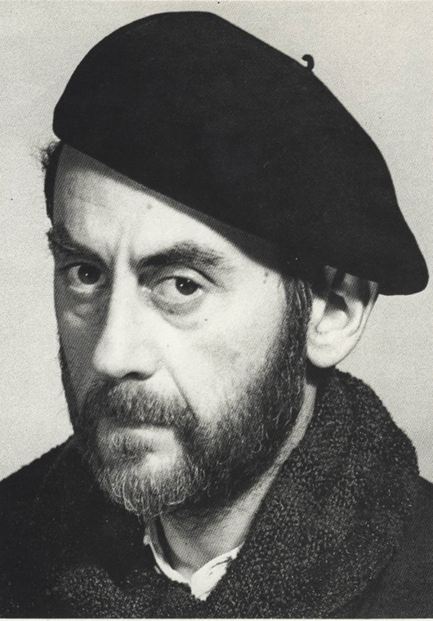
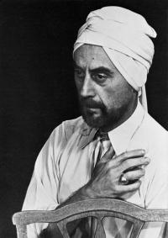
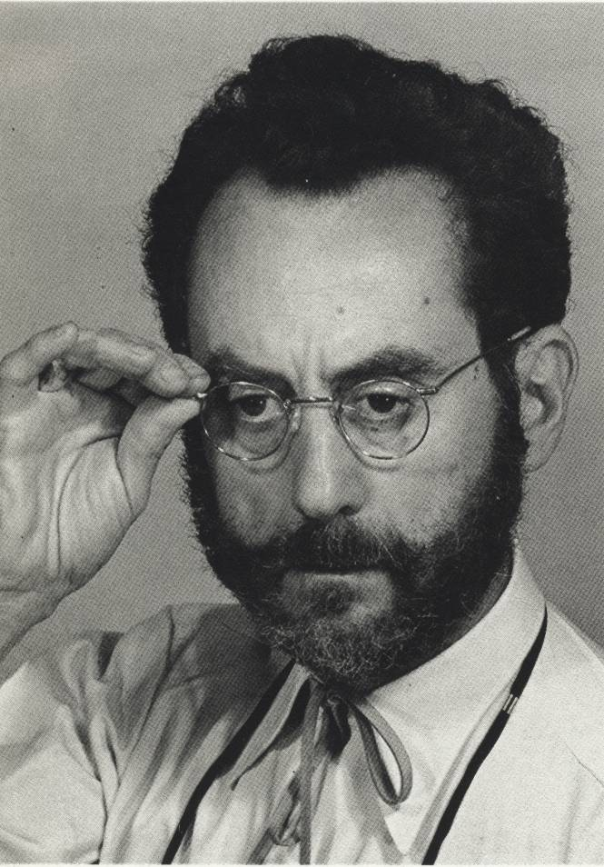
Man Ray, Self-portraits,
1920

Slide 20
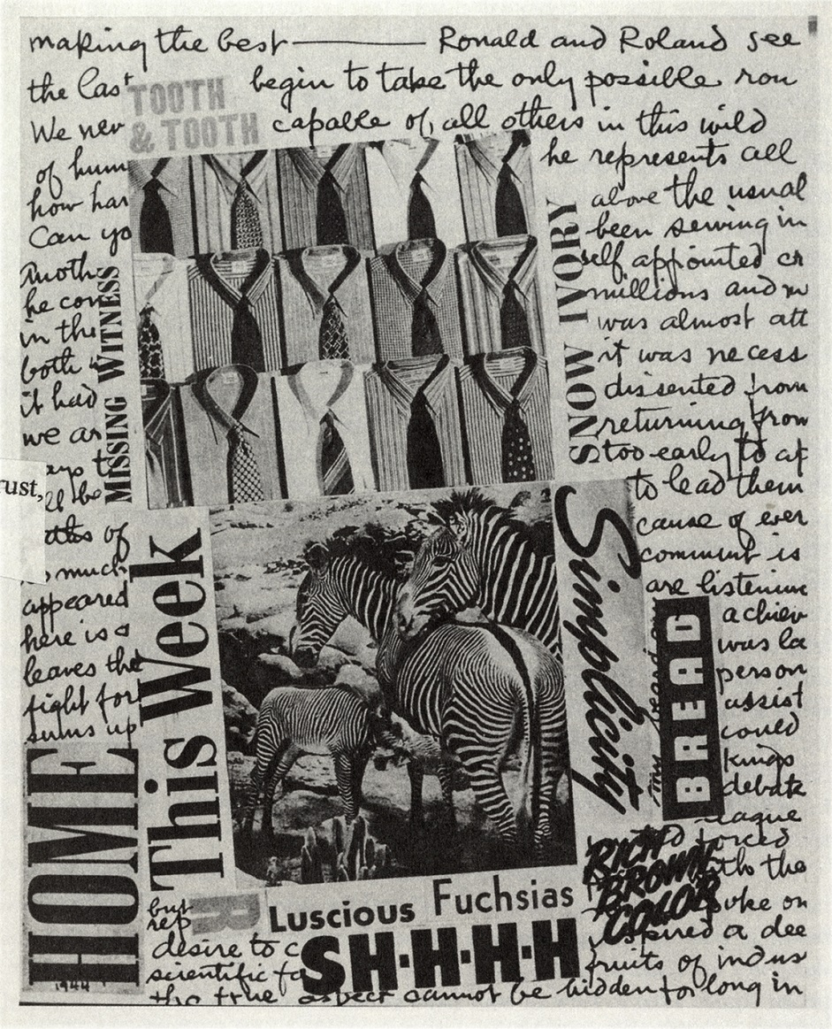
Man Ray, Decollage, 1944

Slide 21
Man Ray, Decollage, 1944

Slide 22
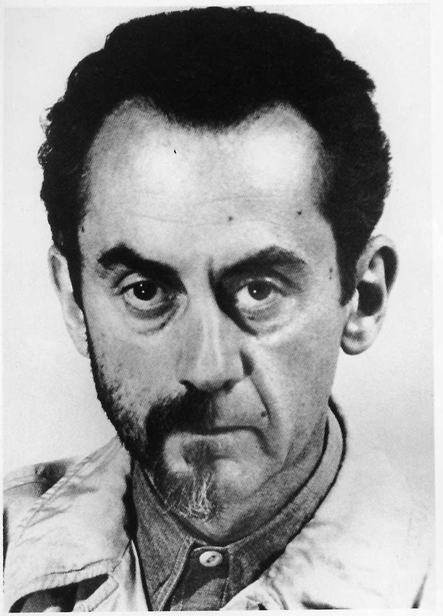
Man Ray, Self Portrait

Slide 23
Man Ray, Decollage, 1944

Slide 24
Man Ray, Decollage, 1944

Slide 25
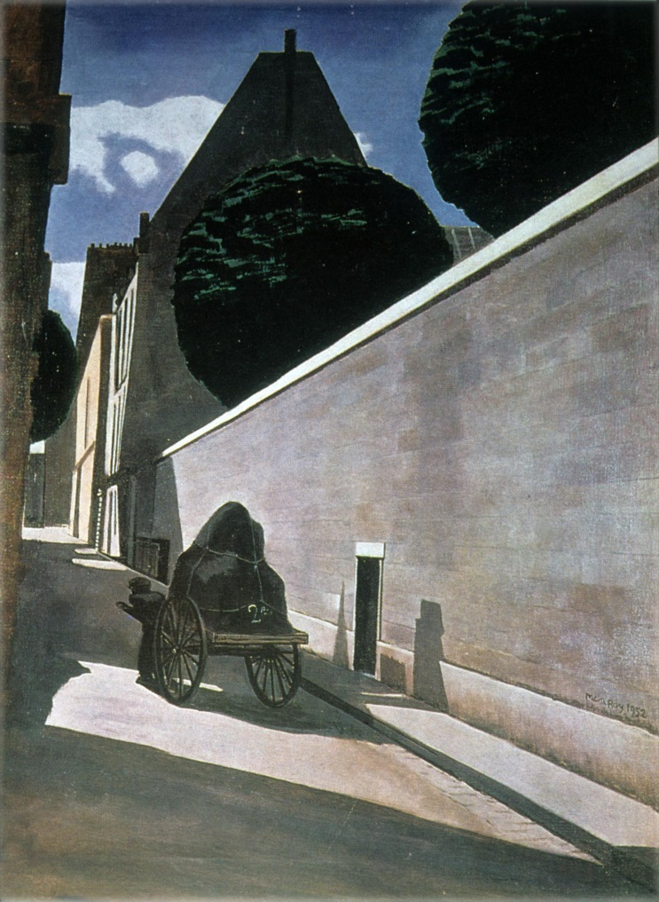
Man Ray, RUE FÉROU, 1952

Slide 26
Man Ray, The Enigma of Isidor Ducasse,
1920, photograph

