Slide 1
Jerusalem in Africa Africa in Jerusalem

Slide 2
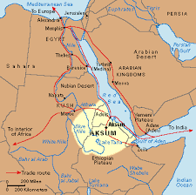
The Kingdom of Aksum in the Early Christian Era

Slide 3
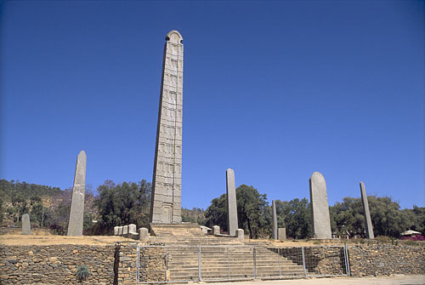
Obelisks in Aksum

Slide 4
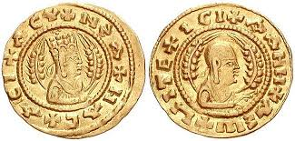
4th century:Ezana’s Christian Coin

Slide 5
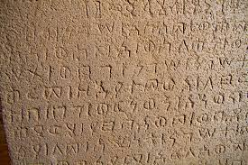
Ezana’s Inscription

Slide 6
Some Hebrew/Aramaic Loanwords in Ethiopic
Ta’ot (Idol)
‘Arb (Eve, Friday)
Haymanot (Religion)
Tabot (Ark)

Slide 7
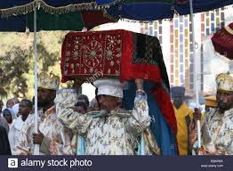
Priest Carrying Tabot (Replica of the Ark)

Slide 8
10 When the queen of Sheba heard about the fame of Solomon and his relationship to the Lord, she came to test Solomon with hard questions.² Arriving at Jerusalem with a very great caravan—with camels carrying spices, large quantities of gold, and precious stones—she came to Solomon and talked with him about all that she had on her mind.³ Solomon answered all her questions; nothing was too hard for the king to explain to her. ⁴ When the queen of Sheba saw all the wisdom of Solomon and the palace he had built, ⁵ the food on his table, the seating of his officials, the attending servants in their robes, his cupbearers, and the burnt offerings he made at^{[a]} the temple of the Lord, she was overwhelmed.
⁶ She said to the king, “The report I heard in my own country about your achievements and your wisdom is true. ⁷ But I did not believe these things until I came and saw with my own eyes. Indeed, not even half was told me; in wisdom and wealth you have far exceeded the report I heard. ⁸ How happy your people must be! How happy your officials, who continually stand before you and hear your wisdom! ⁹ Praise be to the Lord your God, who has delighted in you and placed you on the throne of Israel.

Slide 9
Because of the Lord’s eternal love for Israel, he has made you king to maintain justice and righteousness.”
¹⁰ And she gave the king 120 talents^{[b]} of gold, large quantities of spices, and precious stones. Never again were so many spices brought in as those the queen of Sheba gave to King Solomon…..
¹³ King Solomon gave the queen of Sheba all she desired and asked for, besides what he had given her out of his royal bounty. Then she left and returned with her retinue to her own country.

Slide 10
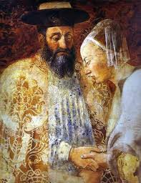
Solomon and Sheba: 15th century Italian

Slide 11
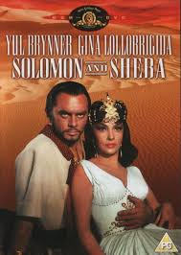
Film 1959
images:

Slide 12
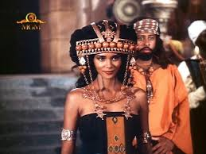
Halle Berry as the Queen of Sheba

Slide 13
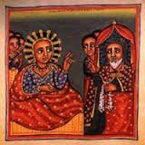
Ethiopian Rendition of Solomon and Sheba

Slide 14
The Kebra Nagast: The Glory of Kings

Slide 15
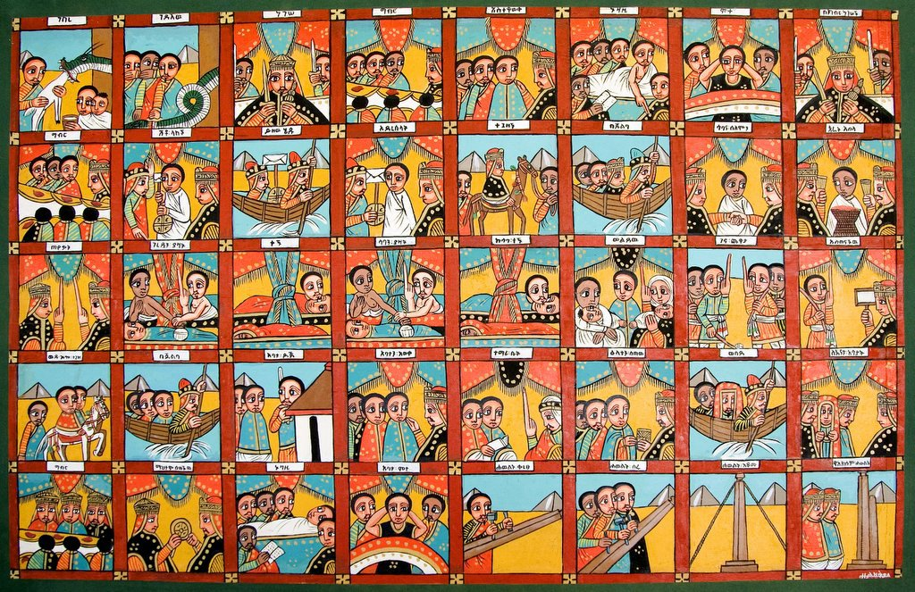
20th century Ethiopian Solomon and Sheba

Slide 16
The Solomonic Dynasty
Amda Tzeyon (1314-1344)
Dawit II
Yeshaq
Zar’a Ya’eqob (1434-1468)

Slide 17
Zion as a young girl/maiden, virgin
(Lam 2:13) “To what can I liken you, that I may comfort you, Virgin Daughter Zion?” (New International Version = NIV)
(Isa 37:22) “This is the word the LORD has spoken against him: ‘Virgin Daughter Zion despises and mocks you. Daughter Jerusalem tosses her head as you flee.” (NIV)

Slide 18
Cities Personified as Women
Isa 23:12 we read: “He said, No more of your reveling, Virgin Daughter Sidon, now crushed!” (NIV). And slightly further on the same prophet intones:
(Isa 47:1) “Go down, sit in the dust, Virgin Daughter Babylon” (NIV)
(Ps 45:12 [13 Hebrew]) “And the daughter of Tyre shall be there with a gift; even the rich among the people shall entreat thy favour.” (English Revised Version)

Slide 19
Ethiopian Miracles of Mary, 15th Century
“The golden ark is, indeed, the likeness of Mary, and the tablet the likeness of her womb, and the Ten Commandments [lit. words] are the likeness of her Son, who is the Word of the Father.”

Slide 20
The Book of Light: 15th century
Moses “who was given the prototype of Mary, the twofold Virgin — the Tablets the analogy of her womb, the Ark of the Covenant the analogy of her body, and the Tabernacle the analogy of her whole entity (lit. flesh).”

Slide 21
Miracles of Mary
: “Now, see from the heart how he called her the Redeemer of the whole world. He called her, furthermore, Zion, the tablet of the covenant, and gave (her) to Moses that she may be the Savior of Israel among all (and) above all the covenants given from the good God.”

Slide 22
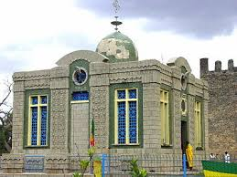
Cathedral Mary of Zion

Slide 23
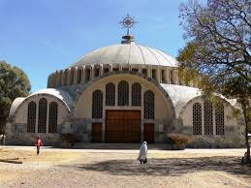
New Building Mary of Zion

Slide 24
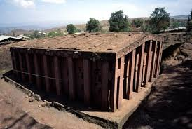
Bet Madhane Alam: Savior of the World. Lalibela
ages:

Slide 25
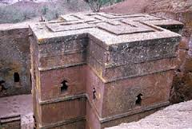
Bet Giyorgis Rock Church Lalibela

Slide 26
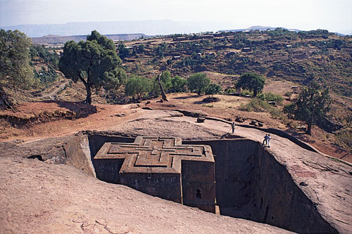
The hill containing the rock-cut church of

Slide 27
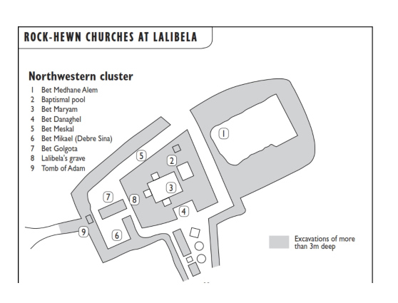
Map of the Churches of Lalibela
Map of north western Lalibela gro

Slide 28
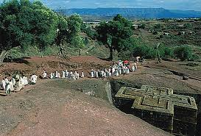
Pilgrims at Lalibela

Slide 29
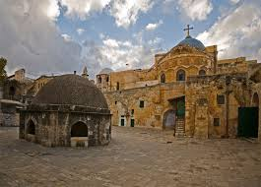
Deir el Sultan on top of the Holy Sepulchre

Slide 30
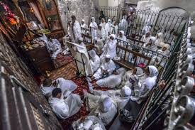
Chapel of Der el Sultan

Slide 31
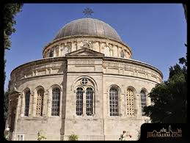
Kidana Mehret (Covenant of Mercy) Church Ethiopia Street Jerusalem
images:

Slide 32
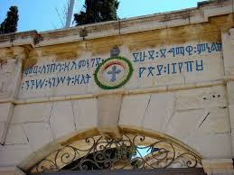
Entrance Ethiopia Street: Conquering Lion King of Kings of Ethiopia Menilek II

Slide 33
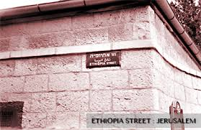
Ethiopia Street. Jerusalem

Slide 34
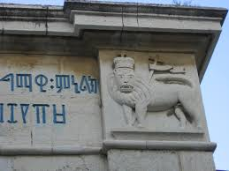
Detail of Entrance to Church on Ethiopia Street

Slide 35
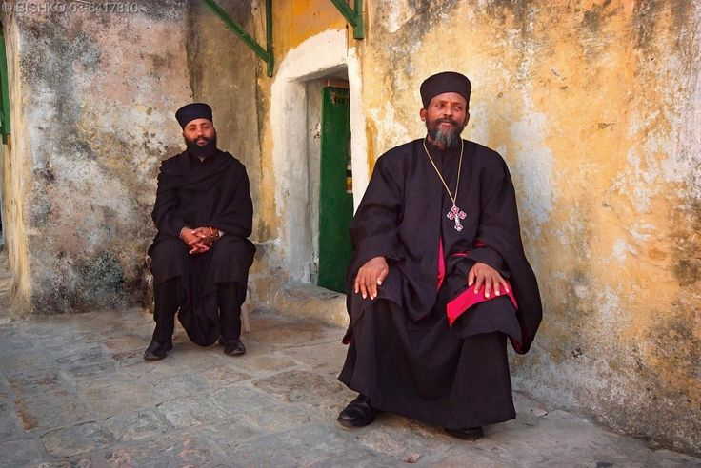
Monks in the Old City

Slide 36
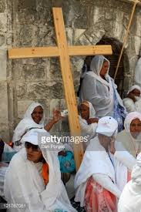
Pilgrims

Slide 37
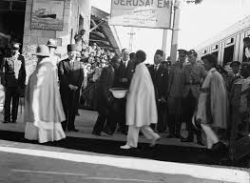
Haile Selassie I arrives in Jerusalem

Slide 38
That until the philosophy which holds one race superior and another inferior is finally and permanently discredited and abandoned; That until there are no longer first-class and second-class citizens of any nation; That until the color of a man's skin is of no more significance than the color of his eyes; That until the basic human rights are equally guaranteed to all without regard to race; That until that day, the dream of lasting peace and world citizenship and the rule of international morality will remain but a fleeting illusion, to be pursued but never attained; And until the ignoble and unhappy regimes that hold our brothers in Angola, in Mozambique and in South Africa in subhuman bondage have been toppled and destroyed; Until bigotry and prejudice and malicious and inhuman self-interest have been replaced by understanding and tolerance and good-will; Until all Africans stand and speak as free beings, equal in the eyes of all men, as they are in the eyes of Heaven; Until that day, the African continent will not know peace. We Africans will fight, if necessary, and we know that we shall win, as we are confident in the victory of good over evil. – Haile Selassie I

Slide 39
Until the philosophy which hold one race superior / And another / Inferior / Is finally / And permanently / Discredited / And abandoned / -Everywhere is war - / Me say war.
That until there no longer / First class and second class citizens of any nation / Until the colour of a man's skin / Is of no more significance / than the colour of his eyes / - Me say war.
That until the basic human rights / Are equally guaranteed to all, / Without regard to race / - Dis a war.
That until that day / The dream of lasting peace, / World citizenship / Rule of international morality / Will remain in but a fleeting illusion to be pursued, / But never attained / - Now everywhere is war - / War.
And until the ignoble and unhappy regimes / that hold our brothers in Angola, / In Mozambique, / South Africa / Sub-human bondage / Have been toppled, / Utterly destroyed / - Well, everywhere is war - / Me say war.
War in the east, / War in the west, / War up north, / War down south - / War - war - / Rumours of war. / And until that day, / The African continent / Will not know peace, / We Africans will fight - we find it necessary /
- And we know we shall win / As we are confident / In the victory
Of good over evil -/ Good over evil, yeah! / Good over evil - / Good over evil, yeah! / Good over evil - / Good over evil, yeah!

Slide 40
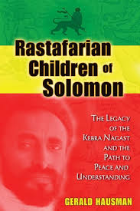

Slide 41
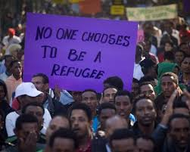
Refugees, Migrants, Infiltrators?

Slide 42
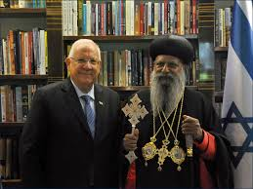
Abuna Mathias and President Rivlin

Slide 43
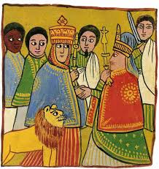
THANK YOU

