Slide 1
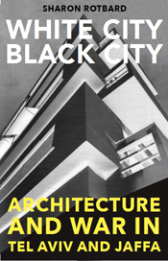
White City, Black City Architecture and War In Tel Aviv and Jaffa Sharon Rotbard

Slide 2
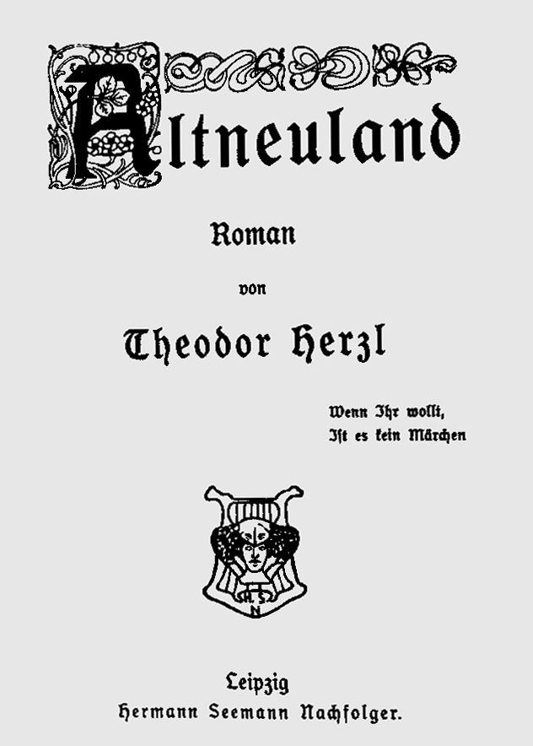
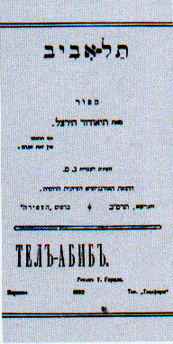
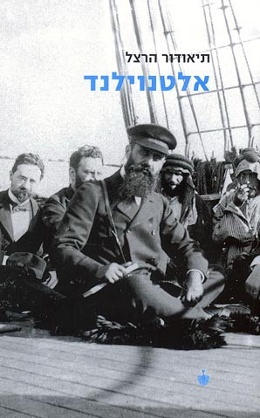
Theodor Herzl, Altneuland (1902), First Hebrew translation by Nahoum Sokolov as “Tel Aviv” (1904), third translation (1997)

Slide 3
UNESCO declaration on the inscription of the White City of Tel Aviv in the list of world cultural heritage sites.

Slide 4
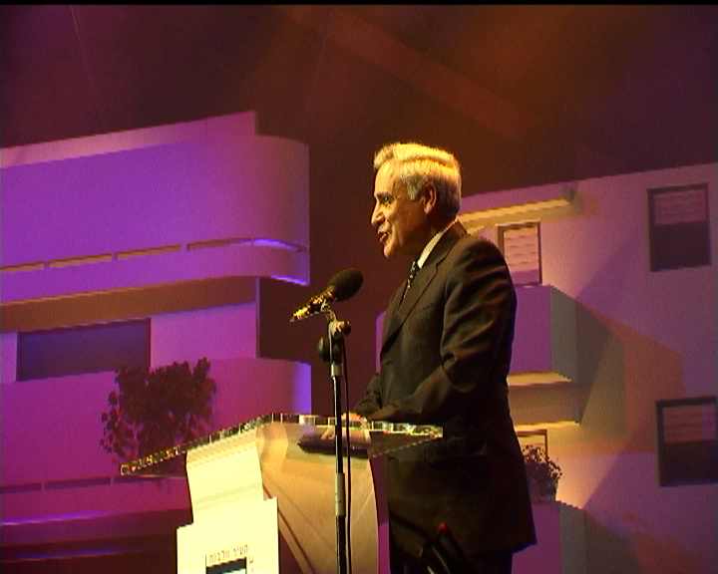
Moshe Katzav, president of the state of Israel, greeting the city of Tel Aviv at the UNESCO declaration ceremony, June 2004.

Slide 5
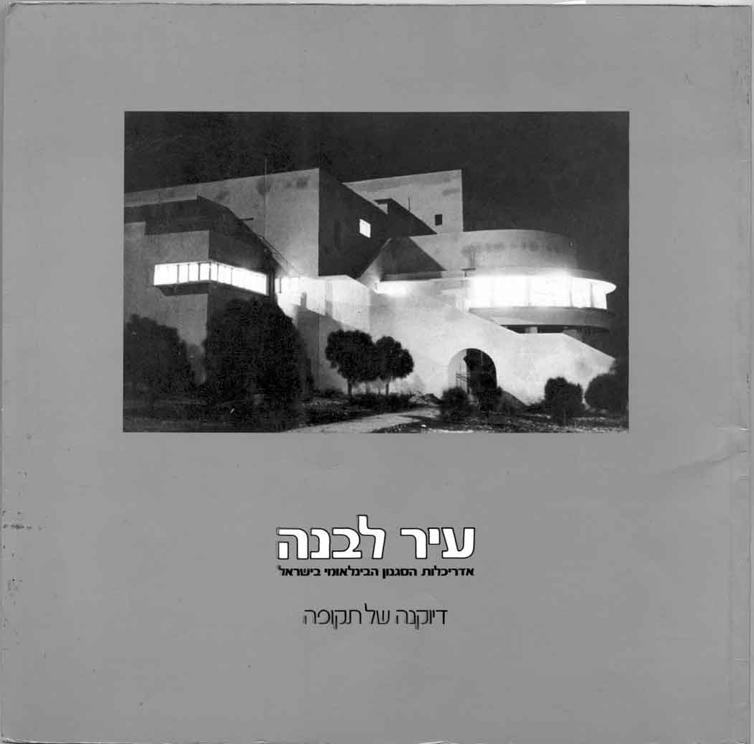
Michael Levin (curator), White City: Architecture of the International Style in Israel, Tel Aviv Museum of Art, Tel Aviv, 1984

Slide 6
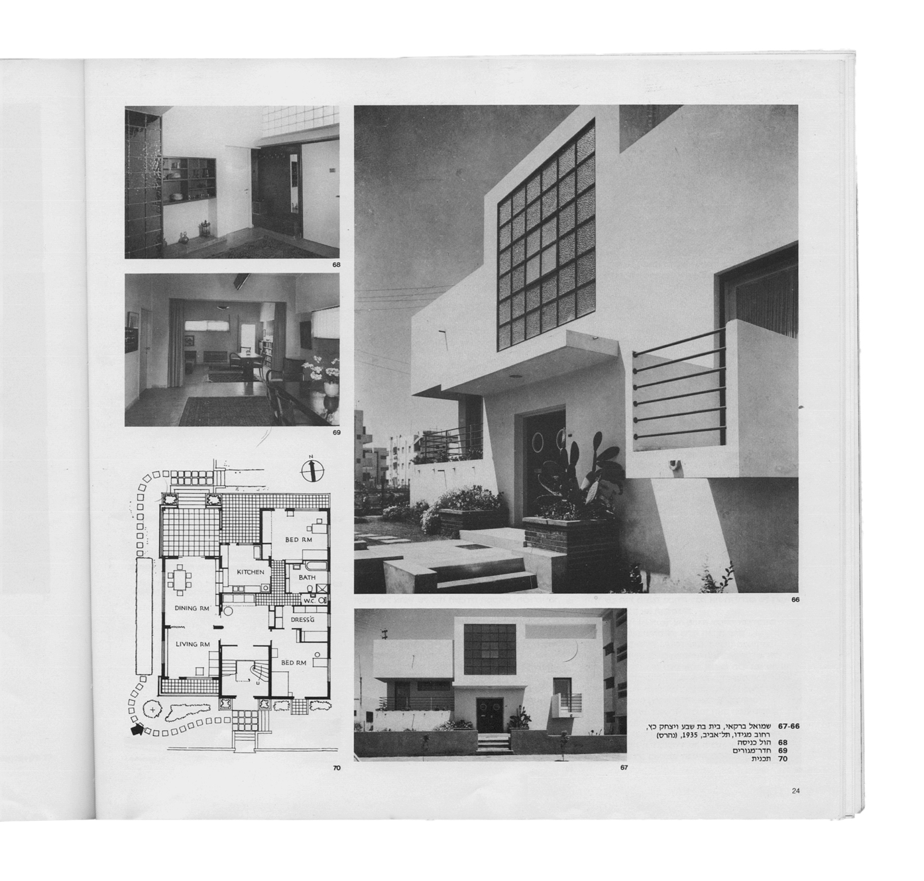
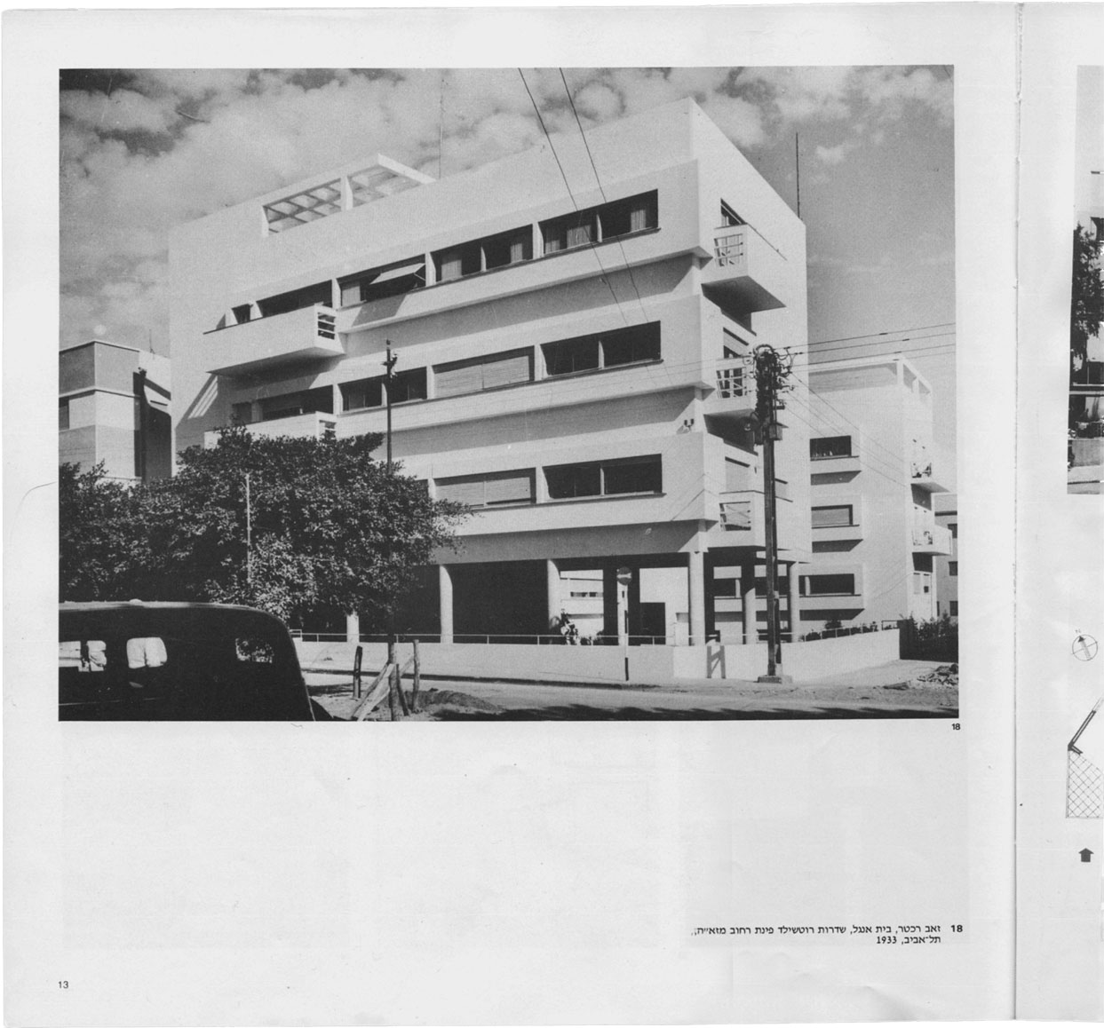
Sam Barkai, architect – a private house in Ramat-Gan, 1935. Zeev Rechter, architect - Engel apartment building, Tel Aviv, 1933.
“White City” catalogue (1984).

Slide 7
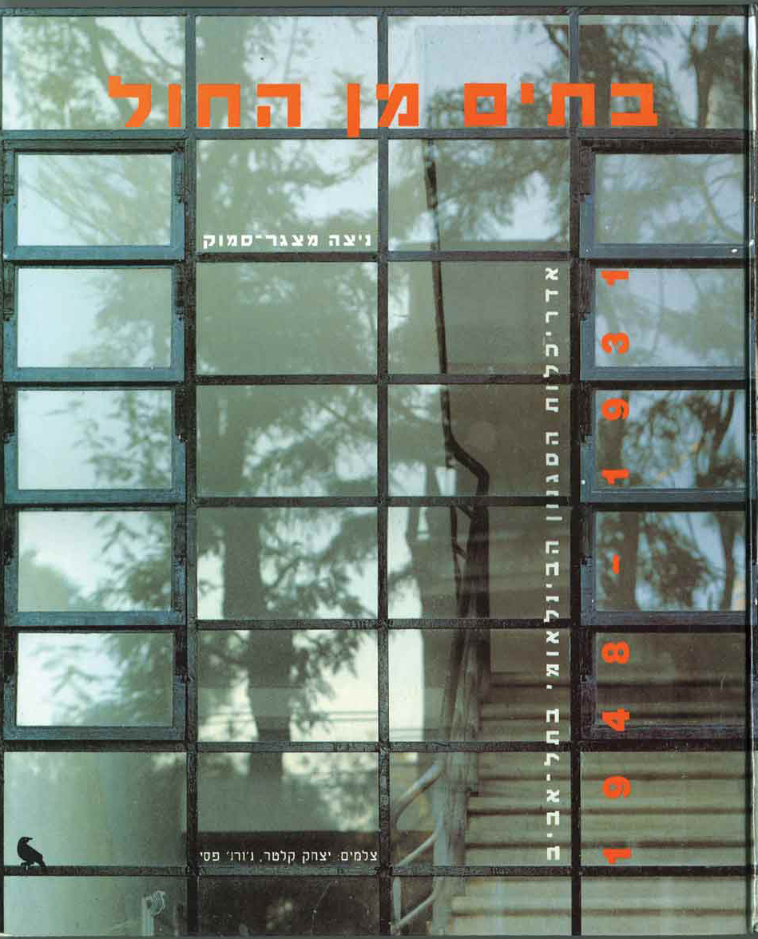
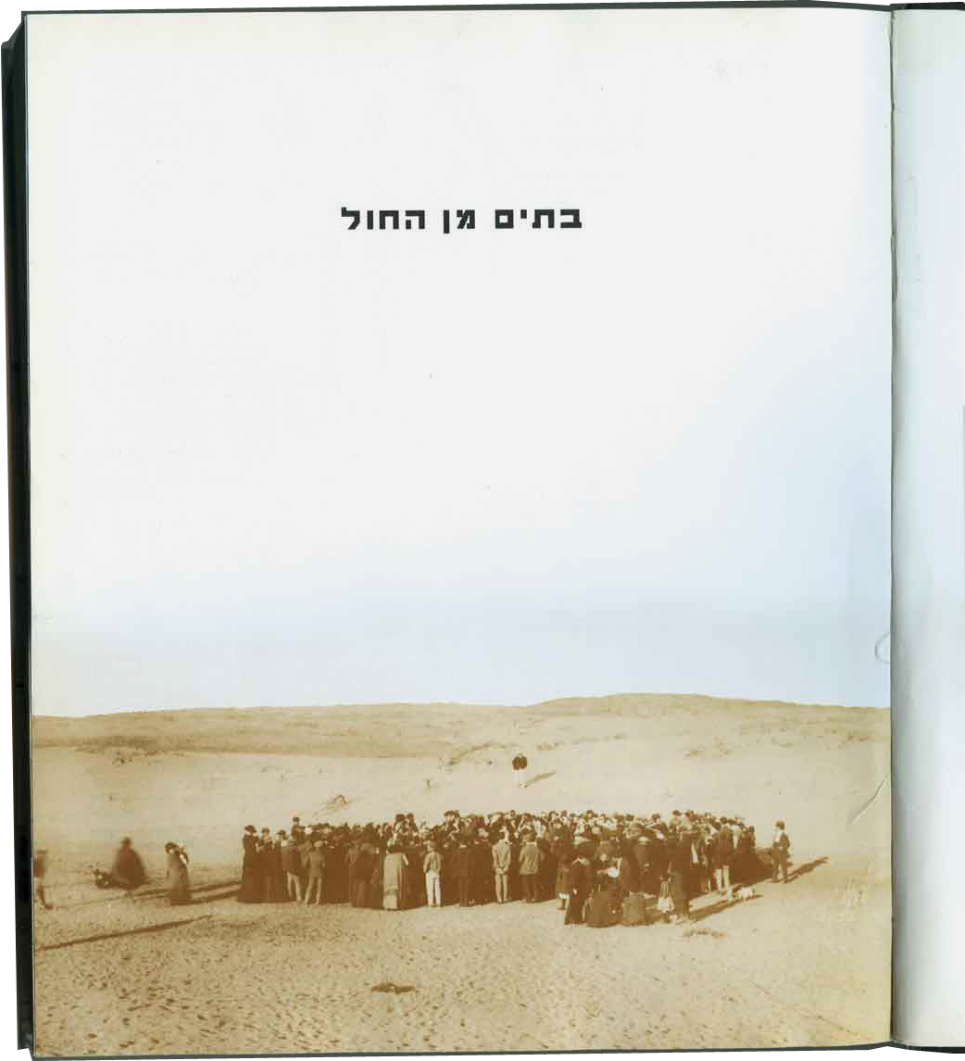
Nitza Metzger-Smuck, Houses on the Dunes, Hebrew edition, 1994: the cover and the title page with Suskin’s famous photo showing the Ahuzat Bait lottery in April the 11th 1909.

Slide 8
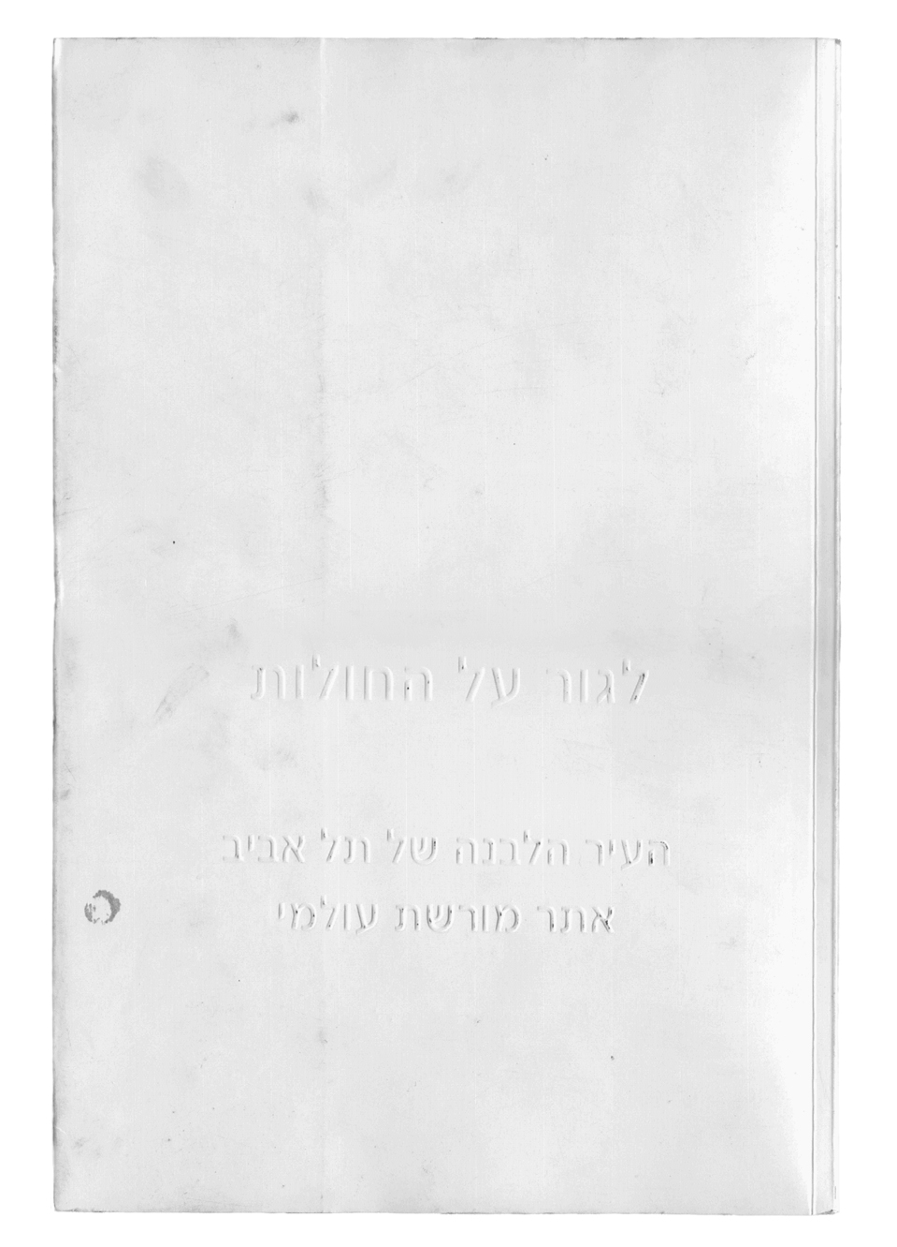
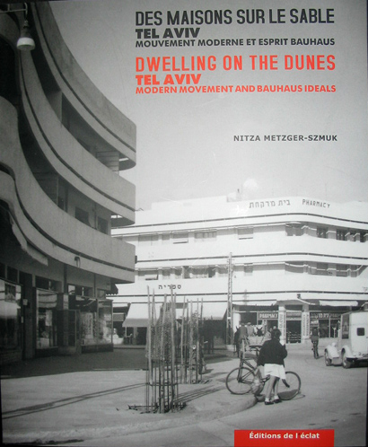
Nitza Metzger-Smuck, Dwelling on the Dunes, Hebrew catalogue of the 2004 Tel Aviv Museum exhibition; English-French edition, 2003.

Slide 9
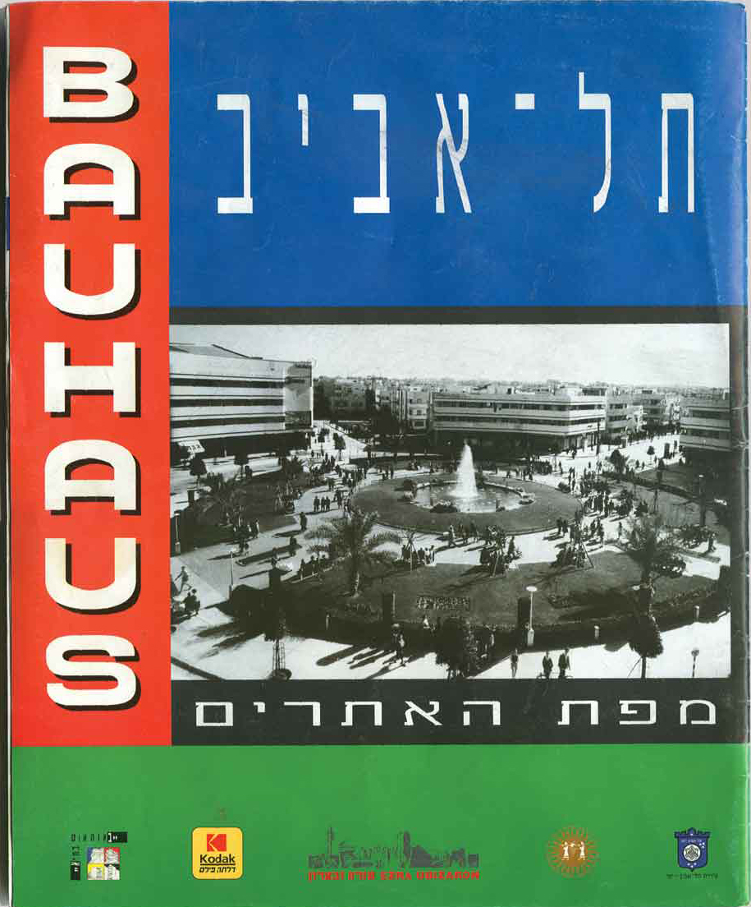
“Bauhaus in Tel Aviv” – site map (1994)

Slide 10
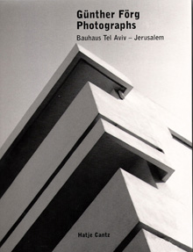
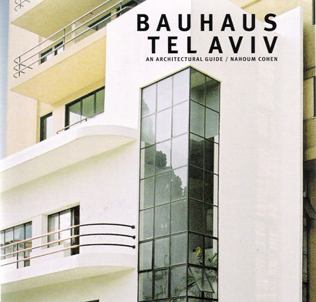
Gunther Forg, Bauhaus Tel Aviv Jerusalem, Tel Aviv 2002 Nahoum Cohen, Bauhaus Tel Aviv, Tel Aviv 2003

Slide 11
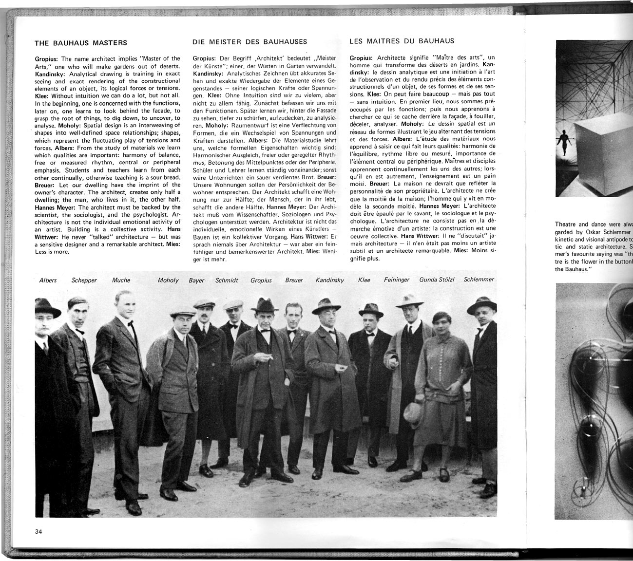
Arieh Sharon, Kibbutz+Bauhaus: an architect’s way in a new land, Stutgart & Tel Aviv 1976.

Slide 12
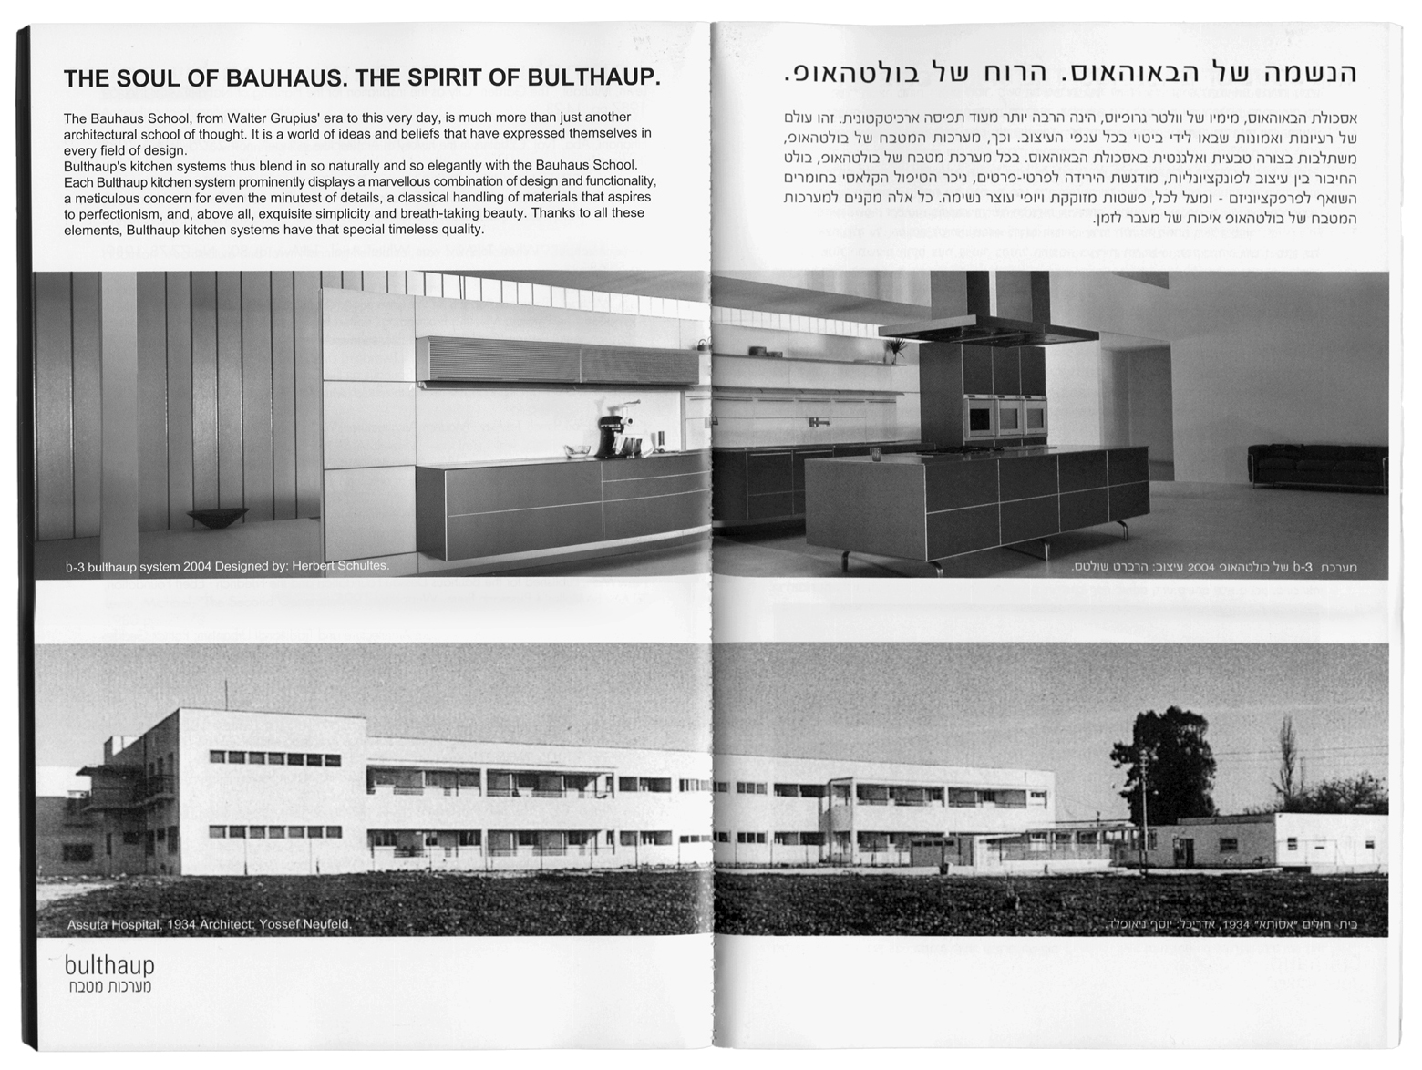
“The soul of the Bauhaus, the spirit of Bulthaup”, sponsorship advertisement comparing the Asuta hospital building in Tel Aviv by Yosef Neufeld (1934) and a modern Bulthaup kitchen, in Nitza Smuck’s “Dwelling on the Dunes” catalogue, Tel Aviv 2004.

Slide 13
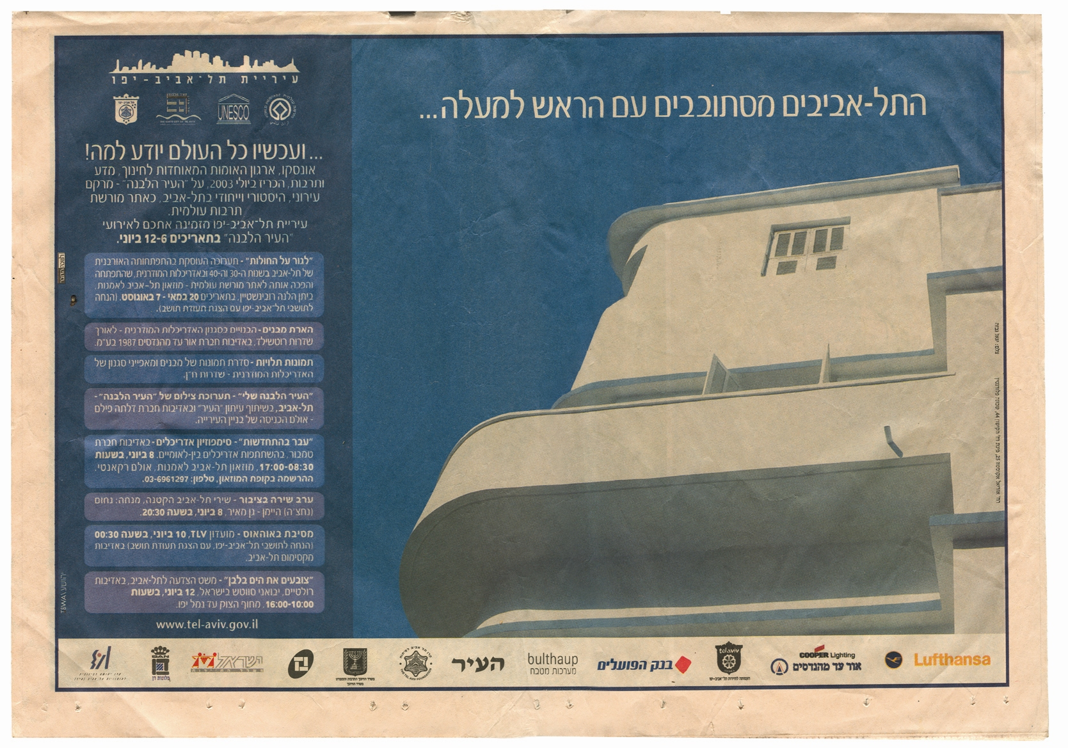
“The Tel Avivians are raising their heads… and now the whole world knows why!” Advertisement of the municipality of Tel Aviv for the UNESCO declaration festival, 2004.

Slide 14
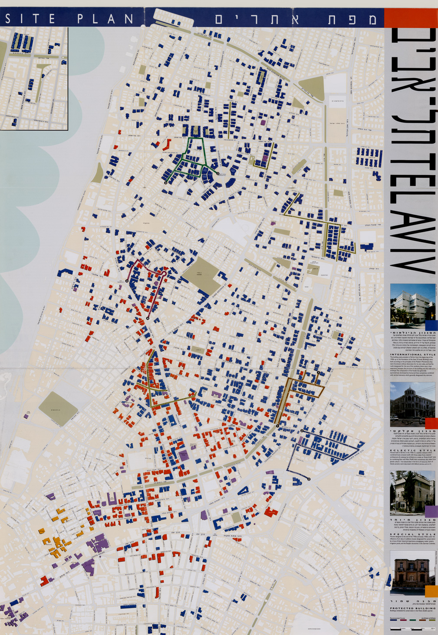
“Bauhaus in Tel Aviv” – site map (1994)

Slide 15
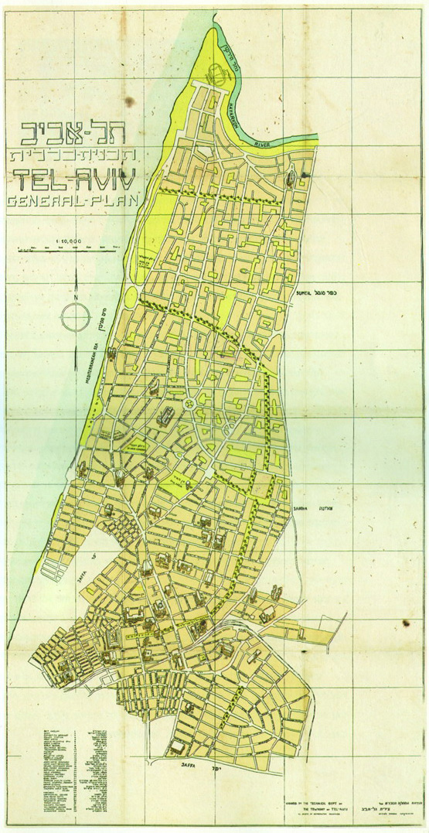
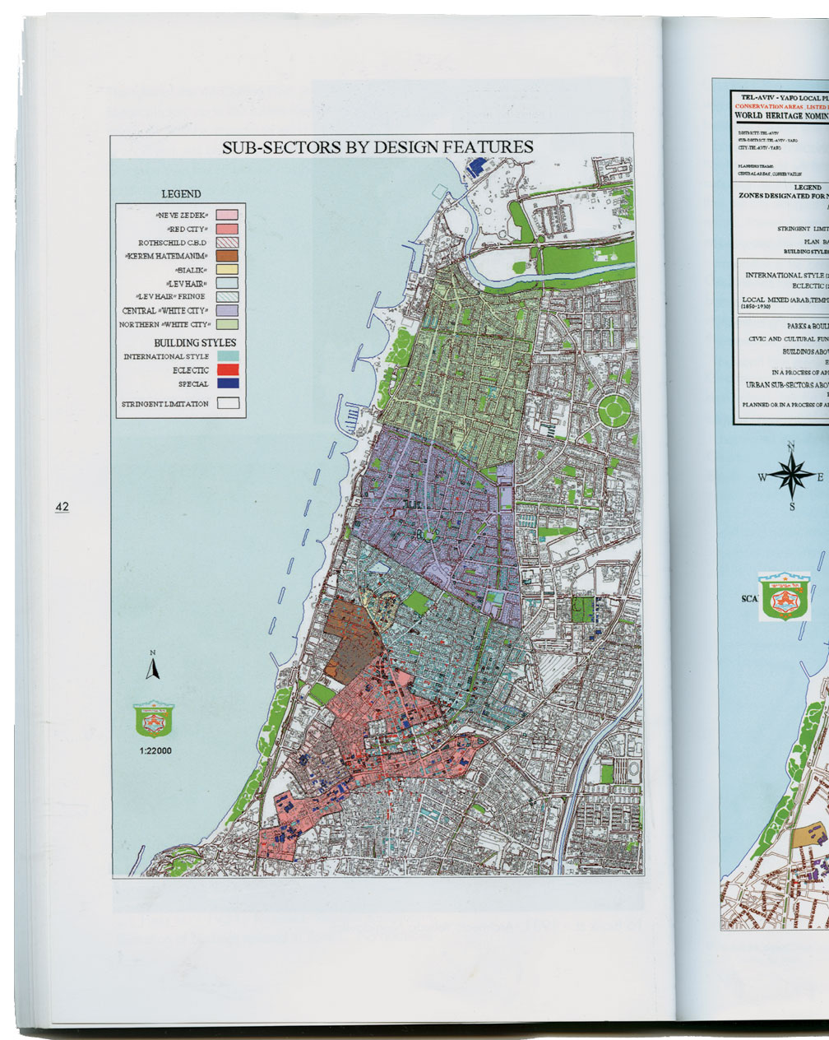
Geddes Plan for Tel Aviv (1931), Conservation plan of Tel Aviv submitted to UNESCO (2004)

Slide 16
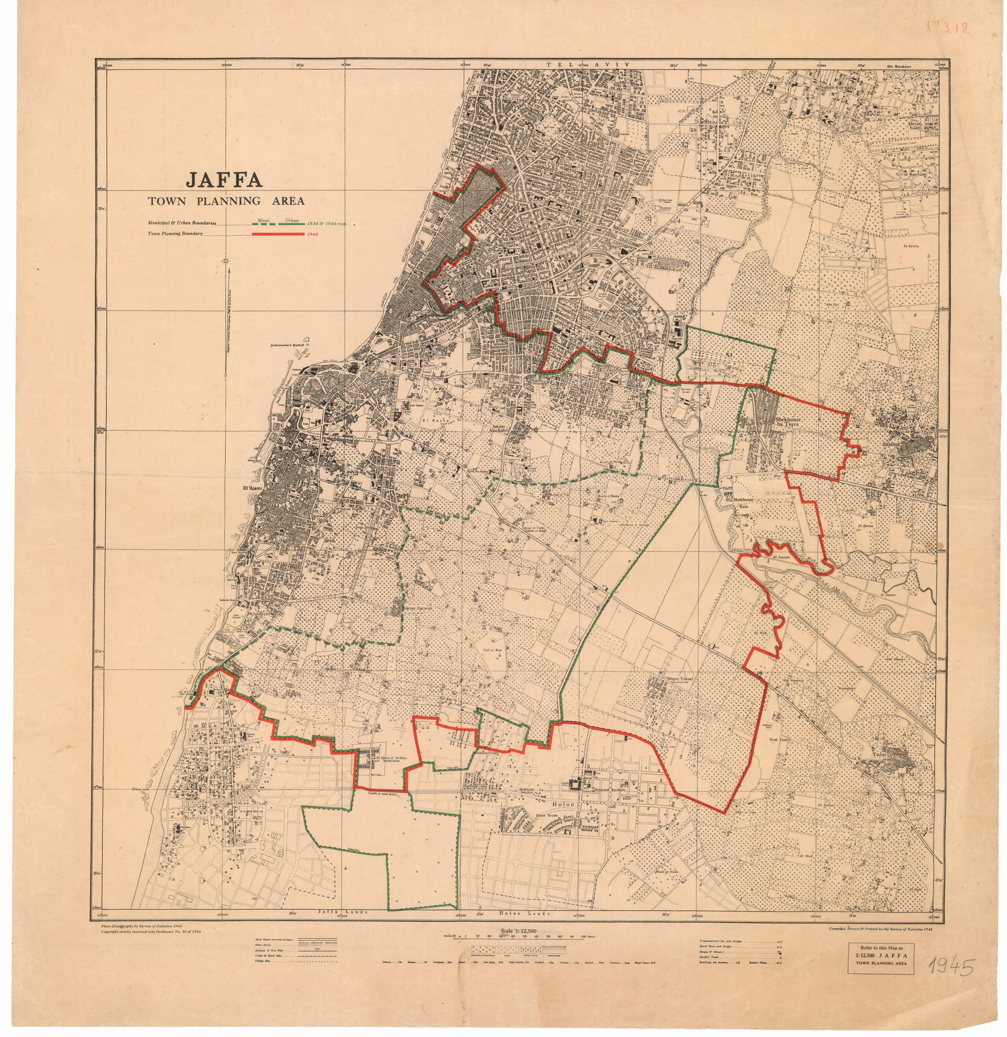
Jaffa area, 1945.

Slide 17
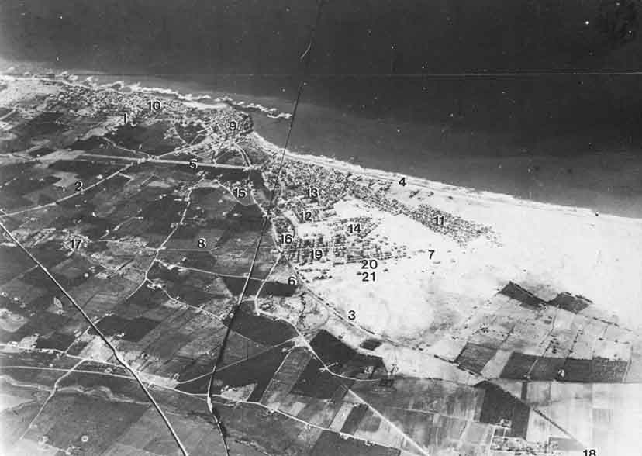
Jaffa and Tel Aviv, 1917

Slide 18
Palestinian Fleeing Jaffa, April 1947

Slide 19
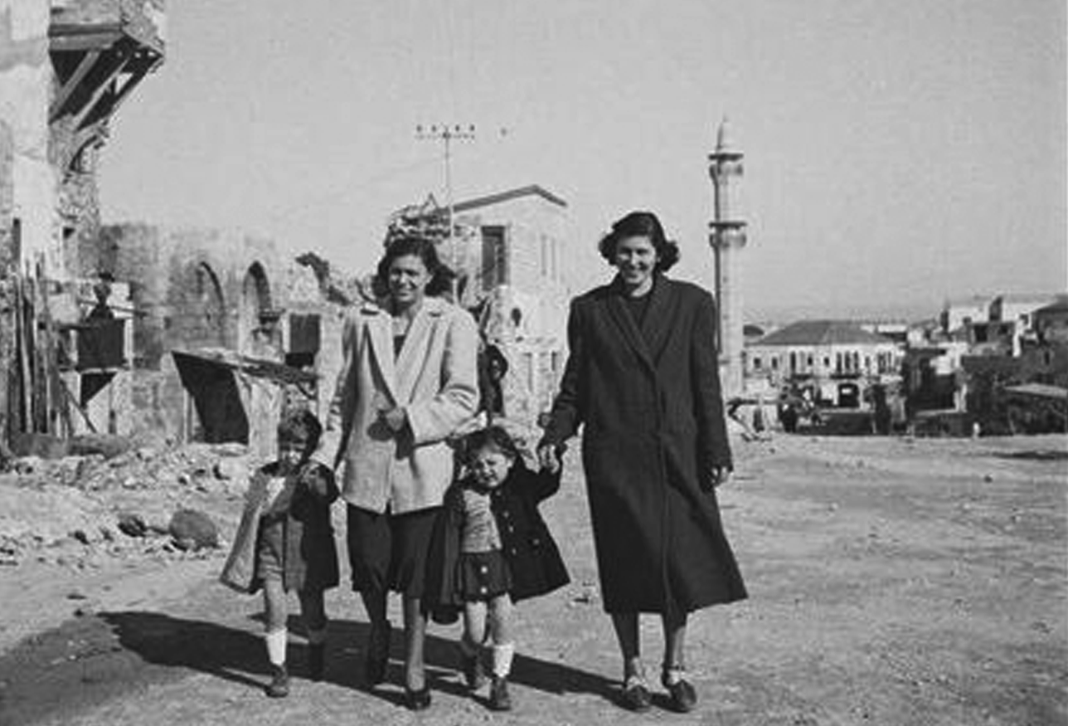
Bulgar new immigrants, Jaffa, 1949

Slide 20
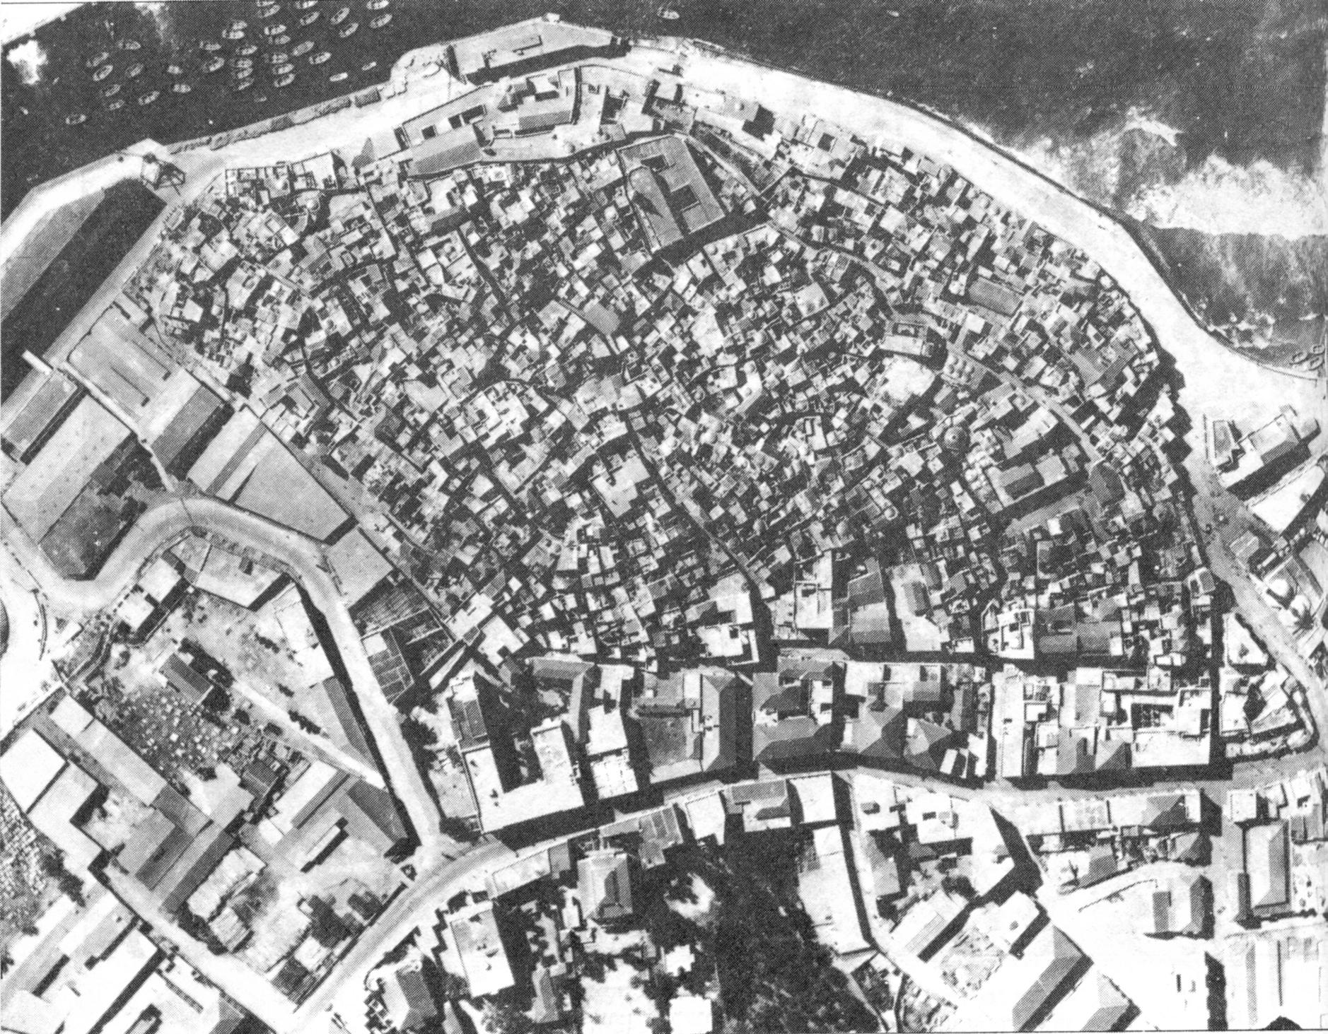
Old city of Jaffa, 1936.

Slide 21
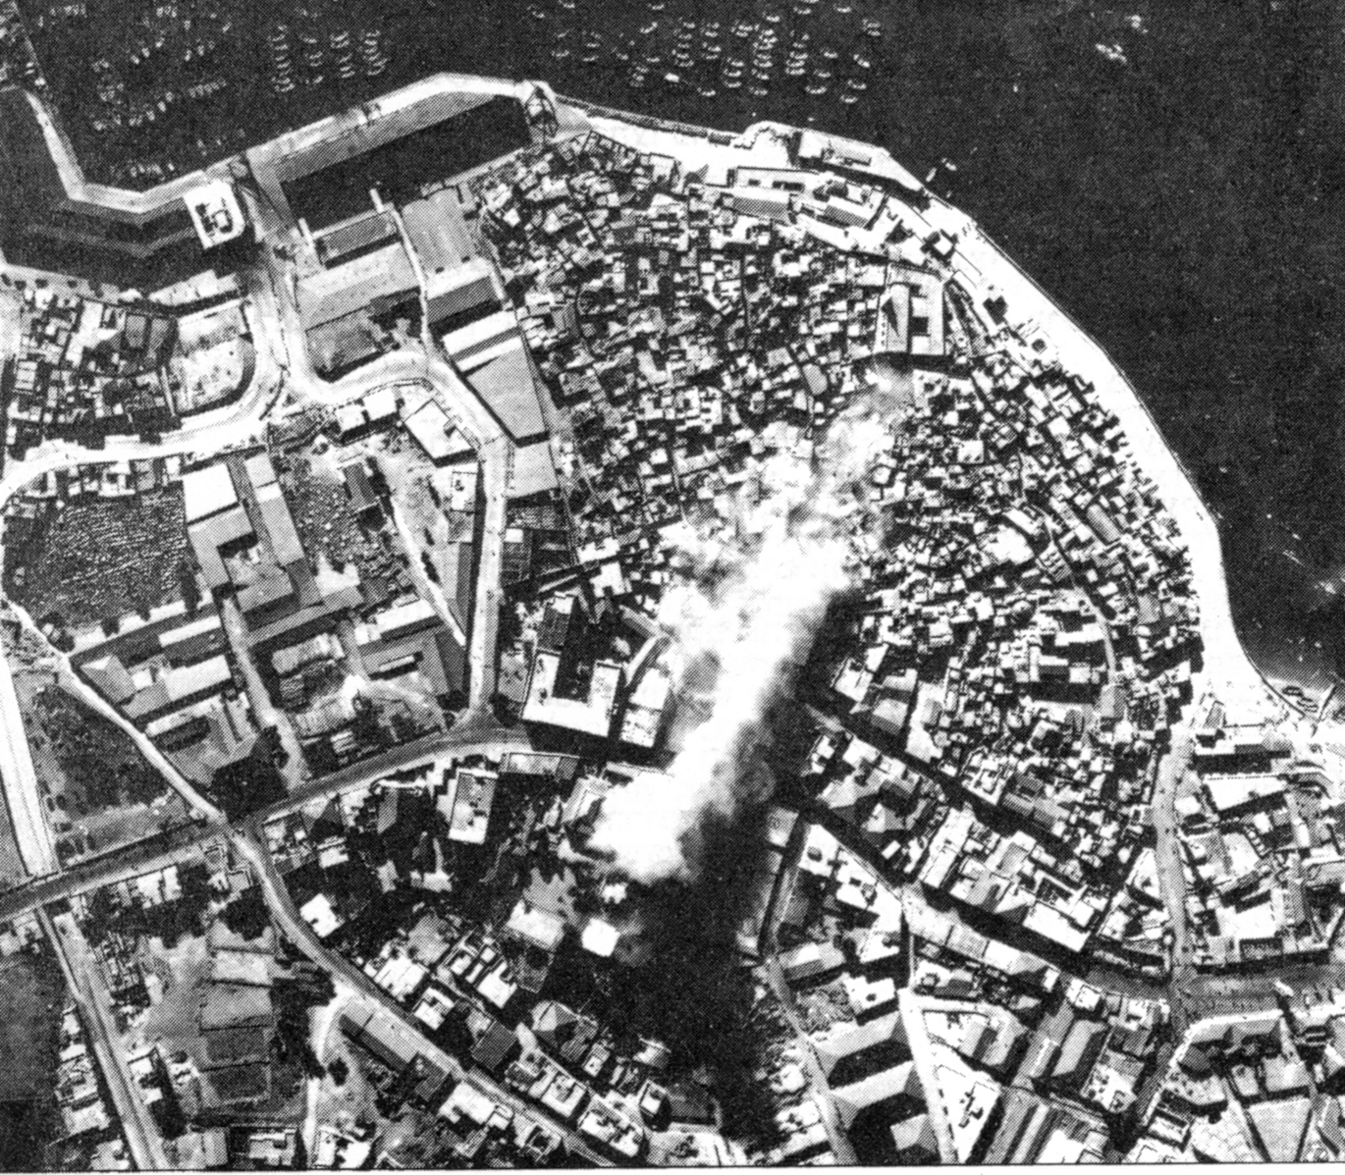
Anchor operation, old city of Jaffa, 1936.

Slide 22
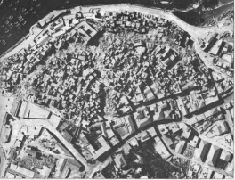
Anchor operation, , old city of Jaffa, 1936.

Slide 23
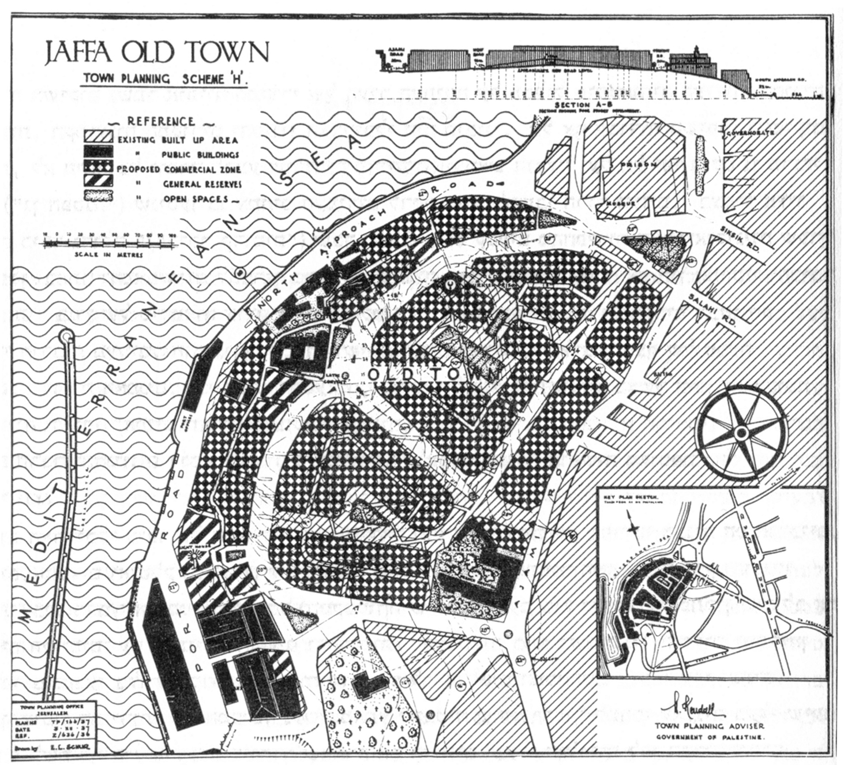
The Kandall-Schur retroactive architectural plan for the old city of Jaffa, 1937,.

Slide 24
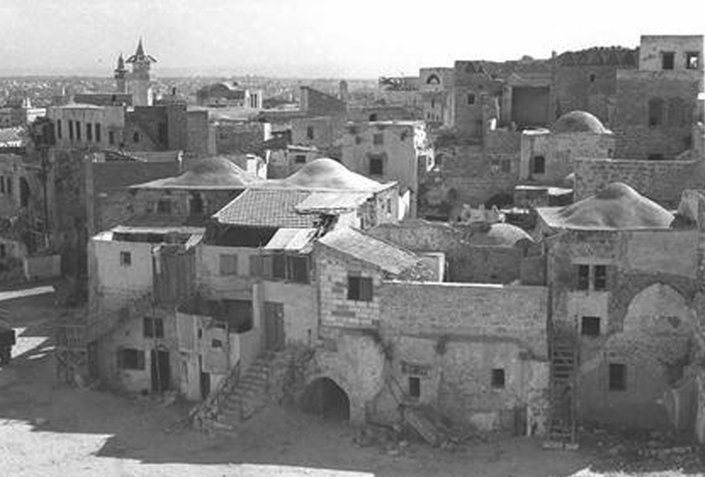
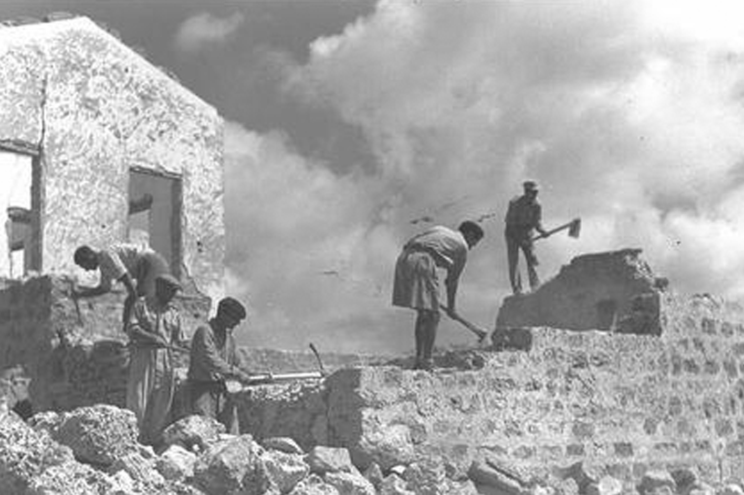
Demolishing the Jaffa “slums”, the old city of Jaffa becoming “The Big Area”, 1948.

Slide 25
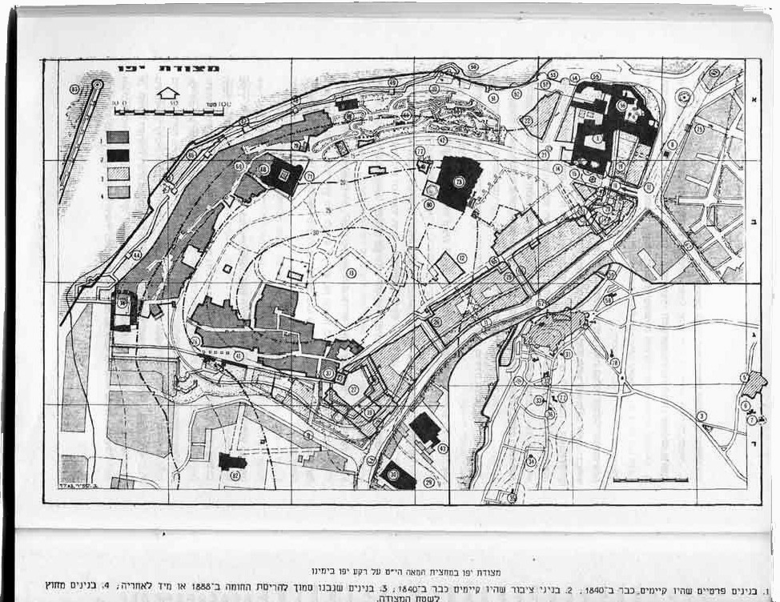
Old city of Jaffa project, Seadia Mandel Architect, 1960’s.

Slide 26
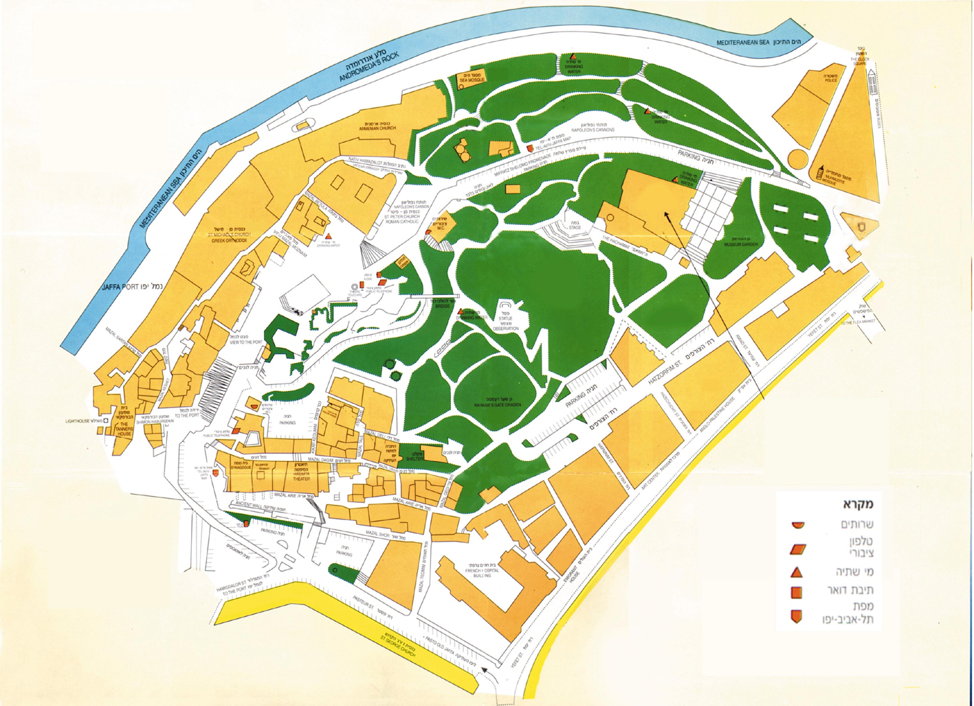
Plan of Old city of Jaffa, Seadia Mandel Architect, 1960’s.

Slide 27
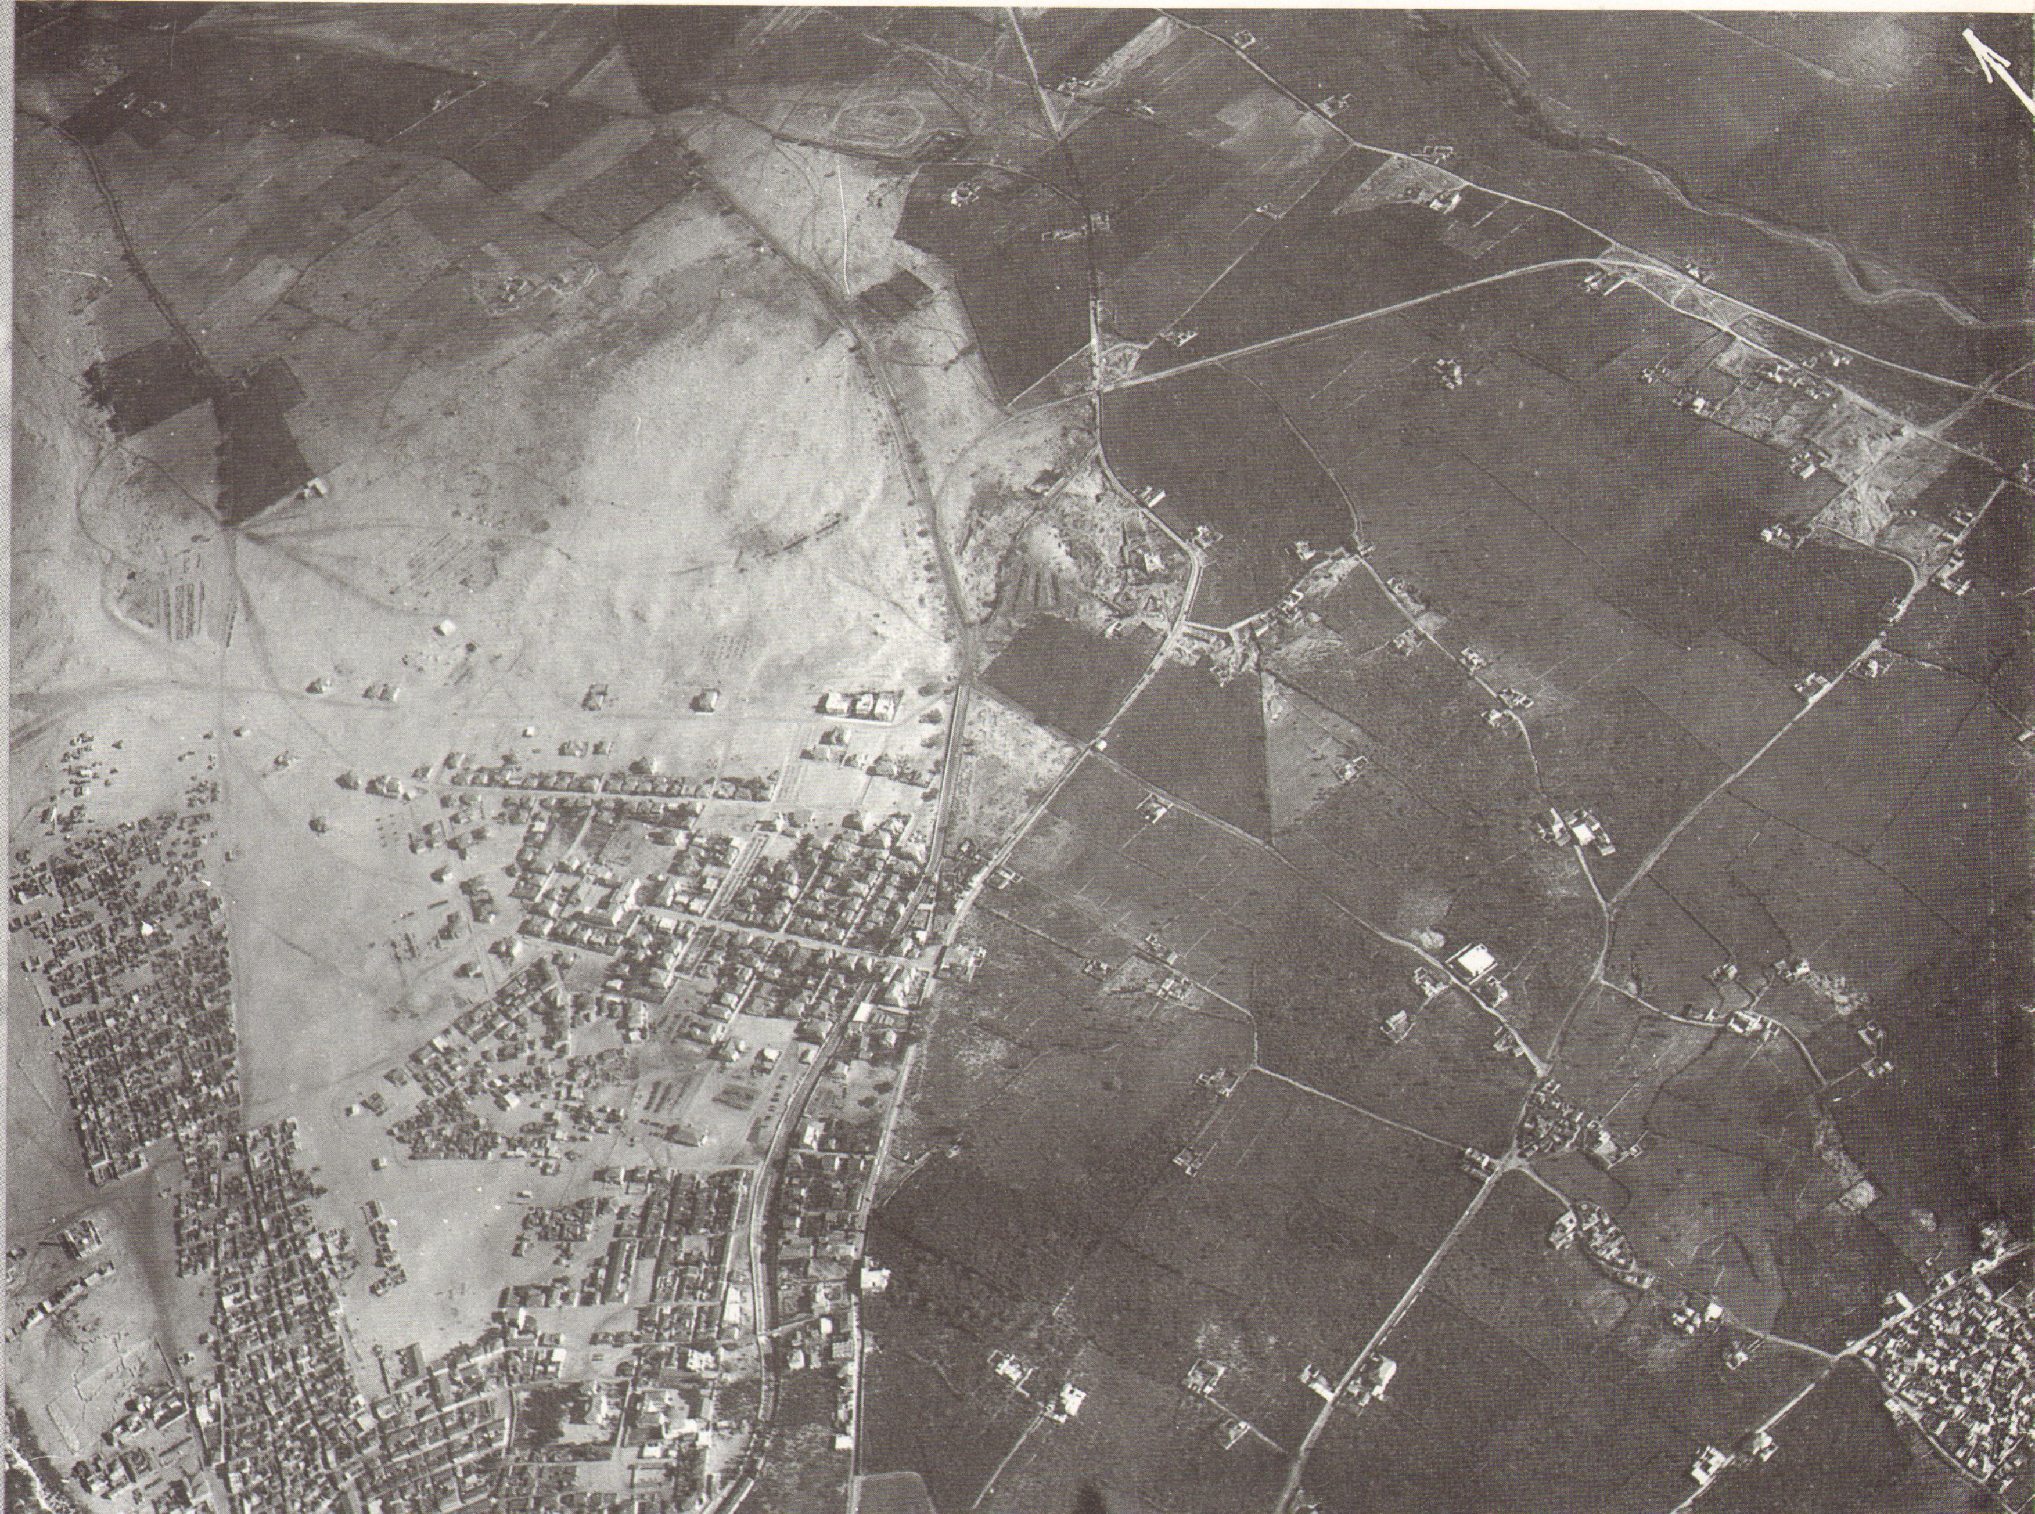
Manshieh neighborhood and Tel Aviv, 1917

Slide 28
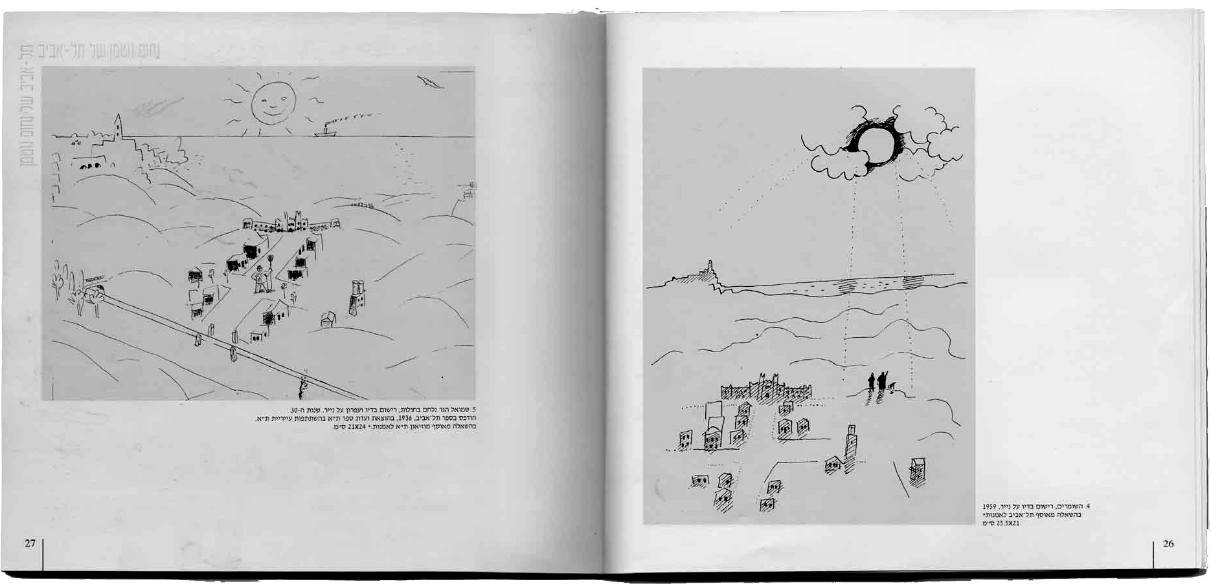
Nahoum Gutman’s drawings depicting “Little Tel Aviv” in 1917 (1937, 1959).

Slide 29
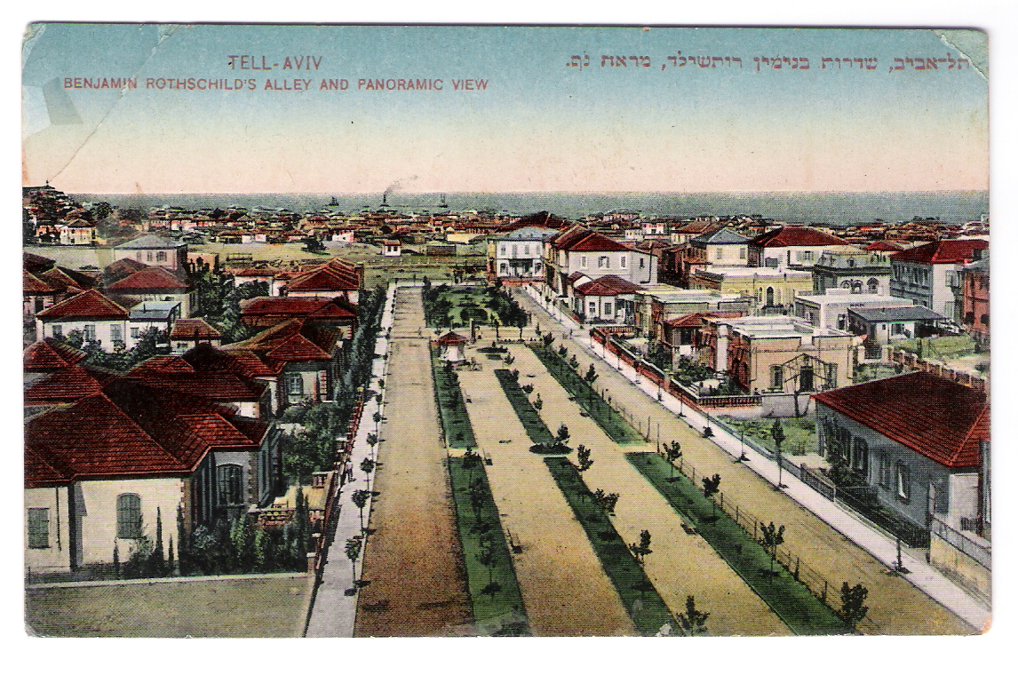
Panoramic view from Rothschils Boulevard, 1920s

Slide 30
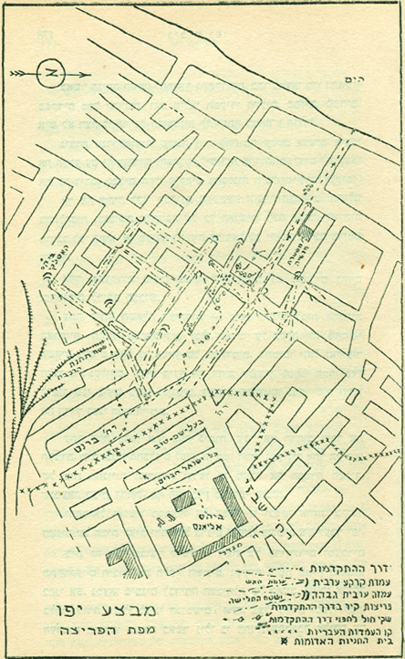
Manshieh neighborhood, Plan of the Irgun’s attack, Mai 1948.

Slide 31
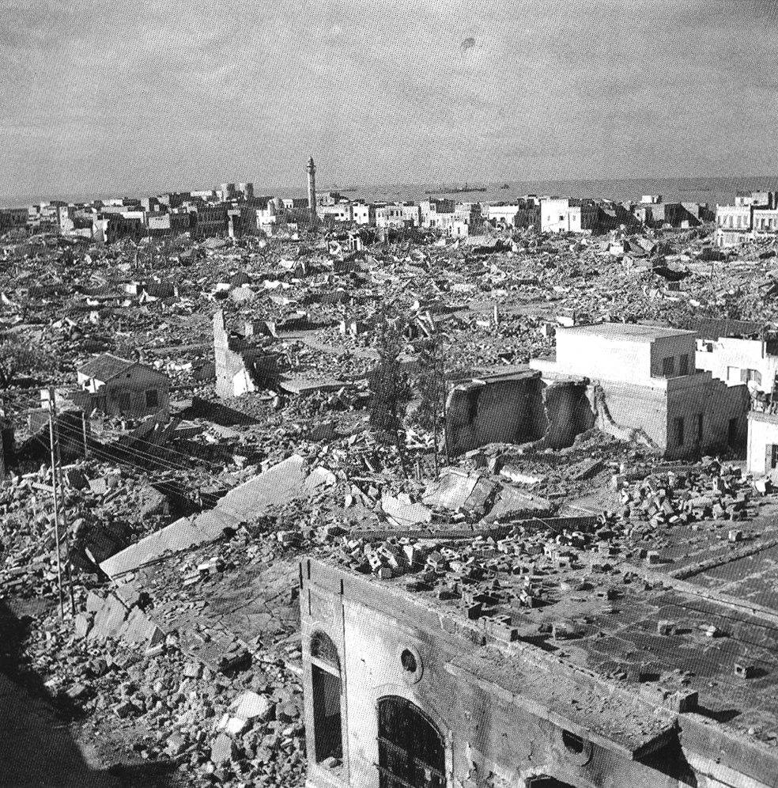
Manshieh neighborhood, Mai 1948.

Slide 32
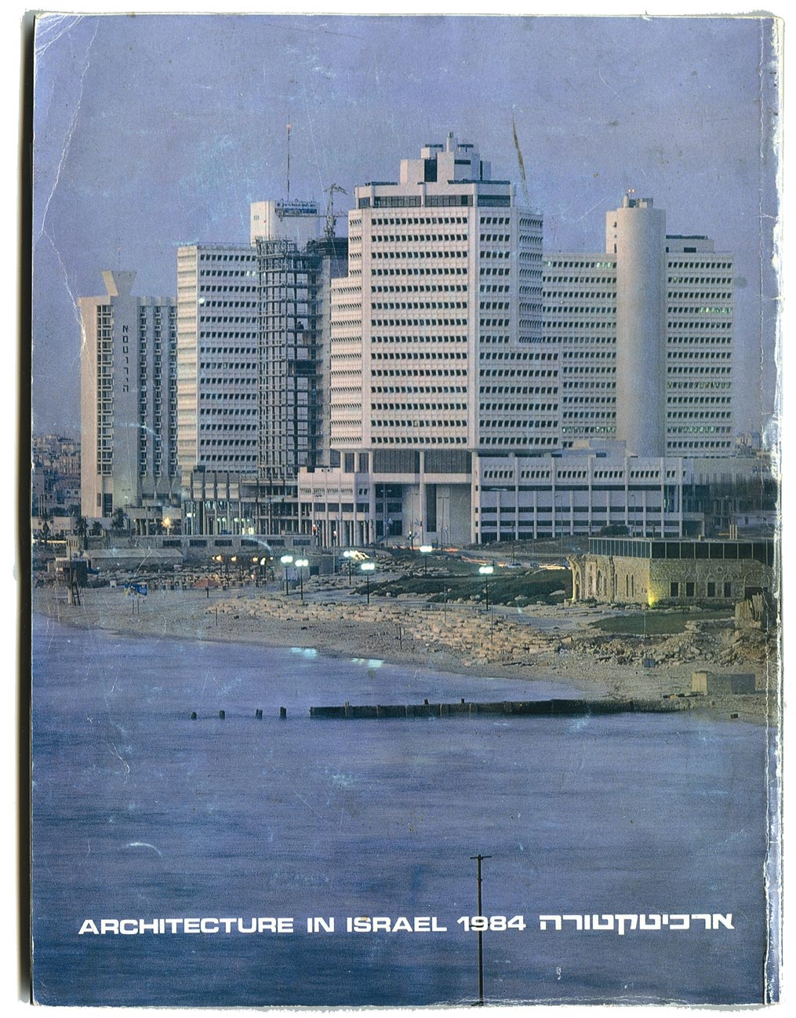
Manshieh business district, early 80’s. Amnon Niv, Amnon Schwartz, Dani Schwartz, architects, 1978. .

Slide 33
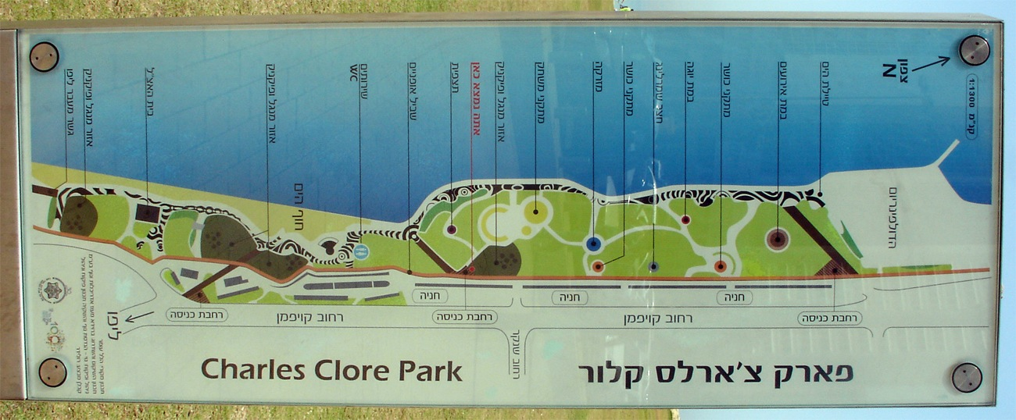
Map of Charles Clore Park (Hillel Omer landscape architect, 1978)

Slide 34
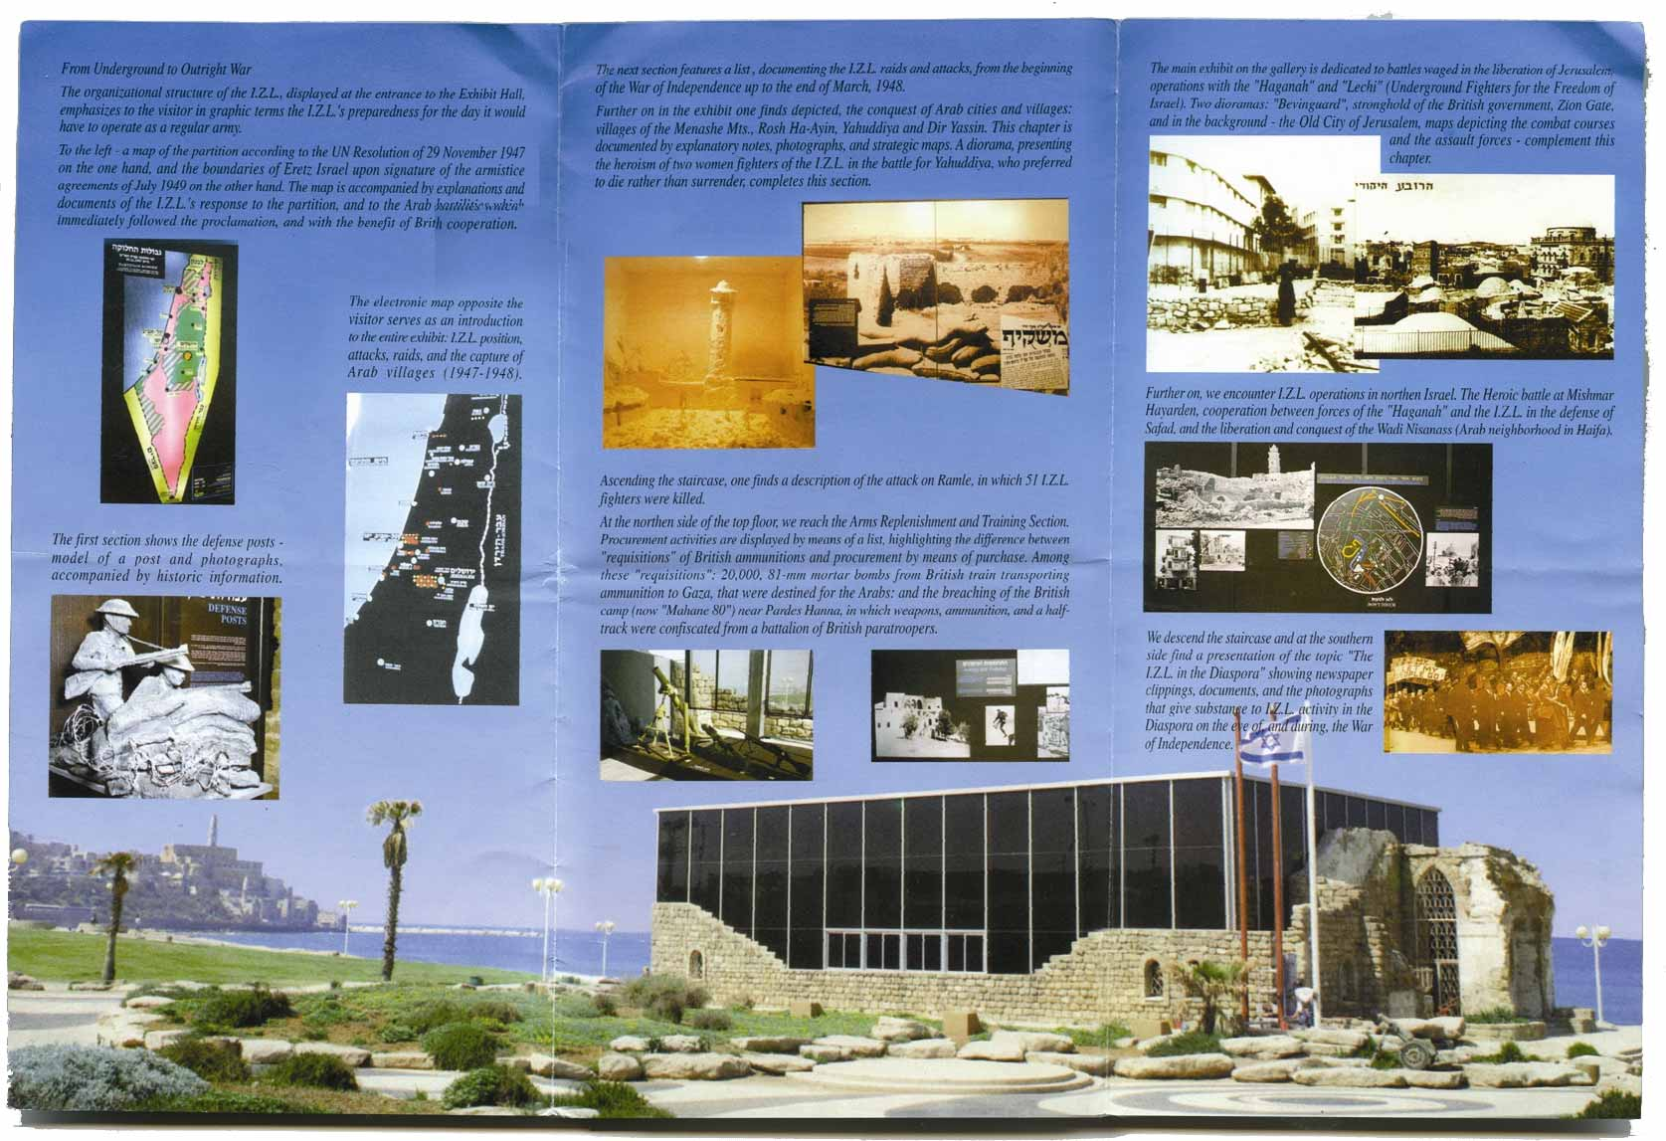
Prospectus of “Beit Gidi”, museum and memorial of the conquerors of Jaffa named after Amihai Faglin, placed in the last house of Manshieh. Amnon Niv, Amnon Schwartz, Dani Schwartz, architects, 1978.

Slide 35
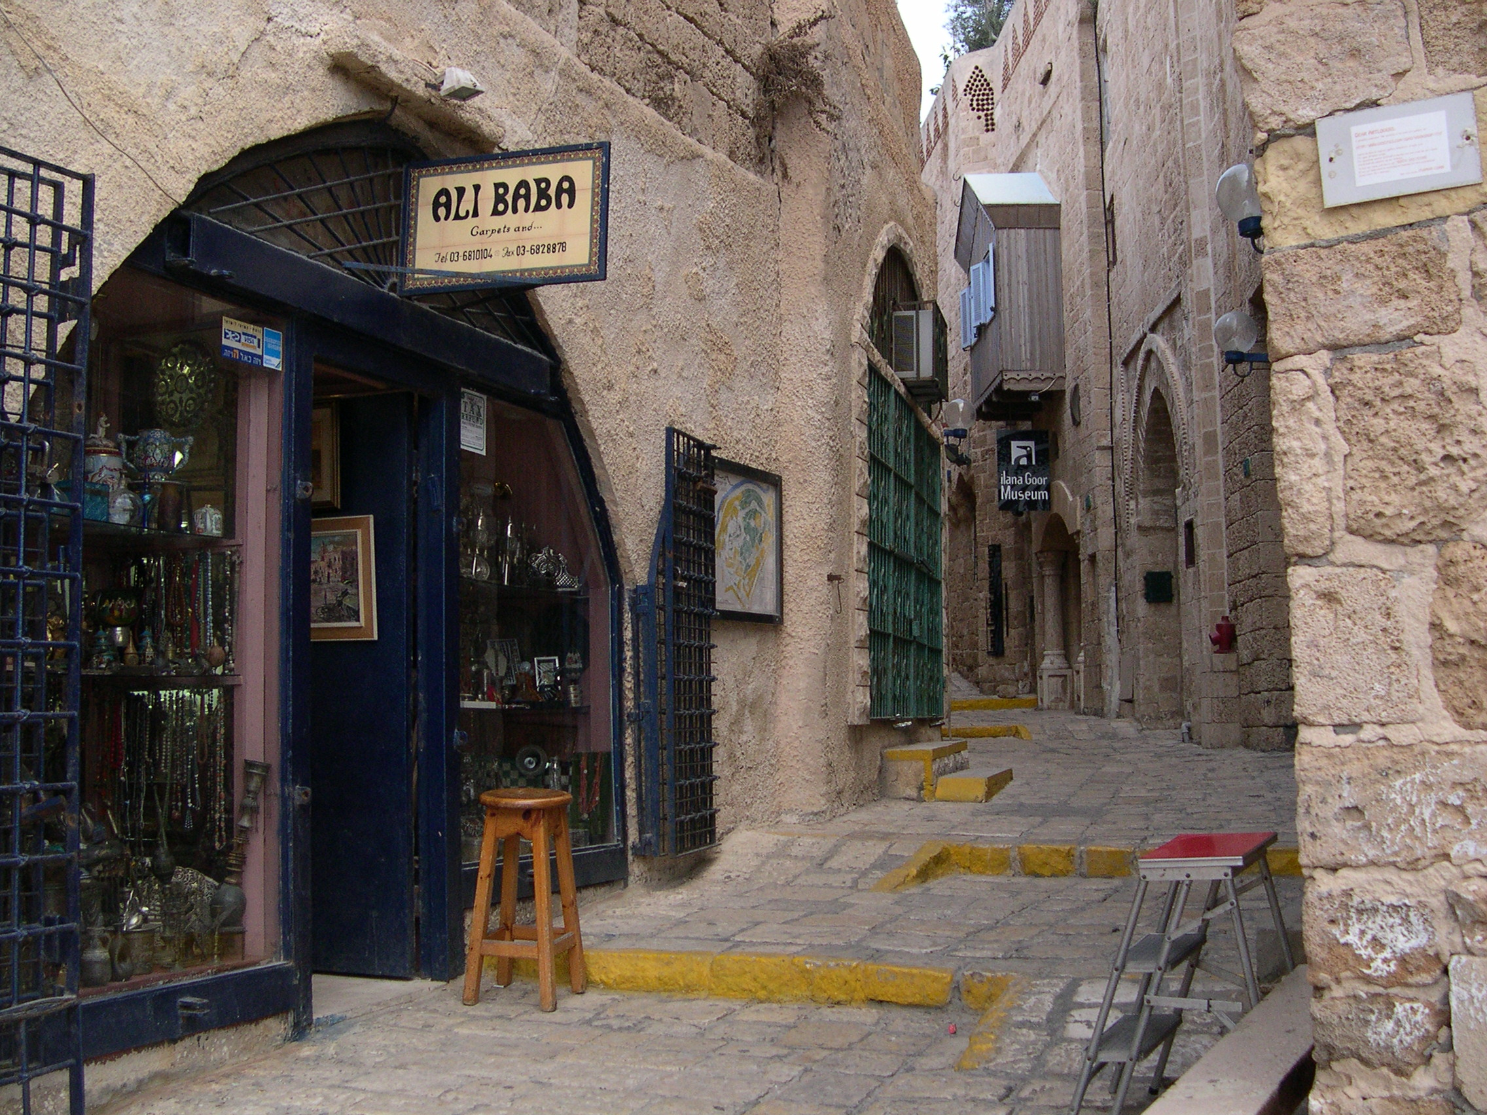
Old city of Jaffa, 21st century

Slide 36
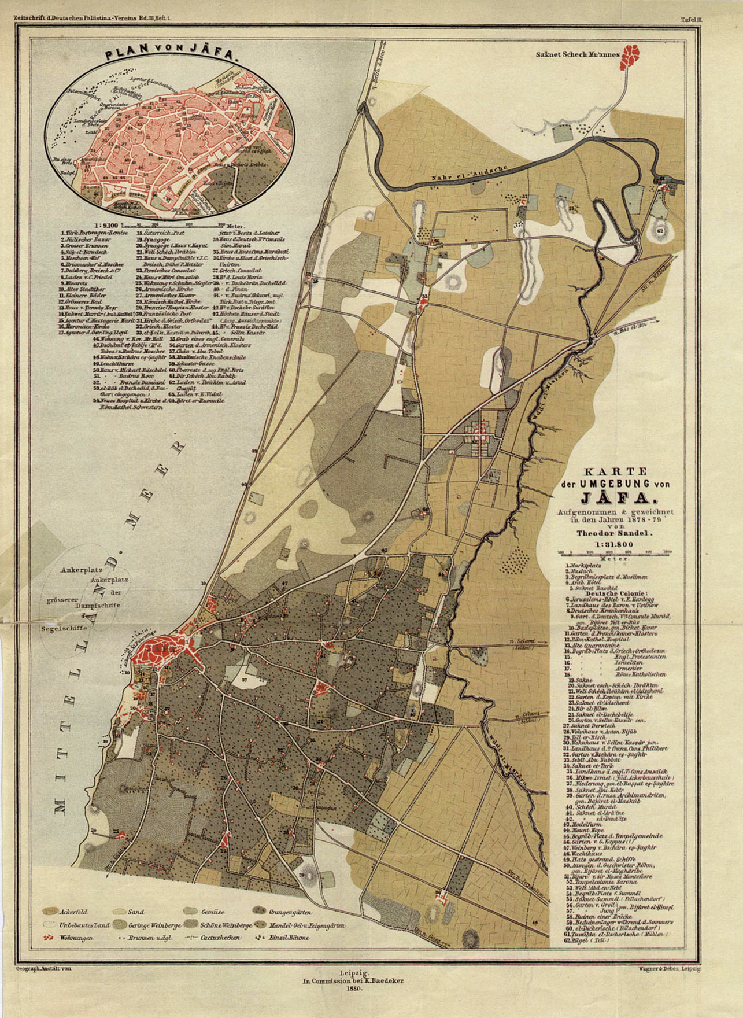
Jaffa’s region, Theodor Sandel Map, 1878

Slide 37
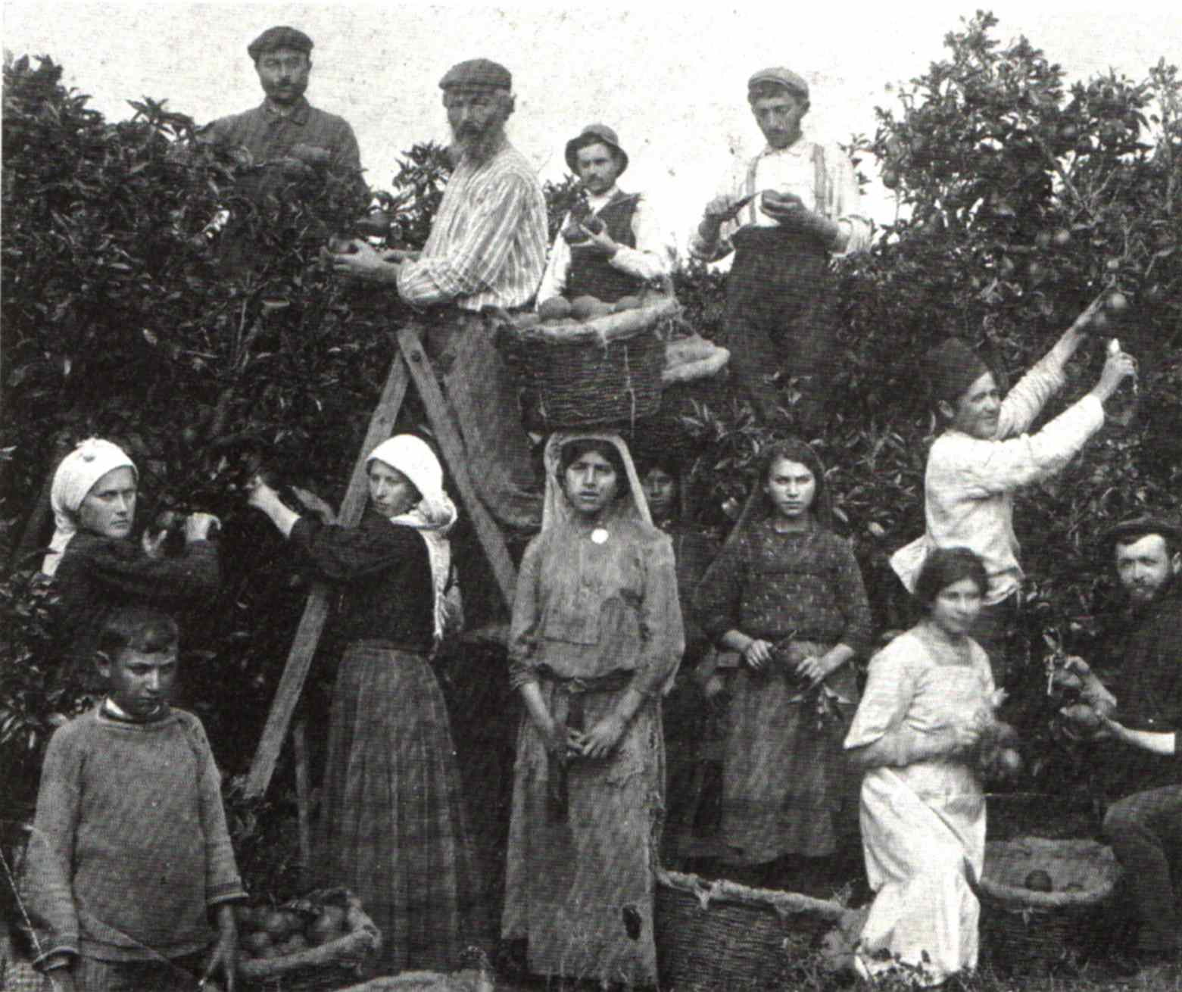
Orange picking in Jaffa, 1920s

Slide 38
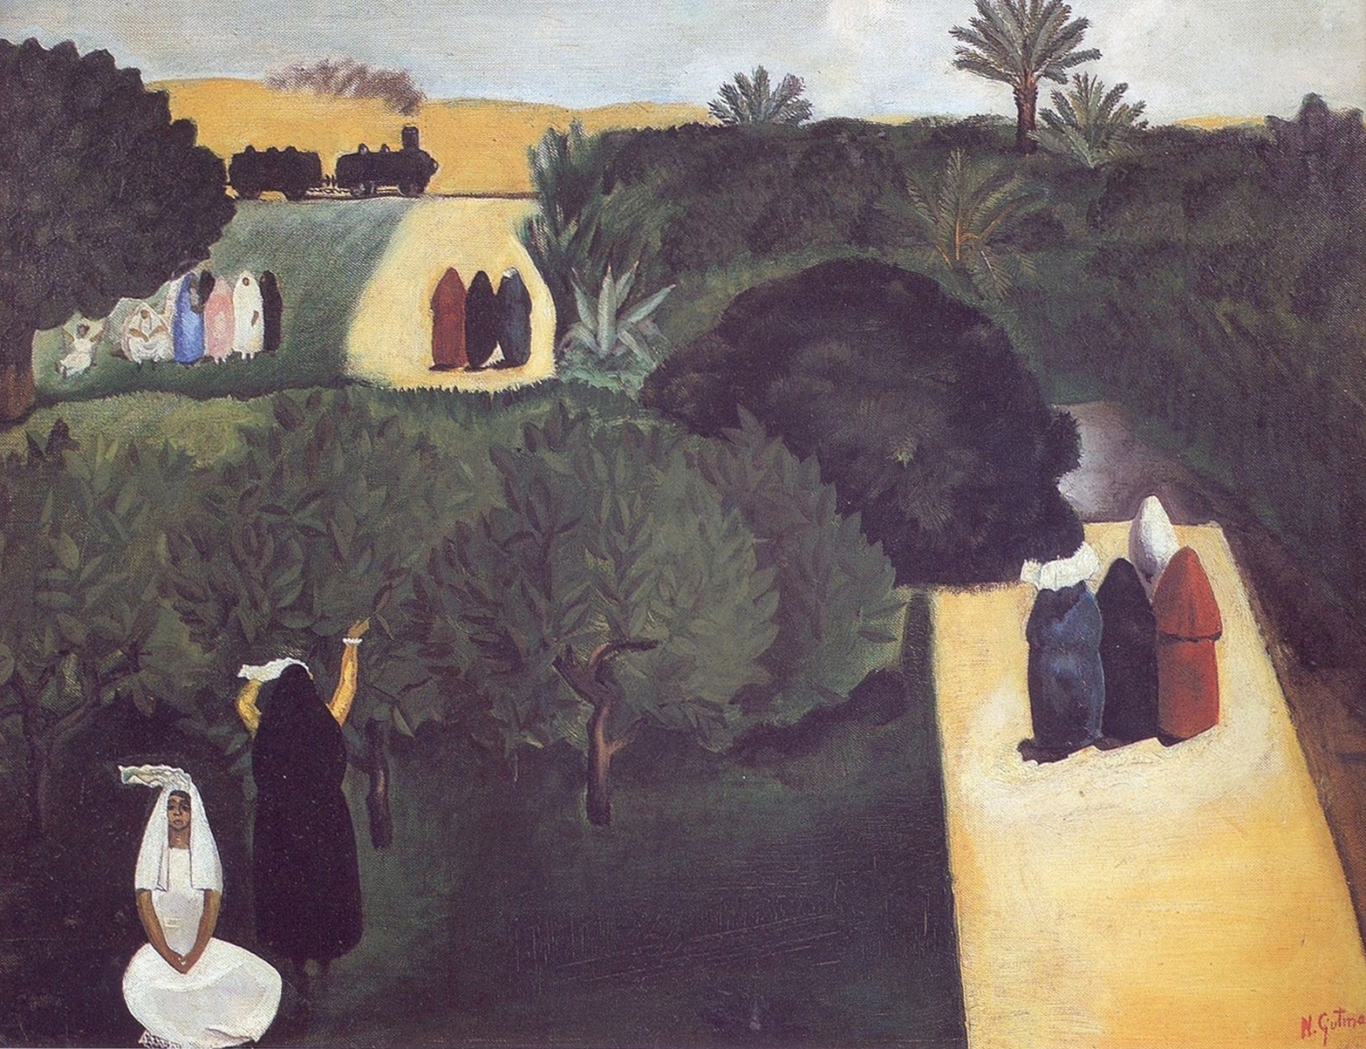
Nahum Gutman’s Jaffa orchards, 1926

Slide 39
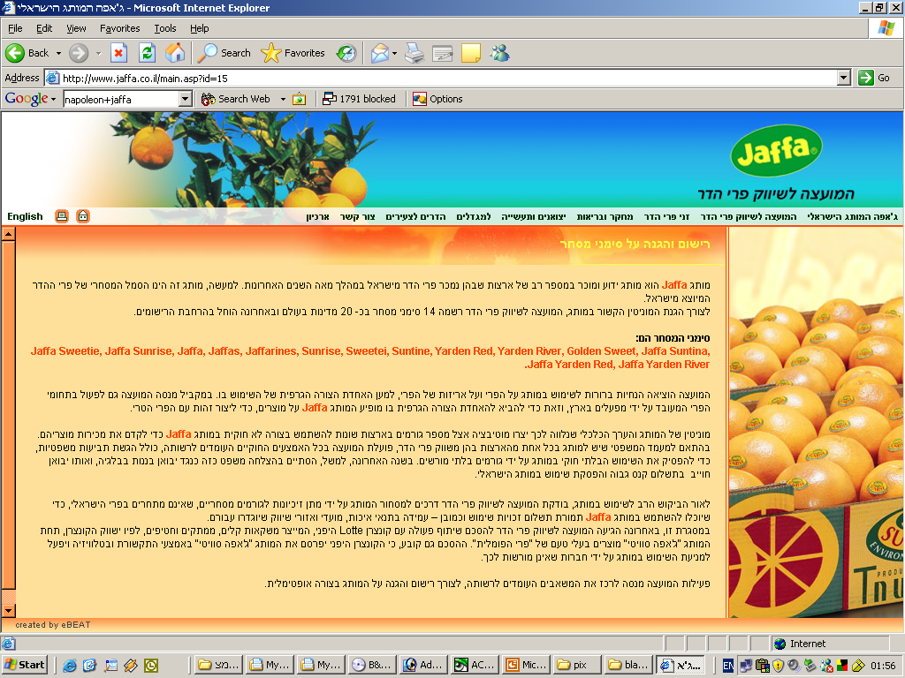
www.Jaffa.co.il - The branding and trademarking of Jaffa oranges by Israeli Citrus Council

Slide 40
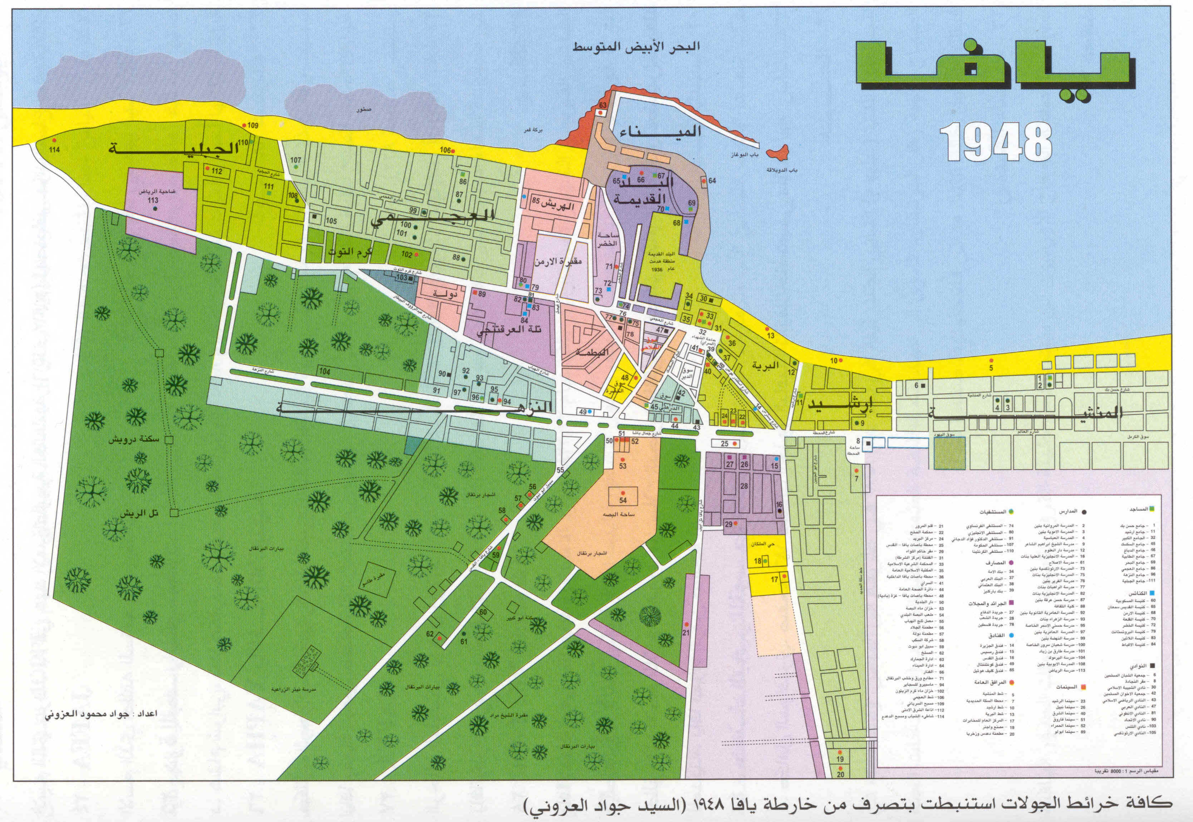
Contemporary reconstruction in Arabic of Jaffa 1948 city map.

Slide 41
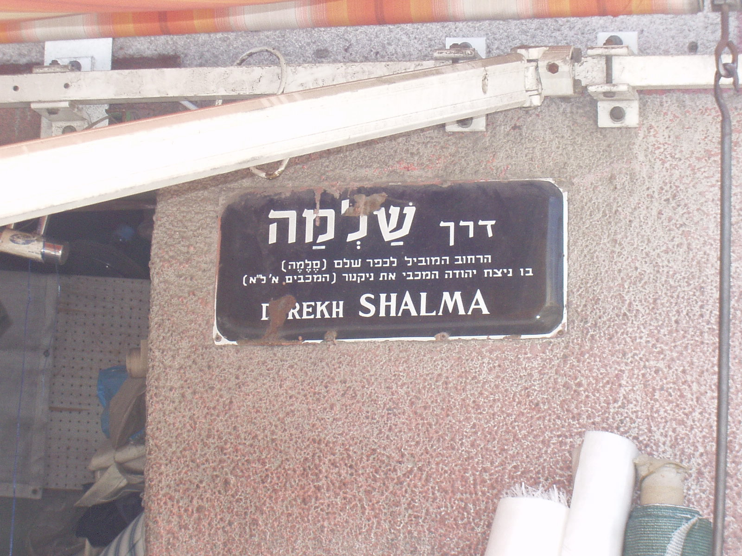
Salame road as “Shalma” road evoking the “historical village of SELEME in which Yehuda the Macabean won a battle against the army of Nikanor” (166BC).

Slide 42
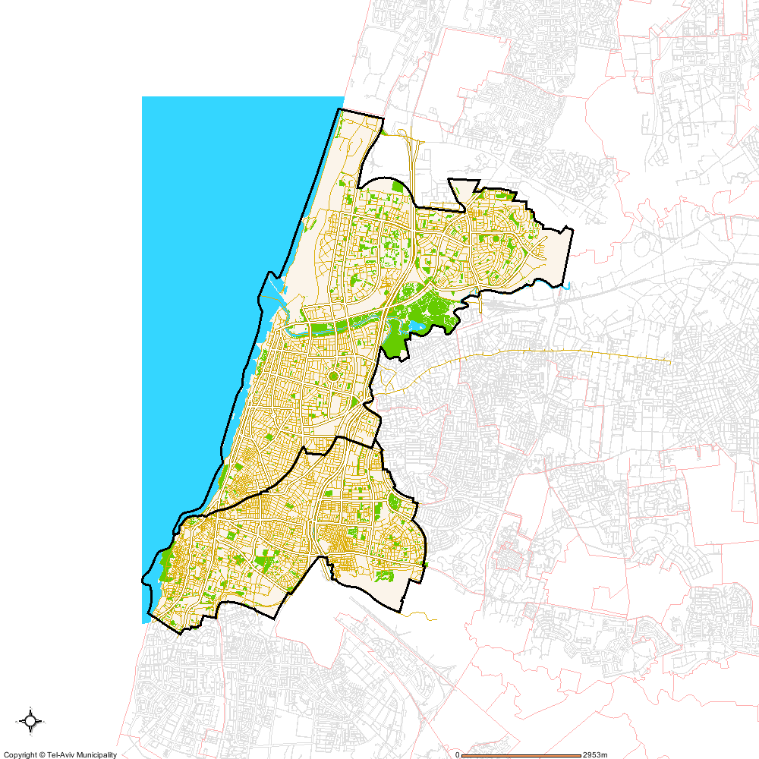
Tel Aviv – Yaffo Police districts: “Yarkon” (White City), “Yiftah” (Black City)

Slide 43
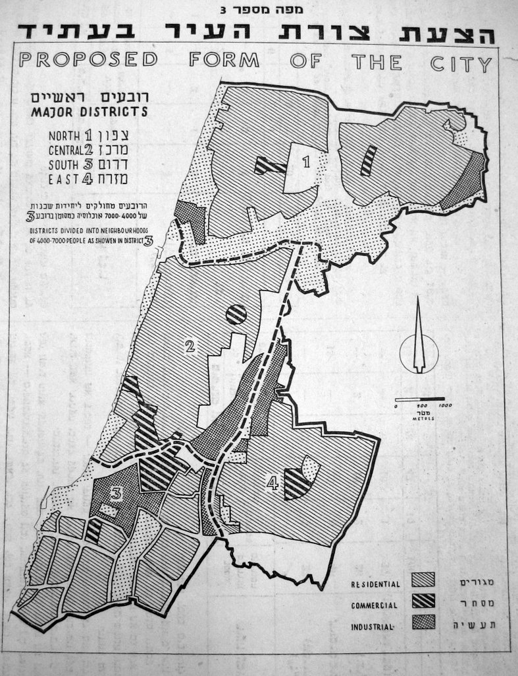
Hurwitz zoning proposal (1954)

Slide 44
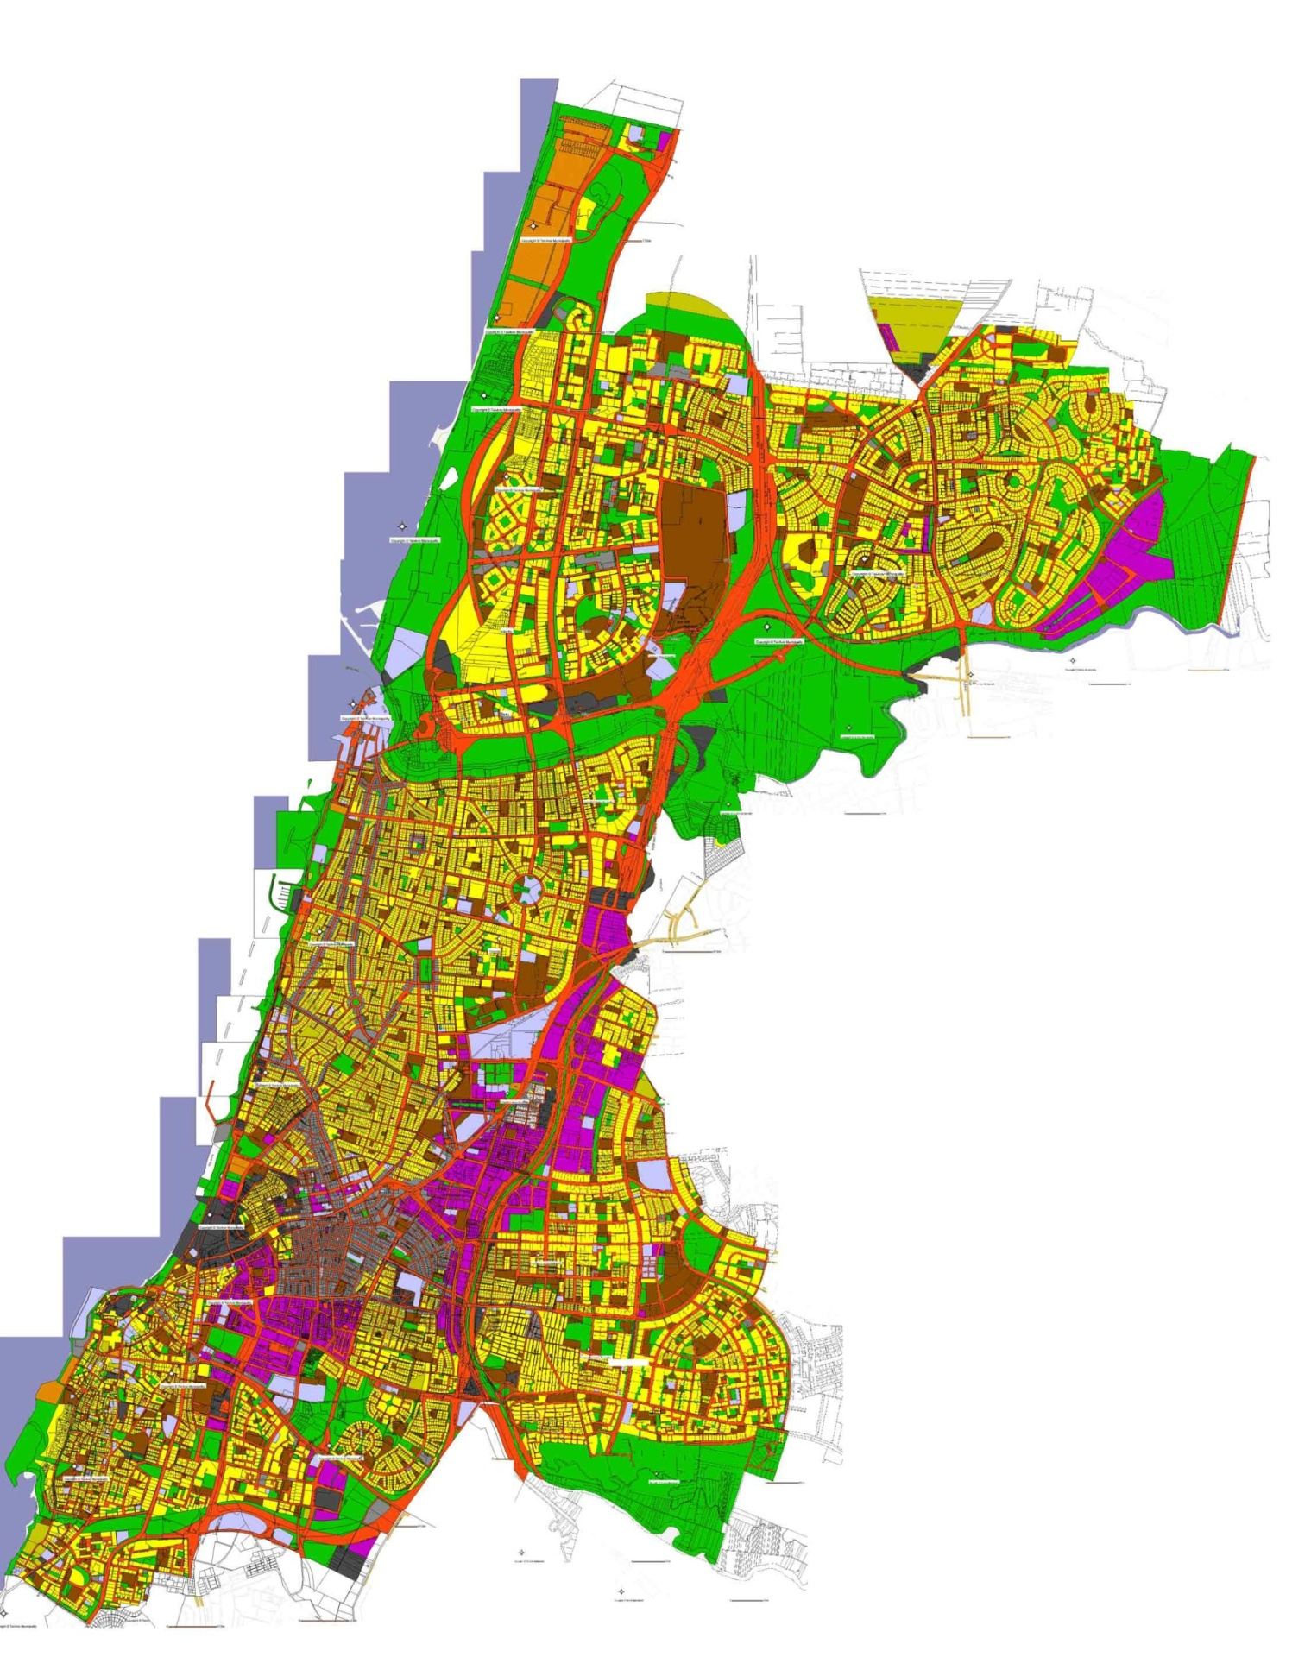
Tel Aviv - Uses

Slide 45
Tel Aviv – 1959 Official plan of Slums in Tel Aviv (right); 1973 Unofficial plan of the TLV Slums Dwellers organization (left), courtesy of Nati Marom

Slide 46
Tel Aviv – Yaffo, persons under care of Welfare departments, 2014

Slide 47
Polluted land in South Tel Aviv and Jaffa, 2010

Slide 48
Memorial for Jaffa (project), Manshieh.

