Slide 1
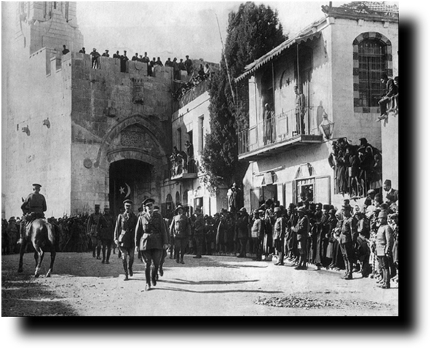
From Empire to Empire
Eshkolot Festival
December 2018
Dr. Abigail Jacobson
The Hebrew University of Jerusalem

Slide 2
Today’s sessions:
Introduction: Late Ottoman Palestine, Late Ottoman Jerusalem:
A mixed city in transition and change
WWI in Jerusalem through the eyes of a Muslim soldier: working with an autobiographical source
Transition between Empires

Slide 3
Ottoman Empire: 1807-1924
Notes:
Introducing the map and geographical context of late Ottoman Palestine. Areas lost. The ottoman context is of course very important here, and I will address several issues related to it. The Ottoman period of course has a very rich legacy until today in the region.

Slide 4
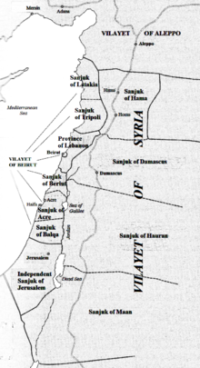
Palestine in the late Ottoman period
Notes:
Provinces and administrative distribution- much of the area we discuss was part of the Vilayet (province) of Beirut. No “Palestine” province, but definitely a sense of a local identity.

Slide 5
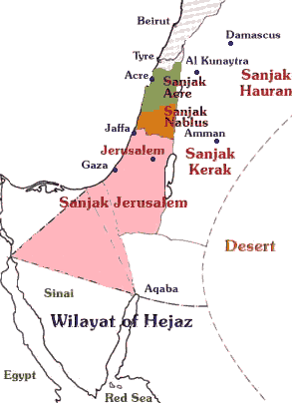
Ottoman Palestine after 1874
Notes:
More closer look.

Slide 6
Demography
Overall population of Palestine in pre- World War I:
689,000-800,000 people.
According to Ottoman data (1913-1914):
602,000 Muslims, 81,000 Christians, 39,000 Jews
(712,000 total).
The Jewish community was divided into three groups:
Sephardim (Spain, Portugal, the Balkans, the Ottoman
lands); Maghrebim/Oriental Jews (north Africa, Middle
East); Ashkenazim (East and Central Europe, “Old” and
“New” Yishuv)
Notes:
Like the rest of the Ottoman Empire, Palestine too was composed of a multi-ethnic and multi-national population, which included Jews, Muslims and Christians.
Different censuses: Ottoman, Zionist, church records
Ottoman subjects-households/foreign subjects.

Slide 8
Jerusalem: a Mixed city in a Process of Transition and Change
Jerusalem, and Palestine, were (and should be treated) as mixed locales, which combined in them multiple groups which were affiliated on ethnic, national, religious and geographical basis.

Slide 9
Jerusalem: a Mixed city in a Process of Transition and Change
The Relational History approach: histories of Jews and Arabs in modern Palestine can only be grasped by studying the ways these communities interacted within a complex web of economic, political, social and cultural interactions and relations. It examines the ways by which inter-communal, and, just as important, intra-communal identities and boundaries were constructed and shaped in the context of the joint geographical locale and the common political framework in which Jews and Arabs lived.

Slide 10
Jerusalem: a mixed city in a process of transition and change
Jerusalem: a Mixed city in a Process of Transition and Change
Inter-communal, as well as Intra-communal analysis of the city and its residents at a time of crisis and transition. Breaking the “Jewish/Arab” dichotomy.
During this time of transition between regimes and empires communal and national identities, such as 'Ottomanism,' 'Zionism' and 'Arabism' were negotiated, and historical alliances between different communities, such as the one between Jews and Muslims, were in a constant process of change.

Slide 11
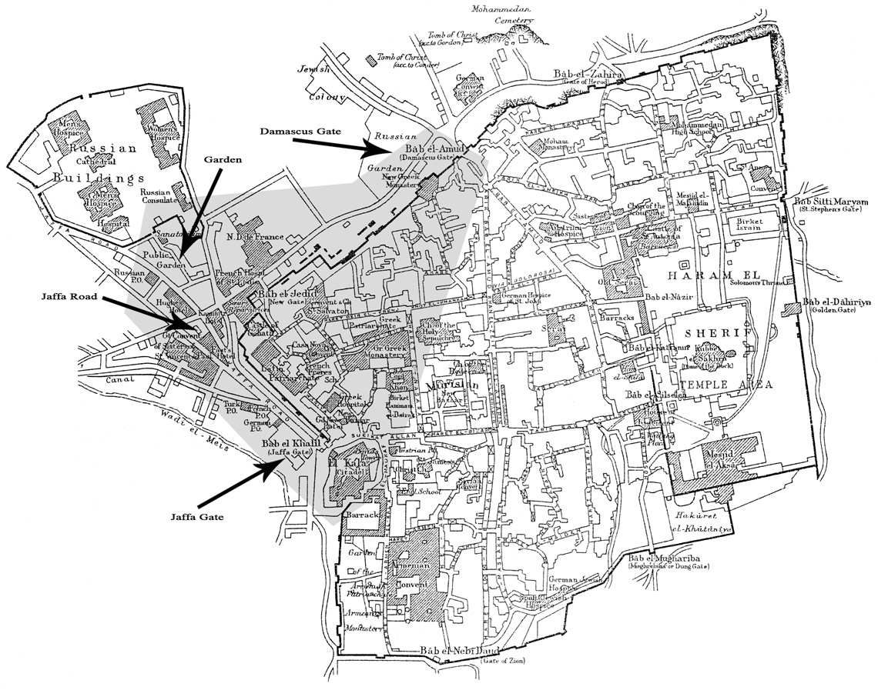

Slide 12
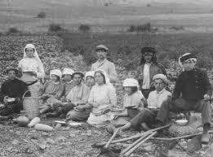
Jewish Immigration to Palestine 1882-1914
1882-1904:
First wave of Jewish immigration;
around 25,000 immigrants.
Most Immigrants settled in the new
Jewish Colonies (Moshavot);
many adopted Ottoman citizenship.
Notes:
Zionist activity in Palestine cannot be discussed without considering the overall context of the 19th century Europe- Push factors, antisemitism, pogroms, what led to the Zionist activity and immigration to Palestine.
1897- first Zionist congress held in Basel.
5 waves of Jewish immigration, the first two took place during the ottoman period, the following 3 during the british mandatory rule.
Issue of Ottoman citizenship is importat- will get back to it in a second.

Slide 13
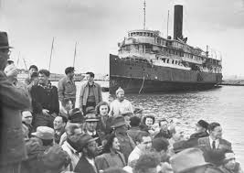
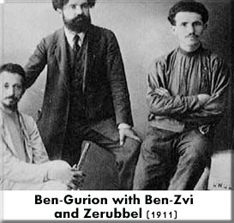
Jewish Immigration to Palestine 1882-1914
1904-1914:
Second wave of Jewish
immigration; around 40,000
immigrants. Most immigrants
came from Eastern Europe, and
kept their foreign citizenship,
mainly Russian and
German.
Notes:
Many of the leaders of labor/political zionism immigrated during this wave of immigration, including Ben Gurion and Ben Zvi.

Slide 14
Local/Ottoman Jews versus “Foreign” Second ‘Aliya Jews:
How did the perspective toward the Arabs and toward future life
in Palestine of local, Ottoman Jews differ from that of “foreign”,
second ‘Aliya Jews?
How did one’s citizenship and affiliation to the Ottoman Empire
affect the views on the evolving national conflict?

Slide 15
Ottoman subjects, Foreign subjects
Foreign subjects had a special status and enjoyed the
conditions of the capitulations, treaties that allowed
Europeans to reside and trade in the Ottoman lands
under the protection of foreign governments.
Ottoman subjects were indigenous inhabitants who
held Ottoman citizenship (or those who adopted
Ottoman citizenship), and were under the subject to the
empire’s judicial and administrative system. They could
participate in its political, judicial and administrative
systems.
Notes:
Explain the meaning of Ottoman and foreign subjects, tensions.

Slide 16
“Inclusive” Zionism
More attuned to the local conditions in Palestine and to the political discontent among the Arabs towards the Zionist movement.
Centrality of Ottomanism and loyalty to the Ottoman Empire.
Belief that the Muslims can be possible partners for future life in the country.

Slide 17
“Exclusive” Zionism
Priority is given to the national struggle.
Arabs are excluded from the discussion on future life in the country until Jewish national interests in the country are promoted.

Slide 18
Jerusalem: a Mixed city in a Process of Transition and Change
Jerusalem during WWI:
Front Line vs. Home Front
Studying the “Home Front”
Socio-Economic crisis in a mixed city

Slide 19
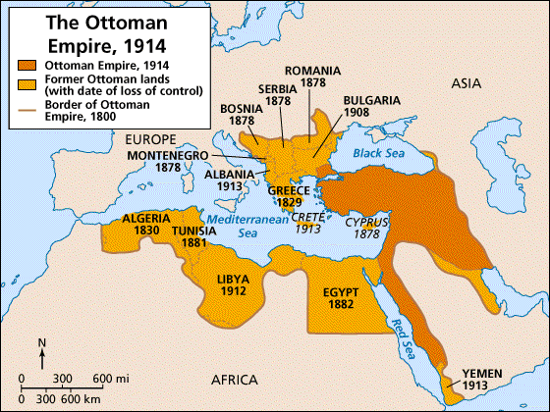
The Ottoman Empire in 1914 (and areas lost)
Notes:
Eve of the war- explain areas lost due to national movements and self determination

Slide 20
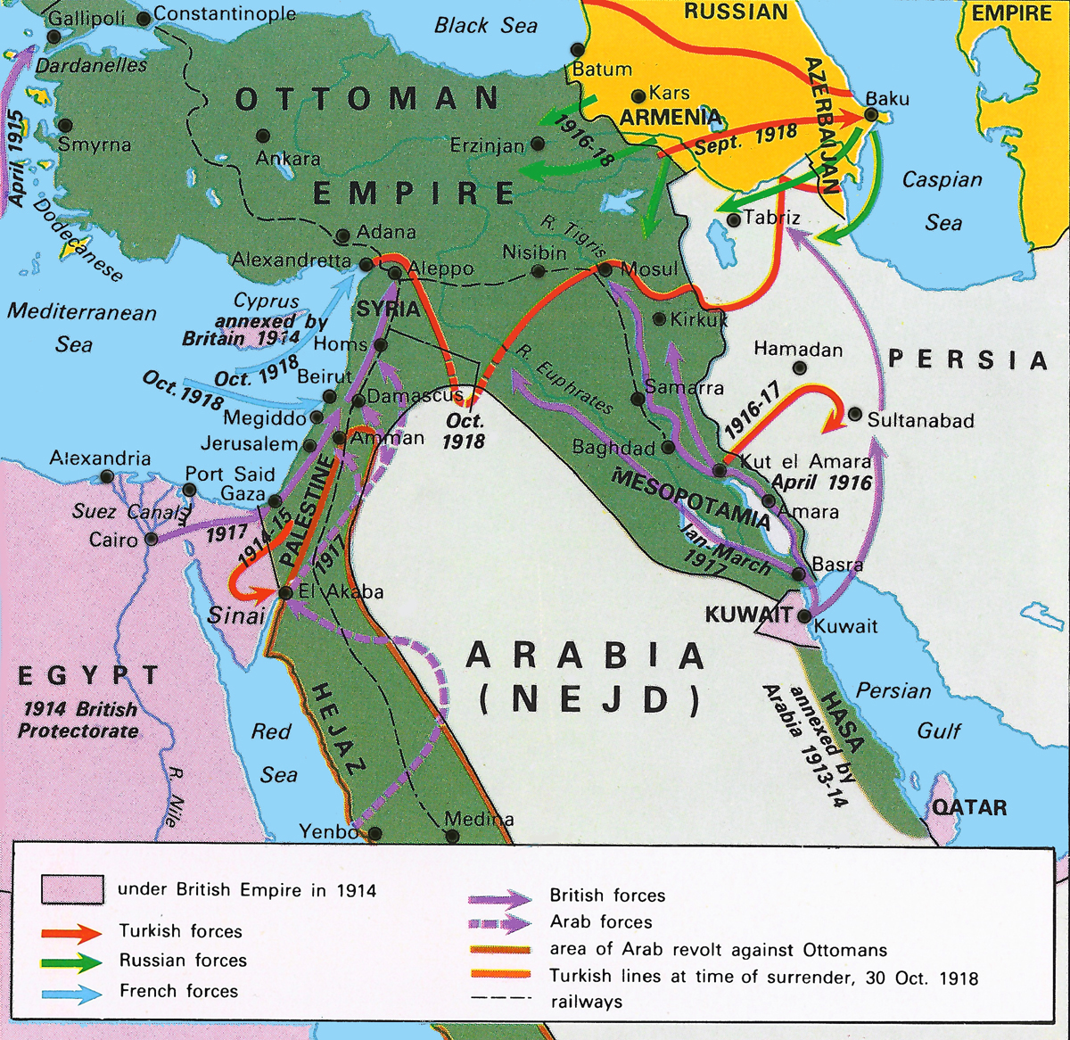
Main fronts during WWI (OE)
Notes:
WWI- The OE joins the war in Nov. 1914, on the side of Germany and Austro-Hungary, against France, Britain and Russia. Was almost “dragged” to the war and entered it after the trauma of the Balkan wars, grave economic situation, not ready militarily.
Nov.1914: the sultan proclaims a jihad,holy war.
Main fronts.
Arab lands and Ottoman Palestine: not a front line for most f the war, a base for ottoman and german forces.
Some historiography on WWI (ME vs. Europe), socia history. Home front vs. front lines…
For our purposes I will focus just on the diplomatic aspects of the war- what happened behnd the scenes.

