Slide 1
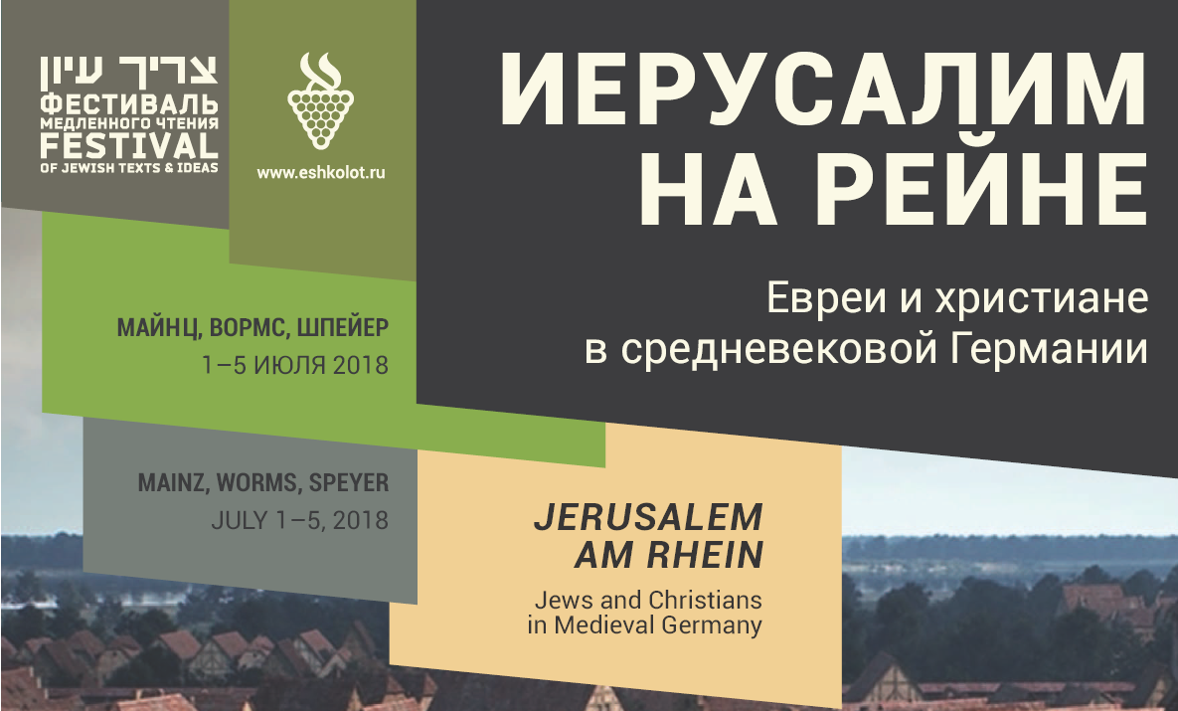
אאא
Song of the One II
Synagogue Poetry in Early Ashkenaz
Dr. Peter Sh. Lehnardt
Ben-Gurion University of the Negev, Beer Sheva
Notes:
Speyer, Sun 1.7.2018 – jued. Gemeindezentrum Speyer

Slide 2
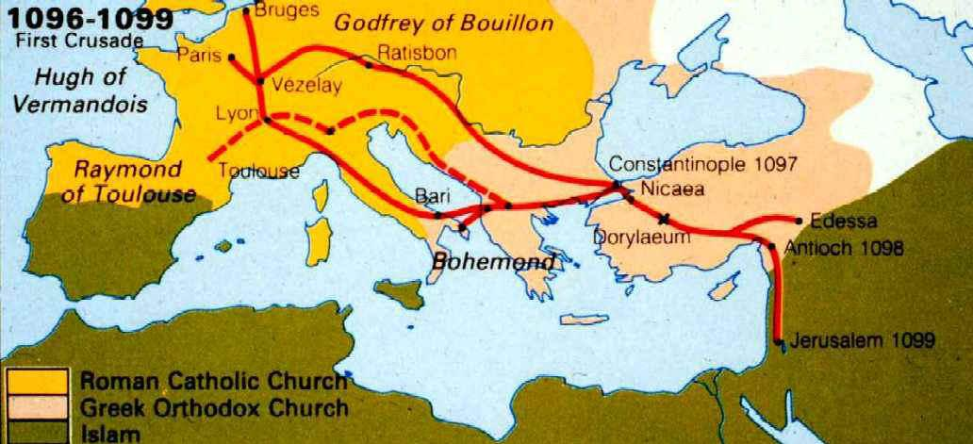
Song of the One - 2 -
8000-9000 Jews in Germanic lands – 2500-3000 ‘lost’
Mayence – Worms – Speyer
The main centers of Germanic Jewry wiped out
Jewish live ‘traumatized’ – martyrology

Slide 3
Song of the One - 3 -
The Events of Summer 1096 in the Germanic countries
27.11.95 Pope Urbanus – crusade sermon in Clermont
April local riots in France – extortion of money from French
Jewish communities
3. May attack on the Jewish community of Speyer – 11/12 dead
18. 1st attack on the Jewish Com. of Worms
23. attack on the JC of Regensburg – forced conversion
25. 2nd attack on the Jewish Com. of Worms – 800 dead
27.- 29. attack on the JC of Mayence – 3 days later 1100 dead
31. attack on the JC of Cologne – looting and dispersion
attack on the JC of Metz – 22 dead – ‘exterminatio’
June ‘custody’ on the JC of Trier – forced conversion – 300 p.
24.- end of the JC of Cologne – 300 dead and forced conv.
July Prague – 500 Jewish fighters – 6 killed in battle
85-90 percent of these French-German crusaders got lost on their way through Hungary ….

Slide 4
Song of the One - 4 -
The first literary responses to the Events of Summer 1096
List of victims / ‘prayer fraternity’ letters / Memorbukh
Remembering the dead by name
Liturgical Poetry – Seliha – Qina – Zulath
Theological reflection on what has happened
Remembering the atoning martyrdom in the community
The “Chronicles” - --- Gezeroth
Recalling events and deeds, Values Clarification, evaluation

Slide 5

Song of the One - 5 -
[1] Memorbukh (Book of Names) of Nuernberg (to 1096)
[Index according Month, Place and date of the persecution in the years 1096–1298]
5 | Iyyar the killed ones of Spira 1096 8th of Iyyar on a Shabbat. Iyyar the killed ones of Wormsa 23rd of Iyyar on a 1st day the first (persecution). Siwan the killed ones of Wormsa 1st of Siwan on a 1st day the second (persecution). Siwan the killed ones of Qoloniya the day after Atsereth 1096 they are remembered on the Shabbat before Shavuoth. Siwan the killed ones of Magentsa 3rd of Siwan and they are remembered [on the Shabbath be]fore Atsereth. Adar the killed ones of Wirtsborq 1247 22nd of Adar. Siwan the killed ones Erfurt [13]61 25th of Siwan. […]

Slide 6
Song of the One - 6 -
5 10 15 | [Spira] The killed ones of Spira 8th of Iyyar on a Shabbath. [Wormeysa] The killed ones of Wo[r]meysa 1st day (of the week) 23rd of Iyyar. And they are remembered on the Shabbat before Shavuoth. Rabbeynu R. Shelomo and his spouse. And Shimshon, and his som and his daughters. Madam Rivqa the widow of R. Shemuʾel and her daughters. R. Lewi bar Shemuʾel. R. Shemuʾel HaKohen. And Shimshon his brother. R. Natronai and his wife and his sons. R. Eliya and his wife and his son. R. Dawid and his wife and his sons. Madam Mikhal and Yehuda and Shemuʾel her sons. The son of Mr. Yosef. Madam Esther and her daughters. Madam Rivqa the daughter of R. Shemuʾel HaLewi. Mr. Yehuda HaLewi and Moshe his son. R. Yaʿaqov the Elder Madam Tsippora and her daughter. Madam Ogiya and her daughters. R. Ḥakim HaKohen and his sons. R, Shemuʾel and Mordekhay his brother. Mr. Yaʿaqov bar Mordekhay. Madam Raḥel and her daughter. Yosef bar Shemuʾel. R. Yitsḥaq and his wife and his sons. R. Shemuʾel HaKohen and his wife and her two sons. Sara the daughter of Mr. Shemuʾel. R. Elʿazar the elder and his wife. Mordekhay his son who was drowned. […] Mr. Shemarya who was buried alive and his wife and his sons and his daughters who were slaughtered. The second persecution on the first day of the week on the New Moon of Siwan. And they too are remembered on the Shabbat before Shavuoth. R. Shimeʿon. R. Yitshaq bar Yoʾel HaLewi the writer. Mr. Yehuda. Mr. Shalom. R. Aleqsandri bar Moshe. Mr. Qalonimus bar Mordekhay […] Tsippora and Madam Ḥanna. Madam Guthilda the drowned. Shemuʾel and Avraham the sons of R. Ursargo.

Slide 7
Song of the One - 7 -
20 25 | [Qoloniya] The killed ones of Qoloniya who were killed in part on the day after Atseret. And they too are remembered on the Shabbat before Shavuoth. Mr. Yitsḥaq bar Elyaqim. Madam Rivqa. Madam Madrona. Mar Shemuʾel bar Asher and his two sons. Mar Yitsḥaq the drowned. Mar Gedalya and his spouse and there sons. The daughter of Mr. Yehuda bar Peter. Madam Gute. R. Shemuʾel bar Yeḥiel. R. Shemuʾel bar Gedalya the son in law. […] Avigail the daughter of Mr. Shelomo the young girl and two maidens throw themselves into the waters and drowned. R. Shemuʾe HaKohen the manager of the synagogue. R. Meʾir. R. Shelomo bar Yitsḥaq and his spouse.
30 | [Magentsa] The killed ones of Magentsa at the 3rd of Siwan. And they too are remembered on the Shabbat before Shavuoth. R. Yehuda ben Ravna R. Yitsḥaq and Madam Yehudith his wife and his son Yitsḥaq. And R. Seʿadya. And Madam Yehudith. And Madam Raḥel and he son R. Moshe HaLewi and his wife Madam Segula and their children. Mr. Yequthiʾel and his wife Madam Bellet. And R. Yaqar. And Mr. Eleʿazar and his house. And Mr. Mordekhay the manager of the synagogue and his wife. […] R. Shimshon HaKohen. R. Meʾir HaKohen. R. Efrayim HaKohen. R. Senior HaKohen.

Slide 8
Song of the One - 8 -
The first literary responses to the Events of Summer 1096
List of victims / ‘prayer fraternity’ letters / Memorbukh
Remembering the dead by name
Liturgical Poetry – Seliha – Qina – Zulath
Theological reflection on what has happened
Remembering the atoning martyrdom in the community
The “Chronicles” - --- Gezeroth
Recalling events and deeds, Values Clarification, evaluation

Slide 9

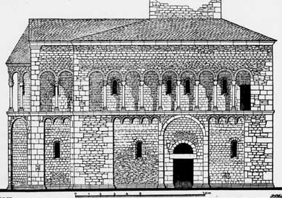
Song of the One - 9 -
The Anonymos of Mainz – chronicle of the events of 1096 (III)
On the twenty-fifth of Iyyar,
the errant ones and the
burghers said: “Let us also
take vengeance against those
who have remained in the
courtyard and chambers of
the bishop.“
People assembled from all the surrounding villages, together with the errant ones and the burghers, and they besieged and fought against them. A great battle was fought between the two groups until they captured the chambers where the children of the Sacred

Slide 10
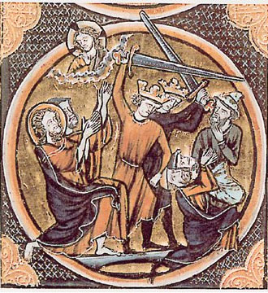
Song of the One - 10 -
Covenant were sheltered. When they
saw that the war was on every side by
decree of the King of Kings, they justi-
fied Heaven's judgment upon them,
placed their trust in their Creator, and
offered true sacrifices, taking their
children and wholeheartedly slaughte-
ring them in witness to the Oneness of the Venerated and Awesome Name. The notables of the community were slain there.
There was a man there by the name of Meshullam, son of Yitshaq, and he called out in a great voice to his beloved wife Lady Tsippora and to all those present: “Hear me, adults and children!

Slide 11
Song of the One - 11 -
God gave me this son; my wife Tsippora bore him in her advanced age. His name is Yitshaq. I shall now offer him up as a sacrifice as our Father Abraham did his son Isaac.“ His wife Tsippora said to him: “My lord, my lord, wait, do not yet move your hand toward the boy whom I have raised and brought up, whom I bore in my old age. Slaughter me first and let me not see the death of the child. He replied: “I shall not tarry even for a second. He Who gave him to us shall take him as His share and place him in the bosom of our Father Abraham.“ He bound Yitshaq, his son, and took the Maakhelet in his hand to slaugh-ter him, reciting the blessing for Ritual Slaughter. The boy responded: “Amen.“ And he slaughtered the boy. He took his shrieking wife and together they left the room.
The errant ones then slew them.

Slide 12
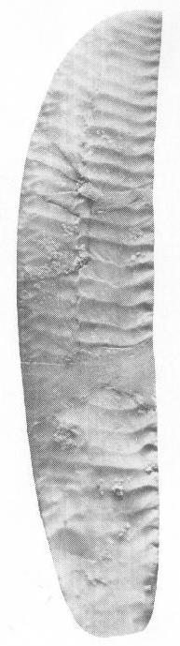
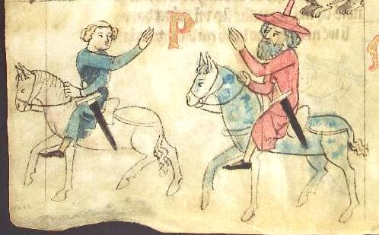
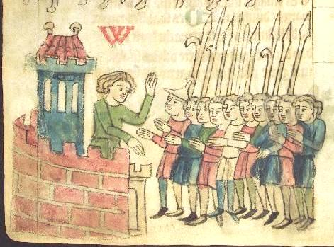
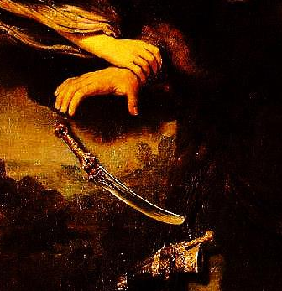
Song of the One - 12 -
The Jew and
the sword
Sachsen-
spiegel,
13th cent.
Maakhelet

Slide 13
Song of the One - 13 -
דוד בירבי משלם, 'אלהים אל דומי לדמי'
סליחה
תיאור: סליחה בעלת חמש עשרה מחרוזות מרובעות המאורגנת באקרוסטיכון אלפביתי כפול ובחתימה: 'דוד בירבי משלם הקטן חזק'. טורים רבים מונים חמש תיבות מבלי שהפייטן כפה זאת כנורמה על כל טורי השיר.
אֱלֹהִים, אַל דֳּמִי לְדָמִי,
אַל תֶּחֱרַשׁ וְאַל תִּשְׁקֹט לְמִתְקוֹמְמִי,
בַּקְּשֵׁהוּ, דָּרְשֵׁהוּ מִיַּד מַחֲרִימִי,
בַּל תְּכַסֵּה אֶרֶץ בְּכָל מְקוֹמִי.
פירוש: אלהים: השוו את העיקרון בבחירת השם לציון אלהי ישראל: 'בכל מקום שנ<אמר> אלהים – מידת הדין' (בראשית רבה, לג, ג [מהד' תיאודור-אלבק, עמ' 308]). 1–2 אלהים אל ... תשקוט: על פי 'אלהים אל דמי לָךְ, אל תחרש ואל תשקט אֵל' (תה' פג 2). 2 למתקוממי: לאויבים הקמים עלי. 3 בקשהו: בקש את דמי השפוך. דרשהו: הלשון על פי: 'ואך את דמכם... אדרש' (בר' ט 5).

Slide 14
David BiRebbi Mashullam, God, Do Not Be Silent - 14 -
David BiRebbi Mashullam,
God, do not be silent over my blood
Seliha, a supplication hymn for fast days
Prosody: 15 quattrains organized by a double alphabetic acrostic and the author’s name: DaViD BIRaBbI MaŠuLlaM Ha-QaṬaN HaZaQ. Many of the lines have 5 words each but not as a metre.
God, do not be silent over my blood
don’t be mute and don’t be quiet over my foes,
ask for it, require it from the hands of those who came over me,
that the earth should not conceal (it) at all my places.
Sources in Mss.: Ashkenazy rite (Western / France / Eastern / Misc.), Italian rite; some 20 commentaries

Slide 15
David BiRebbi Meshullam of Spira,, God, Do Not Be Silent - 15 -
David BiRebbi Meshullam of Spira,
God, do not be silent over my blood
Seliha, a supplication hymn for fast days
God, do not be silent over my blood
Don’t be mute and don’t be quiet over my foes,
ask for it, require it from the hands of those who came over me,
that the earth should not conceal (it) at all my places.
Commentary: 1-2 God, do… foes: do not remain passive, according: “O God, do not be silent; do not hold aloof; so not be quiet, O God! For Your enemies rage, Your foes lift up the head (= assert themselves)” (Ps. 83.1-2), foreshado-wing the transition to the plea for redemption and forgiveness in line 56. 2 foes: literally: those who rise against me. 3 require it: according: “But for your own life-blood I will require a reckoning: I will require it of every beast’ of man, too, will I require a reckoning for human life, of every man for that of his fellow man!” (Gen. 9. 5).

Slide 16
David BiRebbi Mashullam, God, Do Not Be Silent - 16 -
5 It shall be openly revealed,
before You it shall be spilled and sprinkled,
and Your royal purple shall be engraved
(by) the full (number) of corpses.
Persecuted by law shall be the one
who spilled it, blow for blow,
the blood of Your poor ones
that was spilled like that of young bulls.
5 before You… sprinkled: first hint to the liturgy of the offerings at the temple, cf. “and take some of the bull's blood and put it on the horns of the altar with your finger; then pour out the rest of the blood at the base of the altar […] Take some of the blood that is on the altar and some of the anointing oil and sprinkle upon Aaron and his vestments, and also upon his sons and his sons’ vestments. Thus shall he and his vestments be holy, as well as his sons and his sons’ vestments” (Exod. 29: 12, 21).

Slide 17
David BiRebbi Mashullam, God, Do Not Be Silent - 17 -
Together they consulted for council to pour poison
10 to raise the cover that covers the face of the earth,
that there’ll be no remembrance
of the name of Israel, the exalted,
and (only) going after the disgusting despised desolation.
9 Together they consulted for council: most likely an allusion to the crucial synod of Clairmont during November 1095 by an allusion to the basetext of the opening line: “They plot craftily against Your people, take counsel against Your treasured ones” (Ps. 83. 4). to pour poison: in phrasing according “There is a cup in the LORD’s hand / with foaming wine fully mixed; from this He pours; all the wicked of the earth drink, draining it to the very dregs” (Ps. 75. 9) with RaShY’s commentary ad locum: “Yes a cup – of doom is in His hand … He pours fully – the cup is poured fully, to pour it to all people and give (it to them) to drink” and this in bitter irony to the here mentioned plan to extinct the Jews.

Slide 18
David BiRebbi Mashullam, God, Do Not Be Silent - 18 -
The seed of Holy, the children, who won’t deny:
‘This is my God, and Him I shall praise,’
they shouted and sung,
15 ‘The place of our hereditament is He’ –
‘And we’ll profess Him’,
and the life of their one and only
they bundled in the bundle of life.
13 The seed of Holy: the children of Israel, the antonomasy according Isa. 6. 13. the children, who won’t deny: a metaphor of identification according “He (= God) said: surely they are My people, children who will not deny. So He was their Deliverer” (Isa. 63. 8 and cf. context). 14 This is … praise: citation of the Song at the sea (Exod. 15. 2). they shouted and sung: possible allusion to the redemption from Egypt, cf. “and cried out; and their cry for help from the bondage rose up to God” (Exod. 2. 23) with “Then Moses and the

Slide 19
David BiRebbi Mashullam, God, Do Not Be Silent - 19 -
Infants and women vowed themselves to be bound together,
choice lambs in the Chamber, of the House of Fire.
‘Only One and Exalted,
better slain and bowed for Your sake,
20 than to bow the head before the spawn of fornication’.
17 vowed themselves: to die (as martyrs), in biblical Hebrew “they concluded peace”, “they concorded”, but also “they concluded” cf. Job 23. 14 and thus in rabbinical Hebrew “they died”. to be bound together: traditional terminus technicus from the liturgy of offerings for the binding of the limbs of the sacrificial animal, cf. Gen. 22. 9 and bShab 54a. 18 choice lambs: the lambs destined for sacrifice brought to the Beth Ha-Moqed in the inner area of the temple, cf. e.g. Mishna, Tamid 3, 3. in the Chamber, of the House of Fire: probably not as designation of exactly this part of the temple but as a synecdoche for the temple as place of the altar.

Slide 20
David BiRebbi Mashullam, God, Do Not Be Silent - 20 -
21 Yearling Lambs, without blemish for the burnt offering,
burnt offerings were mounted
like the chunks of whole offerings,
to their mothers they say: ‘Don’t be moved by compassion,
as burnt offering for the LORD
we were summoned by heavens’.
21 Yearling Lambs, without blemish: for the daily liturgy (Tamid), according “As a regular burnt offering every day, two yearling lambs without blemish” (Num. 28. 3) and he as metonomy for the infants. 22 burnt offerings were mounted: sc. but in this case there were so many that…. like the fat chunks of whole offerings: that where burnt on the altar while most of the meat and the skin was return to their owners, see tZev 11, 7 (ed. Zuckermandel, p. 496). The comparison is based on the analogy in size and the contrast of the color of blood and the pale fat parts and the lightish skin of the infants.

Slide 21
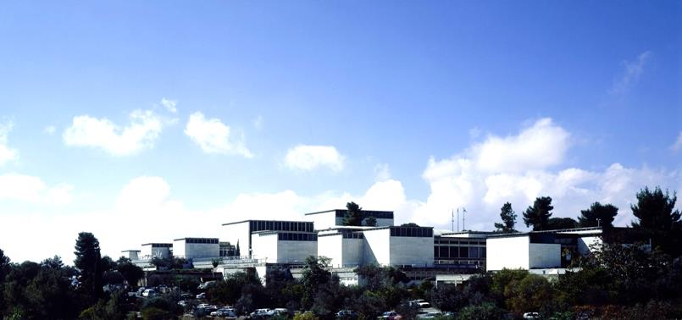
The entanglement of
different aspects
and contexts
Not side by side but the one within the other
Verschränkung
הסתרגות
Notes:
Entanglement – interconnection

Slide 22
David BiRebbi Mashullam, God, Do Not Be Silent - 22 -
25 The children rattle and, one over the other, they twitch,
they hurry to slaughter others weltering in their blood –
given on the floor of Your temple
and in the hands of those who stir it against coagulation
before Your eyes it shall boil for ever.
25 The children rattle … twitch: cf. the use of this phrase in Shelomo bar Shimshon’s chronicle: “Then she put them all on her arms, two children on the one side and two on the other, beside her stomach, and they quivered beside her […] When the father saw the death of his children […] he […] threw himself on the sword and […] writhed in his blood together with the others quivering and writhing in their blood” (Chronik I, ed. Haverkamp, p. 359, Eidelberg, p. 36)..

Slide 23
David BiRebbi Mashullam, God, Do Not Be Silent - 23 -
They arranged before You an arrangement of a big pile –
30 the circumference (of the altar) and the basis too
were to small to contain.
the infants and babies that were slaughtered altogether
as fire offering –
Your fire offering shall turn to ashes
to remember all the oblations for You. Sela.
29 They arranged … pile: (the Israelites) arranged in the temple (as part of the liturgy of offerings the woods) on the altar in a big pile, cf. “the arrange-ment of the pile in the east (of the altar)” (mTam 2, 4). 30 the circumference and the basis too: of the burning altar with its ca. 6 square meters (according Exod. 38. 1) or almost 100 square meters (according 2 Chron. 4. 1). were to small to contain: according “because the bronze altar that was before the LORD was too small to hold the burnt offerings, the meal offerings, and the fat parts of the offerings of well-being” (1 Kings 8.64 from the description of the temple inauguration).

Slide 24
David BiRebbi Meshullam of Spira, God, Do Not Be Silent - 24 -
The corner towers and the inner yards got filled
with meal offerings:
pieces of body fat and limbs, the head, the leg,
and chunks of meat,
35 dry offerings, as pints of moist entrails,
the nest offerings of righteous women –
these are the cherished toddlers.
33 The corner … yards: literally also ‘corners and vestibules’. cf. “The priest shall take some of the blood of the sin offering and apply it to the doorposts of the Temple, to the four corners of the ledge of the altar, and to the doorposts of the gate of the inner court” (Ezek. 45. 19) and here in the plural referring to the places of the liturgy of offerings at the temple in Jerusalem and in Mayence in 1096. 34 pieces of … meat: according “and Aaron's sons, the priests, shall lay out the sections, with the head and the suet, on the wood that is on the fire upon the altar” (Lev. 1. 8) and elsewhere. 35 dry offerings: rabbinical term for the dry ingredients of meal offerings (cf. Lev. 2 and bPes 20a). as pints of

Slide 25
David BiRebbi Meshullam of Spira, God, Do Not Be Silent - 25 -
The corner towers and the inner yards got filled
with meal offerings:
pieces of body fat and limbs, the head, the leg,
and chunks of meat,
35 dry offerings, as pints of moist entrails,
the nest offerings of righteous women –
these are the cherished toddlers.
moist entrails: literally ‘of marrow and brain’, here completing a merism: all kinds of parts of the bodies (of the martyrs), the dry and the moist ones. 36 the nest … women: complex metaphor of identification: the nest offering is inter alia the minimal offering by a woman after childbirth (e.g. two turtle doves) to mark the end of her ritual uncleanness (Lev. 12). Here more than thousand years after the destruction of the temple the children are referred to as sin offering for their mothers and thus their killing as analogy to the atonement sacrifices in the temple. the cherished toddlers: according “Alas, women eat their own fruit, Their dandled babes!” (Lam. 2. 20). – “infants that still grow on the arms of their mothers” (RaShY ad locum).

Slide 26
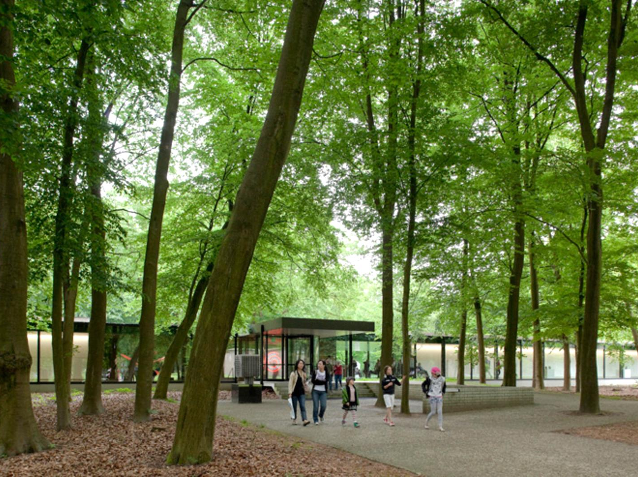
Verschränkung
הסתרגות
Kröller-Müller Museum
Notes:
Aldo van Eyck (16 March 1918 – 14 January 1999

Slide 27
David BiRebbi Mashullam, God, Do Not Be Silent - 27 -
The final offering for the altar are
the children of the house of study –
the offering to atone the people – pupils with teacher,
boiled in the pan – what was never before offered this way
40 a sweet smell – the oblation of Yehuda shall be pleasant.
37 The final … study: metaphorical for school children. The following age group after the infants serves as final offerings of the liturgy, cf.”What is the final offering for the altar? – One takes burning offering (holocaustum) and finishes with them (the series of) the altar (tMen 10, 8 [ed. Zuckermandel, p. 527). the children of the house of study: according the rabbinic term tinoqoth shel bet rabban – the youngest pupils in rabbinic education. 38 the offering to atone the people: cf. “Then Moses said to Aaron: ‘Come forward to the altar and sacrifice your sin offering and your burnt offering, making expiation for yourself and for the people’” (Lev. 9. 7). teacher: here metonomy for a sage according the rabbinical term Ṣurva de-rabbanan (bBer 15a and more) for a category of transmitters of traditions of old age, and the

Slide 28
David BiRebbi Mashullam, God, Do Not Be Silent - 28 -
41 For this priestly service were apt women like men:
the slaughtering, the sprinkling, containing the blood,
they offer and present
the oblation of pure offerings, the souls of the holy ones,
the raising of the chest and of the leg
and of the jaws of the heads.
41 For this priestly… men: thus challenging biblical and rabbinical tradition according to which only male descendents of Aharon – and this only under special conditions of place, time etc. – could take part in a offering liturgy. 42 the slaughtering… present: listing up the four main parts of the (atonement) offering service: shehita – slaughtering, qabbala – containing the blood, holakha – presenting and zeriqat ha-dam – the sprinkling of the blood. 43 the offerings of… ones: complex identification metaphor. The offering of the souls of the holy ones is a pure oblation, and thus - as a metonomy - the sanctification of the name of the Lord in the world, cf. “For from where the sun rises to where it sets, My name is honored among the nations, and everywhere [sc. in Mayence too] incense and pure oblation are offered to My name; for My name is honored among the nations – said the Lord of the Hosts” (Mal. 1. 11). 44 the raising of the chest and of the leg: these are the due to the serving priests, cf. Ex. 29. 27). and of the jaws of the heads: also the share of the offering for the priests, cf. “This then shall be the priests’ due from the people. Everyone who offers a sacrifice, wether an ox or a sheep, must give the shoulder, the cheeks and the stomach to the priest” (Deut. 17. 20). And the list of body parts for the day to day sustenance of the priests, may merge in the imagination of the reader, especially after the metaphors of identification from line 27 up to this line with the limbs of the slawn children.

Slide 29
David BiRebbi Mashullam, God, Do Not Be Silent - 29 -
45 Tears well up from here and there and flow in a trickle,
and those who slaughter with those who are slaughtered
sigh upon one other
the blood of fathers comes in touch
with the one of the sons and accumulate,
they shout the benediction of the slaughtering
‘Hear, O Israel’.
45 Tears well up: of those who slaughter and those who are slaughtered. Cf. already the traditions of the darshanic stories to the Binding of Isaac, e.g.: “And his [sc. Abraham’s] eyes shed tears and the tears dropped into the eyes of Isaac” (Bereshit Rabba 56, 8 [printed editions] and see: Shulamit Elizur, “Aqedat Yitshaq: bi-vkhi o be-simha,” Et ha-daʿat, 1 (1997), pp. 15-35. 46 those who… slaughtered: cp. “’And the two walked of together’ (Gen. 2. 8) – This one to slaughter and this one to be slaughtered’ (Bereshit Rabba 56, 4 [ed. Theodor-Albeck, p. 599]) with “the (female) first one of the slaughteres and of those to be slaughtered” (Shelomo Bar Shimshon, Chronicle I / Eleazar Bar Nathan, Chronicle II [ed. Haverkamp, p. 262]). 47 the blood… sons: according “blood [sc. of violent deeds] come in touch with blood [sc. of violent deeds]” (Hos. 4. 2) and cf. “until blood came in touch with blood… and the blood of the fathers with (that of) the.sons” (Shelomo Bar Shimshon, Chronicle I [ed. Haverkamp, p. 335]). and accumulate: to moisten the surroundings, according a mishnaic term, cf. mToh 3, 1 and elsewhere. 48 they shout… slaughtering: one possible reading, and so backed up by a few manuscripts which read ‘the benediction before the shehita – the ritual slaughtering’, means that those who slaughtered first shouted the benediction and than the Shema Yisrael, and the other - translated here - is based on the fact that the rare term birkat ha-zevah, said before consuming the hagiga-offering like the shelamim offering added to the pesah offering (tPes 10, 13), invites to see it as a metaphor of identification: the shouting of the Shema Yisrael is the benediction said at this occasion. But cf. the realization of this metaphor: “I (sc. your father) will say the benediction before the shehita – the ritual slaughtering and you (sc. my son) shall reply Amen” (Shelomo Bar Shimshon, Chronicle I / Eleazar Bar Nathan, Chronicle II [ed. Haverkamp, p. 416]).

Slide 30
David BiRebbi Mashullam, God, Do Not Be Silent - 30 -
If He’ll be looking, He’ll see
the deeds of faithful daughters,
50 in the heat of the day naked under the sun they are laid out,
the fairest of women with cleaved bellies
and cut into pieces
they spawn between their legs the placenta, a newborn.
49 If He’ll be looking: in analogy to the redemption from the exile of Egypt: “Reoh Raiti – I have marked well the plight of My people in Egypt and have heeded their outcry because of their taskmasters,yes, I am mindful of their sufferings” (Ex. 3. 7); or to His pending attention in the future, according “And Abraham named that site Adonai yireh (the Lord will see), whence the present saying, “on the mount of the Lord there is vision.” (Ber. 22, 14) and cf. the Midrash traditions in Bereshit Rabba 56, 10 concerning the merit that the Binding of Isaac promises for the future The expression yireh yiraeh relies on the hymns of R. Meir bar Yitshaq Shats from Worms. See e.g. in the Aqeda-supplication Eth ha-berith we-eth ha-hesed we-ha-shevuʿa (Goldschmidt, Mahzor le-yamim noraim, II. Yom Kippur, New York 1970, p. 636, l. 14 [Hebr.]) and see the commentary to l. 51. deeds: as metonomy for (their) merits, according “the peʿulat-wages of a laborer shall not remain with you until morning” (Lev. 19. 13). faithful daughters: young women who rely on God, the expression according “You confident ladies, give ear to my speech!” (Isa. 32. 9). 50 in the heat of the day: at midday – in the open daylight, with adaption to the acrostic according the biblical expression “ke-hom ha-yom – at the heat of the day” ( 2 Sam. 4. 5 and elsewhere). under the… out: according “and exposed to the sun […] they shall not be gathered for burial, they shall become dung on the face of the earth” (Jer. 8. 2) and cf. the depiction by Shelomo bar Shimshon, Chronicle I (ed. Haverkamp, p. 352). 51 the fairest of women: the expression according Song 8. 9. The commentator in Ms Oxford, Bodley Can. Or. 109 (Neubauer 1209), fol. 84b affirms that he heard that these words refer to the daughter in law of R. Meir bar Yitshaq Shats of Worms. with cleaved bellies: cp. “dash their little ones in pieces, and rip open their pregnant women” (2 Kgs. 8. 12). cut into pieces: so according the basic meaning of p.l.h. in this conjugation, but the intertextual relation to “When they couch to breake forth their offspring, to deliver their young” (Job 39. 3) conveys an image of a emergency delivery / abortion in death pangs.

Slide 31
David BiRebbi Mashullam, God, Do Not Be Silent - 31 -
If such a thing has ever been heard or seen?
to believe such a thing who could believe?
Great is the awe!
55 They escort their children to the slaughter
as if to a pleasant bridal canopy –
Do You want to withhold about them,
Exalted, who has done great deeds?
55 They escort: the parents, like Abraham according Midrash traditions to the Binding of Isaac, cf. “Abraham was like a man who builds a wedding canopy for his son” (Midrash Wa-Yosha, ed. Wies-Campagner, p. 135). 56 Do You want to withhold about them: according the final clause to an overview of the fate of Israel in the prayer of Isaiah “At such things will You reatrain Yourself, O Lord, will You stand idly by and let us suffer so heavily?” (Isa. 64. 11) and cp. the use of this verse by Elieʿzer bar Nathan, Chronicle II (ed. Haverkamp, p. 501). Exalted: address to God in metonomy, probably hinting to “For thus said He, who high aloft forever dwells, whose name is holy: I dwell on high, in holiness; yet with the contrite and the lowly in spirit – reviving the spirits of the lowly, reviving the hearts of the contrite” (Isa. 57. 15). who has sone great deeds: (already) in the past while redeeming Israel from the exile of Egypt, cf. “gaoh gaah – for He has triumphed gloriously” (Ex. 15. 1).

Slide 32
David BiRebbi Mashullam, God, Do Not Be Silent - 32 -
Once we relied on the Binding on the Mountain of Myrrh
and this would stand up for us
as a hidden (treasure) for the salvation
for every generation, to beware
These and like these were added (now)
until it is impossible to tell –
60 Living One, the acquittal of their hopes keep for us
and end our destitution.
God King
57 the Binding on the Mountain of Myrrh: the Binding of Isaac on the Moriah mountain (Gen. 22 in connection with 2 Chron. 3. 1). and this would stand up for us: as merit. 58 as a hidden (treasure): of merits to tip the scale in the heavenly court. for the salvation: of (sinning) Israel. 60 Living One: address to the God of Israel, according Num. 14. 28 (and elsewere); as it seems in polemic to the God of the Christians who died. keep for us: because we have no merits like those of these martyrs for their hope and cf. “Then You would not count my steps, or keep watch over my sin” (Job 14. 16).

Slide 33
Song of the One - 33 -
The first literary responses to the Events of Summer 1096
List of victims / ‘prayer fraternity’ letters / Memorbukh
Remembering the dead by name
Liturgical Poetry – Seliha – Qina – Zulath
Theological reflection on what has happened
Remembering the atoning martyrdom in the community
The “Chronicles” - --- Gezeroth
Recalling events and deeds, Values Clarification, evaluation

Slide 34
אאא
Song of the One II
Synagogue Poetry in Early Ashkenaz
Dr. Peter Sh. Lehnardt
Ben-Gurion University of the Negev, Beer Sheva
Notes:
Speyer, Sun 1.7.2018 – jued. Gemeindezentrum Speyer

